Slide 1
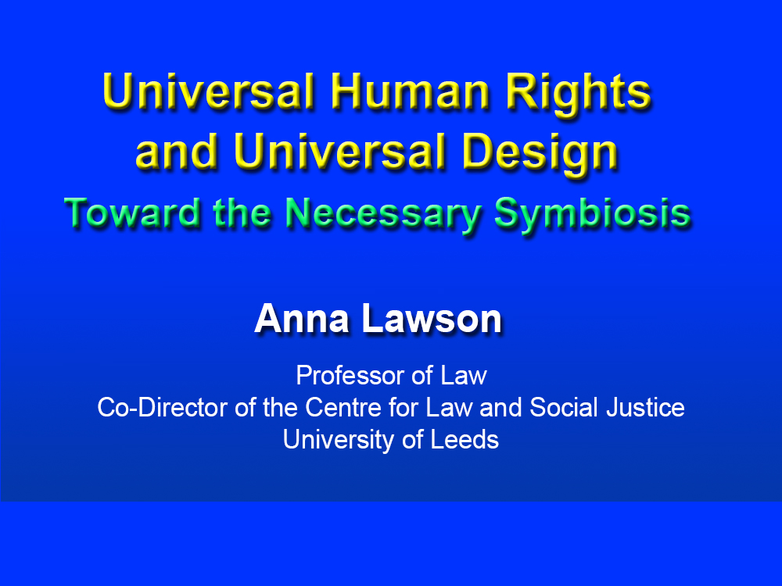
Universal Human Rights and Universal DesignToward the Necessary Symbiosis
Anna LawsonProfessor of LawCo-Director of the Centre for Law and Social JusticeUniversity of Leeds

Slide 2

My Dog

Slide 3

Outline
1. Universal design obligations in the
UN Convention on the Rights of Persons with Disabilities
2. Universal design as part of rights to
‘education’ and ‘work and employment’
3. Reflecting on ‘universality’

Slide 4
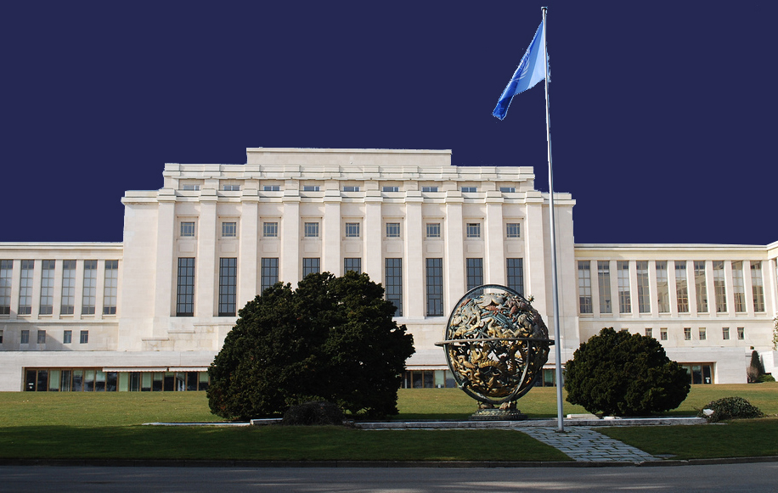
Universal Design Obligations in the
UN Convention on the Rights of Persons with Disabilities
UN Convention on the Rights of Persons with Disabilities (CRPD) 2006
Purpose of the CRPD
Relationship between the CRPD and other international human rights treaties

Slide 5
The Universal Design Obligations in the
UN Convention on the Rights of Persons with Disabilities
Definition of ‘universal design’ – Article 2
Nature of Explicit Obligations
Scope of Explicit Obligations

Slide 6
The Universal Design Obligations in the
UN Convention on the Rights of Persons with Disabilities
Connection with accessibility
Connection with equality and non-discrimination
Connection with intersectionality
Beyond disability – Other non-"normates"

Slide 7

The Universal Design Obligations in the
UN Convention on the Rights of Persons with Disabilities
Rosemary Garland-Thomson

Slide 8

Universal Design as part of Rights to
Inclusive Education and Work and Employment
Universal Design (and Accessibility) in Education

Slide 9
Universal Design as part of rights to
Equality and Accessibility
Universal Design (and Accessibility) in Education
Article 24
General Comment No 4

Slide 10

Universal Design as part of rights to
Equality and Accessibility
Universal Design (and Accessibility)
in Work and Employment

Slide 11
Universal Design as part of rights to
Equality and Accessibility
Universal Design (and Accessibility)
in Work and Employment
Article 12
General Comment No 8

Slide 12
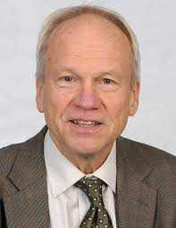
Reflecting on Universality
Jerome Bickenbach

Slide 13
Reflecting on Universality
Universality is at the heart of human rights and universal design
Universal design is critical to the universalising of human rights.
Universal design is required by human rights law.
Universal design is embedded in, and a pre-condition for, the fulfilment of human rights

Slide 14
Thank You: Universal Human Rights and Universal Design Toward the Necessary Symbiosis
Anna LawsonProfessor of LawCo-Director of the Centre for Law and Social JusticeUniversity of Leeds

