Slide 1


Empowering Voices: Using Photovoice as a method to prepare students with intellectual disabilities in third-level education for employment.
Students and Staff of SETU Waterford
Certificate in Personal Development
Department of Nursing and Healthcare

Slide 2

Workshop Aim
To introduce participants to the principles and practice of Photovoice.
To explore the potential of photovoice as a personal tool and also as a tool for supporting students throughout their employment journeys.

Slide 3
What is Photovoice?
A participatory research method.
A way to tell stories through pictures.
Using your voice and ideas to share what matters.

Slide 4
Why is it important?
Pictures help explain our experiences and ideas.
They capture what we see and feel.
Photos can:
Show beauty
Explain problems
Inspire action

Slide 5
Why This Matters for Our Students
When we share our voice:
People understand our needs.
We feel more included and valued.
Our ideas can improve life for everyone.

Slide 6

Application
Photovoice has been applied to support students in modules on communication, mental and physical health, and well-being.
Helping them express their experiences and needs through photography and imagery.

Slide 7

Application Examples

Slide 8
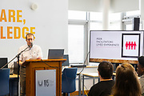
MR GEORGE SOSIC
Student Certificate in Personal Development

Slide 9

How WE FEEL ABOUT ATTENDING UNIVERSITY

Slide 10


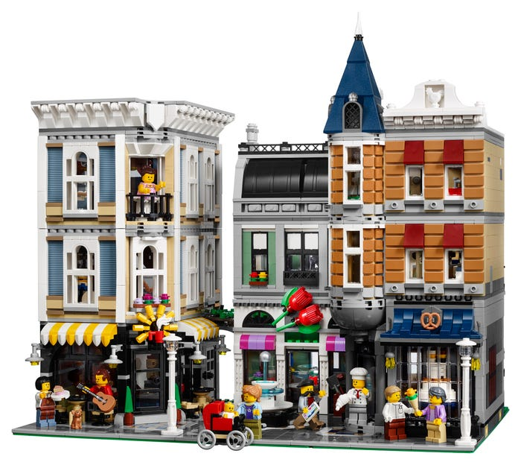

What I like about going to University
I like that university is just like making Lego.
It might be difficult, and you might struggle to complete it but in the end, you have something that shows off all your hard work.

Slide 11
How I Feel About Attending University?
I feel I am like a bird on the ground.
That as I learn more and attend university more
I will learn to open my wings and fly

Slide 12

Challenges I face and Overcome

Slide 13
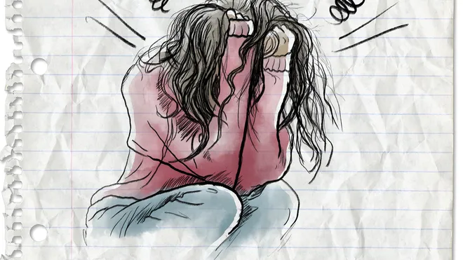
What do I struggle with when it comes to college
I struggle a lot with anxiety

Slide 14

I found it challenging with computers

Slide 15

What I have Learnt About my self esteem

Slide 16
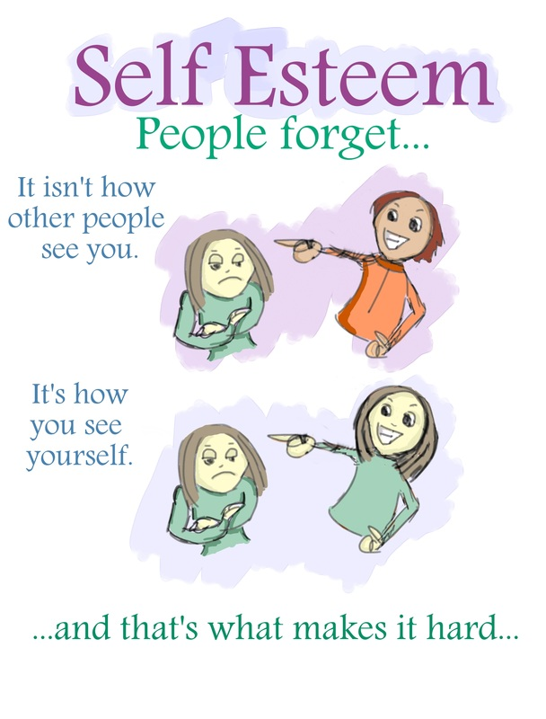
Self Esteem

Slide 17

I am Tall and Proud

Slide 18
I Picked this picture because I am tall and proud, and I love attending college

Slide 19

Self Esteem is about me and how I see myself

Slide 20

I am kind

Slide 21
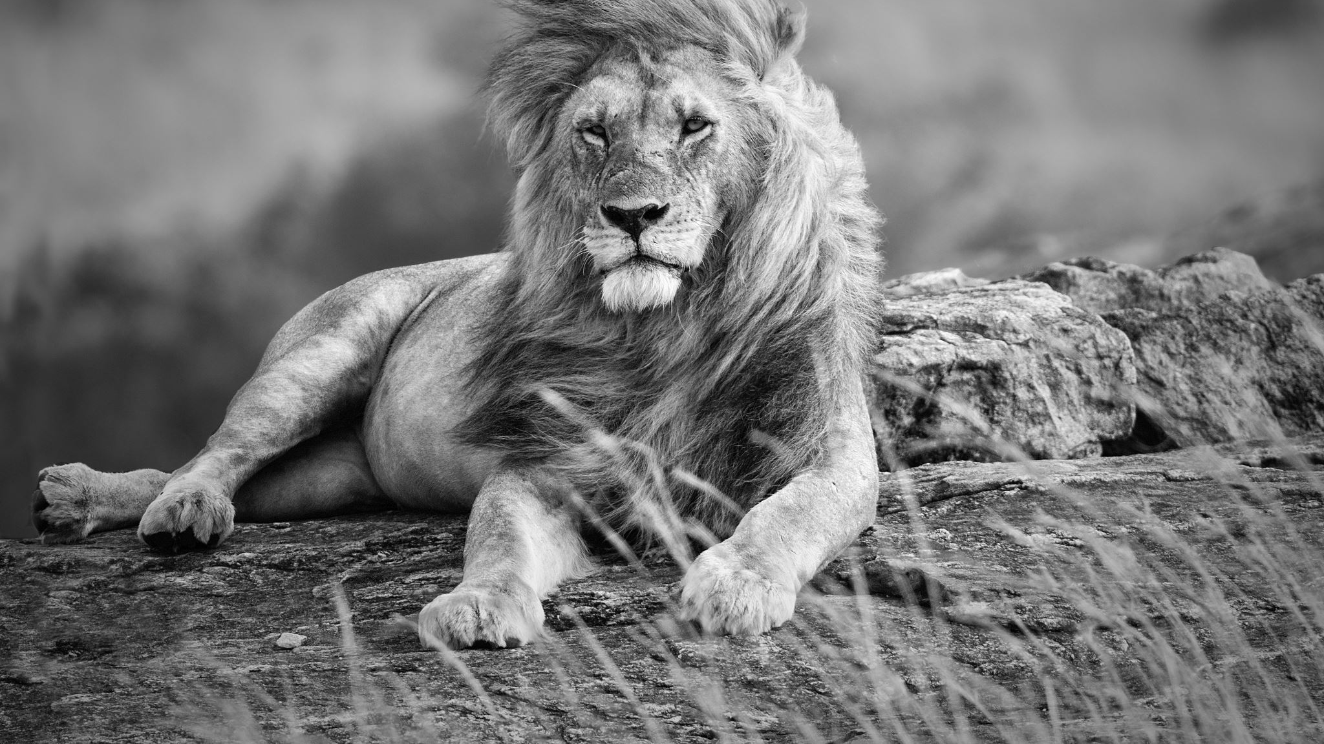
I am Strong willed

Slide 22

What going to University Means to Me

Slide 23

FRIENDS

Slide 24

TRY NEW THINGS

Slide 25

I like all new subjects

Slide 26

Believing in myself

Slide 27






how we see ourself

Slide 28
Application contd
Supporting students with intellectual disabilities in third-level education to prepare for employment.

Slide 29
Employment Goals

Slide 30
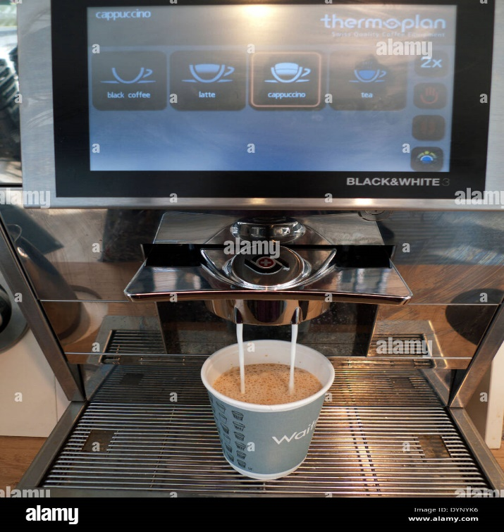
My Career Goal
I chose this images because my dream job is Barista.
I want to learn about coffees.
I want to know the different names of coffee like a flat white

Slide 31
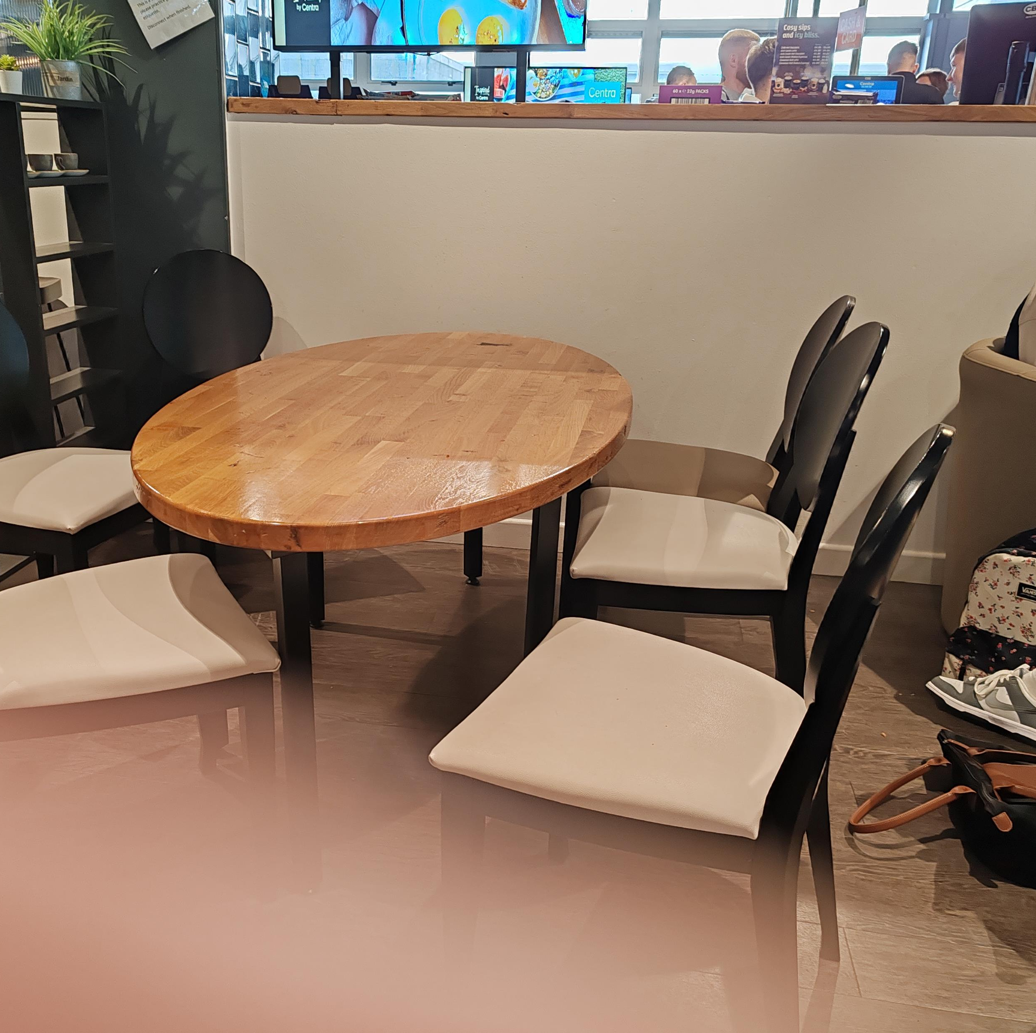
My Career Goal
I chose this image of a table and chairs because I would like to work in a restaurant

Slide 32
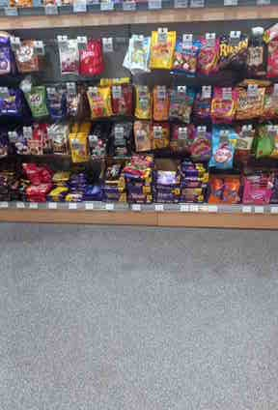
My Career Goals
I have chosen this image because I would like to work in the field of retail.
The reason being I have done previous work experiences in a lot of different places, and I like retail the best.
I believe with the experience I have gathered and the help of my course in SETU I will get the job of my dreams.

Slide 33
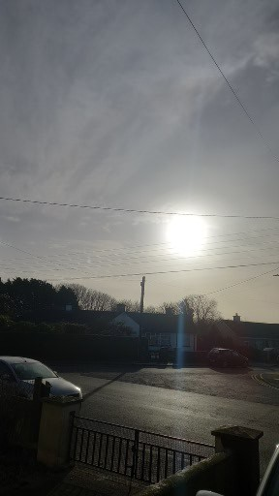
My Career Goal contd
I chose the image of the sun because I believe that the Sun represents hope.
I believe this makes one believe in themselves and gives one a sense of happiness.
You may think it’s not possible but when you look up at the sky and feel that ray of sunshine you have the strength and inspiration to keep going.
To reach your employment goals

Slide 34
Group Work
Participants choose or take an image that represents a career goal or aspiration.
Each group will be facilitated by a staff member/s and student/s of the Certificate in Personal Development Programme.

Slide 35
Reflective Questions
What does this goal mean to you?
What challenges might you face in achieving this goal?

Slide 36
Group Feedback Reflection on the Use of Photovoice
Did you find photovoice useful as a communication tool for considering your career goals and aspirations?

Slide 37
Final Reflections
Would anyone like to share a key lesson or insight they gained from the workshop.

Slide 38

Thank You

