Slide 1


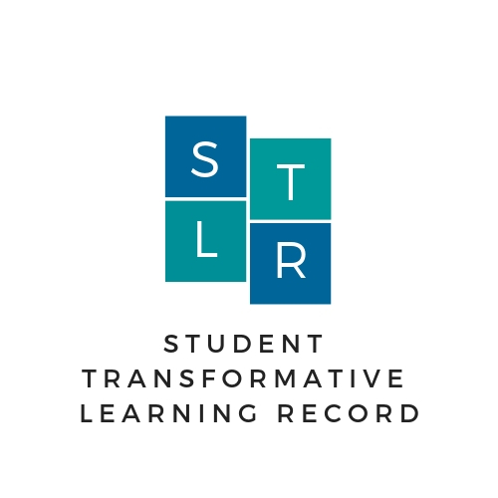
Student Transformative Learning Record (STLR)
"Showcasing TU Dublin Graduate employability skills for employers"
Amanda Dixon, TU Dublin
AHEAD Conference
"Bridging The Gap"
March 2025

Slide 2
Transform Edu
Recap: The Transform-Edu study involved offering students a range of co- and extra-curricular events/workshops to enable them to develop dynamic 21st century graduate profiles.
In collaboration with employers, work-readiness workshops were designed to enable students to develop the specific social and emotional skills that employers were seeking in their area of study.
Attendance at these workshops resulted in.....
1.High percentage of student hires.
3.Improved self-perception of employability for students.
4.Direct access to work-ready graduates for employers.

Slide 3
UD & Employability
Recap:

Slide 4


What is STLR?
Formally Records Employability Skills Development
STLR “stellar”
Recording the development of students beyond their discipline
Transformative Learning Transcript & Digital Badge

Slide 5


Why did we bring STLR to TU Dublin?
Part Time Work
Industry
Within the curriculum
Capturing Transformative
Learning
Recording Employability Skills
Clubs & Societies

Slide 6
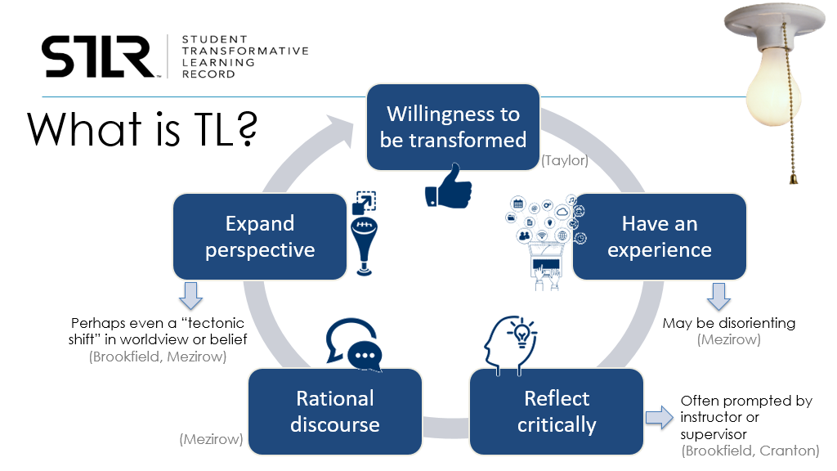
STLR Benefits
Increases students’ employability by giving them a tool to measure and articulate their own effectiveness as citizens and employees.
Records students’ employability skills beyond academic learning
Expands students’ perspectives of their relationship to self, others, community and environment
It will place students at the centre of their own active and reflective learning experiences.

Slide 7

What does STLR capture?
Participating in on campus events and workshops.
Student initiated e.g. based on work experience or volunteering.
Lecturer assigned customised CA's.
Participating in off campus events.

Slide 8

TU Dublin – Opportunities for students to develop Employability Skills
Assessment
Growthhub
Career Development Centre
Student Ambassadors
Counselling Service
TU Dublin SU
Pastoral Care
NTUTORR
Green Campus
Student Success
Faculty Events
Recruitment & Admissions
Peer Mentoring
LIFT
Class Rep's
Student Success
Academic Writing Centre
Library Services
SLWC

Slide 9






STLR – Five Core Competencies
Notes:
Our STLR five core competencies are…….xxxx
Lets talk about a little about these competencies.

Slide 10

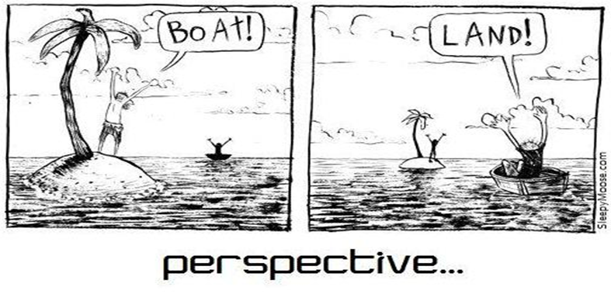

STLR Achievement Level Descriptions
Exposure
Students are exposed to the idea and are aware of their current perspective.
Integration
The student is questioning, planning or beginning to expand upon previously held understanding?
Transformation
Is there evidence the student was truly transformed? Has experienced profound growth.
Notes:
For every STLR tagged event and continuous assessment student receive an STLR achievement. There are three STLR achivements they may receive:
Exposure, means they are beginning to question/plan/begin to expand upon previously held understanding? They are seeing a different way of working. For example they attend a Mindfulness workshop and you submit a reflection to say you will bring in mindfulness into your daily routine.
Integration – this is when they begin to question/plan/begin to expand upon previously held understanding? They are seeing a different way of working. For example they attend a Mindfulness workshop and submit a reflection to say they are practising in mindfulness into your daily routine.
Transformation achievement is where there is evidence in your reflection you have truly transformed, for example you may practice Mindfulness but now you are advocating mindfulness by establishing a mindfulness student society.

Slide 11
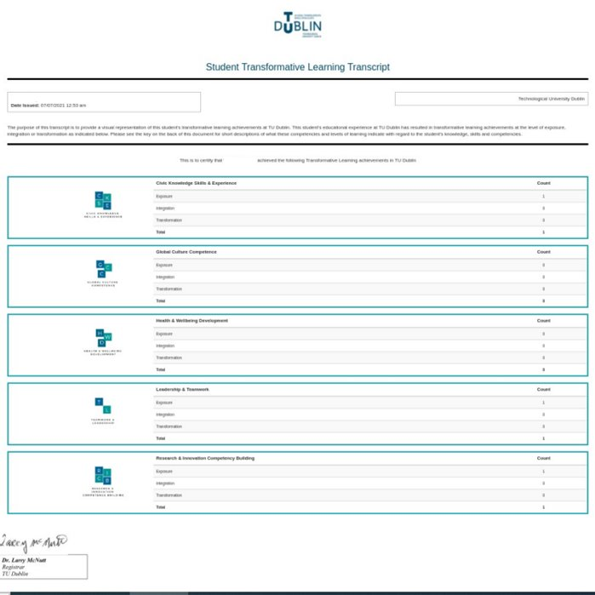
Employability Skills Transcript (STLR)

Slide 12
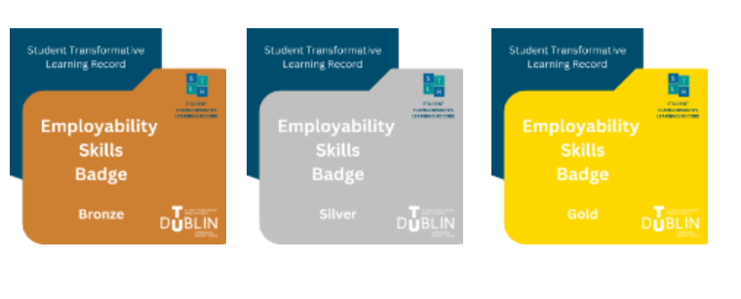
TU Dublin Perspective
Employability Skills Digital Badge

Slide 13
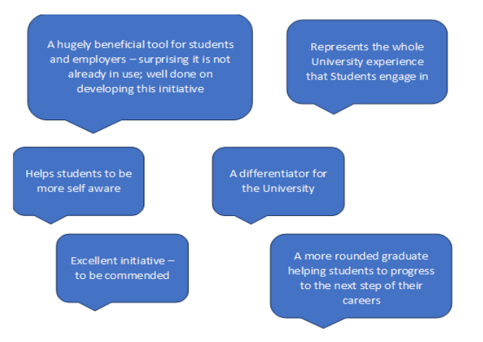
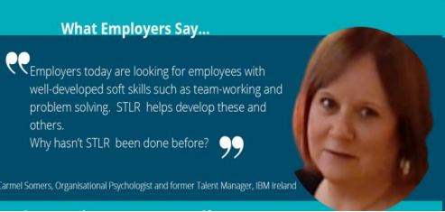
What Employers say.........

Slide 14
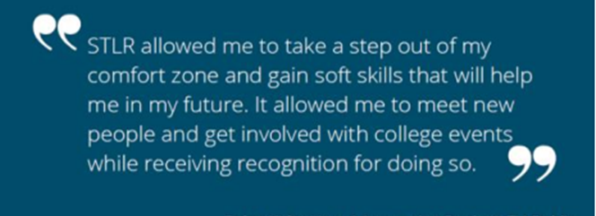
What Students say.........​
STLR helped me accomplish soft skills that complimented my academic knowledge and helped me progress as a graduate. It gave me that extra bit of armour when it came to standing out from the crowd in interviews.”
TU Dublin Accounting & Finance Graduate 2020
Notes:
Increases students’ employability by giving them tools to measure and articulate their own effectiveness as citizens and employees.
Transformative Learning is at the heart requires students to reflect about their experiences as part of their completion of class assignments and participation in events. Students can download a STLR export from the dashboard to share with graduate schools, perspective employers and employers. Employers acknowledge the need for beyond discipline skills. The STLR programme provides an opportunity for students to develop these employability skills.

Slide 15

What Students say about STLR?
STLR helped me accomplish soft skills that complimented my academic knowledge and helped me progress as a graduate. It gave me that extra bit of armour when it came to standing out from the crowd in interviews.”
TU Dublin Accounting & Finance Graduate 2020

Slide 16
STLR Workshop Activity
STLR tagging activity
UD assessment

Slide 17

How STLR Bridges the Gap
The STLR transcript
Tells a prospective employer more about the student than a traditional academic transcript.
Provides a more holistic view of the student capturing learning inside and outside of the classroom supplementing the academic transcript.
Helps students articulate, to employers, the employability skills they have developed.

Slide 18

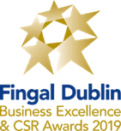
Student Transformative Learning Record Employability Skills Transcript
Best Public Service Organisation Award
Fingal Dublin Business Excellence and Corporate Social Responsibility Awards 2019

