Slide 1

Atlantic Technological University’s
The Next Step: Transitioning to Work Employability module &
MyCareerPath
AHEAD Conference 2025: Bridging the Gap
MyCareerPath Supports Inclusive Employability Module for all students’
Bridie Killoran, Sally Reidy

Slide 2


The Next Step Careers Module?
Level 7, 5 credit module designed to enhance the employability skills
What is MyCareerPath?
An online Career Development Service combining cutting-edge AI tools with personalised one-to-one mentoring.
Notes:
Intro to mycareerpath

Slide 3
Employability Module Learning Outcomes
Employability Module Learning Outcomes | Resources from MyCareerPath
1. Apply active self reflection and research skills to create a sustainable career development plan. | Strengths Tool
2. Construct a comprehensive Career Development e-Portfolio. | CV360 CV Builder Cover Letter Builder
3. Present and articulate professional skills and experience in an employment interview situation. | Interview 360
4. Identify, research and reflect on transversal employment skills. | Career Edge+
Notes:
How does mycareerpath support a wide range of diverse learners to achieve the Learning Outcomes of The Next Step?

Slide 4
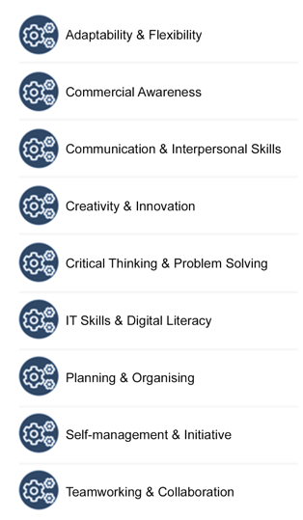
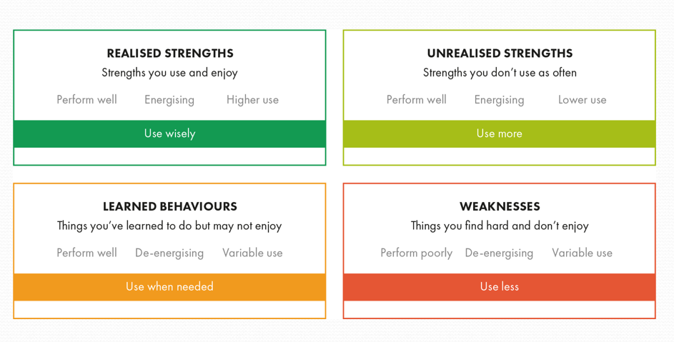
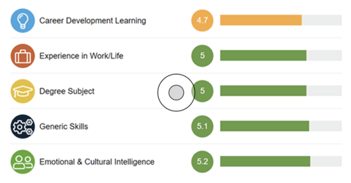


Our Assessments
Career Edge
– Employability Review
Transversal Skills Identification & Development
Strengths Assessment

Slide 5
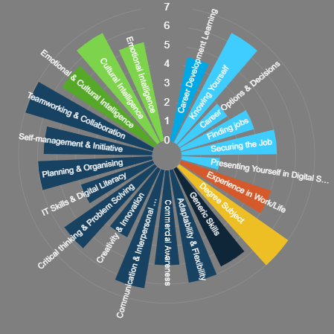
Career Edge+ Employability Checker (Darce, Pool and Sewell, 2007)
Short hand | Item | Description
Career | Career Learning | Understanding career progression, planning, and decision-making.
E | Experience of Work & Life | Practical experience, applying skills in real-world settings, and professional growth.
D | Degree Subject | Leveraging academic knowledge and subject-specific expertise.
G | Generic Skills | Critical thinking, creativity, IT literacy, and problem-solving capabilities.
E | Emotional & Cultural Intelligence | Managing emotions effectively and understanding cultural diversity.

Slide 6
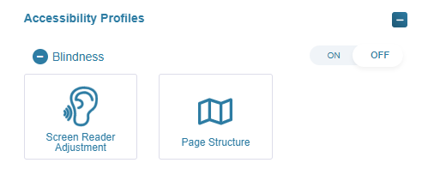
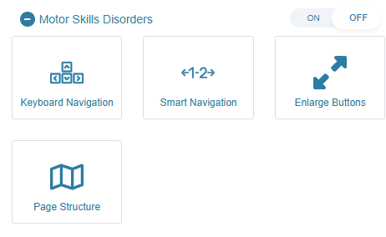
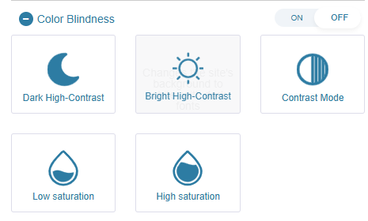
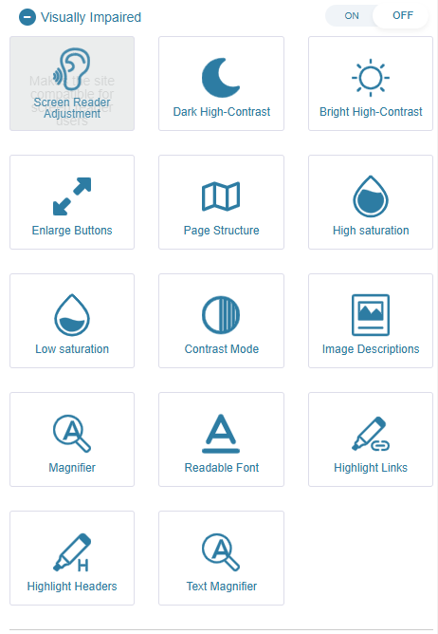
MyCareerPath Accessibility Menu
Accessibility Profiles
Blindness
Motor Skills Disorders
Color Blindness
Visually Impaired

Slide 7
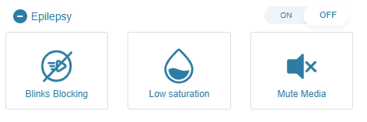
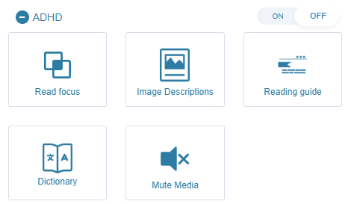
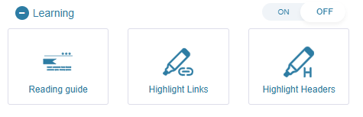
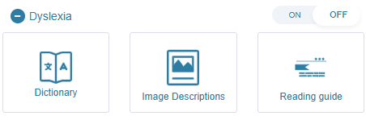
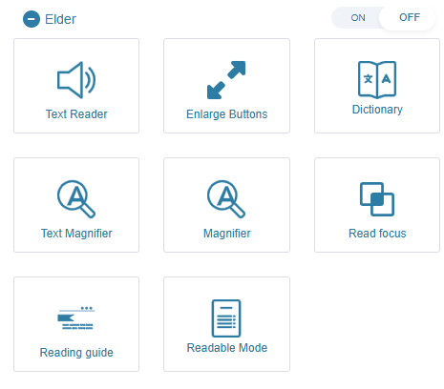
Accessibility Profiles
Accessibility Profiles
Epilepsy
ADHD
Learning
Dyslexia
Elder

Slide 8
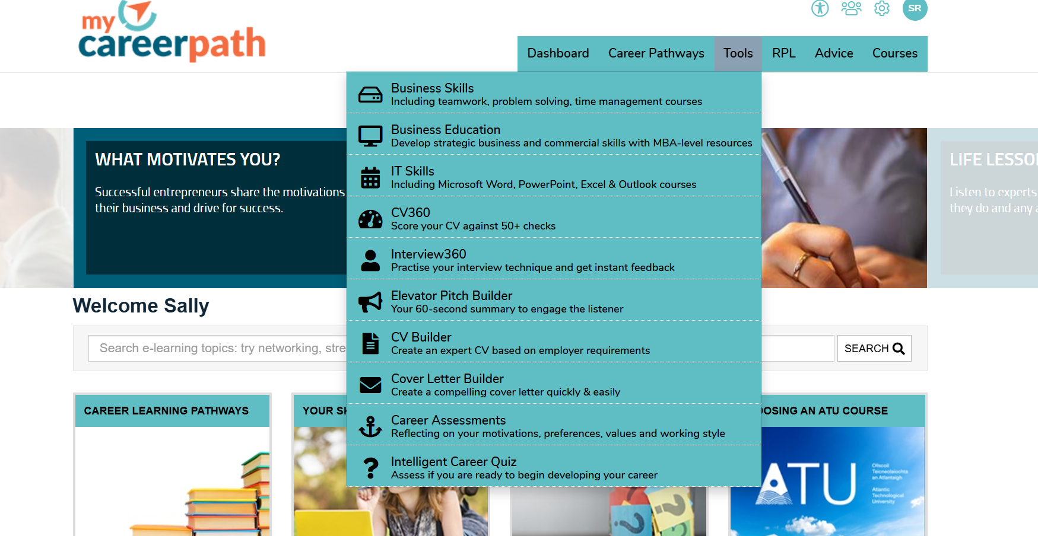
My Career Path Website

Slide 9
Demo of MyCareerPath.ie

Slide 10
References
Darce Pool, L., & Sewell, P. (2007). The key to employability: developing a practical model of graduate employability. Education and Training, 49(4), 227-289 - https://www.ahecs.ie/wp-content/uploads/2020/10/AHECS_GMS_2020-final-soft-copy.pdf
MyCareerPath.ie website - https://mycareerpath.ie/
Strengths PATH Programme Promo Video -https://youtu.be/E7basMvH1gI?si=XQHxRQIZYctErVUg

