Slide 1

AsIAm
Employment Programme

Slide 2
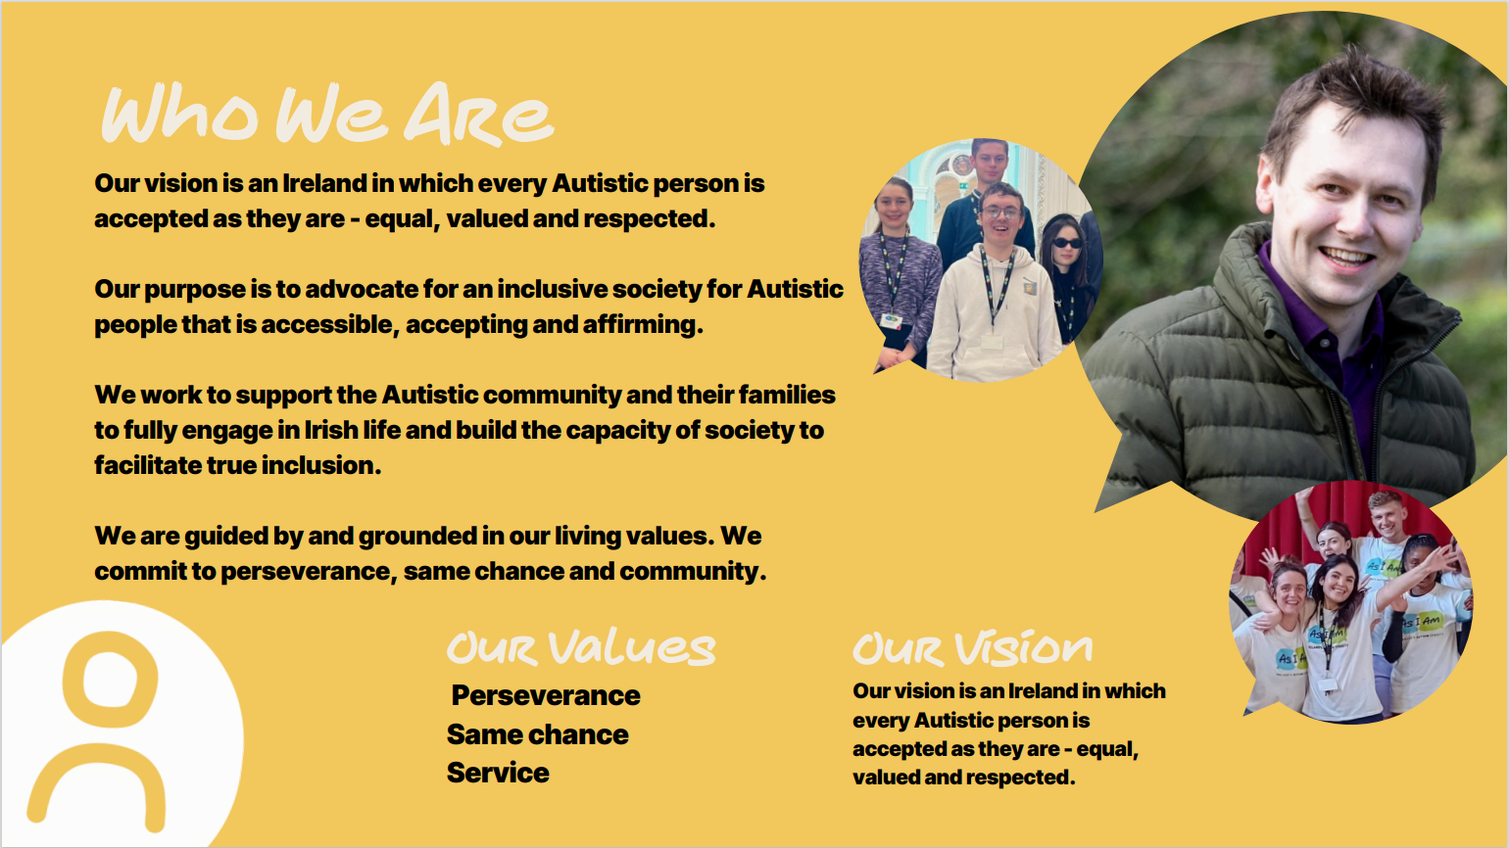
As I Am: Who We Are

Slide 3
The Issue: Autism Unemployment and Underemployment
The Issue
Autism Unemployment and Underemployment
Autistic people face the highest rate of unemployment of all disabled groups.
85% of Autistic people in Ireland are unemployed or underemployed (AsIAm, 2023).
Results in significant financial consequences for our community.
Contributes to social isolation and a loss of independence and dignity.
Critically, it represents a major loss of talent, knowledge, experience, and expertise to both employers and society.

Slide 4
Why Autism Unemployment and Underemployment?
Why Autism Unemployment and Underemployment?
Lack of understanding.
Negative stereotypes.
Unadapted job application and interview processes.
Challenges in maintaining employment due to not receiving necessary support or adjustments.

Slide 5
The Solution: Autism and Unemployment
The Solution
Autism Unemployment and Underemployment
Need for increased understanding, tailored recruitment processes, and workplace accommodations to improve employment outcomes.
Does not require vast Government financial investment, or new programmes.
Requires changes to ways of thinking and working, which can often be small, inexpensive, and capable of rapid implementation.
Many of these changes will not only benefit Autistic people but all employees, jobseekers and employers.

Slide 6

AsIAm Employment Programme
With a goal of ensuring more inclusive workplaces and improved rates of employment for Autistic people, AsIAm uses a two-pronged approach.
Employer Education
Job Seeker Support
Targeted education for employers to better understand the Autistic experience.
Focus on all stages of the complete Employee Lifecycle.
Continuous education through Communities of Practice (CoP) membership.
Targeted support for Autistic job seekers through Employment Groups and 1:1 Career Clinics.
Focus on all experience levels, all roles and industries.
Vacancies available through CoP members advertised through various means.
Connecting Inclusive Employers & Active Job Seekers

Slide 7
AsIAM Employment Programme for Autistic Jobseekers
AsIAm
Employment Programme
for
Autistic Jobseekers

Slide 8
Employment Programme For Autistic Jobseekers
Designed to support Autistic jobseekers in developing the skills and confidence needed to navigate the world of work.
Provides free access to Employment Groups and 1:1 Career Clinics to support:
Autistic Jobseekers
Job Movers
Tertiary Education Graduates

Slide 9

Employment Groups for Autistic Jobseekers
Employment Groups for Autistic Jobseekers
4-Session Programme: Online and in-Person Groups.
Session 1: Job Search Strategy
Session 2: CV Development & Application Letters
Session 3: Neurodiversity in the Workplace
Session 4: Interview Skills

Slide 10

Career Clinics for Autistic Jobseekers
1:1 career support sessions facilitated by career coaches providing:
Job Searching
Job Application Support
CV Development
Mock Interviews
Advice on Reasonable Accommodations, Disclosure etc.
Online via Zoom Platform
In-Person Locations:
Dublin, AsIAm Office Blackrock
Dublin 1, Macro Centre
Limerick, Dóchas Centre
Waterford, Central Library

Slide 11
HEI Collaboration: AsIAm Employment Seminars
Important for Higher Education Institutions and AsIAm to collaborate on employment initiatives for autistic students.
Autistic graduates will receive the tailored support they need to thrive in the workforce.
AsIAm has commenced Employment Seminars hosted at HEIs.
Builds on our Autism Friendly Higher Education Institution (HEI) programme, designed to support and guide HEIs in creating inclusive environments for autistic students.
AsIAm’s first Employment Seminar was hosted by Maynooth University in November 2024 and was a huge success.
Next Employment Seminar will be hosted by National College of Ireland on 29th of March 2025.

Slide 12

AS I Am Employment Seminar
Seminar Information and Booking Link: https://asiam.ie/events/asiam-employment-seminar

Slide 13
AsIAm Employment Seminar NCI 29MAR25
Morning Seminar
Adam Harris CEO AsIAm & Mairéad McHale, AsIAm Employment Officer
James Cussack, CEO Autistica UK’s Autism Research Charity
Employer Partner Talk: Insurance Ireland Representatives
HEI Partner Talk: National College of Ireland
Afternoon
Employment Group Sessions for Autistic Jobseekers

Slide 14
Final Slide: Thank You
Thank You!
Contact:
employmentgroups@asiam.ie

