Slide 1



Pathways to the Professions
- a model to improve access and inclusion for early career success
Kathie Orr, Pathways to the Professions Coordinator, UCD Access and Lifelong Learning

Slide 2

Quotation
“Talent is equally distributed, opportunity is not.”
Leila Janah
Widening participation benefits society as a whole.
Ensures:
Everyone’s talent and potential is realised and harnessed.
Professions are representative of the communities they serve.

Slide 3

Project AimsA
Project Aims
widen participation
promote mainstreaming of inclusion in the professions
Develop transferable model of good practice for professions to support identification of areas for diversity development and planning roadmap
project learning consolidated into toolkit and micro-credential training for employers

Slide 4






Access Barriers
Mapping the Professional Journey
Purpose:
Identify and factor in key barriers.
Ensures initiatives are holistic.
Social inhibitors/lack of resources and supports – social capital.
Lack of peer role models/mentors.
Accommodation issues.
Studying whilst working.
Have to apply for financial support.
Disability or learning difficulty.
Medical or mental health condition.
Caring responsibilities.
English as a Second Language.

Slide 5
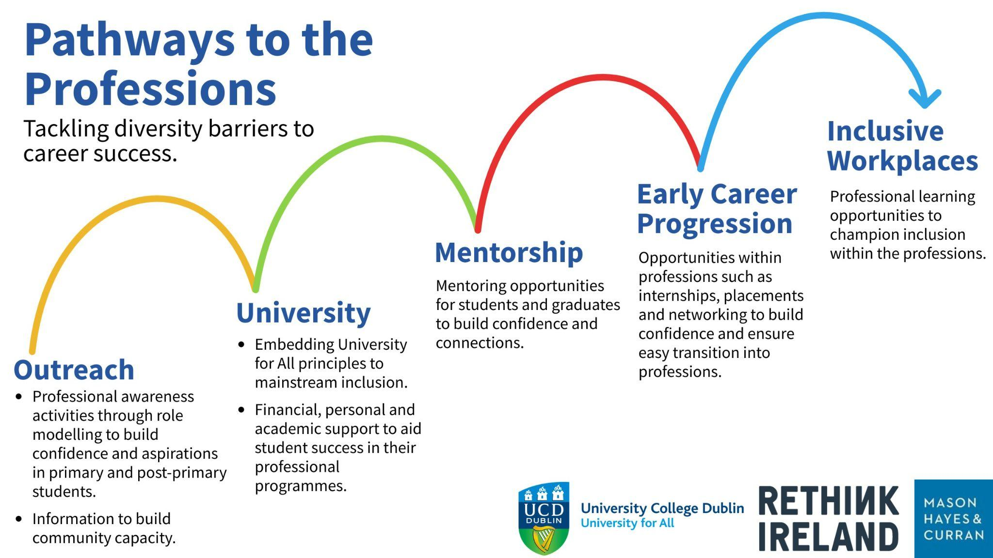
Steps to professional success

Slide 6
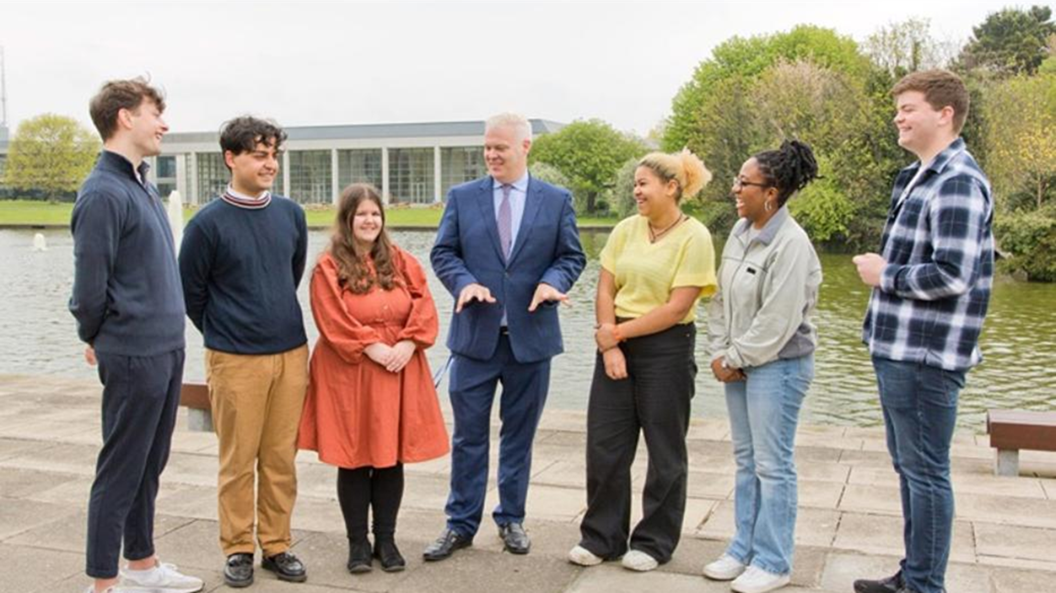

Early Career Progression initiatives
Opportunities within the professions such as:
Mentoring
Internships and work placements and
Networking
to build confidence and ensure easy transition into professions
Collaborative initiatives e.g. with collaboration between UCD Access and Lifelong Learning, UCD Careers and UCD Alumni Relations.

Slide 7
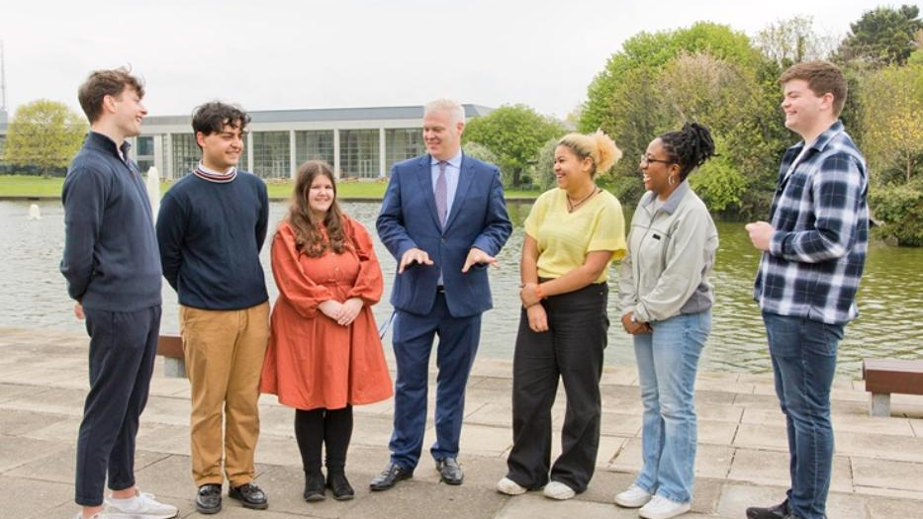
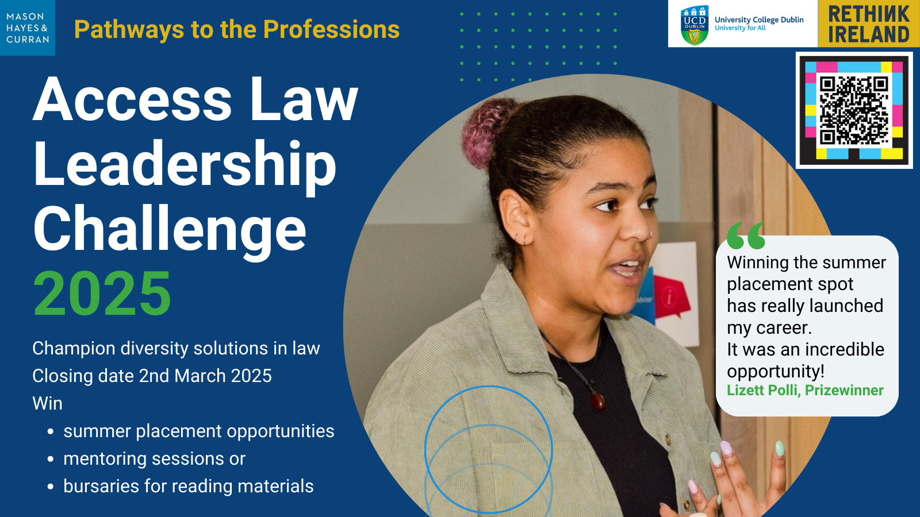
Access Law Leadership Challenge
Invites students to demonstrate outstanding leadership by championing diversity solutions in the legal profession.
Winning submissions awarded paid internships, mentoring, and bursaries for books.
‘I feel I have a better understanding of the legal profession. My mentor has also taught me several job search strategies which are also extremely beneficial. It helped me because I don’t have any family members working in the legal profession who I can ask those sorts of questions.’
Mentorship prize winner
Notes:
Invites students to demonstrate outstanding leadership by championing diversity solutions in the legal profession.
Winning submissions awarded paid internships, mentoring, and bursaries for books
Mentorship : gave participants better understanding of the legal profession. Learned Job search strategies. Helped if no family members working in the legal profession to whom they can ask those sorts of questions.

Slide 8
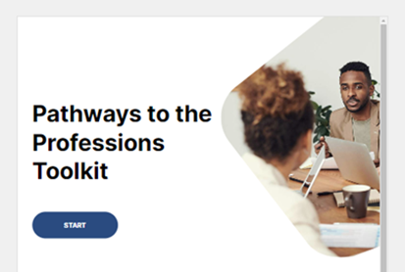
Pathways to the Professions Toolkit
Flexible, transferable ‘roadmap’ collating project strands for systematic rollout of the various pathway steps.
Standalone sections for each ‘step’ in the pathway
Open Educational resources: good practice guidelines and checklists, models/case studies and self assessment checklists

Slide 9
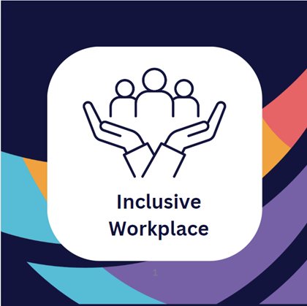
Inclusive Workplaces Digital Training
Supports employers to build expertise in how to use Universal Design to embed a whole organisation approach to access and inclusion.
Open education resource
Extends the Toolkit for Universal Design to the workplace environment

Slide 10
Inclusive Recruitment
Professional Development & Capacity Building
Job Descriptions & Advertising
Retention beyond Recruitment
Blind Screening
Interview & Assessment
Notes:
Job Descriptions and Advertising
Use inclusive language: Avoid gender-biased or industry-specific jargon. Use gender-neutral terms and ensure that the language is accessible to non-native speakers.
Focus on skills: Rather than emphasizing specific degrees or work experience, focus on the skills and competencies required for the role.
Avoid unnecessary requirements: Ensure that the qualifications listed are truly necessary for the job and don't unintentionally exclude candidates (e.g., years of experience).
Diversify job posting channels: Go beyond traditional recruitment platforms by posting on job boards that cater to underrepresented groups (e.g., platforms for women in tech, LGBTQ+ communities, or persons with disabilities).
Use employee referrals mindfully: While referrals are useful, they can sometimes perpetuate homogeneity. Encourage employees to refer candidates from diverse backgrounds.
Blind Screening
Implement blind recruitment: Remove identifying information such as names, genders, and locations from resumes to minimize unconscious bias.
Interview & Assessment
Standardise interviews: Use a consistent set of questions and evaluation criteria for all candidates to ensure a fair comparison.
Use diverse interview panels: Include people from different backgrounds and levels in the organization to bring varied perspectives.
Provide reasonable accommodations: Ensure that candidates with disabilities can easily access interviews and tests, whether virtual or in-person. This might involve offering flexible scheduling or screen-reader-compatible documents.
Communicate your commitment to diversity: Share your organisation’s values around diversity, equity, and inclusion (DEI) prominently in job postings and interviews.
Collect feedback: Solicit feedback from candidates and employees about their recruitment experience to continually improve your process.
Audit your recruitment processes: Regularly review your job postings, recruitment channels, and hiring processes for bias and areas of improvement.
Retention beyond Recruitment
Onboarding process: Ensure that new hires from diverse backgrounds feel welcomed and supported from day one. Offer mentoring and support networks.
Create career development opportunities: Promote leadership development programs, sponsorship, and mentorship initiatives that support underrepresented groups.
Measure and track diversity data: Regularly review your recruitment metrics to assess where improvements can be made and ensure continuous progress.
Ensure flexibility: Be open to flexible work arrangements (remote work, flexible hours) that might help individuals with caregiving responsibilities or other needs.
Professional Development & Capacity Building
Train hiring teams: Ensure recruiters, hiring managers, and interviewers receive training on diversity and inclusion to be more aware of how their biases might affect decision-making.
Foster awareness: Encourage open discussions and education around the importance of inclusive recruitment and work practices and how they benefits the organisation.
Set diversity hiring goals: These can be ambitious but realistic targets for increasing representation across the organisation.

Slide 11
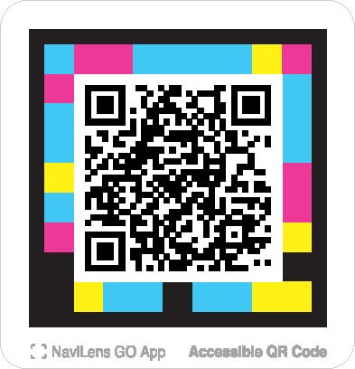
Thank you!
Questions and Answers
Contact us: universityforall@ucd.ie

Slide 12
References
Kelly, A. & Padden, L. (2018) University for All: embedding and mainstreaming equality of access, participation and success in higher education. Studies in Health Technology and Informatics. Volume 256: Transforming our World Through Design, Diversity and Education DOI10.3233/978-1-61499-923-2-483
Kelly, A, Padden, L. & Fleming, B. (2024) Unlocking Inclusion: Toolkit for Universal Design in Higher Education. Dublin: UCD Access & Lifelong Learning.
Kelly, A. M., Padden, L., & Fleming, B. (Eds.). (2023). Making Inclusive Higher Education a Reality: Creating a University for All. Routledge
UCD University for All, Pathways to the Professions webpage

