Slide 1
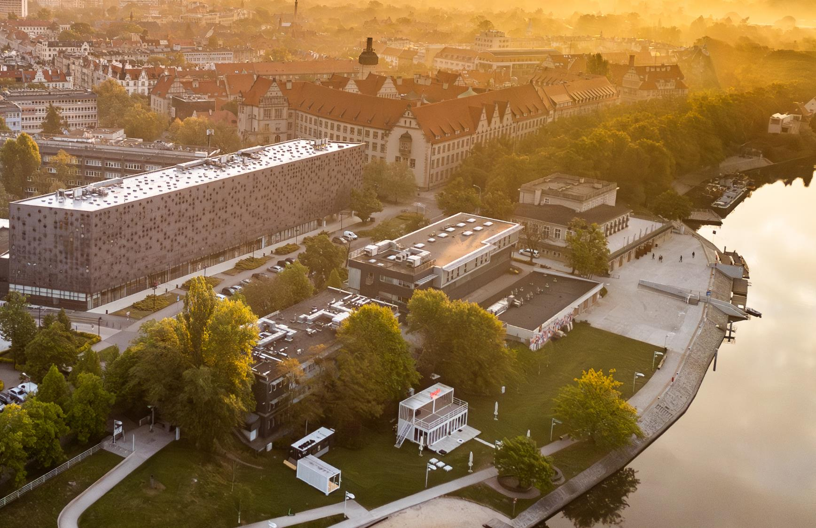
The role of university in preparing students with special needs for future work - the example of Wroclaw Tech
Katarzyna Jach, PhD DSc, Associate Professor

Slide 2

Wroclaw Tech, Poland at glance
~400
Students and staff with disability certificate
21 046
students and
Phd students
2 378
permanent academic staff
~150
Registered students with special needs
1 401
international
students
14
faculties
3
regional branches

Slide 3



Selected initiatives at Wroclaw Tech
Accessibility Leaders as first contact persons at the faculty, including practice and internships organizing
Tutoring as a process of individual development of professional skills
Specialized workshops and counselling services organized by Career Services for students and alumni with special needs.

Slide 4
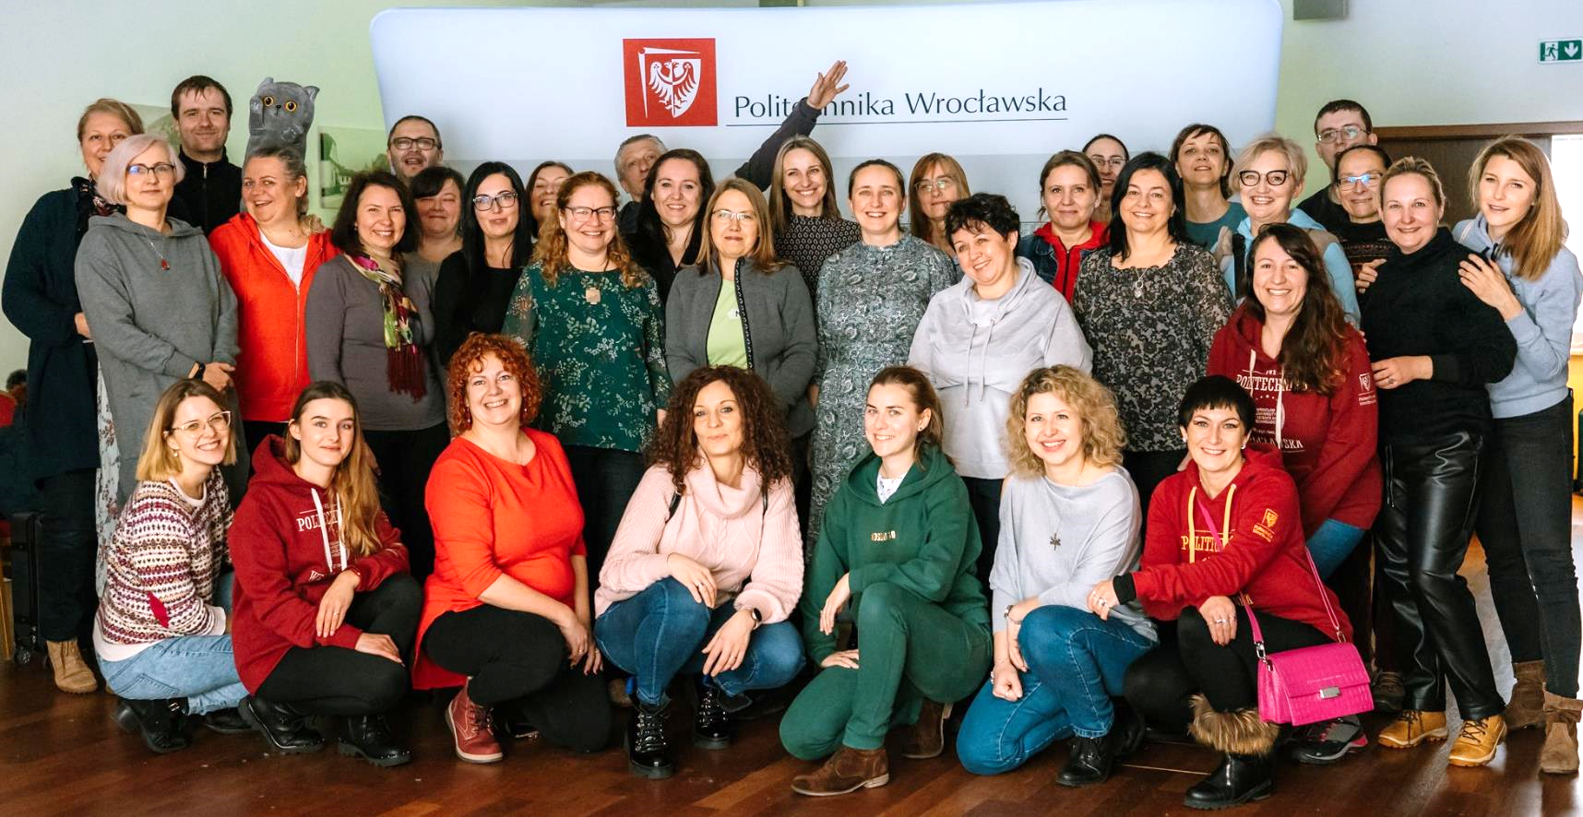
Accessibility Leaders (1/2)
  68 volunteers from all Faculties
  and selected Wroclaw Tech units
  Officially registered
  After 10 training days + participation in various events at the University
  Support available in English: https://ddo.pwr.edu.pl/en/leaders-of-accessibility
  Tailored support and necessary accommodations

Slide 5

Accessibility Leaders (2/2) – intern with hearing impairment
  Workplace: University Library
  Support with:
    organizational issues (documents, working hours registration)
    Communication with leader and colleagues
  Misunderstandings solving, mainly about the language
  After the internship the person is still employed

Slide 6


Tutoring (1/2)
  ~60 tutors after at least 8 training days
  Usually working in 1:1 model
  Developmental, academic or mixed tutoring
  More information: https://tutoring.pwr.edu.pl
  Additionally: peer-to-peer tutoring https://tutech.pwr.edu.pl/

Slide 7
Tutoring (2/2) – student with ASD
  3 years long support
  Organized by Accessibility Office at the beggining
  Main goal: increasing student’s independence
    Social skills training
    Communication skills training
  Tutor coordinated support network (Dean, Dean Office, Accessibility Office, some teachers and peer students)
  Student graduated and started his first work during his last semester

Slide 8

Career Services (1/2)
  ~10 career advisors
  Different work styles
    1:1 consultations (CV, professionally presentation during job interview, strengths and areas that need to be developed analysis etc.)
    Workshops
  Job offers matching
  More information: https://biurokarier.pwr.edu.pl/en/

Slide 9
Career Services for students with special needs (2/2)
1:1 consultations
Dedicated, trained career advisor
Flexible time schedule
Workshops
Open workshops with accessibility checking
Dedicated workshops with special content i.e. disclosure problem
Job offers
Offers labeled „Employer friendly to people with disabilities”

Slide 10

Summary
  Accessibility Leaders, personalized tutoring, and specialized Career Services are examples how to ensure students receive the necessary accommodations and guidance
  University role is supporting strongly at the beggining and increasing the student’s independance at the end of studies
  All the support means should be coordinated and flexible

Slide 11
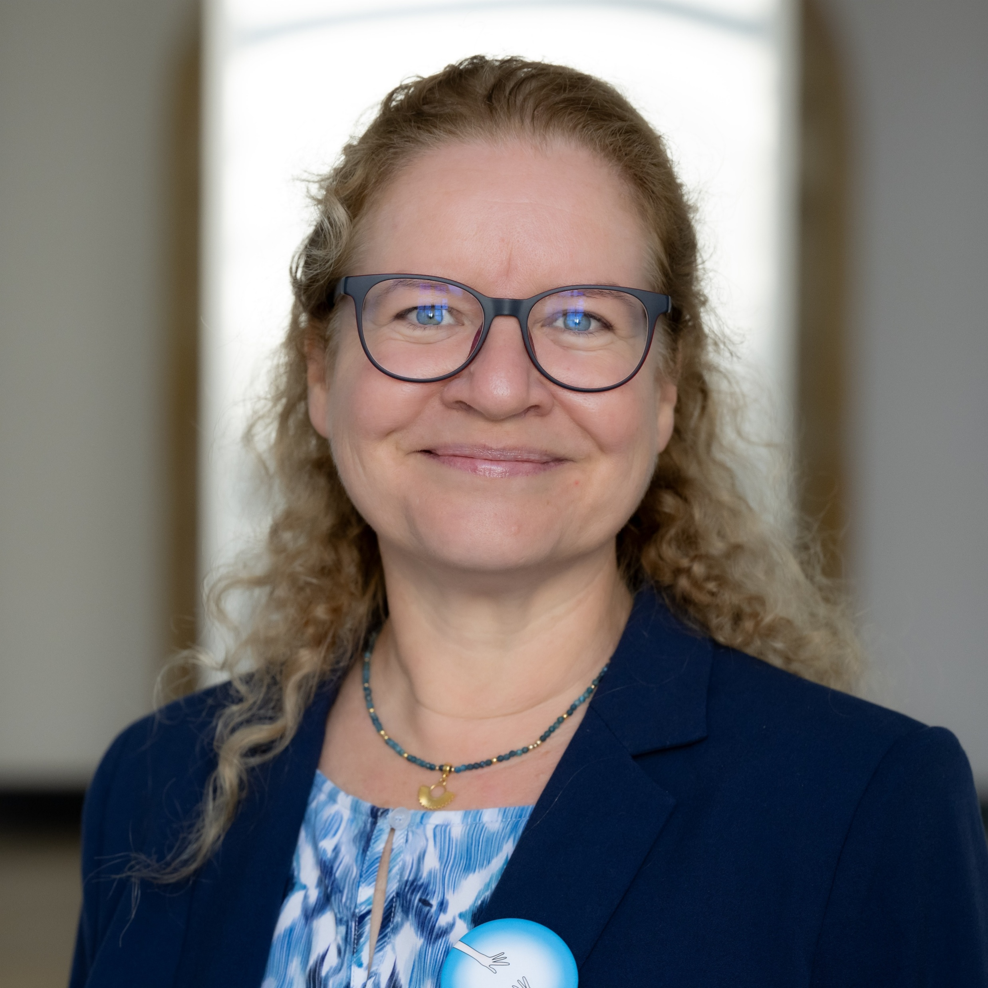
Thank you for attention
Katarzyna Jach, PhD DSc, Associate Professor
Wroclaw University of Science and Technology (Wroclaw Tech), Poland
Mail: katarzyna.jach@pwr.edu.pl www.dzd.pwr.edu.pl/en
Logos and photos from Wroclaw Tech resources.
Images generated by AI or with Creative Commons Licence.

