Slide 1

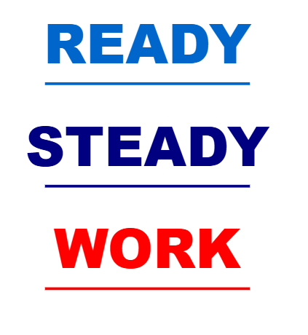
Employability Development Framework
Olga Mitchell,
Ready Steady Work Officer, Munster Technological University (MTU)

Slide 2

Overview
Collaborative
Tailored
Navigate
Employability
Work Ready
Employer Partners
Direct Engagement

Slide 3
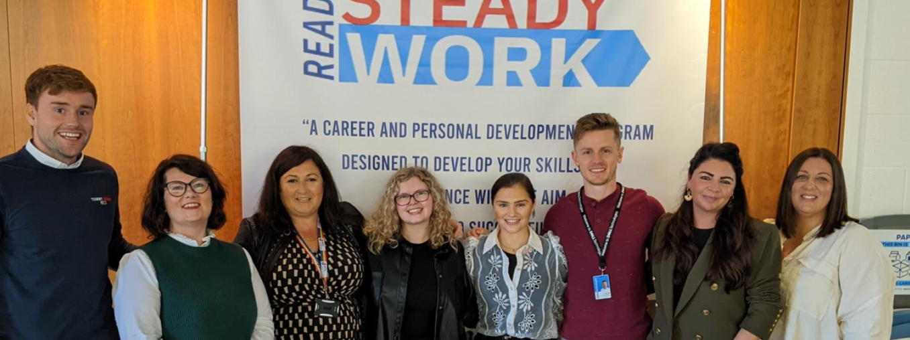
Infrastructure
One to one meetings
Employer partnerships
Core resources
Online supports
In-person workshops

Slide 4
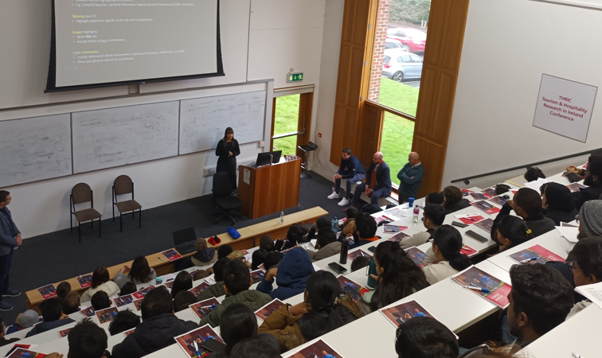
Framework for Ready Steady Work
Employability Profile
Environment evaluation
Skills / Strengths identification
Work Readiness Model *
Employer Task Carving
Workplace Communication
External Visibility

Slide 5
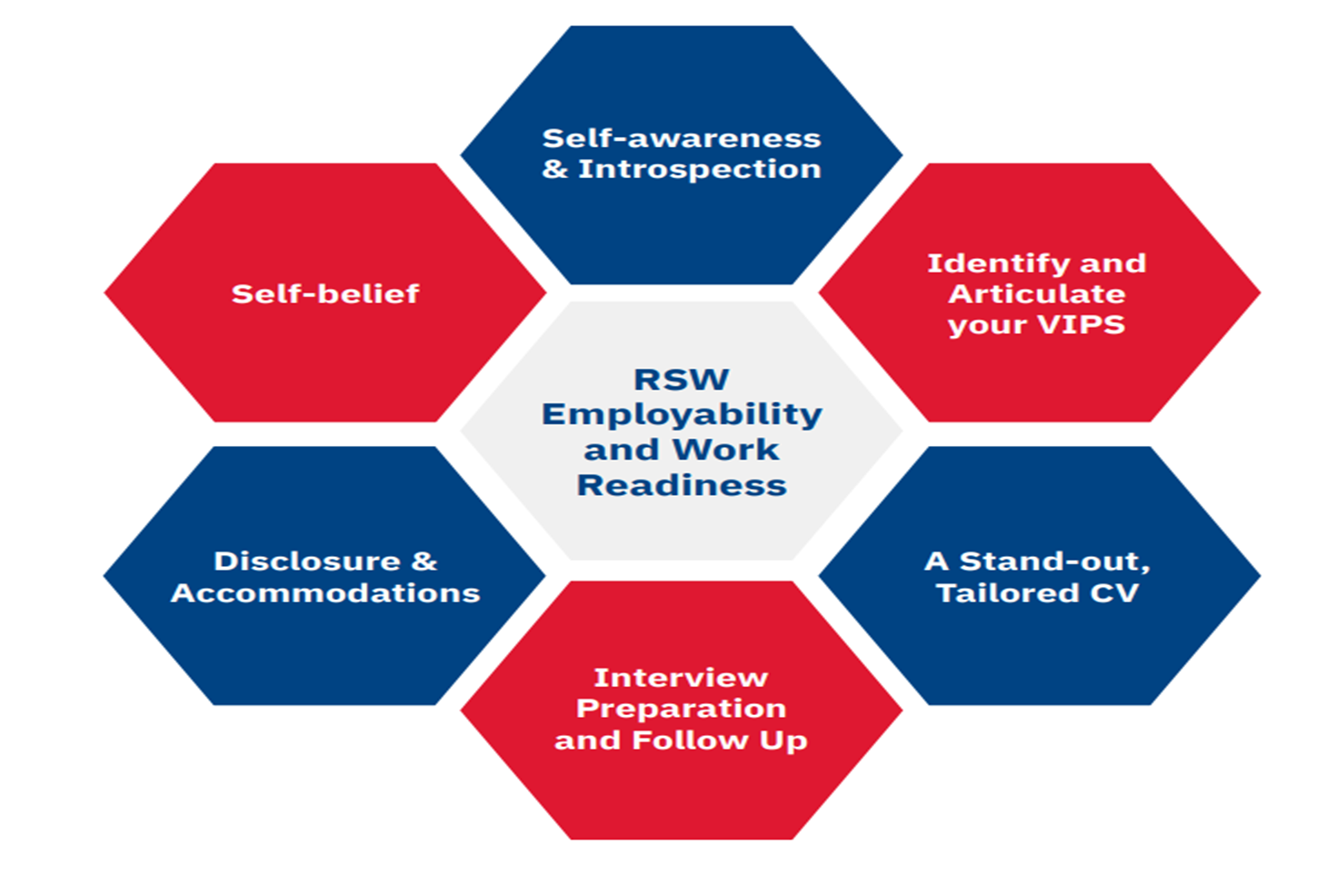
Work Readiness Model
Self awareness and interoception
Core beliefs and Self belief
Identify and Articulate VIPS
Disclosure and accommodations
Generate a tailored stellar CV
Interview preparation and follow up

Slide 6

Student Experience
“As a graduate, applications and interviews were very daunting”

Slide 7

Next?
Increase Engagement
Expand Offerings
Expand Industry Partners
Increase Opportunities

Slide 8
Thank You!

