Slide 1


GAME ON!
EMPOWERING STUDENTS THROUGH ESPORTS FOR CAREER READINESS
AHEAD Annual International Conference 2025​
Serge Davidon (NLN Portlaoise Student)
Ronan Fox (NLN Senior Digital Officer)
Zoe Hartford (NLN Portlaoise Student)
Eimear O’Driscoll (NLN Digital Transformation Lead)​

Slide 2

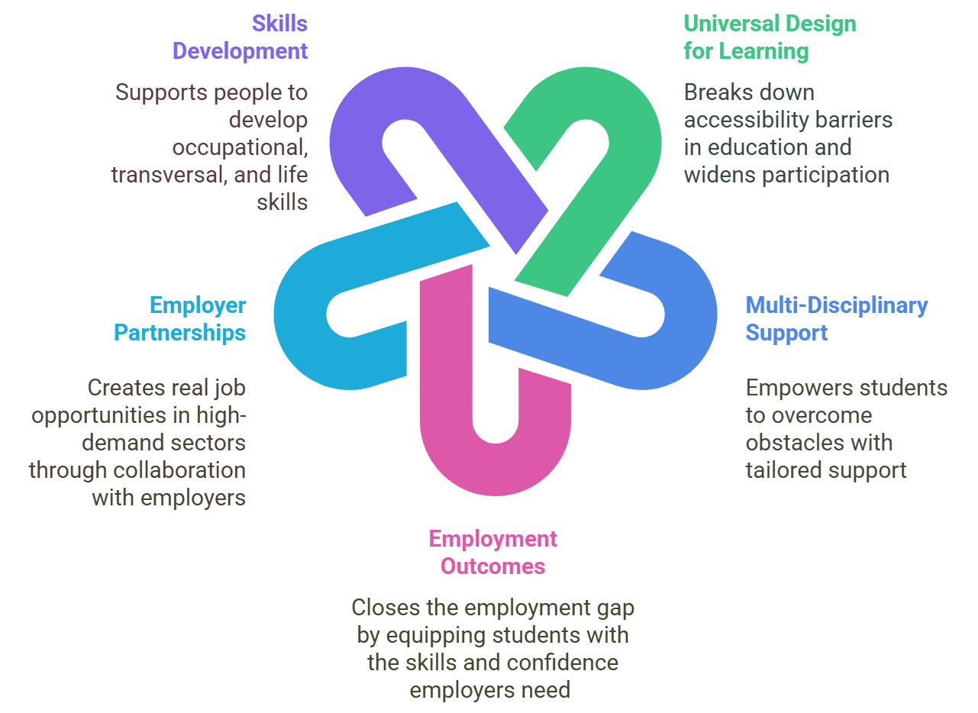
NLN’s Role in Bridging the Disability Employment Gap

Slide 3
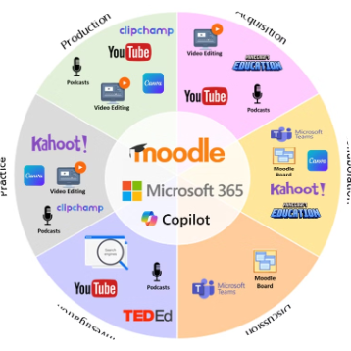
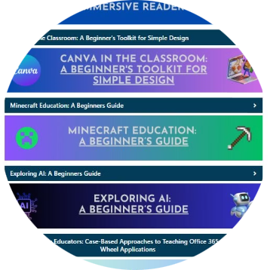
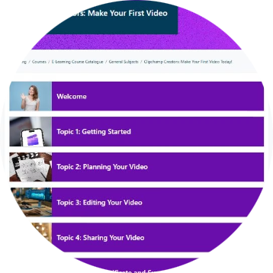
NLN’s Digital Transformation Journey
NLN Tech Wheel
TEL Sessions for
Instructors
Student Online Courses
Approved digital tools for learning and collaboration.
Supports and encourages instructors to build and embed digital skills.
Enhances the student learning experience and builds digital literacy.

Slide 4
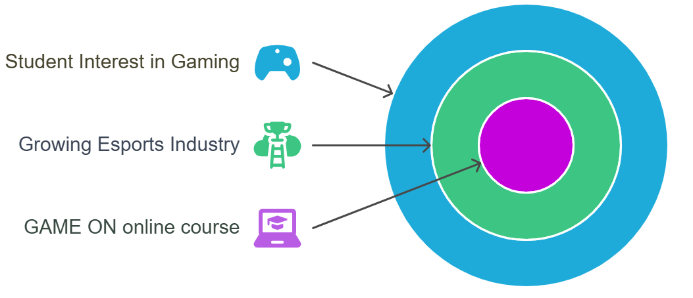
GAME ON: Student Passion Meets Opportunity​

Slide 5
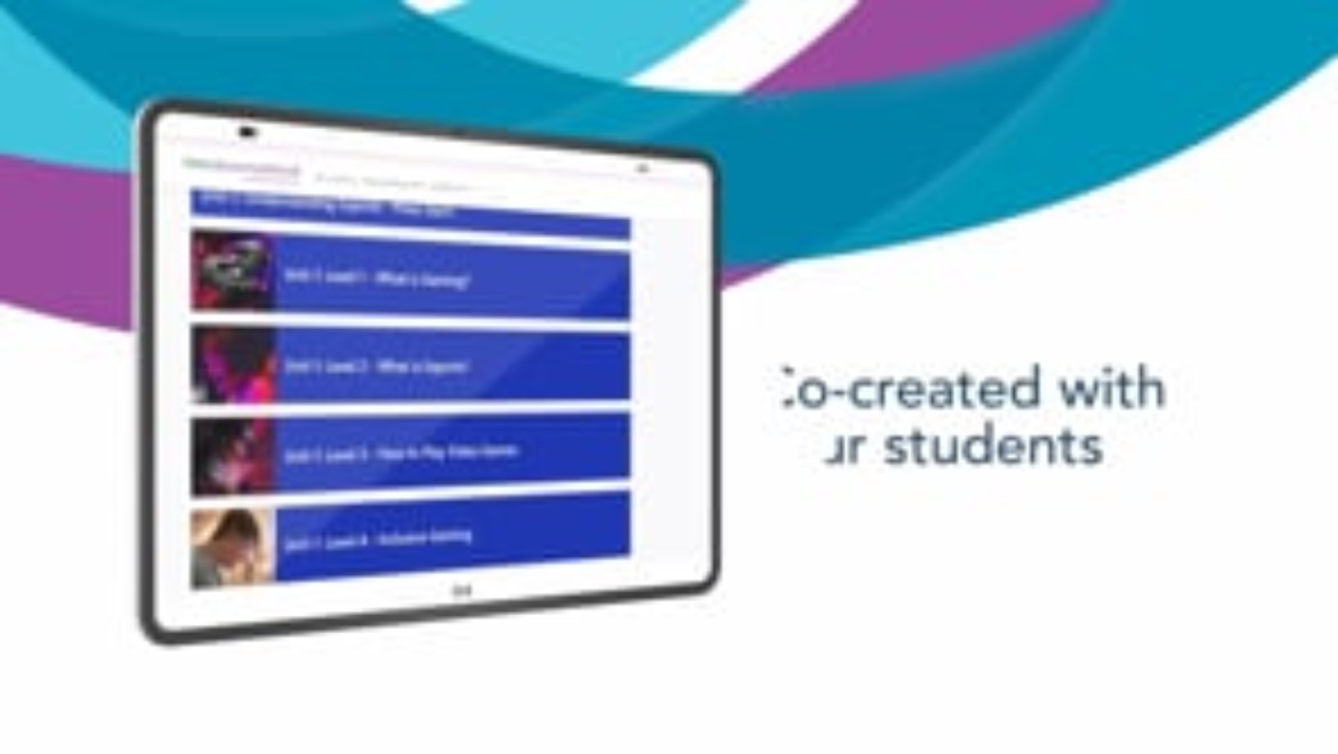
An Online Course to Turn Gaming Passions into Careers

Slide 6
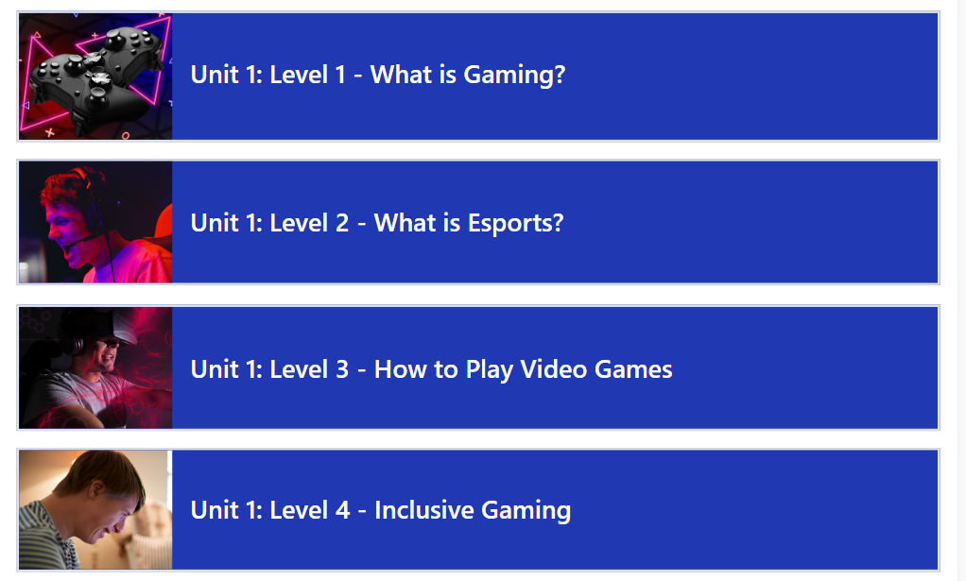
Unit 1: Understanding Esports – Press Start!

Slide 7
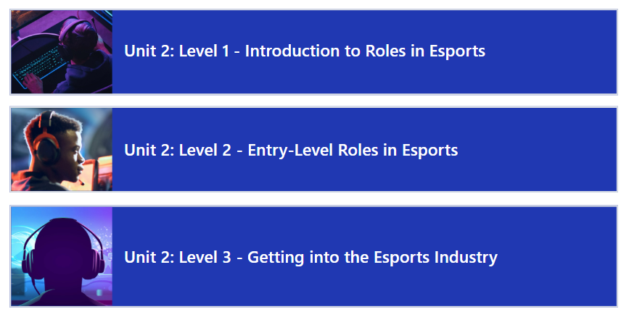
Unit 2: Esports Roles – Choose Your Character!

Slide 8
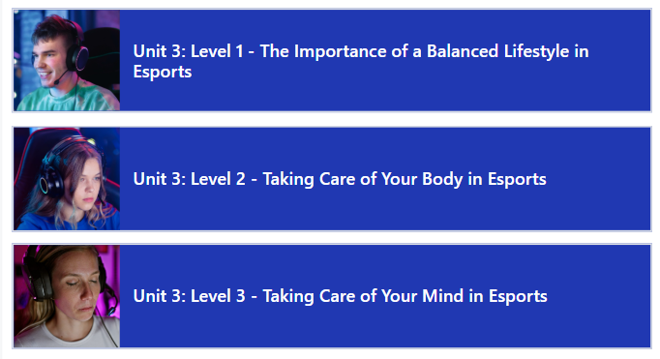
Unit 3: A Balanced Lifestyle in Esports

Slide 9
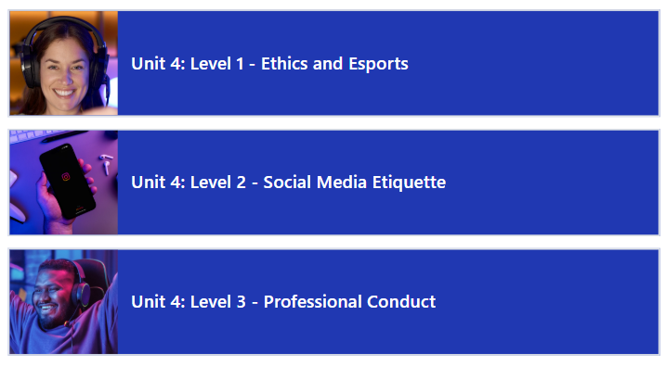
Unit 4: Pro Code – Doing the Right Thing in Esports

Slide 10
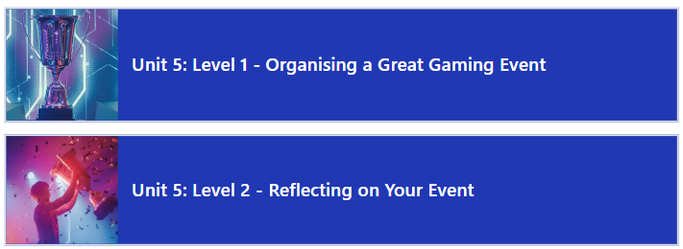
Unit 5: Mastering Event Planning –
Quest for the Ultimate Gaming Experience

Slide 11
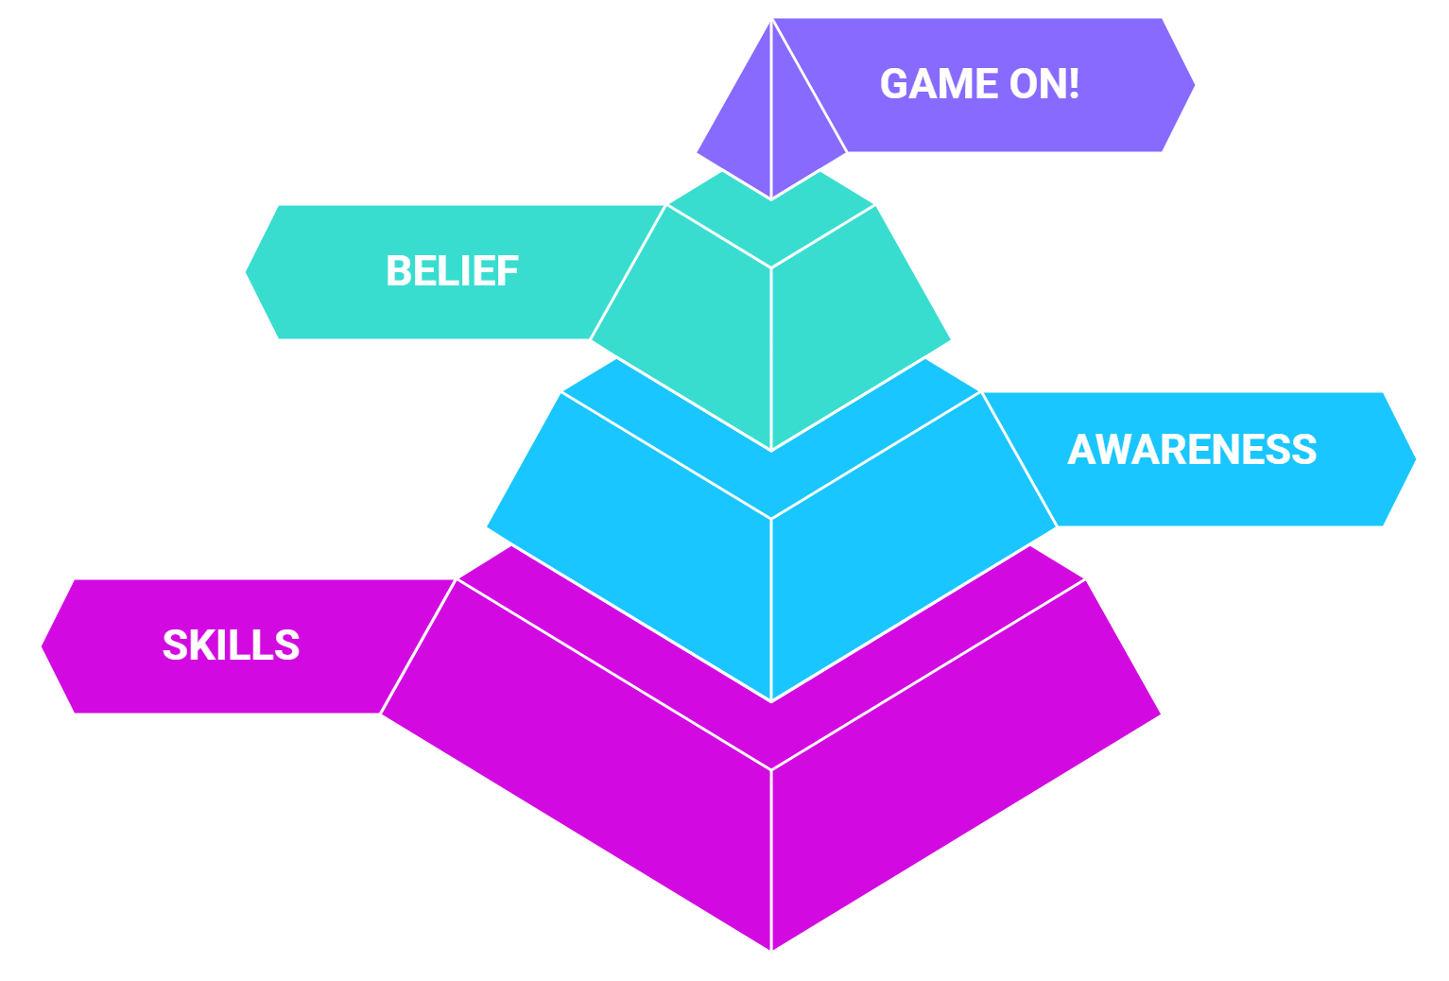
GAME ON: Tools to Thrive in the Esports Industry

Slide 12
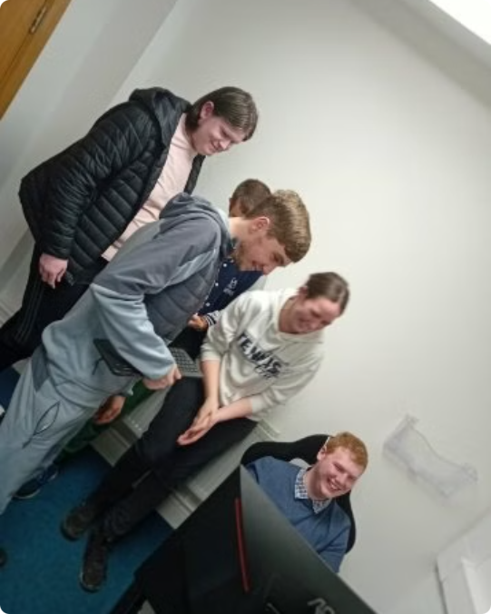
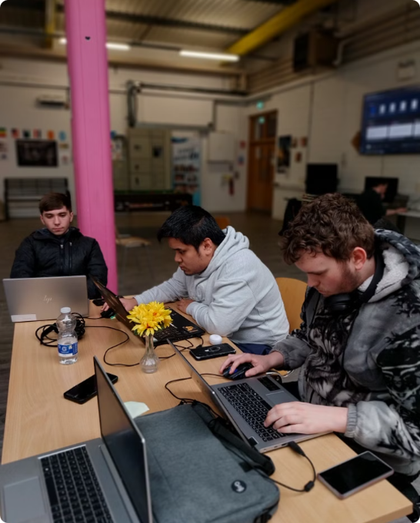
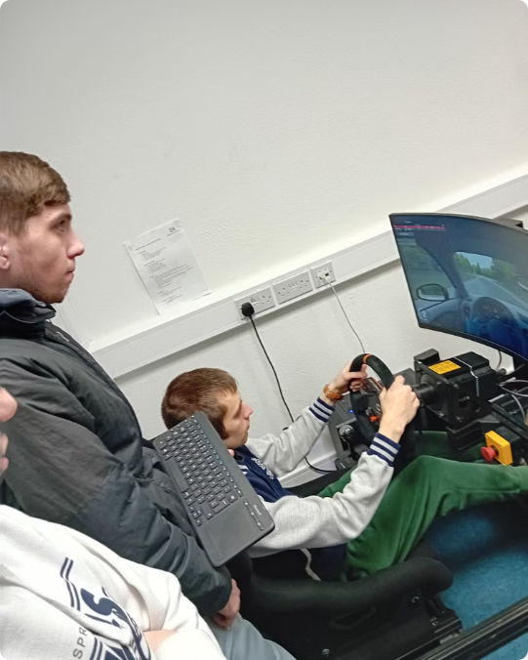
Student Focus: GAME ON!

Slide 13

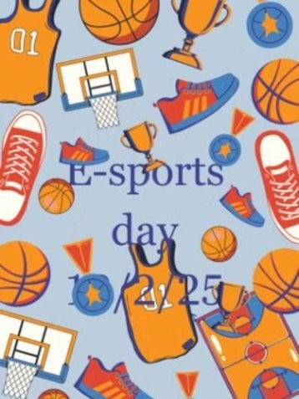
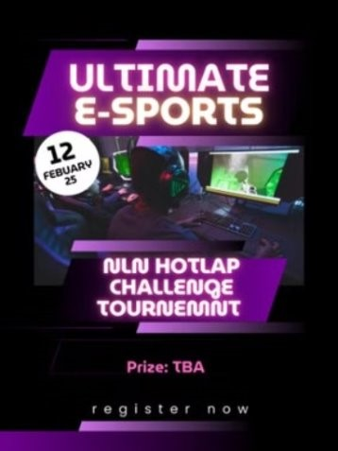
Get Ready for the NLN AHEAD Esports Event!​

Slide 14
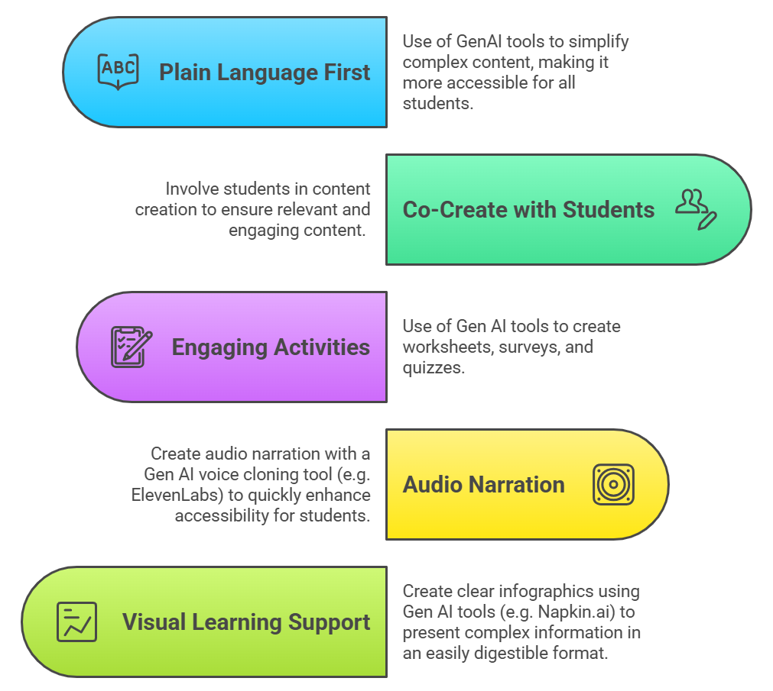
NLN’s Tips on Creating an Inclusive Online Esports Course

Slide 15
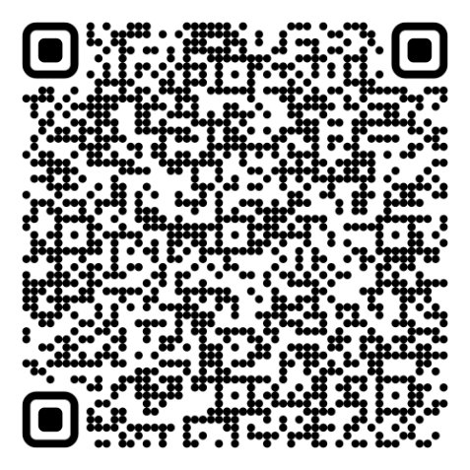
Scan For Tips on Building Inclusive Online Courses

Slide 16
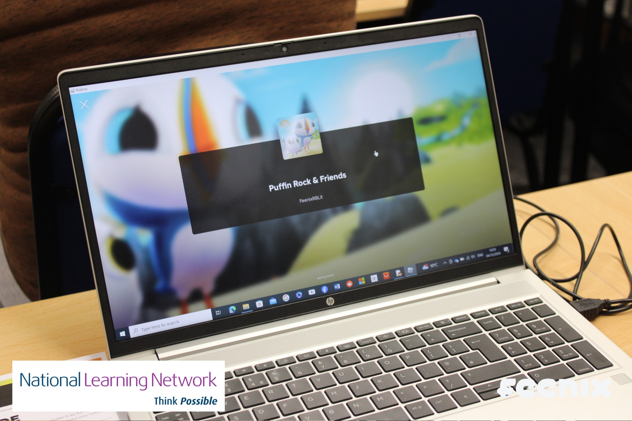

GAME ON: Empowering All Gamers for Career Success
“Gamers come in all shapes and sizes, backgrounds and abilities, and we believe that all of them deserve an equal chance to not only enjoy accessible gaming, but to gain real opportunities to achieve their dream jobs in the industry.”
Sinéad Hosey
Co-Founder of Feenix Group​

