Slide 1
Supporting your neurodivergent colleagues from the perspective of an autistic person
Sarah Pattison
Instructional Designer
Dept. Technology Enhanced Learning, MTU
Bluesky: @sarahpattison.bsky.social

Slide 2
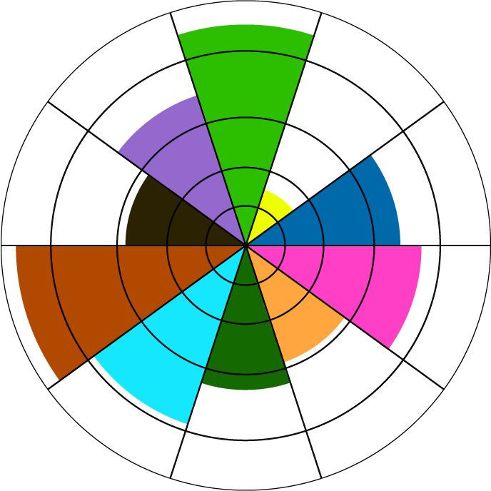








Autistic characteristics
Social
difficulty
Social/general anxiety
Being blunt without meaning to
Difficulty understanding what others think or feel
Difficulty articulating how you feel
Taking things literally
Needing to stick to routines/repetitive behaviour
Avoiding eye contact
Sensory issues
Abnormal
Posture
Poor
eye contact
Noise
sensitivity
Flat Speech
Tics and
Fidgets
Anxiety
Depression
Aggression
Fixations
Autistic characteristics
Notes:
Autism is not a linear spectrum. It’s not a straight line from less autistic to more autistic. It’s more like a colour wheel with different autistic traits, where autistic people are higher in multiple traits compared to neurotypical people. Here are some more common characteristics for autistic people.

Slide 3


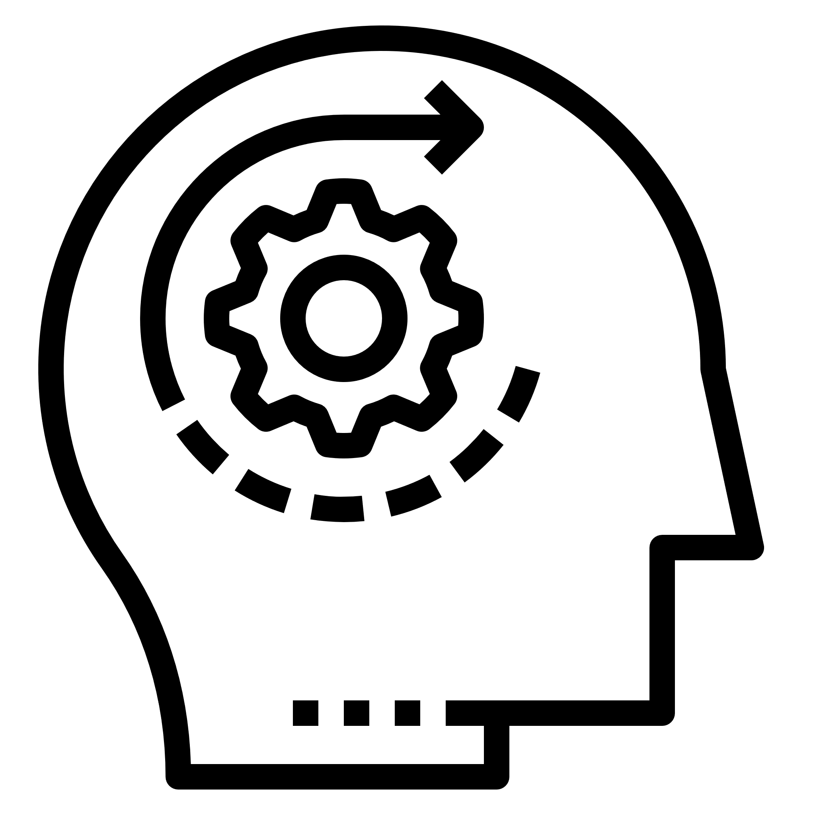





Autistic employees
Embracing neurodiversity at work
Creativity and innovation
Improved wellbeing
Customer/staff/student engagement and trust
Autistic traits that may benefit work
Strong sense of justice
Unique skill sets
Focus
Attention to detail
Different way of approaching problems
Autistic employees
Notes:
Beyond meeting legal requirements there are multiple reasons it’s great to embrace neurodiversity in the workplace

Slide 4








Autistic people and the hiring process
Difficulties
Feeling discouraged to apply
Social aspects
Body language
Too “honest”
Processing information
Helpful steps
Clear job description/application form
Describe work environment
Ask to demonstrate abilities
Focus on suitability for the job over social competence
Autistic people and the hiring process
Notes:
85% of autistic people are unemployed or underemployed but many autistic people want to work. The hiring process can be quite daunting.

Slide 5

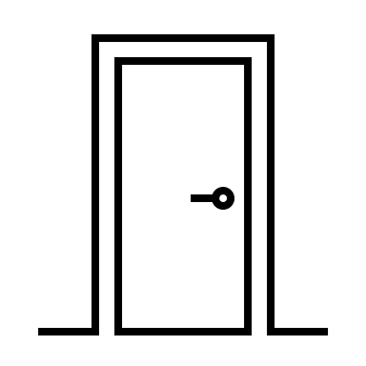








Reasonable accommodations
“An employer shall do all that is reasonable to accommodate the needs of a person who has a disability by providing special treatment or facilities”
Employment Equality Act, 1998
Noise cancelling headphones/ earplugs
Freedom to pace/fidget
Work from home
Reduced requirement to travel
Captions
Routine
Avoid last minute requests
Preferred working hours
Private space
Autistic led training for staff
Reasonable accommodations
Notes:
According to the Employment Equality Act, autistic people are entitled to reasonable accommodations in their work. These can include..

Slide 6
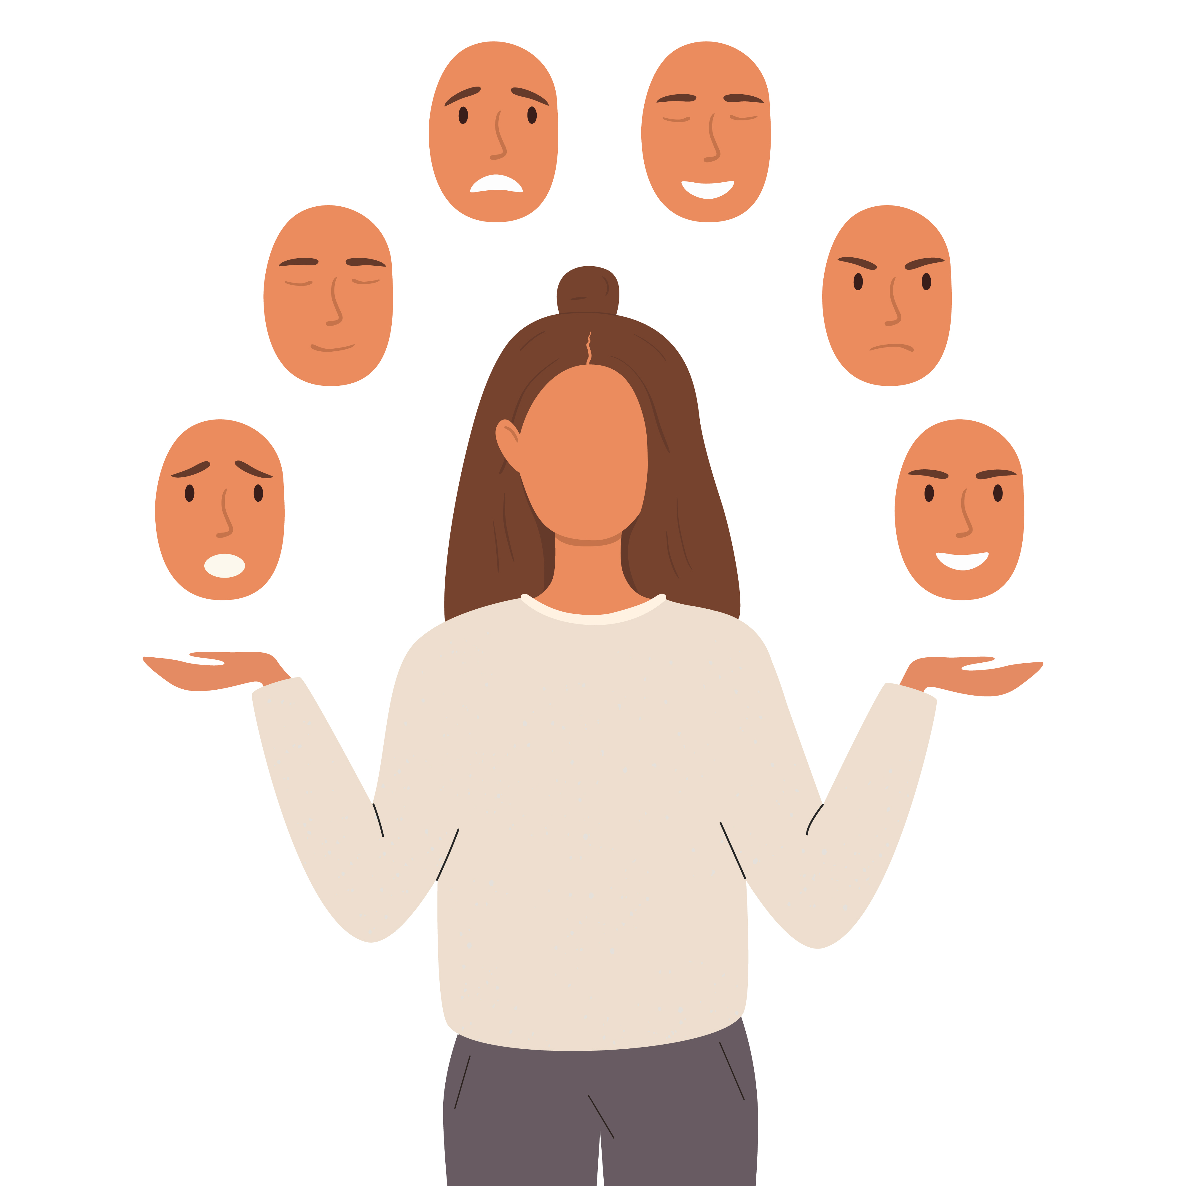

The privilege of diagnosis
The HSE does not usually provide autism assessments for adults.
Autistic women are more likely to “mask” their autism.
15 to 20% of people are thought to be neurodivergent.
3.3% of Irish population are autistic
Notes:
The HSE does not usually provide autism assessments for adults.
I am privileged that I was able to afford an assessment last year, but not everyone can.
Autistic women are more likely to “mask” their autism so are underdiagnosed, which happened to me.
This is why I think it’s important to have a neurodiverse friendly work environment whether you know your staff or neurodivergent or not.

Slide 7
References
As I Am & Irish Jobs. (2021). Autism in the workplace: Creating opportunity for autistic people. In Irish Jobs. https://www.irishjobs.ie/recruiters/wp-content/uploads/2021/03/AsIAm-IrishJobs.ie-Autism-in-the-Workplace-Report_April-2021-FINAL.pdf
Employment Equality Act, Irish Statute Book, s.16. (1998), Office of the Attorney General
Health Service Executive. (n.d.). Autism in adults. HSE.ie. https://www2.hse.ie/conditions/autism/about-autism/autism-in-adults/
Health Service Executive. (n.d.-b). How to get assessed for autism. HSE.ie. https://www2.hse.ie/conditions/autism/assessment-and-support/assessment-autism/
Honeybourne, V. (2019). The neurodiverse workplace : An employer's guide to managing and working with neurodivergent employees, clients and customers. Jessica Kingsley Publishers.
What is autism? (n.d.). As I Am. https://asiam.ie/advice-guidance/what-is-autism
References

