Slide 1

Preparation and Performance: Supporting Students with Intellectual Disabilities into Internships
Barbara Ringwood – TCPID Senior Occupational Therapist
Emer Murphy – TCPID Senior Occupational Therapist
Marie Devitt – TCPID Business Partnerships Manager

Slide 2




What is the format of the TCPID programme?
A Structured College Programme
Business Partner Network
Student / Graduate
Support

Slide 3

Barrier Bingo

Slide 4
Bingo Score Card
1
2
3
4
5
6
7
8
9

Slide 5

1. Yes!
Worried about saying the wrong thing or getting something wrong.
Offending someone.

Slide 6
2. Yes!
Impact on benefits.

Slide 7
3. Yes!
Being treated differently from other people.

Slide 8
4. Yes!
Complicated job applications

Slide 9
5. Yes!
Lack of previous experience/knowledge of work or work role.

Slide 10
6. Yes!
Not finding the right work for a person.

Slide 11
7. Yes!
Knowing what jobs are available

Slide 12
8. Yes!
Feeling worried or not having confidence about skills or getting the right support.

Slide 13
9. Yes!
Lack of education or understanding about intellectual disabilities.

Slide 14
Answers to Bings Slide Card
1 Worried about saying the wrong thing or getting something wrong. Offending someone. | 2 Impact on benefits. | 3 Being treated differently from other people.
4 Complicated job applications. | 5 Lack of previous experience/knowledge of work or work role. | 6 Not finding the right work for a person.
7 Knowing what jobs are available | 8 Feeling worried or not having confidence about skills or getting the right support. | 9 Lack of education or understanding about intellectual disabilities.

Slide 15
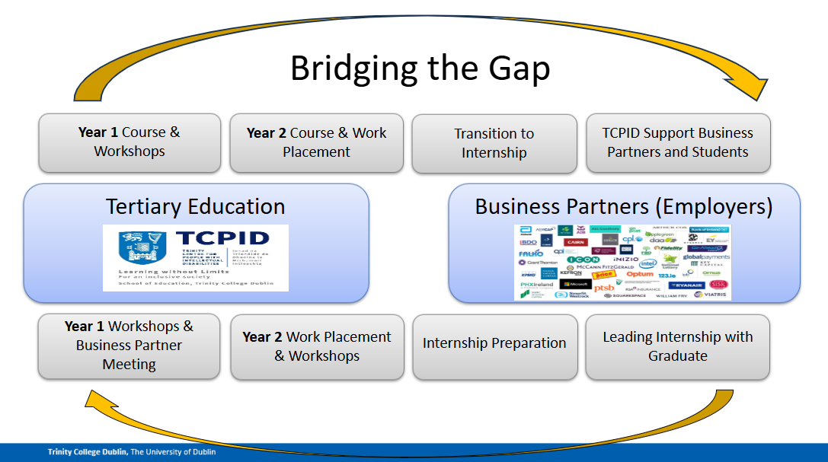
Bridging the Gap

Slide 16
Thank you
Barbara Ringwood – bringwoo@tcd.ie
Emer Murphy – murphe78@tcd.ie
Marie Devitt – devittma@tcd.ie

