Slide 1




Building skills, confidence and community through inclusive peer learning
Kerry Lawless
CÉIM Engagement Coordinator
Joe Kennedy
CÉIM Graduate Intern

Slide 2


During the workshop
Keep in mind...
01
We will use ‘disabled persons’ and ‘persons with disabilities’ interchangeably as there is no single correct terminology and each person has their own preference.
02
Every student is different and will require different supports and needs. Adapting practices to facilitate disabled students can benefit the wider student community as well.
03
We are always learning and adapting. If you have any questions or recommendations we will have a Q&A at the end.

Slide 3

What are we going to talk about?
Workshop Structure
Background on CÉIM Shared Learning
UD(L) and CÉIM - recruitment, training, coaching and running sessions
Interviews with Neurodivergent (ND) Leaders and personal experiences
The interactive piece - looking at barriers, current practices, and future inclusive practices
Q&A

Slide 4

What is CÉIM
Peer learning programme for 1st year students in University of Galway Students’ Union- est. 2013
Based on well-evidenced Supplemental Instruction/ Peer Assisted Learning (SI/PAL) model
Operating across 3 colleges and reaching over 2000 students
120 leaders in 2024 volunteered as leaders

Slide 5
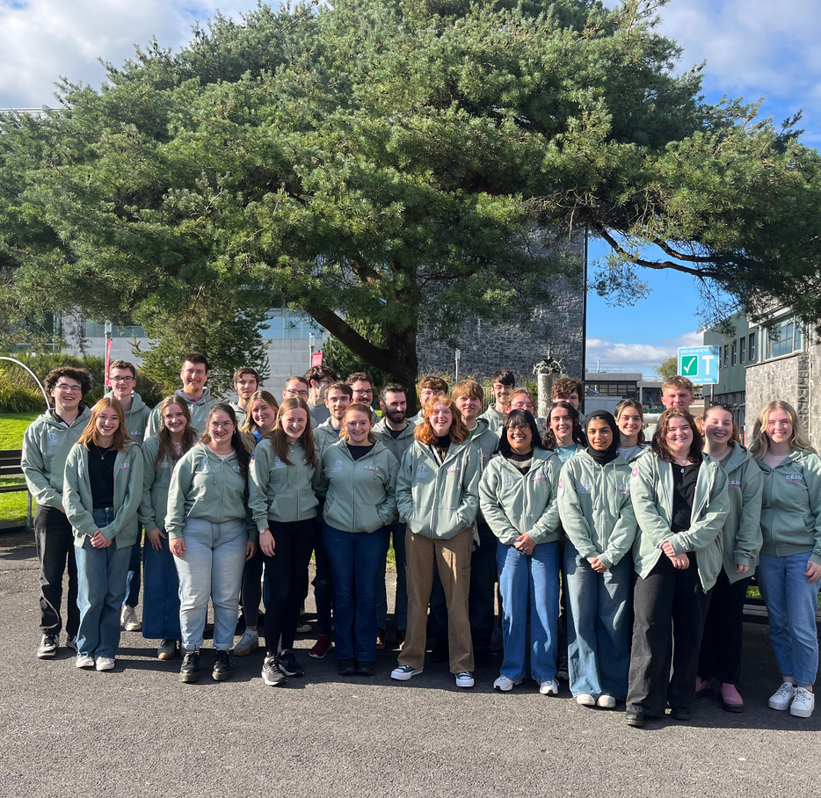

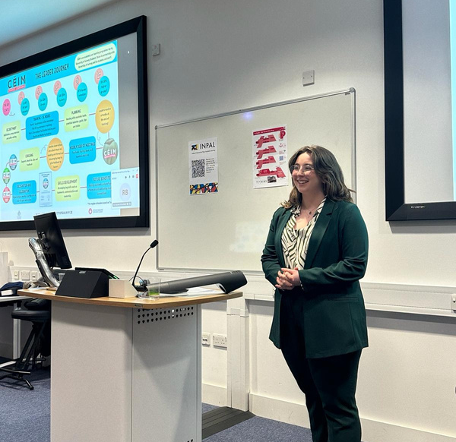
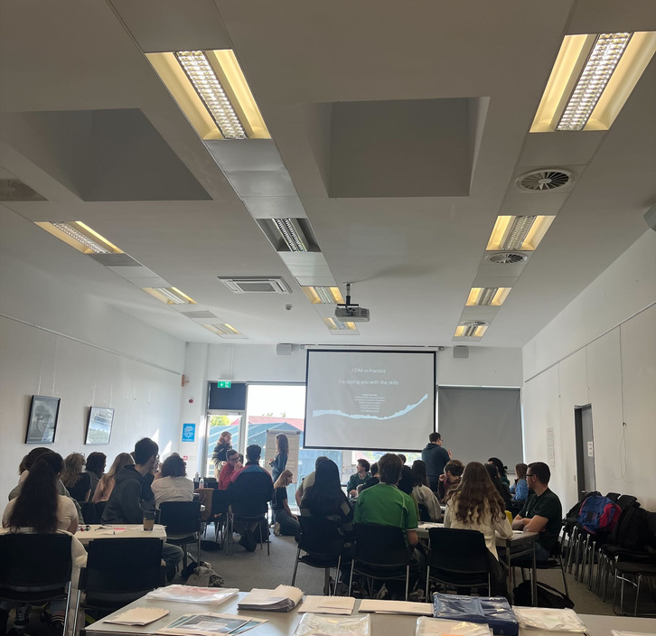
CÉIM Leaders
Recruited through online applications and group interviews (3-7 people)
Training on facilitation techniques, relevant IT skills, and wellbeing and student supports (how to help and refer students to the relevant resources)
Receive coaching throughout the academic year
Maintain contact with the CÉIM team through check-ins, debriefs and emails
Are made aware of the supports available to them before and throughout their time volunteering

Slide 6





How do we incorporate inclusive practices?
And who are the best people to ask about them?

Slide 7



The short answer? We ask disabled students.
Including people with disabilities in research and decision making is essential
In May 2024 we interviewed 7 student leaders to get an idea of how the volunteer programme supports and works for them, and what we can do to improve our support structures and create more awareness for disabled students and volunteers.

Slide 8
What did we find?
For both students and leaders:
CÉIM volunteering is an excellent space to build confidence and skills for ND students.
Playing to students’ strengths with creativity and fun
What does CÉIM do well to support ND student leaders:
Session drop-ins, checking in, and coaching.
Offering variety of communication (F2F, WhatsApp group, Email)
CÉIM values different perspectives and variety of different year groups, genders, etc. in leader groups
Debrief meetings provide an example of what not to do, and multiple examples of what you can do instead. This includes different forms of working and plays to leaders' strengths in different ways.
Multiple methods of engagement – Padlet, dynamic slides, videos etc.

Slide 9
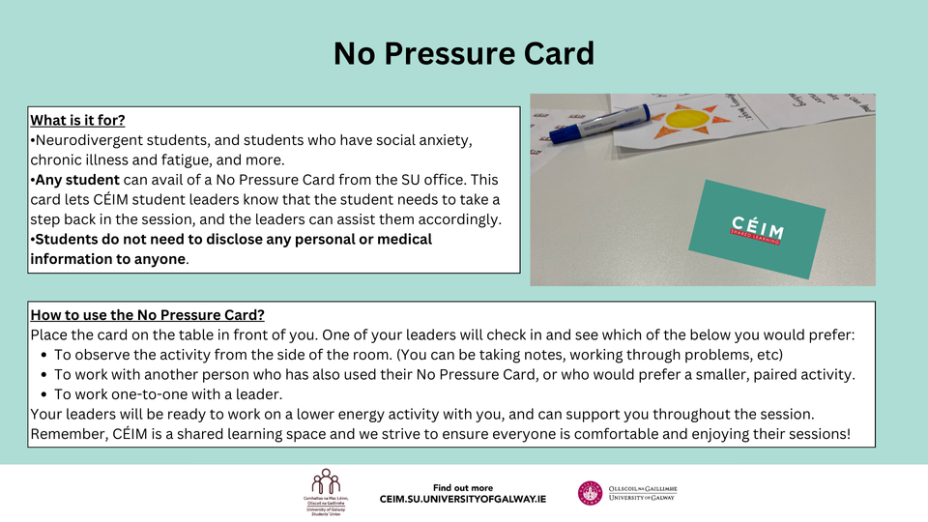
What did we do?
Aim of providing a positive space for students and leaders to build their skills, confidence and a sense of commuinity.
Roll out of No Pressure Card in 2024 academic year for CÉIM Sessions
Availability of fidget toys
Group Agreement and how to work with me
Neurodivergent Soc x CÉIM study skills and note taking workshop
UD(L) training for the CÉIM team

Slide 10
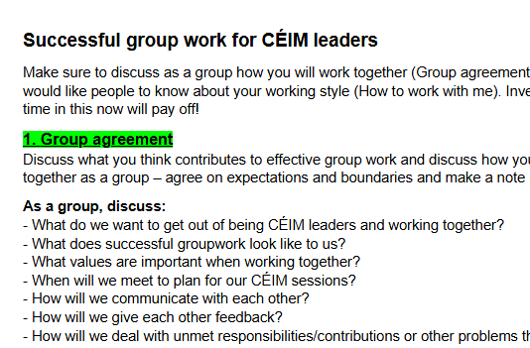
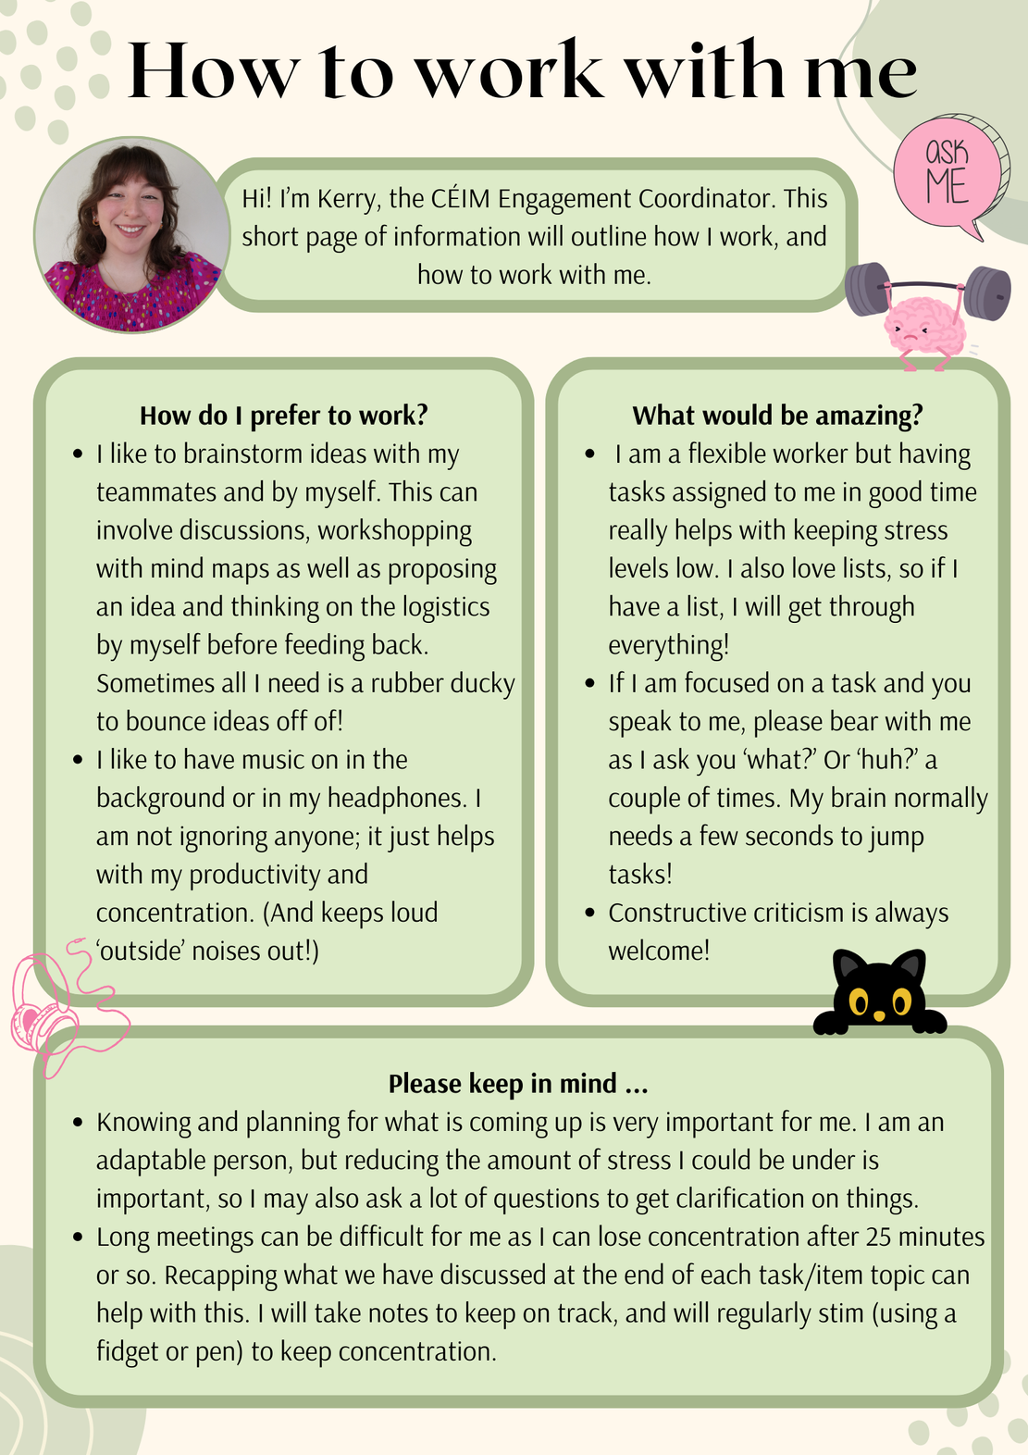
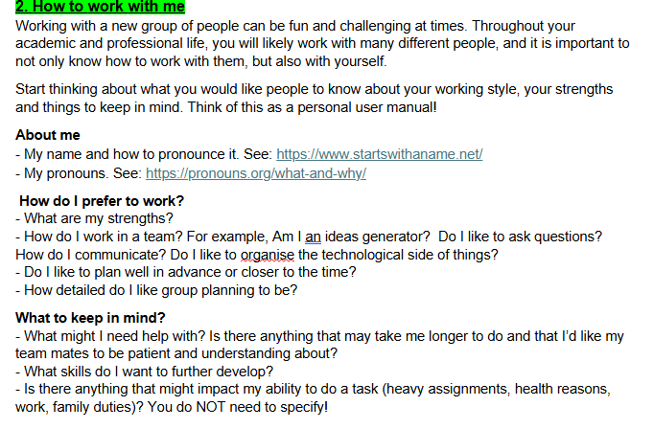

How to work tiwht me: Example

Slide 11
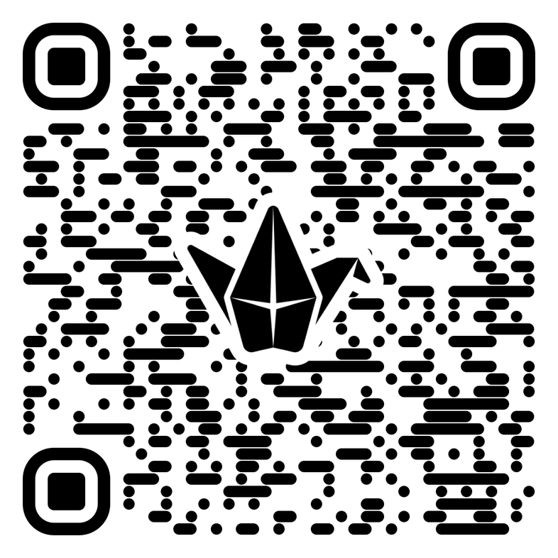
Padlet Sandbox
Scan the QR code or click on the link in the zoom chat
In Groups you will:
Assign a scribe / person to screenshare
Discuss the following questions and write down your answers
We will get feedback as we go

Slide 12

Peer Learning Activity
What barriers do you face in your work / your institution? How could these affect disabled employees? Can you identify other barriers that may be there for disabled students just leaving 3rd level.

Slide 13

Peer Learning Activity (2)
What current practices does your institution use to encourage skill building for students with disabilities?
Or
Are you aware of any ongoing practices in institutions that encourage skill building for students with disabilities?

Slide 14

Peer Learning Activity (3)
How could you increase accessibility and engagement in different processes?
For example, signposting that you are a place to go for disabled students, show you have the resources and drive to provide a good working environment that will encourage growth all around, recruitment and onboarding, etc.

Slide 15

Peer Learning Activity (4)
Where applicable – how could different aspects of peer learning and what we have presented be relevant / useful for your organisation's practices.

Slide 16





Main takeaways:
Peer learning creates a space for growth for students and volunteer leaders.
Any changes made with inclusion at the forefront will benefit students as a whole.
Inclusive practices can be as big or as small as you make them.
Consult disabled, ND, and other marginalised groups, students and staff when exploring past, present and future practices.

Slide 17


Thank you for listening!
Get in touch at su.ceim@universityofgalway.ie
Find out more​​
​
November 2015 - From students to leaders: evaluating the impact on academic performance, satisfaction and student empowerment of a pilot PAL programme among first year students and second year leaders | Stacey Scriver, Amber Walsh Olesen, and Eoghan Clifford - Academia.edu​​
​
​March 2021 - Partnering for success: a students’ union-academic collaborative approach to supplemental instruction: Irish Educational Studies: Vol 0, No 0 (tandfonline.com)​​
​
​September 2022 - How have Supplemental Instruction-Peer Assisted Study Sessions (SI-PASS) programmes adapted during the Coronavirus pandemic? | Student Engagement in Higher Education Journal (raise-network.com)​​
​
December 2022 - NStEP Case Study Hub - CÉIM Shared Learning ​

