Slide 1


Empowering Employment
An overview of AHEAD’s WAM Programme and GetAHEAD initiative
AHEAD Conference | 20th March 2025
Philip Carroll | Senior WAM Project Officer
Banba Fitzgerald | GetAHEAD Officer

Slide 2

Celebrating 20 years and 700+ graduates in 2025
Widen access to mainstream employment while working and supporting employers to become more inclusive
Employers offer ring-fenced roles at graduate level
Comprehensive training prior to recruitment and placement
Workplace needs assessment conducted with all graduates
Ongoing support from WAM Team throughout
Graduates get paid work opportunities and experience the world of work in a supported way

Slide 3

Employer Benefits
Disability proofing of HR and recruitment practices
Access to our graduate database
Training for HR staff and line managers on disability awareness
A safe space to ask questions
Advice on workplace supports and accommodations through the AHEAD Needs Assessment process
Online learning courses for the line manager and mentor
Free attendance to WAM employer networking events
A WAM Leader award

Slide 4

WAM Programme - FAQs

Slide 5

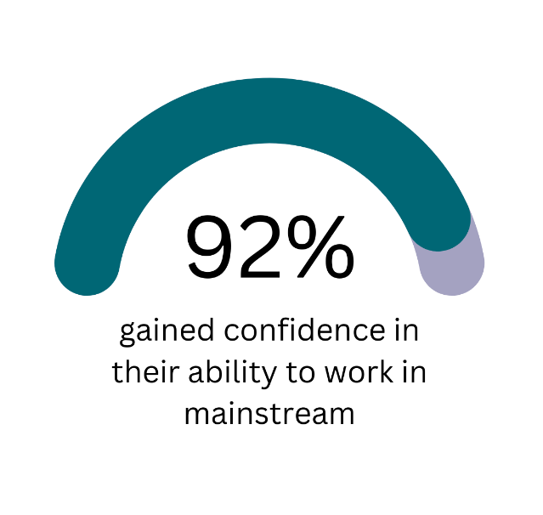



Graduate Benefits
Download Full Report!
Notes:
3,665 applications for WAM placements and 460 needs assessments carried out by AHEAD
81% of WAM graduates secured employment as a direct result of their WAM placement.
1 in 5 applicants required accommodations for a traditional interview.
1 in 7 applicants required accommodations for a virtual interview.
1 in 3 required accommodations for testing and screening recruitment processes.
Two-thirds of workplace accommodations do not incur any cost to the employer and are in relation to work tasks.
42% of graduates require time off to attend disability related medical appointments
92% of WAM graduates gained confidence in their ability to work in a mainstream environment
69% of WAM graduates were no longer in receipt of any disability or illness payments.

Slide 6
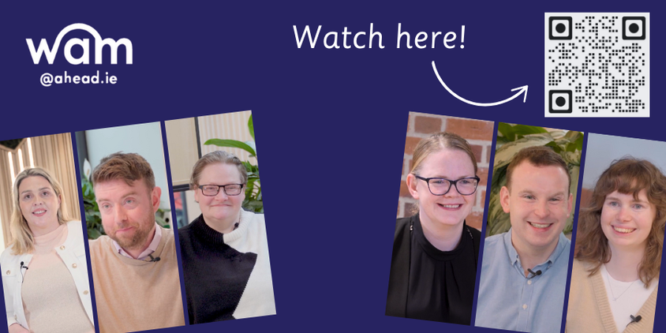
WAM Graduate Video Series

Slide 7

What is GetAHEAD?
GetAHEAD supports students and graduates with disabilities in their transition from third-level education to full-time employment.
The programme provides practical guidance, training, and resources to equip students with the skills they need to navigate the workplace successfully. Find out more here.

Slide 8


GetAHEAD Events
Free Employability Training!
Think Twice Workshops
Transferable Skills
CV Writing
Interview Preparation
Disclosure
Assistive Technology

Slide 9

Building the Future
Hosted by Citi in Dublin
Date to be confirmed – June 2025
  Mock Interviews
  CV clinic
  Headshot station
  Employer Exhibition Space
  Workshops

Slide 10
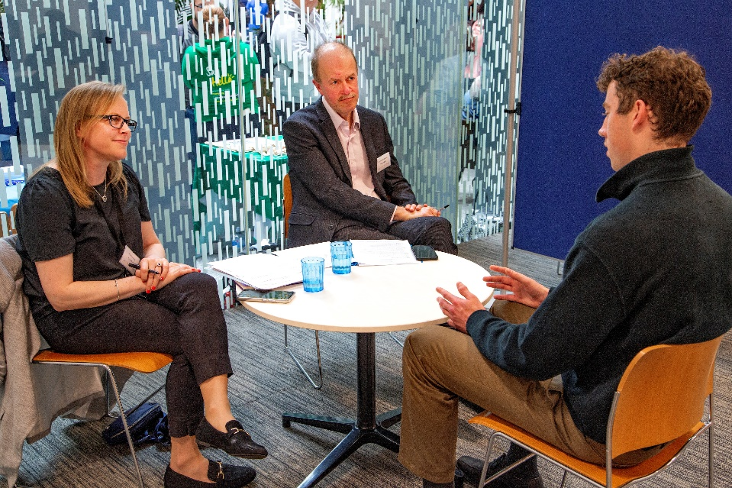
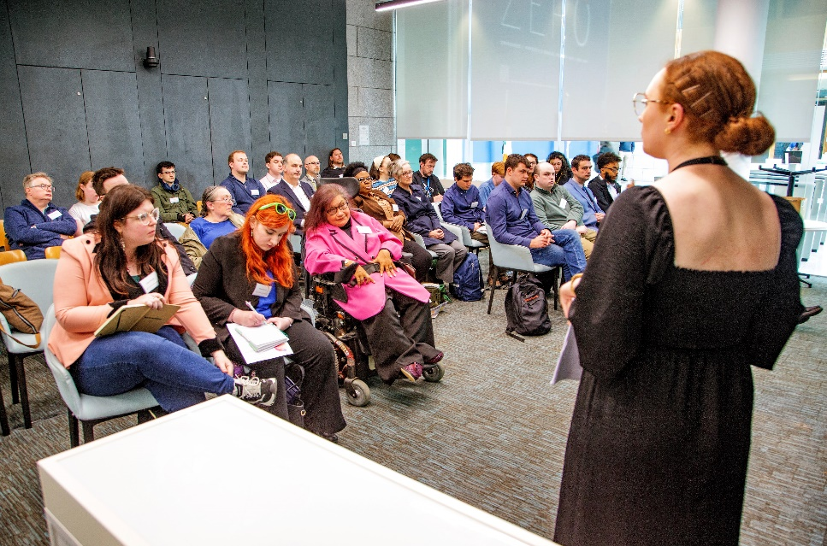
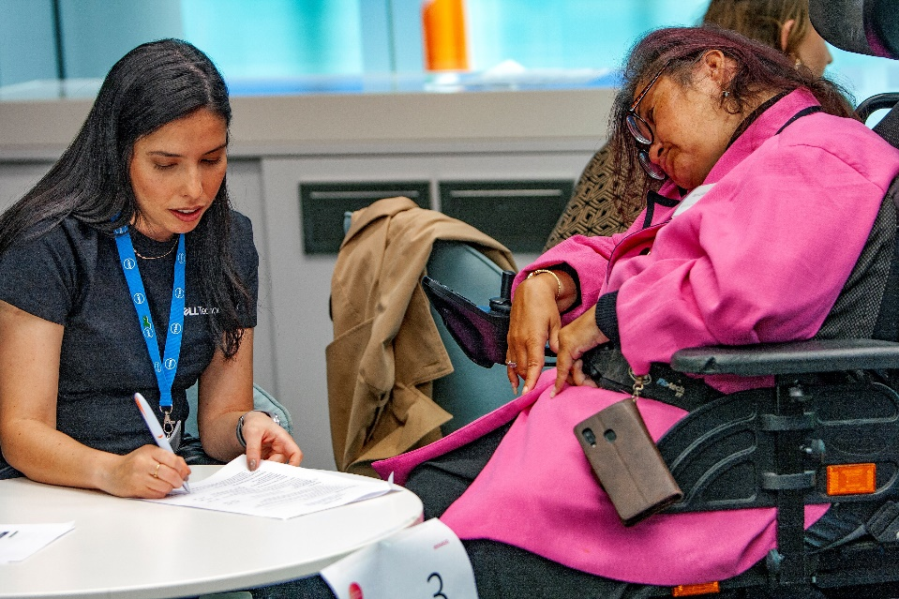
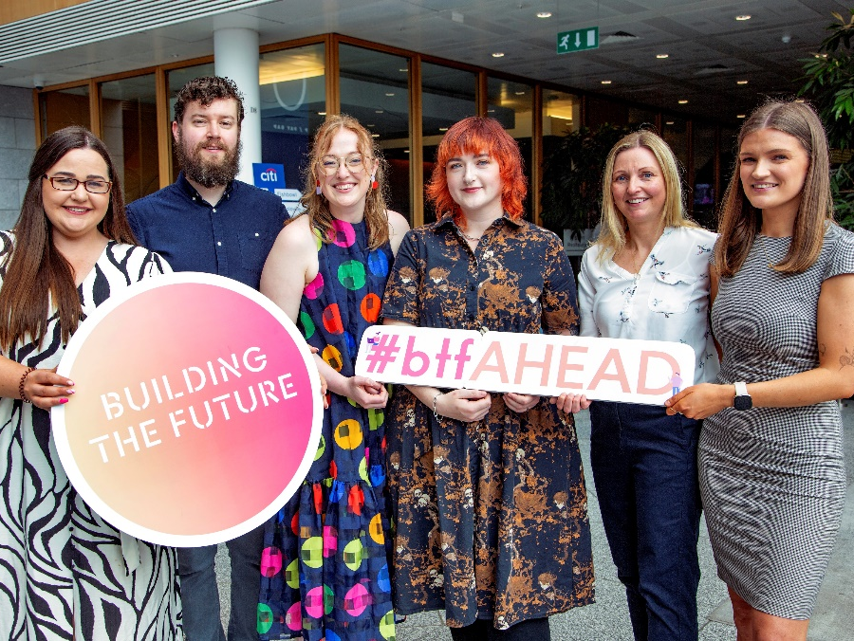
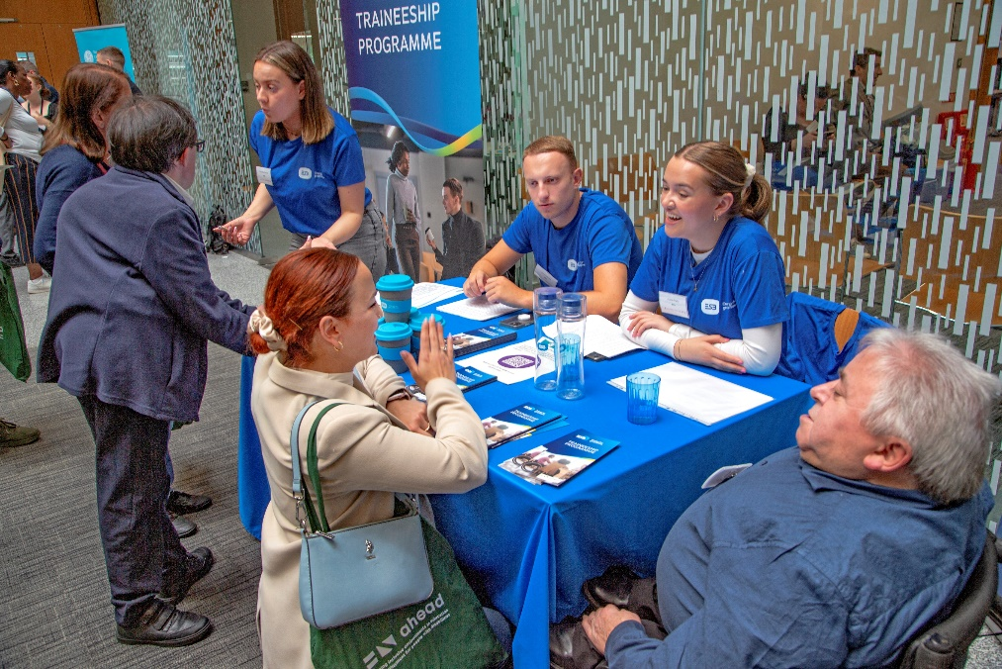

Building the Future Event

Slide 11
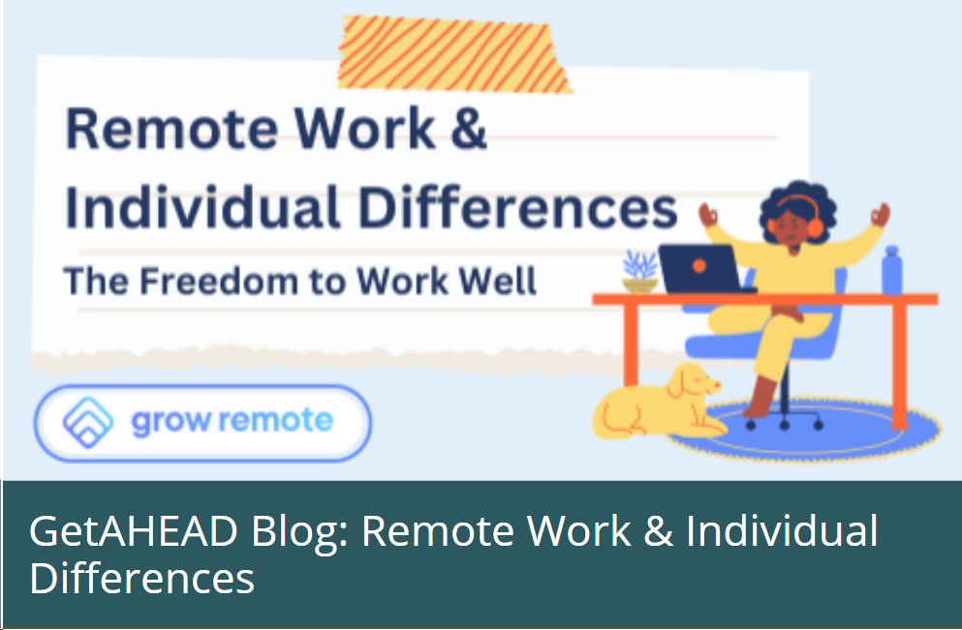
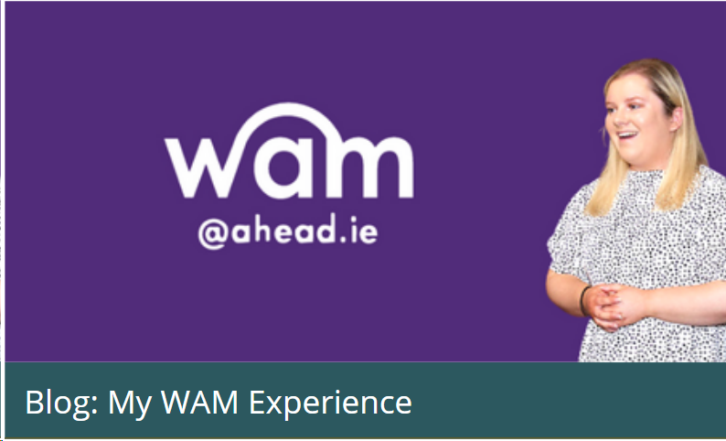
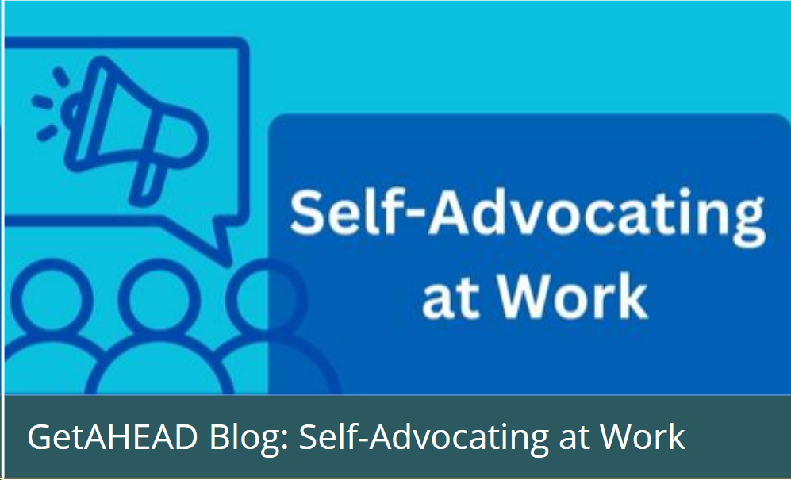


GetAHEAD Blogs – Tips & personal stories
Lived experience
Tips & tricks
Event insights
Explore the GetAHEAD Blogs here!
Submit your own story here

Slide 12


GetAHEAD Resources
Disclosure
Legislation
Accommodations at work
Grants available
Resources – AHEAD
Job Search – AHEAD

Slide 13
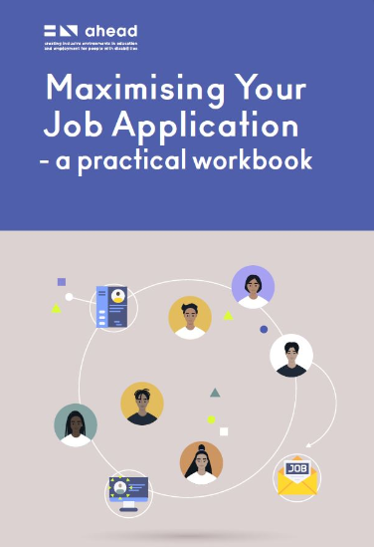



Publications
Maximising Your Job Application
Going to College Guide
Disclosure Guide
Workplace Wellness Guide

Slide 14
Disclosure Guide
Disclosure is one of the most complex aspects of having a disability
The decision can be made by weighing up the benefits against potential discrimination, labelling etc
Aim of guide: To inform students and graduates with disabilities of their rights and to give them the tools to decide whether or not to disclose

Slide 15

Action Plan for Disclosing
Why
What
When
Who
How

Slide 16
Workplace Wellness Guide
Identified a need for a guide to support the wellbeing of students and graduates with disabilities in the workplace
Aim: to give an overview of workplace wellness & provide practical, actionable guidance for managing wellbeing in the workplace

Slide 17



Workplace Wellness

Slide 18


WAM Job Opportunities
Guidewire - Open now, closing 26th March
2 positions available for 6-month contracts.
NFQ level 8 required in
Computer Science/Engineering
Software Engineering
Bord Bia - Opening – 2nd April 2025
1 position available for a 9-month Contract
NFQ Level 6 required in any discipline

Slide 19

Register on our WAMWorks Database!
Students and graduates with disabilities should firstly register on our WAMWorks Database
www.ahead.ie/wamworks
Get notified and attend workshops and events on upskilling in the workplace
Get notified and apply for paid graduate level jobs exclusively for people with disabilities

Slide 20

Any questions?
WAM: WAM@ahead.ie
GetAHEAD: banba.fitzgerald@ahead.ie
Our website: www.ahead.ie
Instagram: aheadireland
X: aheadireland
LinkedIn: AHEAD (Ireland)
Facebook: AHEADIreland

