Slide 1

Sink or Swim?
Let’s Build a Better Boat for Learners in Transition
Dr. Mary Quirke

Slide 2
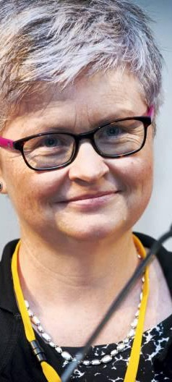
Who am I?!
Dr. Mary Quirke
  Qualified guidance 30+ yrs
  Competed PhD in Career Guidance, Inclusion and UDL
  Have engaged in research with a focus on diverse learners including disability and transitions
I invite you to
  Ask questions
  Always remember - no-one has all the answers
The images are for decoration – but where important I will speak to them

Slide 3

Today you are planning a sailing trip…
What do you need to do?

Slide 4
Why does planning for transition matter?
Steps in Planning to Job Hunt - Self-Assessment: Identify your skills, strengths, and career goals. Research: Explore career options, industries, and roles. CV & Cover Letter: Tailor documents for each application. Job Search: Apply for jobs, set up alerts, and network. Interview Preparation: Practice interview questions and research companies. Professional Presence: Update LinkedIn and clean up social media. Evaluate Offers: Compare salary, culture, and growth opportunities. First Day Preparation: Get ready with logistics, wardrobe, and company research. Ongoing Learning: Keep improving skills and adapt to the work environment.
The three things employers value most are
Skills and Experience, Cultural Fit, Work Ethic and Attitude
(Forbes)
Notes:
Because learners need to know where they are going!

Slide 5

”Sink or swim”
We need to stop throwing learners in at the deep end and build better systems of support for transition.
Key Message: All educators and stakeholders have a role
Not just an add-on; its a core responsibility.

Slide 6
Research Questions
Research Question 1: Can inclusive education and/or universal design for learning practices be used to influence career guidance where there is a greater diversity of students?
Research Question 2: What can we learn from the experience of the small cohort of ‘successful‘ people with disabilities that can be applied to career guidance?
In essence – can we redesign guidance and transitions using a UDL approach?

Slide 7
Changes over time…
1950’s
Changing world of work
Vocational guidance emerges as a practice
Medical model of disability dominant
1980’s
Career guidance theory considers women and other cultural minorities
Social model of disability emerging
Inclusive Design/ UD ‘Thinking’ emerging
1990
Influencers for career guidance practice: EU and national policies
Legislation and policies – rights-based approach
Changes in demographics in education and work
2000’s
Legislation in terms of equality in education, work and society
UN Convention on the Rights of Persons with Disabilities (2006)
SDG’s
2025+
Learning
Work
Policy, practice, experience

Slide 8
The Transition Challenge: Who’s Falling Through the Gaps?
“They were the people in power, so they felt we know best”
“Well meaning, I think would probably be the best way to describe my career guidance experience”

Slide 9
Some Statistics
24% employment in VI community – 1 in 4 are employed (2016 Irish Census)
The National Disability Authority, Ireland reports only 47.3% of individuals who are Deaf are employed – with significant underemployment.
The Disability Federation of Ireland reports employment rate for PWD 32.6%, 20% below EU average of 51.3%

Slide 10

Ongoing exclusion…
OECD Education at a glance country notes and national-level surveys highlighted
  in the Netherlands, 12% of students dropout within their first-year;
  in Spain, 1 out of 5 students drop out, ­the cost comes to 395 million euros;
  in France, 59% fails to complete degree, with highest dropout rates in first year;
  in Ireland, 63% complete degrees within their theoretical duration. (https://supportingstart.eu)
1 in 3 students in higher education have seriously considered quitting due to financial pressures, personal reasons or other factors, a new survey shows.
(https://www.irishtimes.com/ireland/education/2023/11/29/one-in-three-college-students-have-seriously-considered-quitting-their-course-national-survey-finds/)

Slide 11
The Power of Learner Voice in Transitions
“We weren’t talking about what I needed, we were talking about what they thought I needed”
“I just did it all by myself”
Notes:
Transition strategies must be built with learners, not for them.
Lessons Learned: How can we include learner voice meaningfully going forward?

Slide 12
Self Advocacy
“I was like if he is gonna do it, I gotta do it as well” (brother)
“down to my sheer stubbornness and determination”

Slide 13
Self Efficacy
“I want to get the most out of life”
“There was two perspectives. And one of them wasn’t nice…”

Slide 14
The Capability vs. Disability Debate
Many learners have skills but are locked out due to inaccessible systems and/or lack of support.
Or is it poor advice and information?
“they were almost forecasting or ensuring that you would continue to be excluded in the future,”

Slide 15
Other - efficacy
Where do you think learners go for career advice?
Others
Social media
Family
Friends

Slide 16
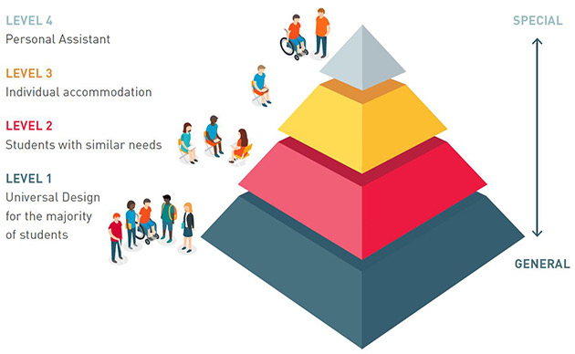
Universal Design for Learning, Transitions and Guidance
An Inclusive Education Pyramid (Quirke & McCarthy, 2018).
The tiered approach illustrates different levels of support in line with UD principles.
For professionals other than teachers – what does this look like?
How does this impact on transitionary planning?

Slide 17

Universal Design for Learning (UDL) & Universal Design for Guidance (UDG):
A Framework for Success
UDL in Action: Designing learning with flexibility and accessibility in mind.
UDG (Universal Design for Guidance): How career guidance and transition supports can be designed to be inclusive from the outset.
WAM – What we’ve learned about bridging education and employment through inclusive placements, it works.

Slide 18
UDG – Appreciate the Power
1. Guidance A Powerful Relationship
PowerPlay In Inclusive Career Guidance
5. "Career Guidance Professional" -Power To Redefine
2. Career Conversations Have Power
3. Disability Versus Capability Lens
4. Knowledge Of Inclusion In Learning And Work
6. Understanding Of Inclusion In Context Of Career Guidance

Slide 19

What Are We Doing and Where Do We Need to Go?
Sustainable careers can be described in terms of happiness, health, and productivity.
Three key dimensions are useful to study sustainable careers: person, context and time.
”jobs that facilitate personal development over time”
    De Vos, A., Van der Heijden, B. I., & Akkermans, J. (2020). Sustainable careers: Towards a conceptual model. Journal of Vocational Behavior, 117, 103196.

Slide 20
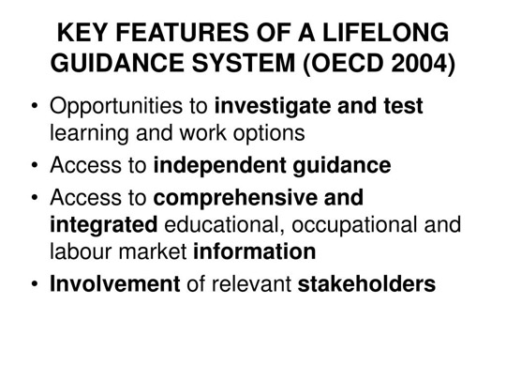

Lifelong Guidance Framework

Slide 21
Sustainable Development Goals (SDGs)
SDG 4 (Quality Education) and SDG 8 (Decent Work and Economic Growth) and SDG 10 (Reduce Inequalities).

Slide 22


Start earlier - primary level

Slide 23
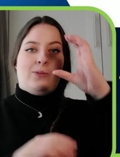

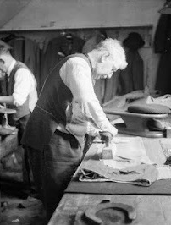
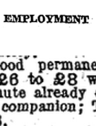
Recognise that work is changing for everyone
A visual snapshot of changing work experiences for the Deaf community…from tailor to accessible work to technologies. (Quirke and McGuckin, 2024)

Slide 24

Impact of Technology on Learning – and Work

Slide 25

What Needs to Change? Build a Better Boat
For Educators: Embed transition planning across the curriculum and appreciate the role of guidance.
For Employers: Move beyond compliance to genuine inclusion, and inform guidance.
For Policymakers: Evidence-based transition supports.

Slide 26

Reflection
How can adopting a Universal Design for Learning (UDL) approach in guidance and transition planning create new opportunities for all learners?

Slide 27
Conclusion – Hope for the Future
Nod to my first AHEAD conference!:
If “even fish can get seasick”, we need to stop assuming all learners, including those with a disability will simply "adapt" without proper support.
Call to Action:
Let’s ensure no learner is left to "sink or swim" alone—we can and must build a better boat together.

Slide 28
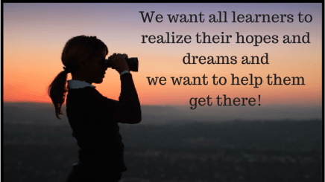
UD (L) must be applied to Guidance and transitions…
Adopt a A N*UDE Approach (Quirke, Mc Guckin & McCarthy, 2023)
This Photo by Unknown Author is licensed under CC BY-NC-ND

Slide 29
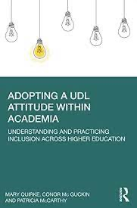
Adoping a UDL Attitude within Academia

Slide 30
Further Reading
Arthur, N., & McMahon, M. (Eds.). (2018). Contemporary theories of career development: International perspectives. Routledge.
CEDEFOP (2009) Professionalising Career Guidance: Practitioner Competences and Qualification Routes in Europe http://www.cedefop.europa.eu/EN/Files/5193_ en.pdf Available in English and German
CEDEFOP (n.d) https://www.cedefop.europa.eu/en/country-reports/inventory-lifelong-guidance-systems-and-practices-ireland-0#guidance-for-persons-with-disabilities
Herr, E. L (2001). Career Development and Its Practice: A Historical Perspective. The CDQ: Special Millennium Issue, 49(3), 196 -211. Retrieved from ABI/INFORM Global. (Document ID: 69742177).
Hooley, T., & Sultana, R. G. (2016). Career guidance for social justice. Routledge
Quirke, M., & Mc Guckin, C. (2024). The sound of silence: deconstructing notions of inclusion in career guidance on exploring the experience of deaf people. British Journal of Guidance & Counselling, 1-20.
Quirke, M., & Mc Guckin, C. (2019). Career guidance needs to learn from ‘disability’ if it is to embrace an uncertain future . . . European Conference on Educational Research (ECER): “Education in an. Era of Risk - The Role of Educational Research for the Future”, Universität Hamburg, Hamburg, Germany, 3rd - 6th September, 2019.
Leong, F. T. L., & Brown, M. T. (1995). Theoretical issues in cross-cultural career development: Cultural validity and cultural specificity. In W. B. Walsh & S. H. Osipow (Eds.), Contemporary topics in vocational psychology. Handbook of vocational psychology: Theory, research, and practice (pp. 143-180). Hillsdale, NJ, US: Lawrence Erlbaum Associates, Inc.
Mann, A., Denis, V., & Percy, C. (2020). Career ready?: How schools can better prepare young people for working life in the era of COVID-19. OECD Library
OECD(2002) Who am I? The inadequacy of career information in an information age http://iccdpp.org/wp-content/uploads/2014/ 03/OECD-Inadequacy-of-Career-Info-2002.pdf Available in English and French

