Slide 1

From Education to Employment: Turning Barriers into Opportunities
2025 AHEAD Conference
Dr Eng. Marta Skierniewska mba
19-20.03.2025 Dublin

Slide 2

Inclusive Education - Definition
Inclusion understood as a social process assumes seeing the school as a link in the process of creating social policy, focused on purposeful, systematic and organised actions aimed at changing the environment of a person with a disability in order to eliminate obstacles that prevent active participation in social life, so that it is as little restrictive as possible for successful development in accordance with the student's potential.

Slide 3

Research problem
The problem concerns the systematic and methodical solution of the issue of partial exclusion of persons with disabilities in the context of their educational aspirations confronted with the imperfection of the organization of the education system in the management of higher education institutions.
University
University for all

Slide 4
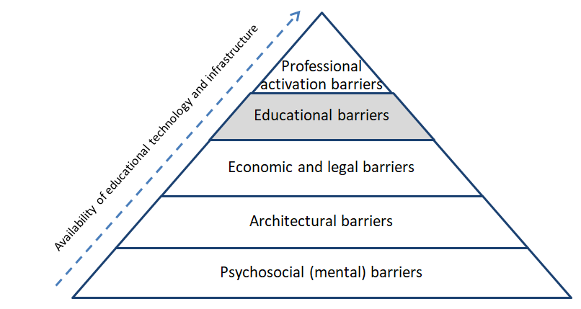





Breaking the barriers
Turning Barriers into Opportunities
Policies and regulations supporting inclusive employment,
Employer awareness and diversity training,
Companies with strong diversity hiring programs,
Cooperation between educators and employers
5
4
Principles of Universal Design for Learning (UDL),
Assistive technologies and digital accessibility,
Internships and work experience programs
3
Research grants,
Overcoming economic and social constraints,
Government financial support
2
Principles of Universal Architectural Design (UAD),
Application of assistive devices
1
Understanding the needs of people with special needs,
Overcoming discrimination & prejudice at Universities,
Training of academic & administrative staff at all levels,
Support & mentoring programs for students and staff
Barrier pyramid developed by Dr Eng. Marta Skierniewska mba

Slide 5
Summary
Creating an inclusive job market requires cooperation between educators and employers, as well as the implementation of policies supporting diversity and accessibility. Key actions include employer training on diversity, internship and work experience programmes, and the use of assistive technologies alongside the principles of Universal Design for Learning (UDL) and Architecture (UAD). Government financial support and the removal of economic and social barriers are essential for increasing equal opportunities. Education and training for academic staff also play a crucial role in providing better support for people with disabilities and combating discrimination at universities.

