Slide 1
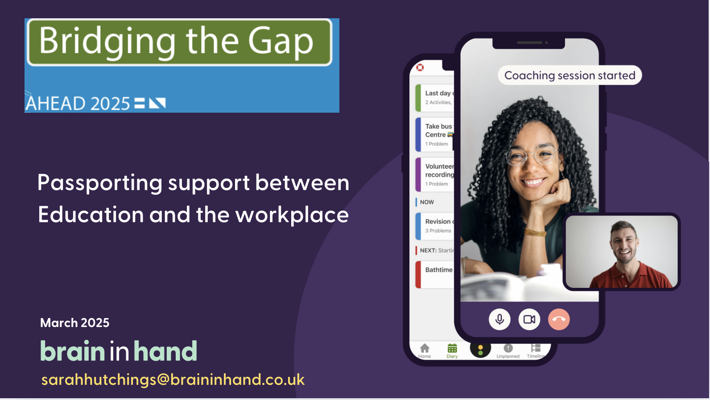
Passporting Support Between Education and the Workplace
Notes:
My name is Sarah Hutchings, and I am the Head of Education at Brain in Hand thank you very much to the AHEAD team for inviting me to present today. We primarily support users who are autistic, have ADHD or mental health anxiety related conditions. We currently support over 8,000 students each academic year who receive Brain in Hand through the government’s Disabled Students’ Allowance (DSA) funding, as well as those whose universities and colleges purchase our services directly. In addition to our work in education, we are experiencing significant growth in supporting individuals in the workplace. Through the UK government's Access to Work (ATW) scheme or direct purchases from employers.

Slide 2
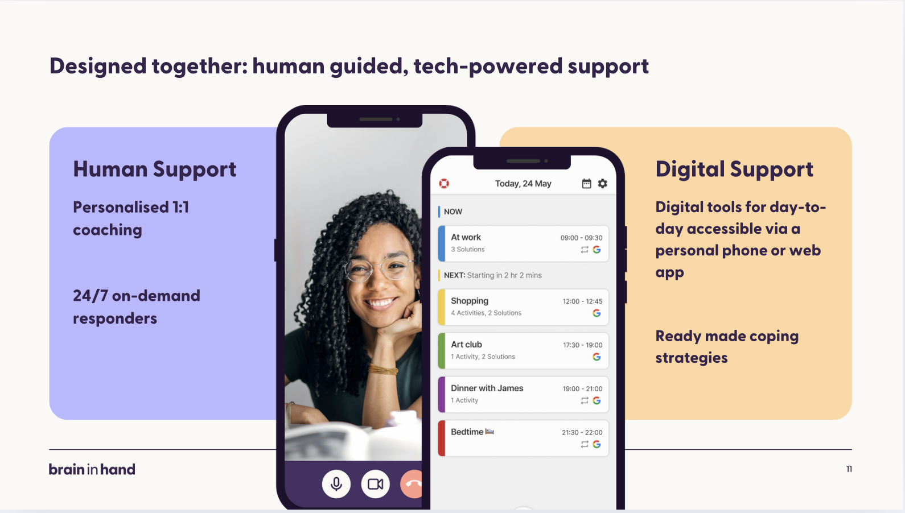
Designed Together: human-guided, tech-powered support.
Notes:
Brain in Hand is a hybrid digital support system that combines personalized tools with expert coaching. The app features a diary to help users manage their time effectively with routines, prompts, and reminders. It offers pre-planned, personalized solutions for unexpected challenges, allows users to reflect on their feelings through the traffic light system, and track their mood and progress via a timeline.
To fully maximize the app's potential, each user is paired with a dedicated coach who helps them develop routines, address challenges, and set personal goals. Our qualified coaches take a solution-focused approach, guiding users in making the most of the system. Additionally, we offer a 24/7 on-demand response service to provide support during moments of anxiety or overwhelm. Users can quickly request assistance through the app, with a team of responders ready to help within minutes—usually within a minute. Please note, however, that this service is not a substitute for crisis intervention or emergency support.

Slide 3
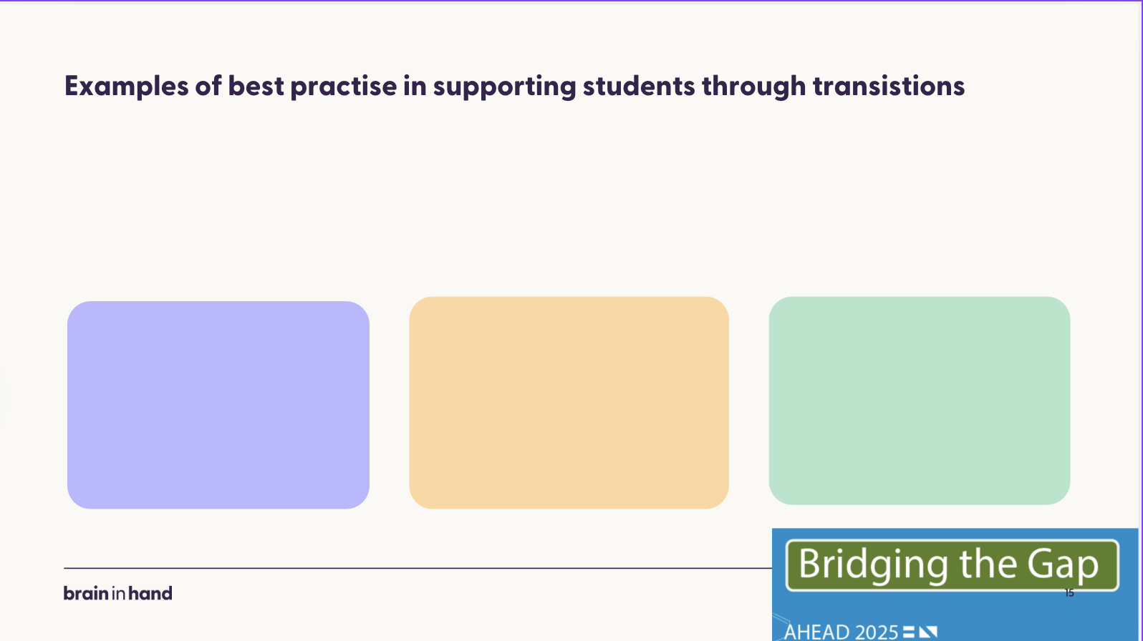

Examples of best Practise in supporting student through transitions
Supporting students through transition
Change
Transition into university
At university & Placements
Transition into the workplace
Notes:
Neurodivergent students don’t struggle because they lack capability—they struggle because they haven’t been provided with the right tools. With the right support, structure, and understanding, they can succeed. However, one of the biggest barriers they face is change, which is particularly prominent for the individuals we support, both in education and the workplace.
In the UK, we collaborate with universities that equip their neurodiverse first-year students with Brain in Hand to support them during the lead-up to their transition into university as a form of pre-interim support.
At university, the constant change becomes a significant challenge. We know that student support needs to reflect this. Many students start to worry about leaving university early on in their degree. Others face additional transitions, such as placements, which can create further challenges as they adjust to new environments and expectations.
Transitioning from university to the workplace can be overwhelming for anyone, but it can be especially challenging for those who are neurodivergent. Many students receive a good standard of support while studying, but sometimes this support often ends abruptly once they graduate.

Slide 4





James
James
Math’s teacher in Cardiff
James Studied Mathematics but had to re-sit his final year
James graduated
James studied for a post grad teacher qualification including placements
Transitioning into work
1
Notes:
Meet James. James is autistic and successfully managed independently during his first two years at Cardiff University, where he studied Mathematics. His long-term goal was to become a maths teacher. However, when it came time to transition into his final year, James faced a significant challenge.
Within the next 12 months, he knew he would need to change universities for his postgraduate teaching qualification at Cardiff Met, which included 24 weeks of school placements. The thought of all this change and the uncertainty of what lay ahead became overwhelming.
Feeling unable to cope, he reached a breaking point and, during the first term of his third year, made the difficult decision to drop out.
However, due to the excellent support from the wellbeing team at Cardiff University, James was equipped with the right tools, including Brain in Hand, to help him return and resit his final year. While the academic work itself wasn’t the issue, it was the constant grey cloud of overwhelm and uncertainty about what came next that was preventing him from moving forward.
With support from Cardiff University, Cardiff Met, and Brain in Hand, we ensured James had the ongoing support he required during his postgraduate qualification. This was funded by the government’s Disability Student Allowances and gave reassurance to James while transitioning between the two universities.
A year later, I received an email from James letting me know that he had successfully passed his postgraduate qualification and was beginning to apply for teaching jobs. He also mentioned that he would like to privately fund Brain in Hand during this transition. It was then that I approached the team at Brain in Hand about the Passporting initiative—where we could temporarily provide support for students transitioning from education into the workplace. This was agreed on a trial basis, we also want to make sure we do not over support people so they become reliant on us.
This worked really well for James. He adapted Brain in Hand to support him with the preparation and pressures associated with job interviews. Within a few months, he successfully secured a teaching position and applied for Access to Work, which provided funding for his ongoing support. He has now settled into his teaching role and no longer requires any support. He needed that support to reach his goal of becoming a teacher, and despite facing many changes and challenges as a neurodivergent student, he succeeded.
James, of course, is one of the very few. While this initiative has been successful, it represents only a small fraction of the broader work needed to support students with disabilities in entering the workforce. By offering Passporting, we provide users with the reassurance of ongoing support, mitigating the risk of being left in a gap between funding streams, and ensuring they can continue to use tools like ours while seeking alternative funding.

Slide 5

Recent Student Feedback
Recent Student feedback
“I found the coaching support especially helpful in assisting
me with transitioning
into the workplace and setting up my app to suit my changing situation”
“ I was transitioning from the second year of my undergraduate degree to a placement year in industry. I have now returned to studying following my year in employment I have found Brain in Hand to be so useful every step of my transition”
1

Slide 6
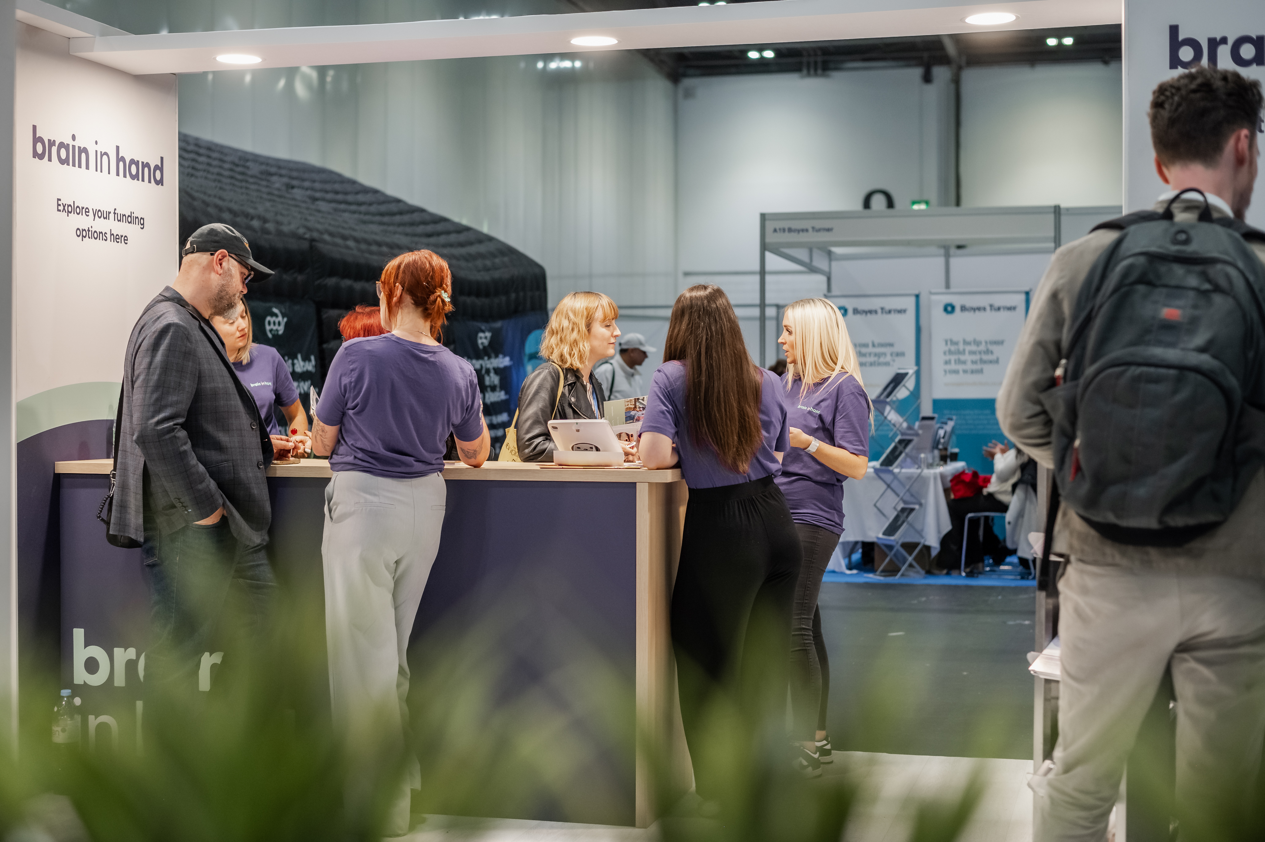
Thank you!

