Slide 1




Experiences of students with dyslexia in higher education on the use of technology (incl. AI)
Cathal O’Connor
Microsoft
PhD candidate
UCD School of Mathematics and Statistics
Supervisor: Assoc. Professor Anthony Cronin
Director of Maths Support Centre
UCD School of Mathematics and Statistics
Cathal
O’Connor

Slide 2
Topics
1
Summary Findings
2
Challenges / Opportunities
3
Recommendations
4
Q&A

Slide 3

The aim of this research study is to…

Slide 4

Better understand how technology can be used to support students with dyslexia in higher education…

Slide 5

…and inform the development of more effective interventions to improve learning outcomes.

Slide 6
Summary Findings

Slide 7
203 students with dyslexia participated in the study
18
Youngest
67
Oldest
21.5%
22.8
Response rate
Average Age
Source:
“Experiences of students with dyslexia in higher education on the use of technology” (O’Connor, 2024)
Online questionnaire | 18years+ | Students with dyslexia registered with UCD support services | UCD Ethical committee approval | Fully informed consent

Slide 8
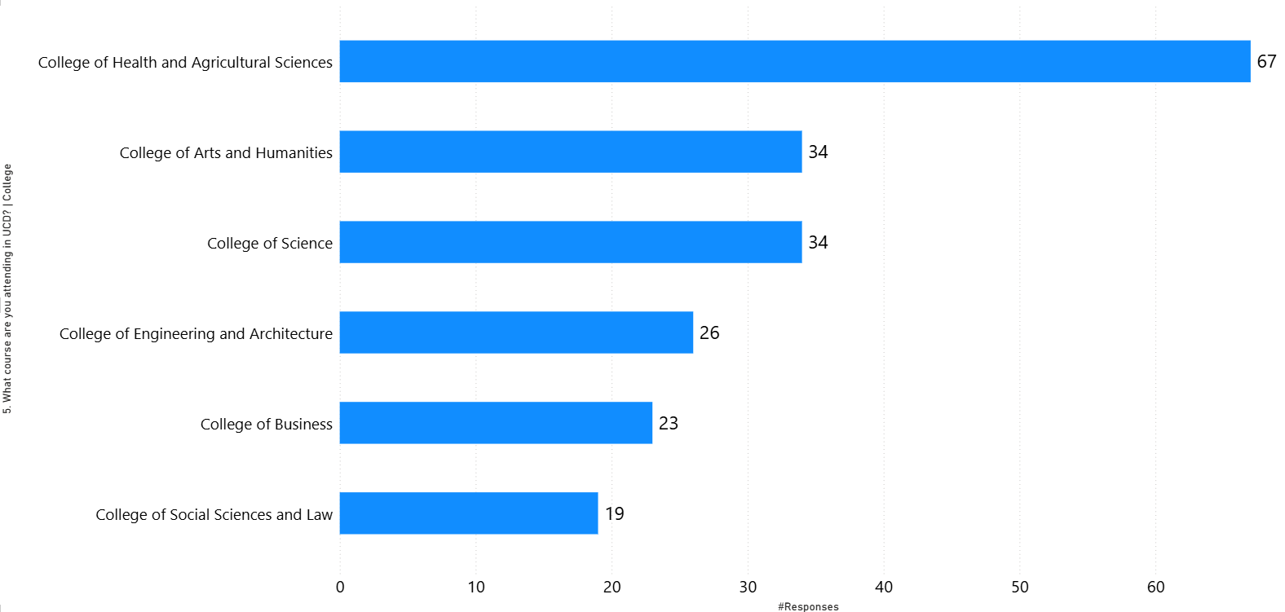
Gender: 67.5% female; 32% male and 0.5% Prefer not to say
What course are you attending?
Source:
“Experiences of students with dyslexia in higher education on the use of technology” (O’Connor, 2024)

Slide 9
Students with dyslexia are benefiting from exam accommodations.
86%
66%
compared to
In University
In School
Source:
“Experiences of students with dyslexia in higher education on the use of technology” (O’Connor, 2024)

Slide 10
Students with dyslexia have experienced concern about self-esteem and anxiety levels
37%
58%
compared to
In University
In School
Source:
“Experiences of students with dyslexia in higher education on the use of technology” (O’Connor, 2024)

Slide 11
85% of students with dyslexia experience difficulties with reading.
What aspects of reading do you find are most challenging? (You may select more than one answer)
Muddling up words in sentences so that they don't make sense 60%
Reading aloud in front of others 59%
Missing out little words or the endings of words when reading 59%
Proofreading your written word 58%
Understanding what you have read 58%
Identifying key points when faced with large quantities of information 57%
Summarising information 44%
None, I have not experienced any reading challenges 5%
Other* 3%
Percent of Respondents
Source:
“Experiences of students with dyslexia in higher education on the use of technology” (O’Connor, 2024)

Slide 12
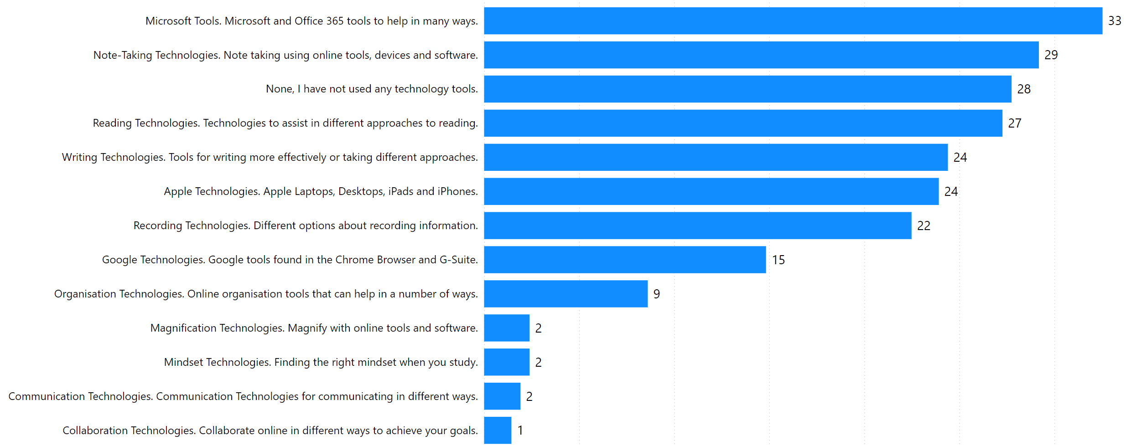
72% of students with dyslexia have used one or more technologies in dealing with dyslexia.
%
%
%
%
%
Response
%
%
%
%
%
%
%
%
Other*
2 %
Percent of Respondents
Source:
“Experiences of students with dyslexia in higher education on the use of technology” (O’Connor, 2024)
Notes:
The image is a bar chart that illustrates the usage of various technology tools. The x-axis represents the number of responses, while the y-axis lists different technology tools. Here are the details:
Microsoft Tools: Microsoft and Office 365 tools to help in many ways – 33% responses
Note-Taking Technologies: Note-taking using online tools, devices, and software – 29% responses
No Technology Tools Used: No, I have not used any technology tools – 28% responses
Reading Technologies: Technologies to assist in different approaches to reading – 27% responses
Writing Technologies: Tools for writing more effectively or for structuring your writing – 24% responses
Apple Technologies: Apple Laptops, Desktops, iPads, and iPhones – 24% responses
Google Technologies: Google tools found in the Chrome Browser and G Suite applications – 15% responses
Organization Technologies: Online organization tools that can help in a number of ways – 9% responses
Magnify with Online Learning Technologies/Tools/Software - 2% responses
Mindset Technologies: Finding the right mindset when you study – 2% responses
Communication Technologies: Communication technologies for communicating with others – 2% responses
Collaboration Technologies: Collaborate online in different ways to achieve your goals – 1% response

Slide 13














Technology experiences of students with dyslexia what tools are used to support your reading? (1 of 3)
1. Note-Taking Software
OneNote for organizing notes. Notability for recording lectures and taking notes. Apps that summarise and reduce information for easier study.
OneNote
+ Organising lecture notes
Notability
+ Recording lectures
+ Taking notes
Glean Notes
+ Summarise notes
+ Taking notes
Grammarly
+ Grammer checking
+ Sentence structuring
Microsoft Word
+ Spell check
+ Immersive Reader
+ Read aloud
C-Pen
+ Reader pen
2. Reading and Writing Assistance
Grammarly for grammar checking and sentence structuring. Text-to-speech software to aid in understanding written material. Spell check features in Microsoft Word and other writing platforms.
Chrome
+ Read aloud
Brightspace – Ally
+ Read aloud
Natural reader
+ Read aloud
Beeline reader
+ Read aloud
Bionic Reader
+ Read aloud
3. Audio and Listening Devices
Audiobooks as an alternative to reading text. Calming music playlists to aid concentration. Audio recordings of lectures for repeated listening.
Audiobooks
\ eBooks
+ Alternative to reading text
Calming music
+ Aid concentration
Recorded lectures
+ Repeated listening

Slide 14











Technology experiences of students with dyslexia what tools are used to support your reading? (2 of 3)
4. Organisational Aids
Google calendar
+ Scheduling and reminders
Laptop / Tablet
+ Highlighting features
for reading materials
Whiteboards
+ Organising thoughts
+ Visual planning
Digital calendars (like Google Calendar) for scheduling and reminders. Tablets with highlighting features for reading materials. Whiteboards for organising thoughts and visual planning.
iPad
Mac, Apple Siri
Laptop
5. Visual Aids
Highlighters
+ Emphasising key points
Mind maps and flashcards
+ Visual learning
Coloured paper and backgrounds
+ Reduce visual stress
Coloured highlighters for emphasing key points in text. Mind maps and flashcards for visual learning. Coloured paper and backgrounds to reduce visual stress.
Different fonts / sizes
+ Preferred font settings for reading
6. Study and Review Platforms
Quizlet for creating study sets and flashcards. Anki for spaced repetition and memorisation. NVIVO for organising and actively reading papers for literature reviews.
Quizlet
+ Study sets
+ Flashcards
Anki
+ Repetition and memorisation
NVIVO
+ Organising papers
+ Literature reviews

Slide 15








Technology experiences of students with dyslexia what tools are used to support your reading? (3 of 3)
7. Focus and Concentration Tools
Pomodoro technique apps for timed study sessions. White noise or ASMR sounds to help with focus. Watches with timers to manage study periods and avoid time blindness.
Pomodoro technique
+ Timed study sessions
White noise or ASMR sounds
+ Help with focus
Watches with timers
+ Manage study periods
8. Proofreading and Editing Services
Peer proofreading
+ Feedback on written work
AI Services
OpenAI ChatGPT
+ Text summarisation
+ Bullet points
Proof reading software
+ Grammer checking, sentence structuring
Peer proofreading for feedback on written work. AI services like ChatGPT for summarising readings and key points. Proofreading features in writing software.
9. Learning and Memory Aids
Mnemonics and memory techniques for retention. Concept maps and summaries for understanding complex material. Active recall methods like practice problems and past papers.
Mnemonics and memory techniques
+ Knowledge retention
Concept maps and summaries
+ Understanding complex material
Practice problems and past papers
+ Active recall methods

Slide 16
Challenges

Slide 17

We are allowed access to a reader pen in exams, although I have never tried it as I worry about disrupting other people
“
Science student, aged 67

Slide 18
We are allowed record lecturers but it's from our laptop and so we pick up all the noise around us and not just the lecturer.
“
Engineering student, aged 18

Slide 19

With text to speech software there is a lack of training associated with the technology so I don't find it beneficial.
“
Medical student, aged 23

Slide 20
My case is probably somewhat different than your average student, as I am almost 62 years old. I was only diagnosed when I was 52 and spent most of my life trying to hide the fact that I had dyslexia. What I have found in the last few years, is that most of the technologies now available are not suitable for me. (This is certainly not a criticism of the support that the Access Team provide) but because I have been living with this for so long, I have developed (probably subconsciously) ways of doing things, to get around the more traditional or normal ways of doing things. .
“

Slide 21
Opportunities

Slide 22
I use AI to summarise and pick out key points of readings, I use Grammarly to help me with spelling and grammar, I have friends proofread my work before i submit it, I take extra time to do my assignments.
“

Slide 23
Recommendations

Slide 24
Thank you

