Slide 1


Universal Design for Practice Learning
Dr John P Gilmore (he/they) – Assistant Professor
Dr Freda Browne (she/her) – Assistant Professor
University For ALL Faculty Partners
Co-Designing practical guidelines with Nursing students.

Slide 2
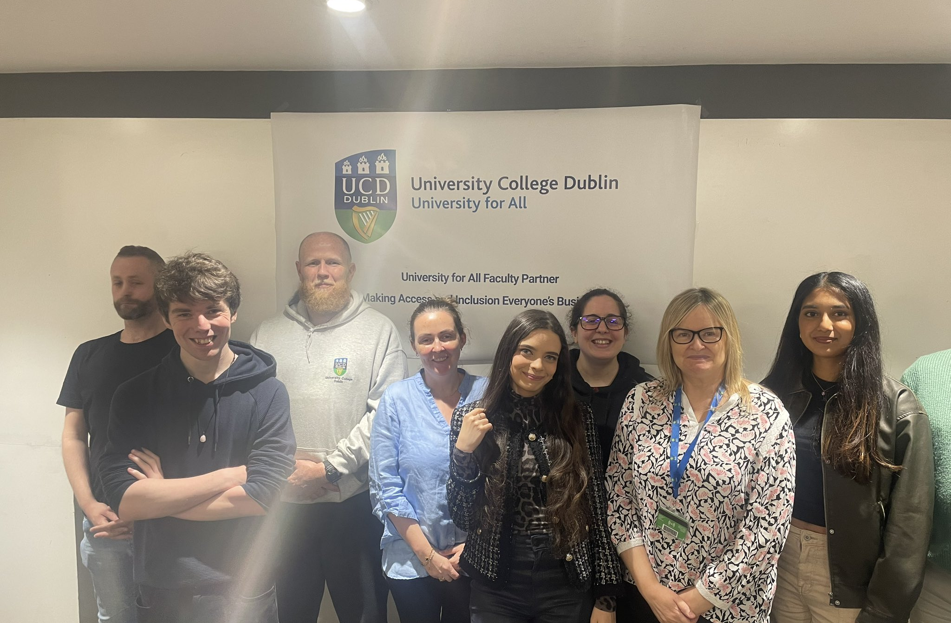


Session Aims
Describe the context shaping nursing education at UCD.
Give examples of the principles of Universal Design for Learning (UDL) in clinical practice.
Outline the process of developing UDL-based guidelines for clinical practice learning describe the context
TEAM
Dr John Gilmore
Dr Freda Browne
Student Collaborators
James Sage
Pamela Walsh
Eileen Noone
Brian Rusk
Blanca Jimenez Rodriguez
Tiarnan Donegan
Zlata Kulbako

Slide 3







Context
Largest School of Nursing in Ireland
High proportion of student admissions from Widening Participation routes
Pioneers in disability supports within practice learning environments
UDL as Social Justice Pedagogy in Nursing (Gilmore et al. 2022)
Highest participation within UDL training in UCD
50% of degree is delivered in clinical practice learning environments
National Competency Assessment Framework
Gilmore, J. P., Halligan, P., & Browne, F. (2022). Pedagogy as social justice–Universal Design of Learning in nurse education. Nurse education today, 118, 105498.

Slide 4
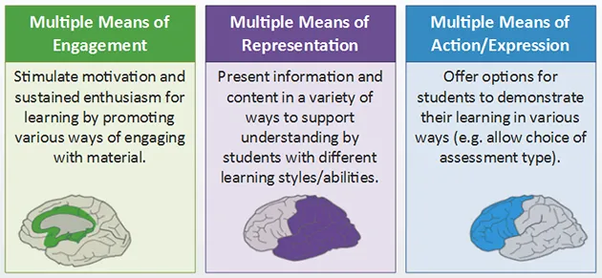
PRINCIPLES OF UNIVERSAL DESIGN FOR LEARNING
CAST, (2018). Universal design for learning guidelines version 2.2. https://udlguidelines.cast.org

Slide 5












PROJECT DEVELOPMENT ROADMAP
Iterative Improvement & Refinement. Peer review followed by expert refinement
Idea generation and funding from UCD Access and Lifelong Learning
UDL Training for student collaborators
Student collaborator recruitment
Guideline Writing Workshops x 3 focusing on translating UDL principles (CAST, 2018)
Implementation workshop with practice education experts

Slide 6
Examples of Checkpoints for UDL in Practice Learning
ENGAGEMENT
Checkpoint 7.2 - Optimise Relevance, Value, and Authenticity
Show relevance by recognising student contributions (e.g., in handovers).
Provide placement site profiles and align clinical tasks with career goals and personal interests.
REPRESENTATION
Checkpoint 1.2 - Offer Alternatives for Auditory Information
Provide written supplements for verbal handovers and demonstrations.
Use visual aids like diagrams to support auditory instructions.
ACTION AND EXPRESSION
Checkpoint 6.1 - Guide Appropriate Goal-Setting
Set structured, realistic learning goals collaboratively, using frameworks like SMART.

Slide 7








Next Steps
Final guideline publication
Recruitment of pilot sites for evaluation
Pilot implementation across sites
Evaluation
Universal Design as core in practice learning

Slide 8

THANK YOU
John.Gilmore@ucd.ie
Freda.bowne@ucd.ie

