Slide 1
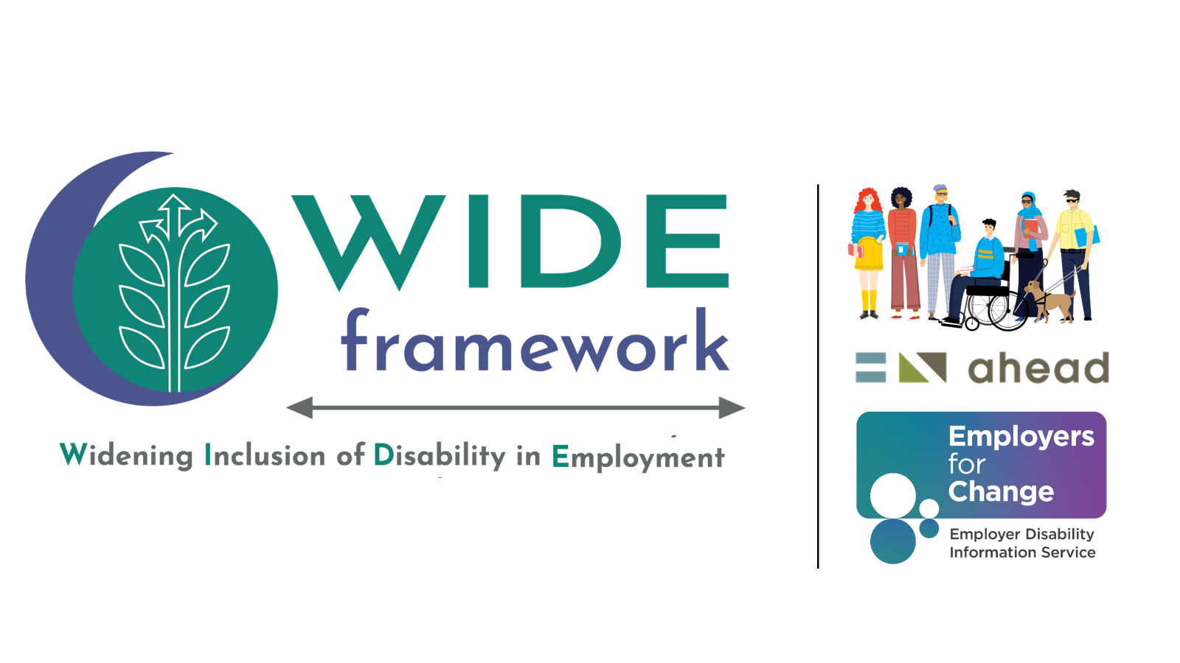
Title page
Funded by the Department of Social Protection
Notes:
Hello, my name is Catherine Murray, I’m the researcher working on the WIDE Framework with Dara Ryder, CEO of AHEAD.

Slide 2


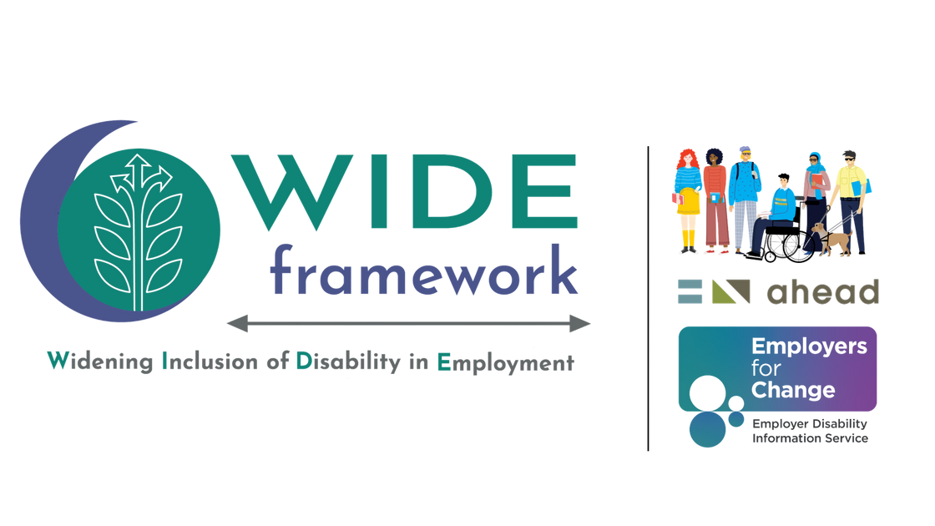

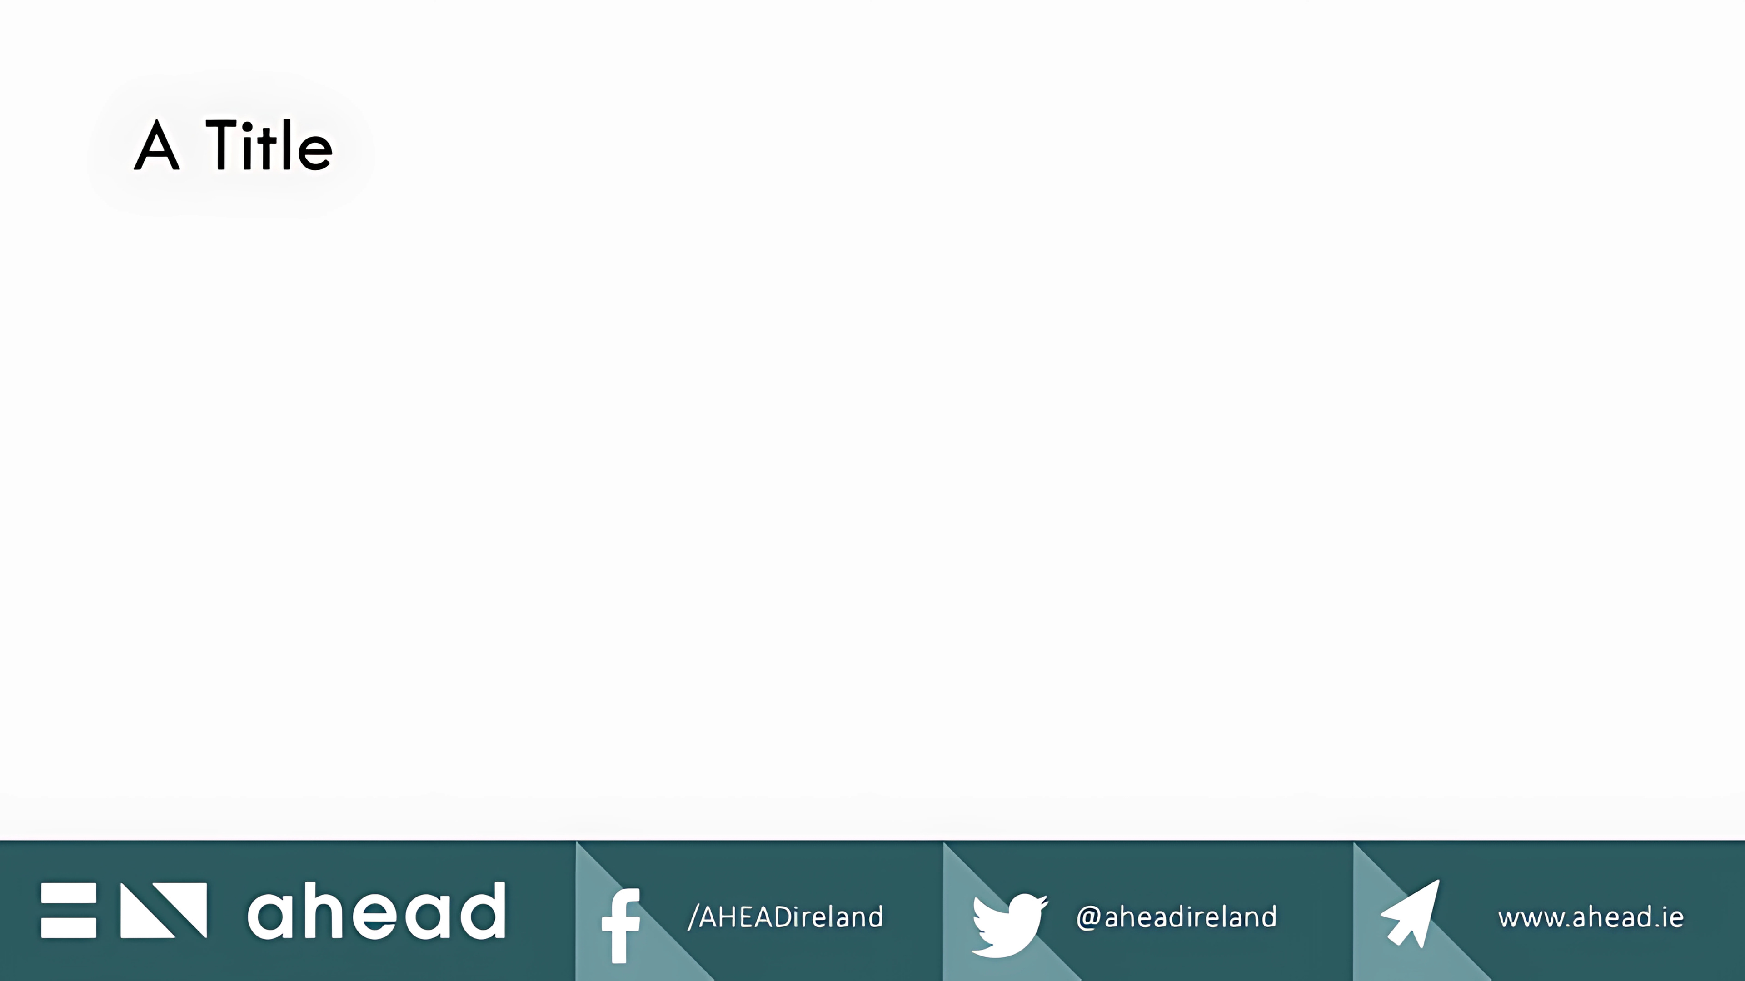
Agenda
  Establishing our aim (contextual understanding)
  3. Methodology and findings
  4. Future action
  2. WIDE Framework
Notes:
In 6 minutes, I'll discuss disability and employment in Ireland,
introduce the WIDE Framework
I’ll discuss our methodology and key findings,
and shamelessly convince you to work with us and help fix the problem.

Slide 3

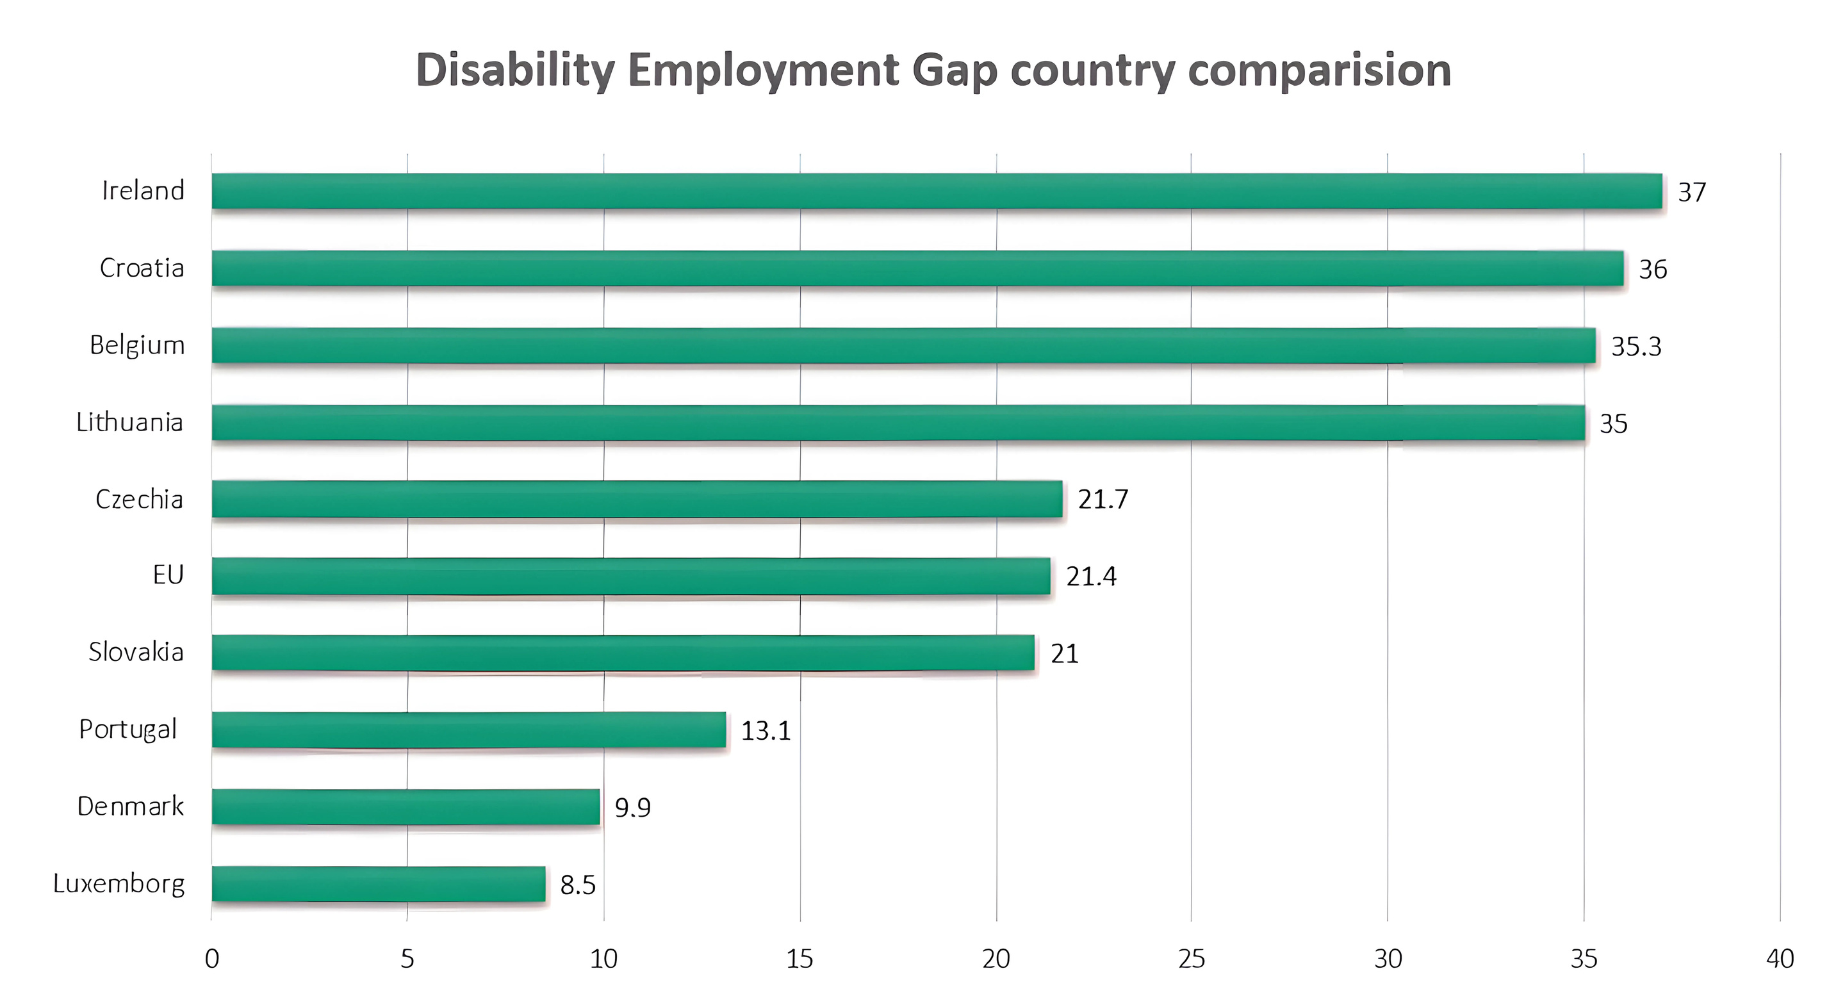



Contextual Understanding
1
Can you afford to not to have an effective workforce?
Highest employment gap between disabled people and people without disabilities
Notes:
So, what is the problem?
Ireland has the EU's widest disability employment gap, employing only 39.7% of disabled people.
Disabled women are impacted the most, with only 35.6% employed.
Simply put, we in terms of the employment gap, we rank worst in Europe.

Slide 4

Programme for Government 2025 – Securing Irelands Future
Commitment to boosting employment for disabled people by:
  Meeting EU-average employment rates
  Ensuring equal access and accommodations
  Supporting inclusive education and training
  Expanding job programs
  Developing a hiring code of practice
Notes:
In response to these stats, the Programme for Government has committed to improving disabled people’s lives by
raising employment rates to the EU average,
ensuring workplace accommodations,
expanding job programs,
supporting inclusive education,
and developing a hiring code of practice.

Slide 5


Legislation and Morals
Legislation and Morals
  Greater disability representation
  Employee accessibility engagement
  Inclusion Goals
  Hiring, accommodation and career policies
Notes:
Why should colleges and FETs as employers be interested in meeting these obligations?
Firstly, Irelands equality legislation including the CSRD and HEA's responsibilities regarding double equity, emphasise inclusion.
Ensuring pathways into inclusive workplaces is the right things to do for our disabled population, which account for over a fifth of the working age population in Ireland.
To be blunt, lack of inclusion, means a negative impact on your bottom-line.
But by embedding disability inclusion, businesses can strengthen their workforce through
diverse hiring practices,
equitable supply chains,
accessibility innovation and
developing deeper consumer trust.
This not only benefits disabled employees but signifies a business commitment to human rights in an increasingly sustainability-conscious global market.

Slide 6

Question to employers
Employers...
Can you afford not to have an effective workforce
Notes:
The question then becomes can you afford not to have a fully effective workforce?

Slide 7

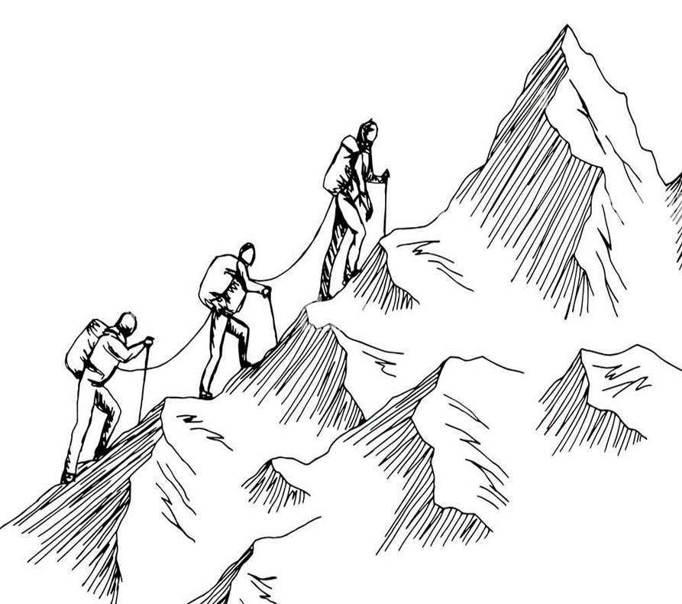
The WIDE Framework
2
Framework aims
To support employers in
hiring, retaining and promoting disabled employees,
creating inclusive work environments.
What it will be...
freely accessible web platform/software
providing employers with a improvement focused tool for
self-review
Notes:
In AHEAD we believe employers can and want to do better, in terms of ensuring effective workforces.
It isn’t just about compliance; we understand that you want to position yourself as the leader in sustainability and equity, giving you competitive advantage.
To achieve this, we know that some help would be nice. This leads me onto the WIDE framework.
Starting at the top of the mountain, the framework aims to provide support for all employers in all sectors of all sizes in Ireland,
to hire, retain, and promote more disabled employees, and create inclusive workplaces.
In terms of what it will be; it will be a web platform/piece of software, freely accessible to employers.

Slide 8


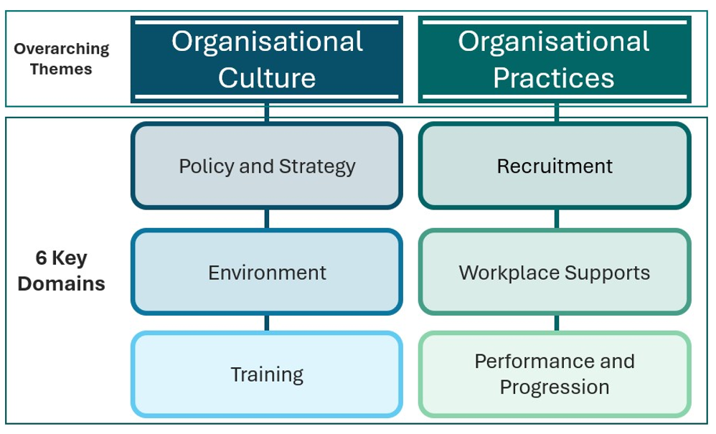

WIDE Framework Domains
Inspired by the UDL Framework
(Trusted, flexible and visible)
Notes:
The framework consists of two themes including organisation culture and practices
and 6 domains of
policy and strategy,
environment,
training,
recruitment and selection,
supports
and performance and progression.
Each domain features “areas of effort” containing “actions” to work towards.
Each actions have guidance notes to help you implement it with resources linking to legislation.
The web platform functionality offers
individual and organizational logins,
task assignment,
a self-scoring tool,
a progress dashboard,
exportable reports,
a service provider directory,
and an opt-in employer networking feature.

Slide 9










Methodology
Consultations with
25 disabled people
Thank you to all our
co-researchers!
Consultations with
33 disability organisations
Creation of the
6th Framework draft
Consultations with
14 employers
Analysis
Notes:
How did we go about creating this framework?
The project started in September 2023, when we partnered with Employers for Change,
completed the literature review with Dr Joanne Banks
and formed The National Advisory group consisting of 16 representatives.
Throughout 2024, we completed 3 rounds of consultations with our incredible co-researchers, many thanks to each of them.
The first round included 25 individuals with lived experience of disability, representing all ages,
various educational and employment perspectives, and intersectional minorities.
We then completed 2 employer consultations with 14 employers,
representing 4 company sizes,
11 sectors operating nationally and internationally
from private, semi-state, public and the civil service.
Last but not least, we held 2 consultations with 33 disability organisations representative of NGO’s, DPO’s and other disability groups.
Putting our rocket launchers on, Dara and I sped through massive amounts of data from the consultations and post consultation surveys thematically analysed it all and created our 6th Framework draft.

Slide 10




Findings
Employers
  Flexible policies help productivity
  Employment of people with intellectual disabilities =
gold standard
  Use grants to ensure accessibility
  Embrace “Life Passports”
Disabled people
Disability Orgs
  Universal design is essential
  Training must be lived-experience-led
Notes:
In terms of the findings; I’ve cherrypicked the 6 most significant.
Disabled people emphasized the need for flexibility and targeted recruitment, especially for those with intellectual disabilities,
they highlight this as the gold standard of employment.
They also explained that currently disclosure often leads to discrimination.
Employers underscored the value of grants and "Life Passports" in fostering inclusion.
Meanwhile, disability organizations stressed that universal design is key and
that all training should be led by those with lived experience, as they are the experts.

Slide 11
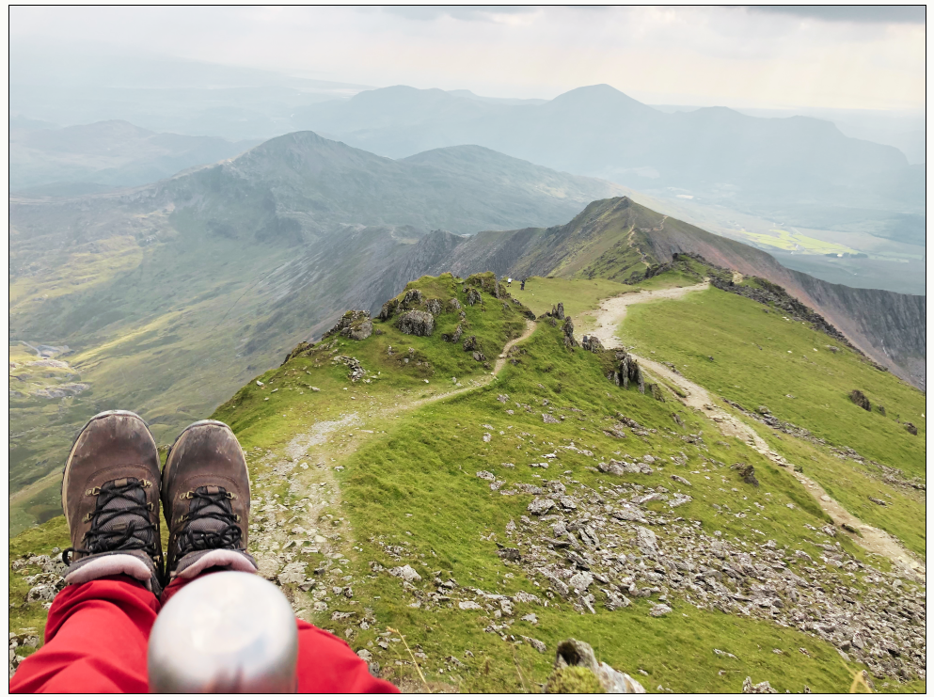


Next steps
4
4) Autumn 2025 Launch!
2) Spring consultation
round up with all
co-researchers
(7th final Framework)
3) Web design
Creation, trial and testing
1) Advisory group meeting
(tomorrow)
Notes:
We’re kicking into action tomorrow,
having a meeting with our advisory group,
followed by the Spring consultation with all co-researcher to help finalise the 7th and final Framework content!
During the spring and summer, we will be web designing thus we need accessibility and employer testers!
Finally, we will have a fabulous launch in Autumn 2025.

Slide 12

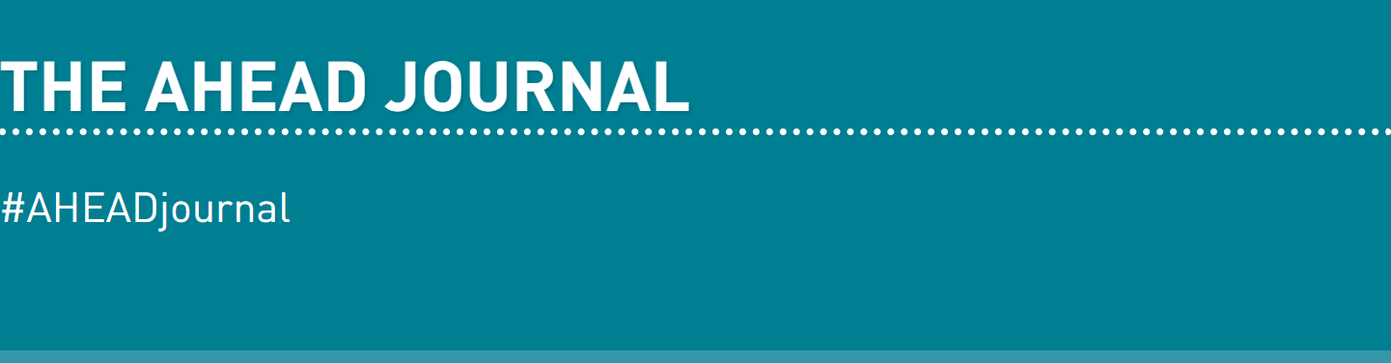
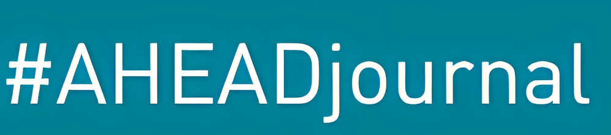

AHEAD journal papers to read
Widening Inclusion of Disability in Employment (WIDE):
Findings from the Voices of Lived Experience of Disability, Employers, and Disability Organisations
Disability and the Corporate Sustainability Reporting Directive (CSRD) – A Driver for Change?
AHEAD WIDE Framework
Notes:
If you’d like to learn more about the WIDE framework,
perhaps you’d like to read about the full findings,
please visit AHEAD WIDE Framework or
You can read our 2 papers about WIDE and the CSRD in the newly released AHEAD journal issue 18, which is out now!

Slide 13

Pathways to Possibilities
Notes:
Additionally, you can find out about 3 large projects that the research team and I are doing, by attending our webinar titled Pathways to Possibilities on April 29th!

Slide 14
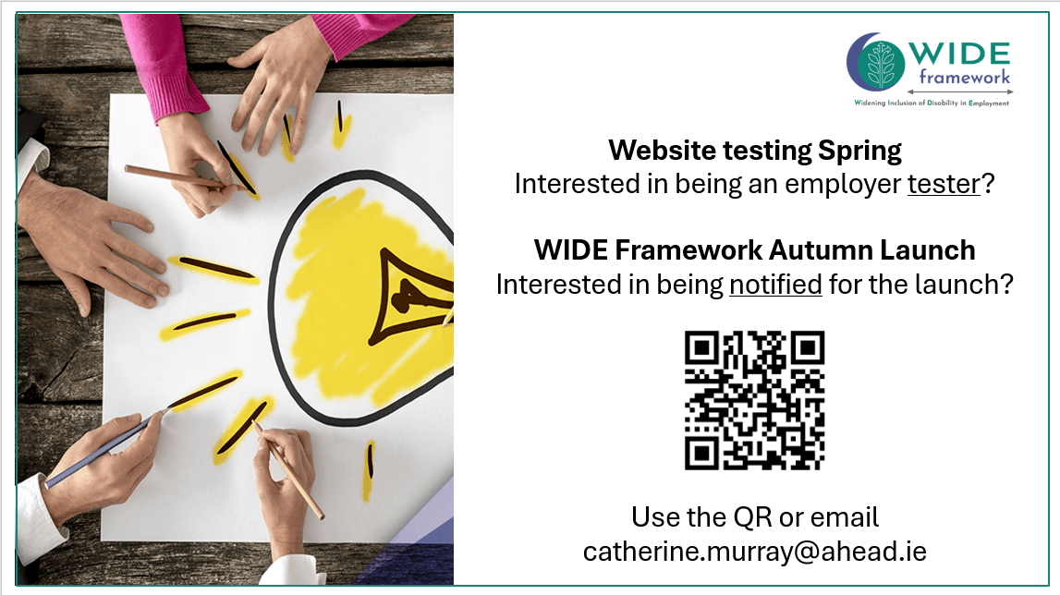
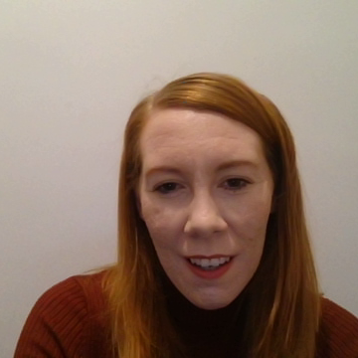
Sign up to be a web tester and or to be notified for the launch
Notes:
Lastly, of you are as excited about inclusion as we are,
help us get the framework over the line so we can lunch nationally across Ireland.
We are looking for web testers and
we would love to have you at the launch – so please do sign up!

