Slide 1

Rosalind Threadgold
Access & Inclusion Officer
Sarah Lavan
Adult Education Officer Equality, Diversity & Inclusion

Slide 2
Transitioning from School
Many learners that have an Intellectual disability have great difficulty in transitioning from school, especially if they have attended a Special School.
Their advocates are unsure of where they will go and what can be achieved and often there is no guidance available in school on afterschool options.

Slide 3
Life Long Learning and support to employment for people that have an Intellectual Disability.
Some learners will be invited to make application to Specialist Training Programs having completed their Leaving certificate or Leaving Certificate applied. Other learners will leave without any formal qualification or work experience. Their usual route is Adult Day Services Rehabilitative Training which last for three years and then Adult Day Services which are facilitated by the HSE.
Educational needs don’t stop after school and even if young adults, don’t immediately go to Further and/or Higher Education there are many opportunities available to them.

Slide 4
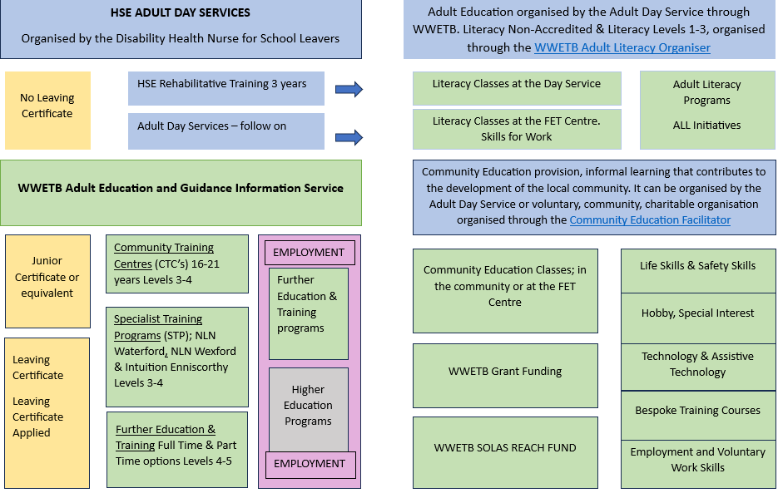
Available Supports

Slide 5
Learner Profiles
To support the conversation on provision for learners who have an Intellectual Disability, Learner Profiles can be very beneficial to outline possible pathways through the education system.
This can give educators or guidance, details on the learner, and the possible pathways available for them. We created profiles of three different Pathways through wwetb for learners who have Down Syndrome. Staff resource for Learner with ID
Learner profile 1-Special School Leaving with no formal Accreditation
Learner profile 2- Mainstream School Junior Cert Applied - CTC
Learner profile 3 – Mainstream School Leaving Certificate Applied-STP

Slide 6
Learner Stories
In Adult Day Services Person Centred Planning (PCP) is very important to individualise supports, services and outreach opportunities for people who have an Intellectual Disability. Sometimes we do not have view of the PCP.
While on the Advocacy course our learners completed two pieces of work that really helped us achieve a customised program with the learner at the centre of their learning.
Weekly Schedule/ timetable of Activities – These are customised to learners
About Me worksheets or Creative Art gives us an opportunity to understand about interests, values, hopes and dreams of our learners.
These two pieces of work helped us to understand the rich tapestry of our learners lives and what their future plans were for employment or further education and training.

