Slide 1
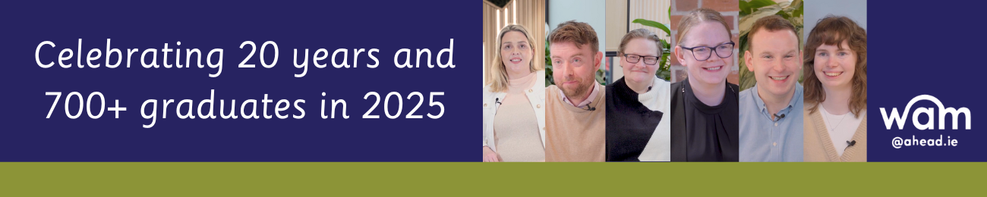
  This year, we celebrate 20 years of WAM! It's a milestone that highlights two decades of AHEAD supporting over 700 graduates with disabilities to secure paid and mentored work placements while also championing inclusivity in the workplace.

Slide 2
  The Willing, Able, Mentoring (WAM) Programme was established in 2005 and is currently funded by the Department of Social Protection.
  The central objective of WAM is to widen access to employment for graduates with disabilities while working with and supporting employers to create more inclusive workplaces.

Slide 3
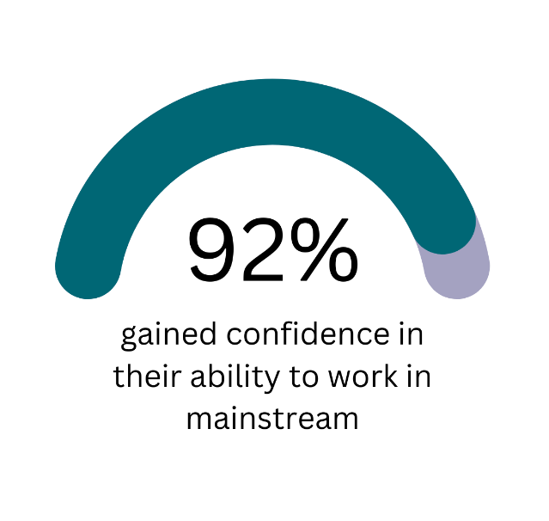


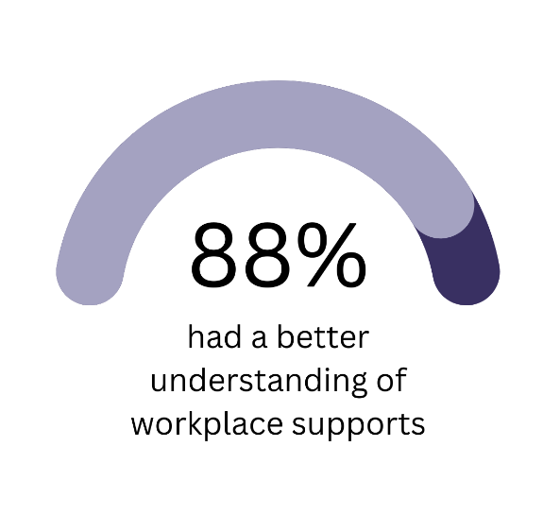

WAM Graduate Benefits!
Notes:
3,665 applications for WAM placements and 460 needs assessments carried out by AHEAD
81% of WAM graduates secured employment as a direct result of their WAM placement.
1 in 5 applicants required accommodations for a traditional interview.
1 in 7 applicants required accommodations for a virtual interview.
1 in 3 required accommodations for testing and screening recruitment processes.
Two-thirds of workplace accommodations do not incur any cost to the employer and are in relation to work tasks.
42% of graduates require time off to attend disability related medical appointments
92% of WAM graduates gained confidence in their ability to work in a mainstream environment
69% of WAM graduates were no longer in receipt of any disability or illness payments.

Slide 4
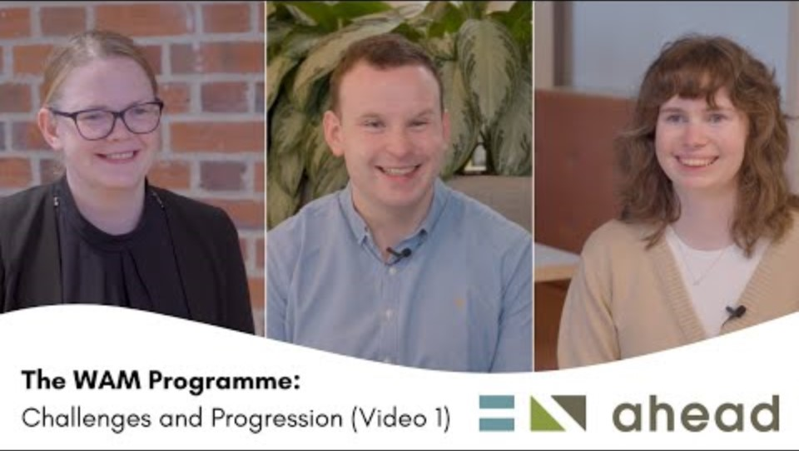
Video 1

Slide 5
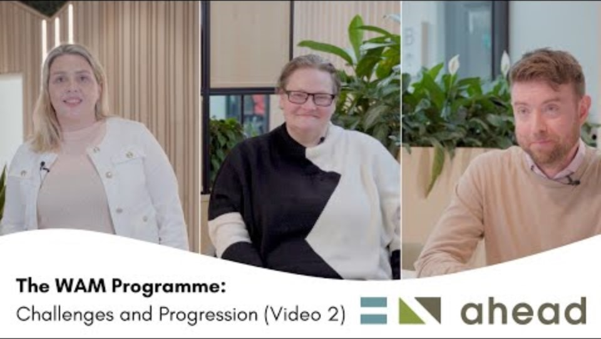
Video 2

Slide 6
  Celebrate this milestone with us!
  We invite you to join us on the top floor to celebrate 20 years of WAM! Let's come together to honor our achievements, share stories, and look forward to the future.

