Slide 1

3 AI tools that can be used to enable multiple means of engagement and representation
Ann Kennedy
Notes:
Name
From
What I teach
I have done a lot of work on action and expression
but
Today I’m going to talk about how teachers can leverage AI tools to enable multiple means of engagement and representation

Slide 2
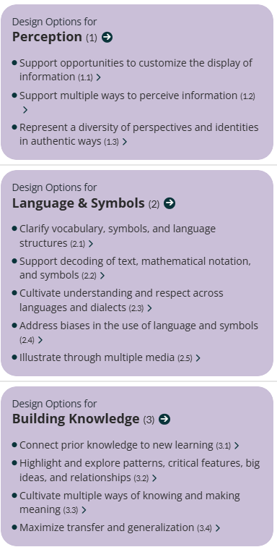
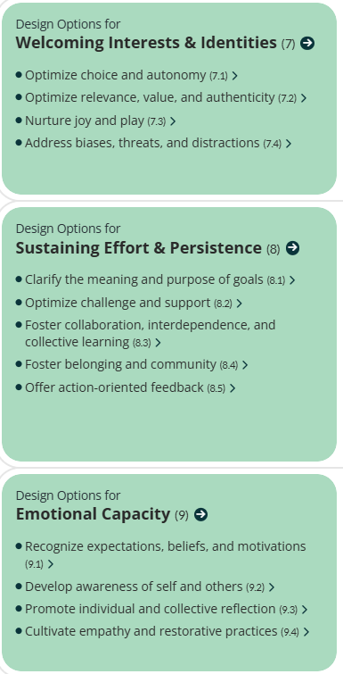
Challenges where AI can help
Tools
NotebookLM
https://notebooklm.google.com
Nearpod
https://nearpod.com
GenAI
https://openai.com/
https://claude.ai/
https://www.perplexity.ai/
https://gemini.google.com/
Engagement
Representation
https://udlguidelines.cast.org/
https://universaldesign.ie/about-universal-design/the-7-principles
Notes:
Engagement – choice and autonomy
nurture joy and play
Sustaining effort
Representation – supporting multiple ways to perceive information
Illustrating through multiple media

Slide 3
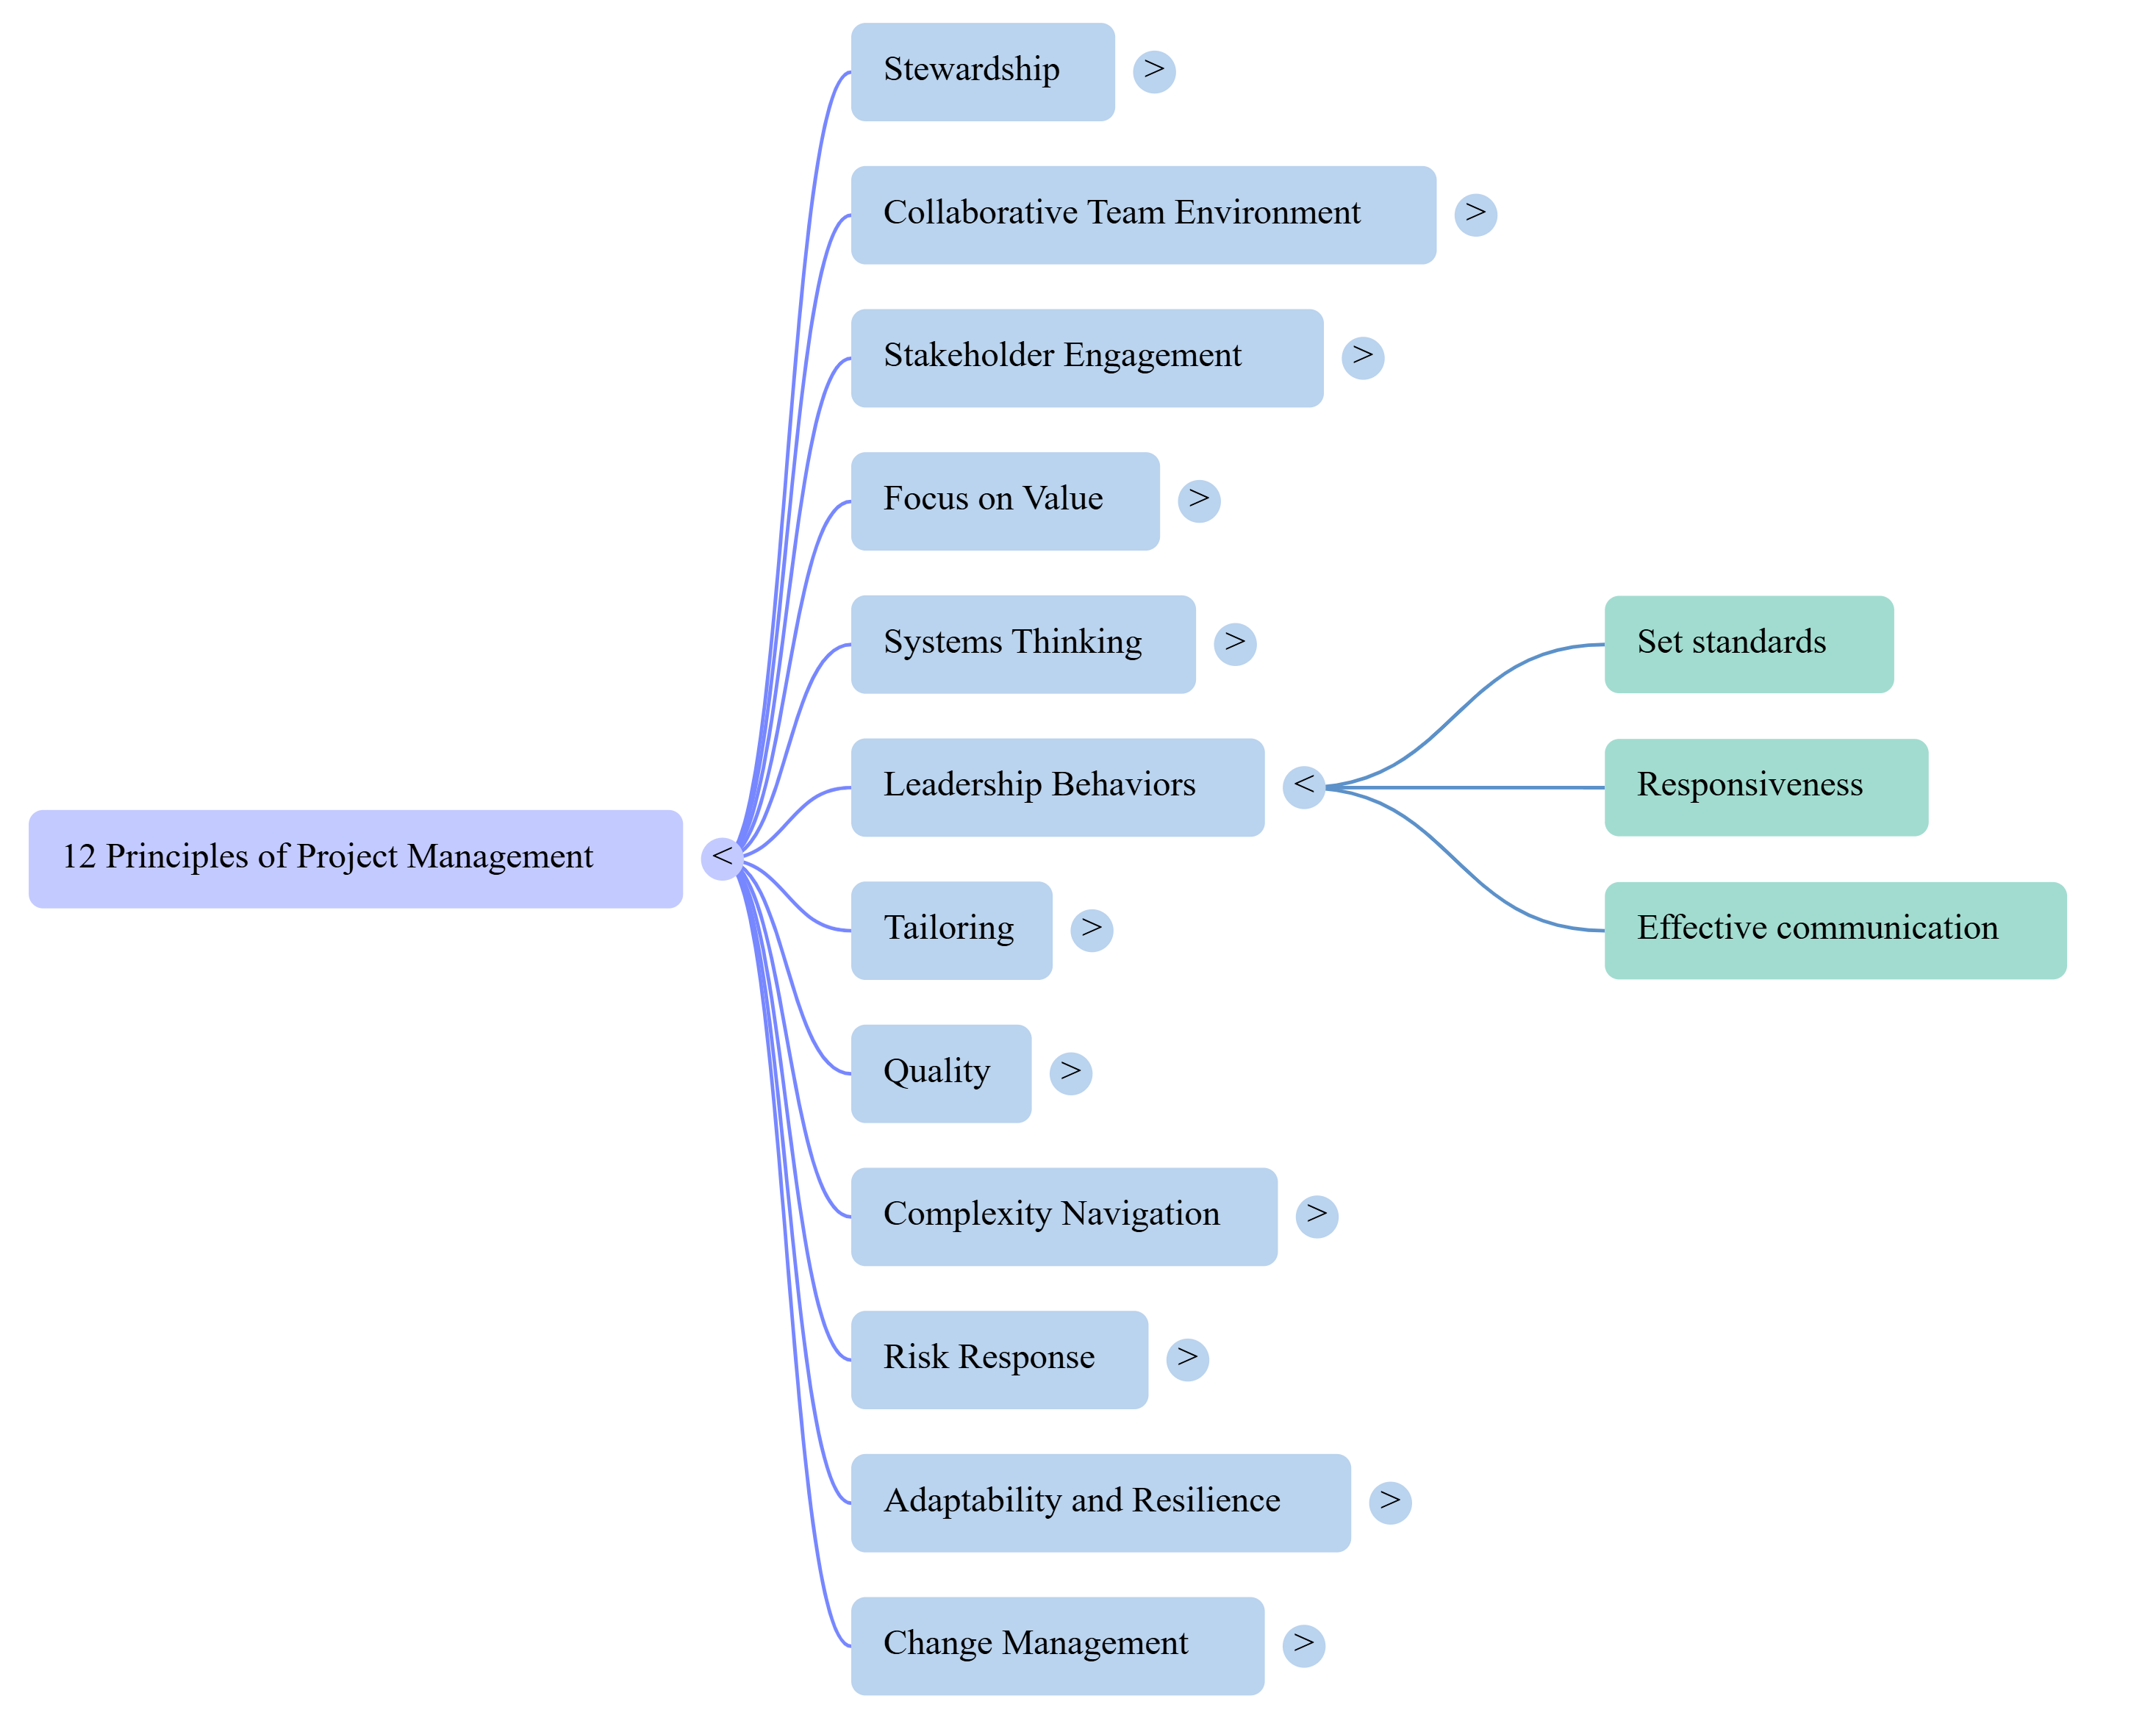

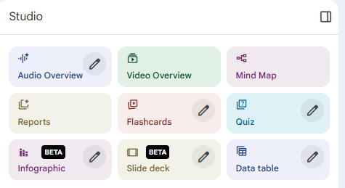
NotebookLM
https://notebooklm.google.com
How I use it
Creation of different means of engagement
Create podcasts
Mind maps
Flash Cards

Slide 4
NotebookLM (2)
https://notebooklm.google.com
How I use it
Creation of different means of engagement
Create podcasts
Mind maps
Flash Cards
Advantages
Very easy to learn how to use it
Podcasts are excellent for students who learn through listening
Things to watch out for
Can get a bit repetitive. Use sparingly
Student need account for full use

Slide 5

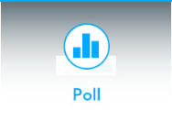
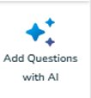
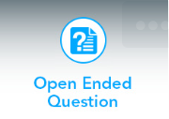

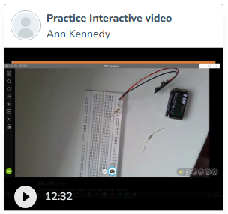

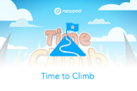
Nearpod
https://nearpod.com
How I use it
Generate class engagement
Visual and audio representation

Slide 6
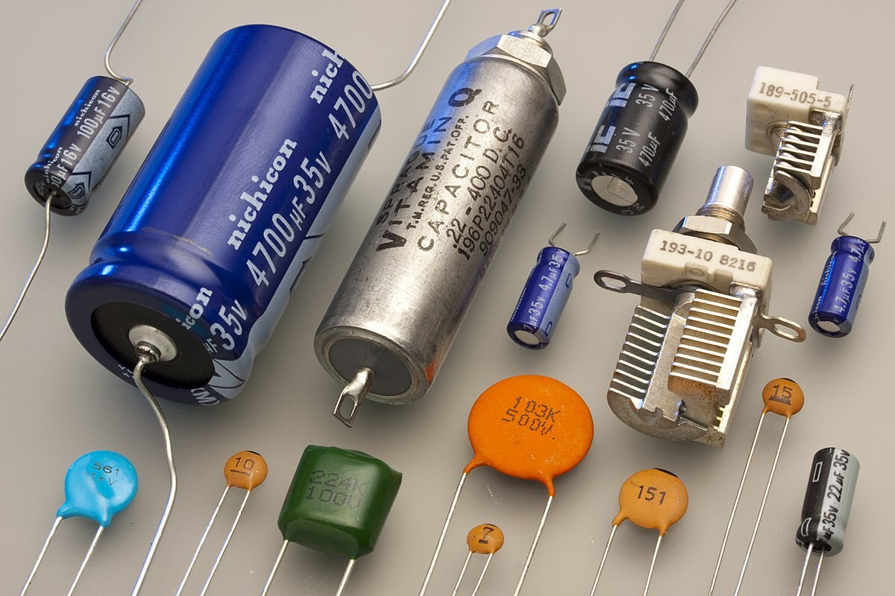


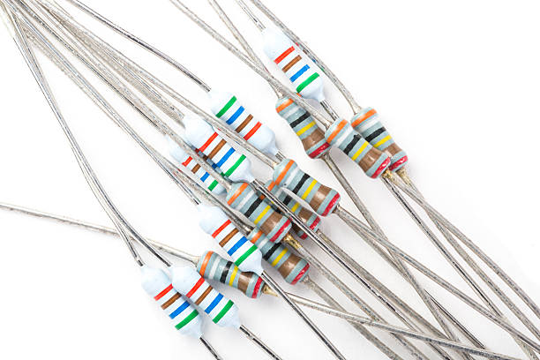

Nearpod (2)
Caution
https://nearpod.com

Slide 7
Nearpod – Use, Advantages
https://nearpod.com
How I use it
Generate class engagement
Beginning of the year
For classes that can use a lot of interaction
Heavy theory that needs revisiting by the student
Visual and audio representation
Where there are useful videos / audio to assist learning
Advantages
No student account needed
Lots of fun
Free version gives a reasonable amount of features
AI is useful when prompted correctly for questions and for reading levels
Things to watch out for
Needs time to get comfortable with the interface and presentation
Takes a lot of energy for the students
The AI needs good prompting, not as useful at pure creation

Slide 8

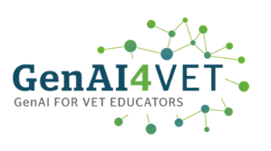
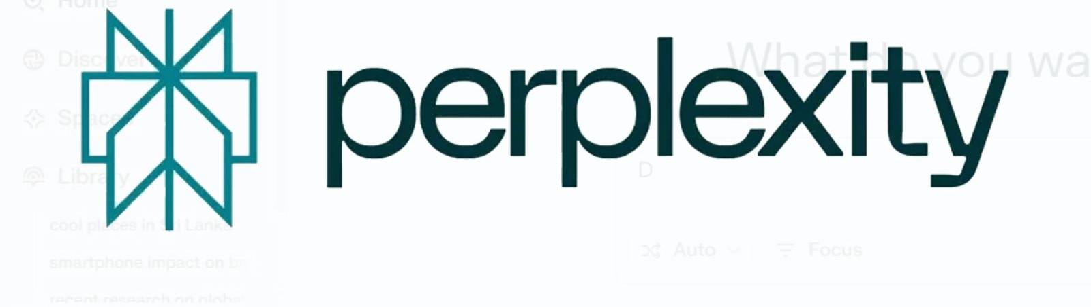
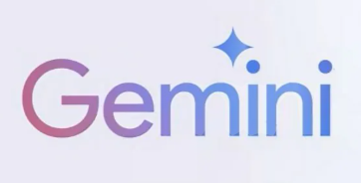

Generative AI Prompt Engineering
Generative AI is a powerful resource that teachers can use in different aspects of education. This presentation will illustrate the power of UDL-centred prompt engineering to help teachers broaden engagement, representation as well as action and expression.
https://genai4vet.eu/

Slide 9
Generative AI Prompt Engineering (2)
What do I use GenAI Tools for?
Gives me different ideas on questions that could be asked about materials
Assesses documents for accessibility and diversity representation
Sample Prompts
Upload document of materials that I present in class and ask for
Text based questions
MCQs
True or false
Mix and Match
Check document for accessibility
Check document for diversity representation

Slide 10
Overall
Engagement
Representation
Tools
NotebookLM
Nearpod
GenAI
Take Away
Human oversight
Clear starting information
Clear ask for what is needed
https://udlguidelines.cast.org/
https://universaldesign.ie/about-universal-design/the-7-principles
Notes:
Engagement – choice and autonomy
nurture joy and play
Sustaining effort
Representation – supporting multiple ways to perceive information
Illustrating through multiple media

Slide 11
Thank you for listening!!
Ann Kennedy
Notes:
Name
From
What I teach
I have done a lot of work on action and expression
but
Today I’m going to talk about how teachers can leverage AI tools to enable multiple means of engagement and representation

