Slide 1


Integrating UDL Principles into
Module Design and Assessment Strategies
Dr. Liam Morris
Lecturer
Dept of Mechanical and Industrial Engineering
School of Engineering
Atlantic Technological University – Galway
ATU Galway City, Old Dublin Road, Galway, H91 T8NW, Ireland
Contact: liam.morris@atu.ie
Notes:
Hello, my name is Liam Morris and I am a Lecturer in the Mechanical & Industrial Engineering Department – ATU – Galway City. I would like to thank AHEAD for giving me this opportunity to present to you today. The title of my Talk is “Integrating UDL Principles into module design and assessment strategies”

Slide 2
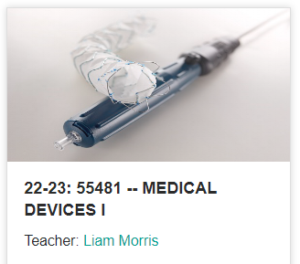
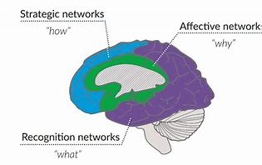
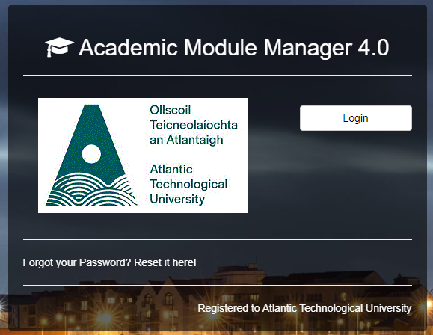

Introduction
Notes:
The module I will be presenting today, is a Level 8, Stage 4 module titled “Medical Devices I” which is taught on the BEng in biomedical engineering and as a specialisation stream for BEng in mechanical engineering programmes. It is a 5-credit module with a weekly 2 hours lecture and 2 hours lab.
This presentation will present strategies on how to implement UDL within a module designed within the Academic Module Manager software.
The Academic Module Manager Software is a syllabus management software designed for academic institutions which is used by the Atlantic Technological University. It assists in organizing and managing various aspects related to courses, syllabus and curriculum and course management.
There are also many challenges that need to be taken into consideration for this module such as
The Mechanical Engineers have not completed biomedical related modules previous to this module.
There are various outside class time constraints for learners such as jobs, families, accommodation, costs ect
There are more diverse cultures, International students, Mature students
With Biomedical Engineering, we have increased female participation in engineering
There is Neurodiversity within our classroom such as Dyslexia, ADH, ADHD - Most of the time we are in the dark on this
We also want to make our students more employable within the MedTech and healthcare Sectors

Slide 3


Incorporation of UDL
Learning Outcomes
Module Descriptor
Indicative Syllabus
Assessment Strategy
Notes:
Academic Module Manager comprises of many sections which provides an opportunity for UDL inclusion.
The first section is the Module Descriptor which can be normally quite wordy. ULD can be incorporated within this descriptor by including the following – “The national access plan emphasising equity of access, participation and success in higher education will be implemented throughout this module via the principles of universal design for learning.”
The next two sections – Learning outcomes and Indicative Syllabus does not provide an opportunity for UDL inclusion.
While the Assessment strategy can be transparent to learners by providing a detailed tabular description indicating the assessment types, descriptions, and showing how UDL can be achieved e.g. by providing a choice in presentation styles and showing which UDL checkpoints are implemented.

Slide 4
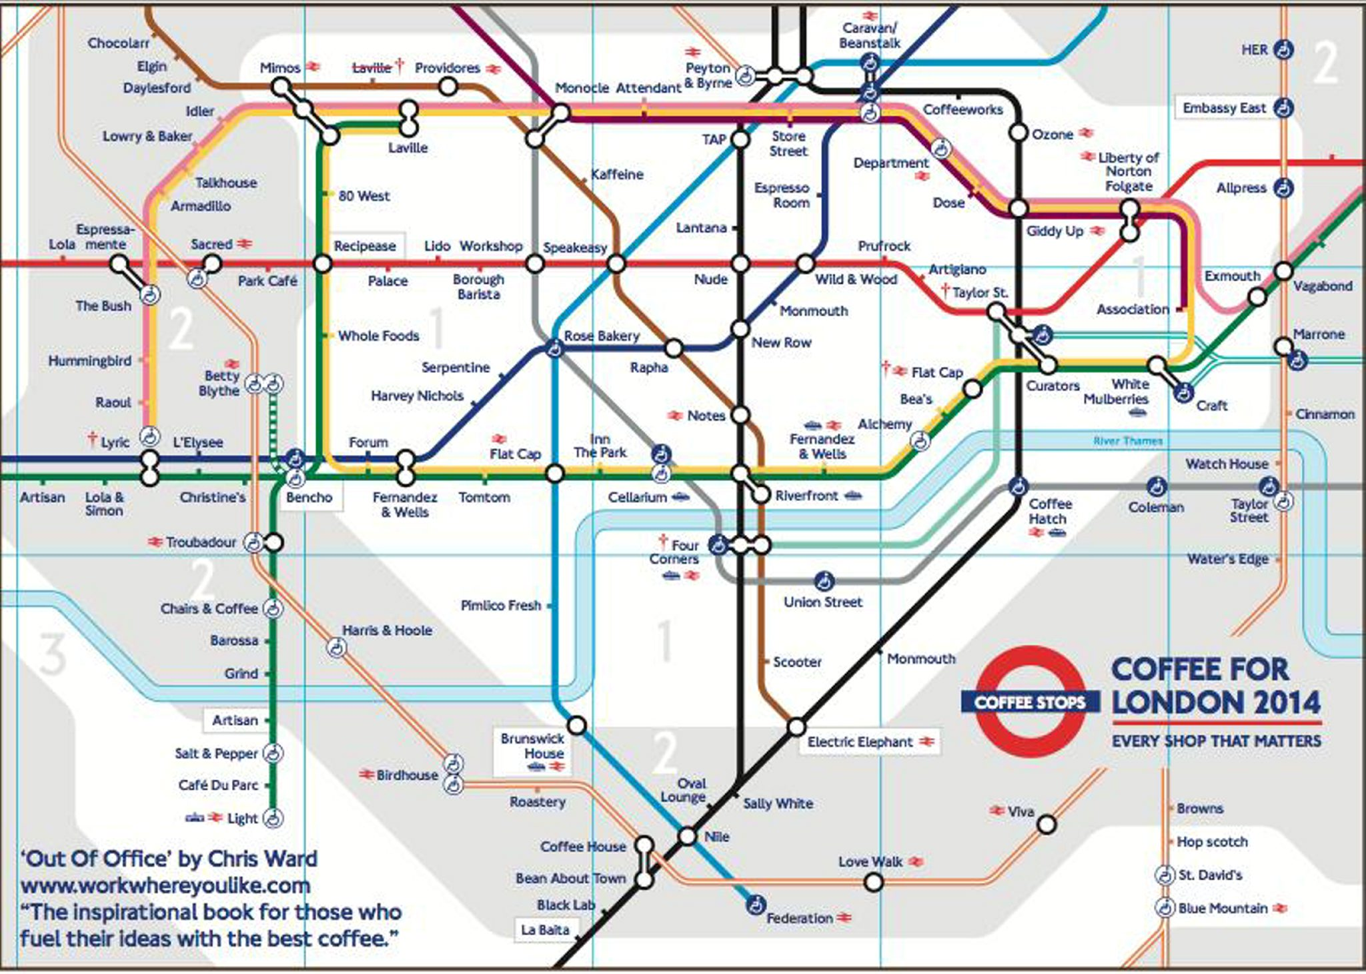
UDL Mapping
Checkpoint 7.2
Videos
Checkpoint 1.3
Medical data
Checkpoint 6.4
Self-reflection questions
Notes:
A detailed UDL mapping of all possible UDL checkpoints should be included within Academic Module Manager and this is a very useful exercise in understanding UDL implementation within first a module and then at programme level.
A short snapshot of how some checkpoints were achieved in this module are shown here.
Checkpoint 7.2 – can be implemented with videos – screencasts, youtube, variations on notes, integratating research with teaching
Checkpoint 1.3 – providing medical data, medical devices, 3D phantom anatomical models for visualisation and testing within our research facilities.
Checkpoint 6.4 – Self-reflection questions embedded in lab reports, rubrics/peer feedback and descriptors provided

Slide 5
Percentage of Implemented Checkpoints
87% of UDL Checkpoints were Implemented
Notes:
For this module a detailed UDL mapping was conducted for as many of the checkpoints that could be accommodated.
Up to 87% of all UDL checkpoints were implemented within this module, with a detailed description on how each of these checkpoints were implemented.

Slide 6
Integrating UDL
Enhances Transparency
Ensures Equity
Provides Further Improvements
Notes:
Integrating UDL within module descriptors
Enhances transparency – learners know exactly how UDL is implemented at the various stages of the curriculum design.
Ensures equity of educational access for all students
And provides further improvement in module delivery, learning and assessment for all learners.

Slide 7
Further Reading
Armstrong, P. (2010). Bloom’s Taxonomy. Vanderbilt University Center for Teaching. Retrieved [11/12/2022] from https://cft.vanderbilt.edu/guides-sub-pages/blooms-taxonomy/
Bates, B (2019). Learning Theories Simplified: …and how to apply them to teaching. Sage Publications Ltd. London. 1st Edition.
Blanco C.A. (2014). The principal sources of William James' idea of habit. Frontiers in Human Neuroscience (8) doi: 10.3389/fnhum.2014.00274
CAST Guidelines. https://udlguidelines.cast.org/
Dreamstime. Retrieved [11/12/2023] https://www.dreamstime.com/illustration/vark.html
Goldstein M. (1994). Decade of the brain. An agenda for the nineties. West J Med. 161(3):239-41.
National Access Plan, August 2022: https://www.gov.ie/en/publication/b156c-national-access-plan-2022-to-2028/
CAST website. Retrieved [11/12/2023] https://www.cast.org/
UN – CRPD, Adopted December 2006 – United Nations – Convention on the Rights of Persons with Disabilities. Retrieved [11/12/2023] https://www.un.org/development/desa/disabilities/convention-on-the-rights-of-persons-with-disabilities.html

