Slide 1
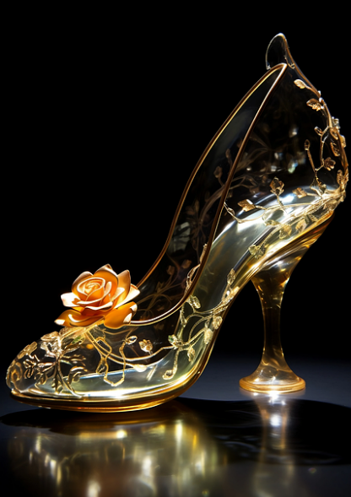
Cinderella's Revenge
how the European Accessibility Act changes everything

Slide 2
Plot summary
Hardworking girl at the bottom of the family pecking order gets all the unglamorous jobs and no thanks or recognition
Stepsisters locally recognised but don’t let Cinderella out .
Fairy Godmother reconfigures mice and pumpkins to enable access to the ball.
Non-standard footwear results in Cinderella being finally recognised by authorities.

Slide 3
Cinderella variants
Greek
Roman
Egyptian
Persian
French
Chinese
Vietnamese
Korean
Indonesian
Japanese
Iranian
Italian
German

Slide 4
Cinderella as metaphor
in English-language folklore Cinderella … has, by analogy, come to mean someone whose attributes are unrecognized.
Wikipedia

Slide 5
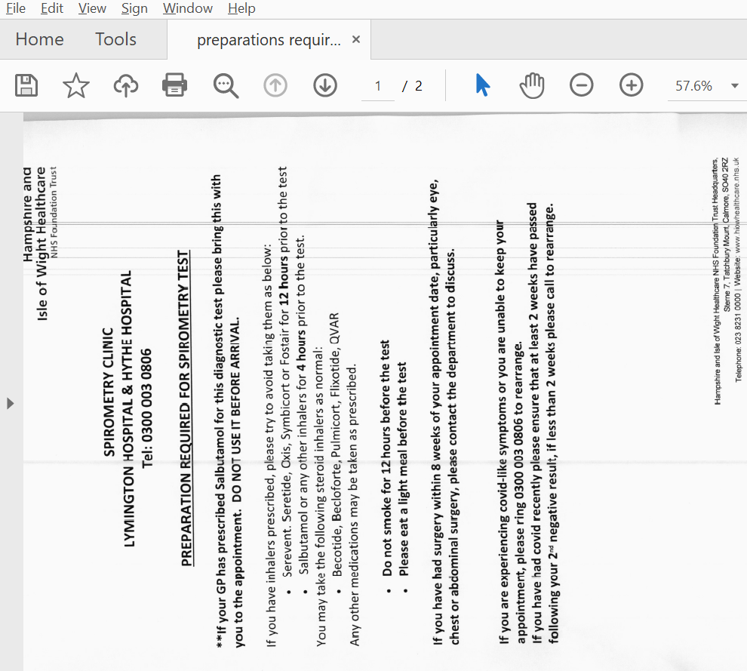
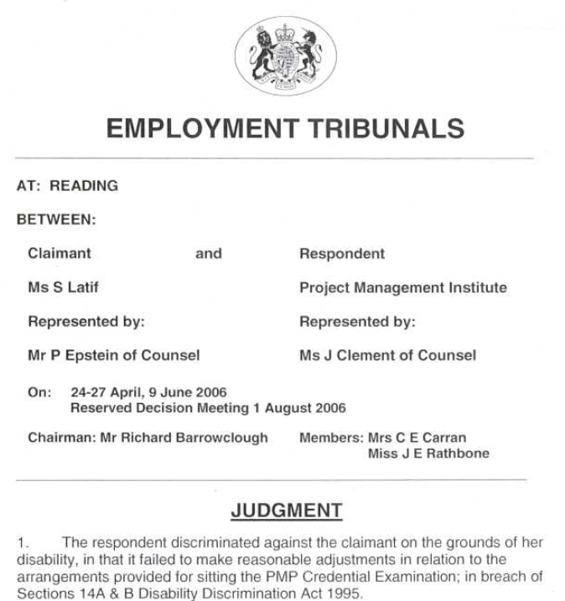
Ugly-sistering in FE and HE - 1
Technophobic lecturer scanning badly photocopied resource and uploading as an image PDF?

Slide 6
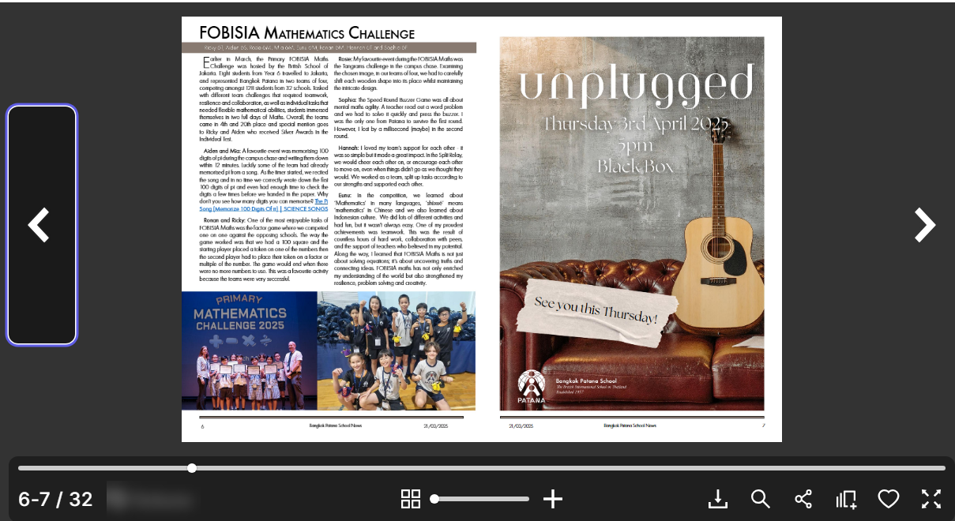
Ugly-sistering in FE and HE - 2
Technophile lecturer choosing some flashy new teaching app or format with poor accessibility (eg FlipBook-style of presentation).

Slide 7

Ugly-sistering in FE and HE - 3
Lecturer with penchant for PowerPoints with colour contrast disasters or distracting animations.

Slide 8
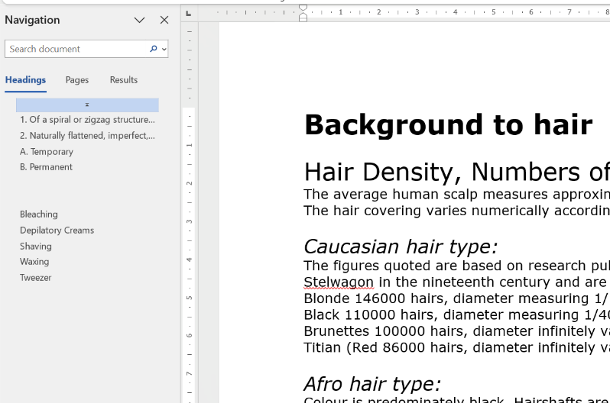
Ugly-sistering in FE and HE - 4
Long Word documents with no heading structure or long PDFs with no Bookmark outline.

Slide 9
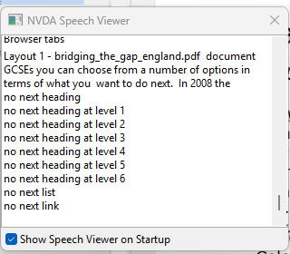
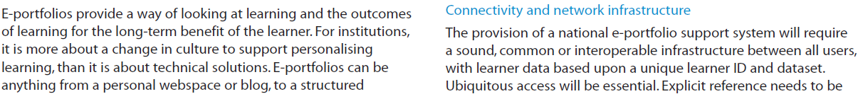
Ugly-sistering in FE and HE -5
Long PDF documents with no heading structure or tagging for accessibility.
Or poor reading order!
“E-portfolios provide a way of looking at learning and the outcomes connectivity and network infrastructure of learning for the long-term benefit of the learner for institutions, the provision of a national e-portfolio support system will require it is more about changing culture to support personalising a sound, common or interoperable infrastructure between all users…”

Slide 10
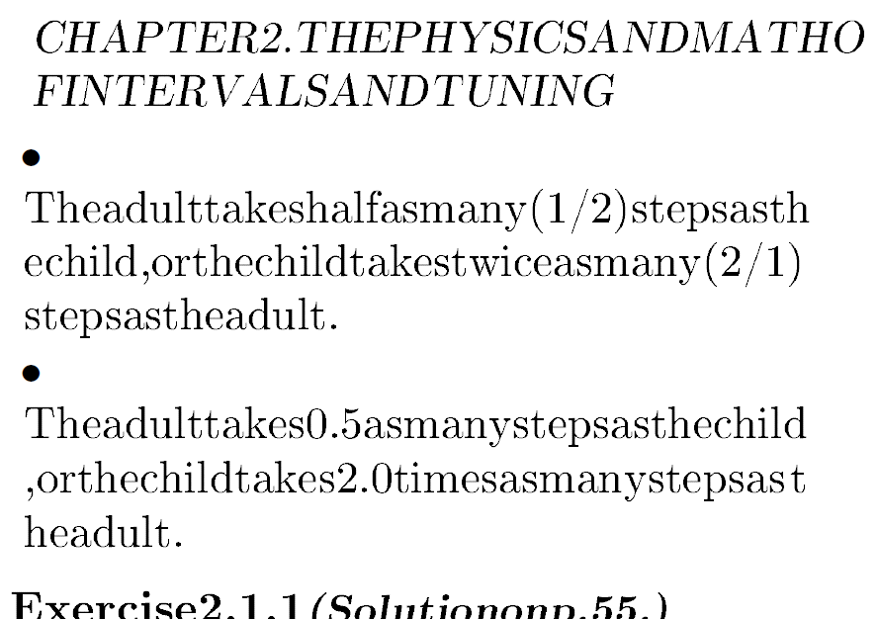
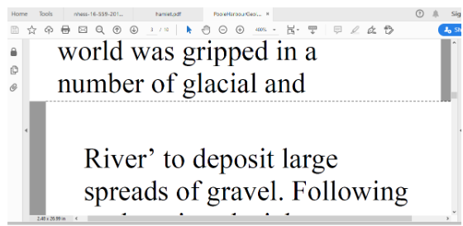
Ugly-sistering in FE and HE - 6
PDFs that don’t reflow reliably when used with View>Zoom>Reflow
in Acrobat Reader

Slide 11
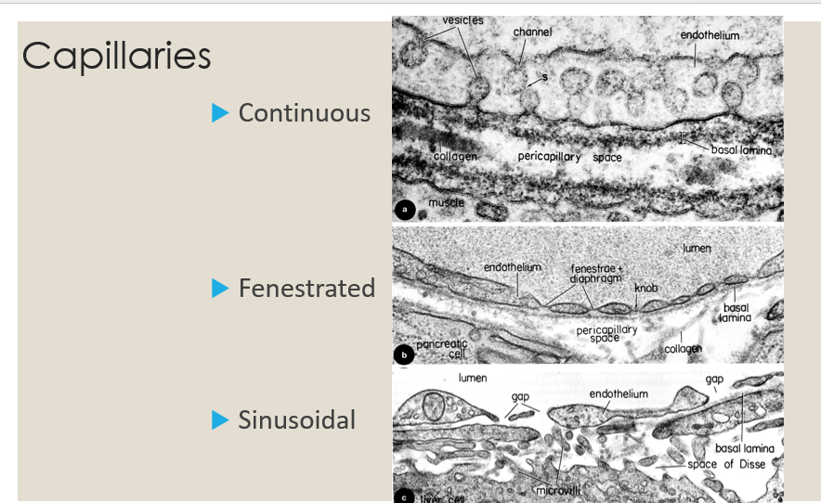
Ugly-sistering in FE and HE - 7
Image rich resources with no alternative text or other accessible description.

Slide 12
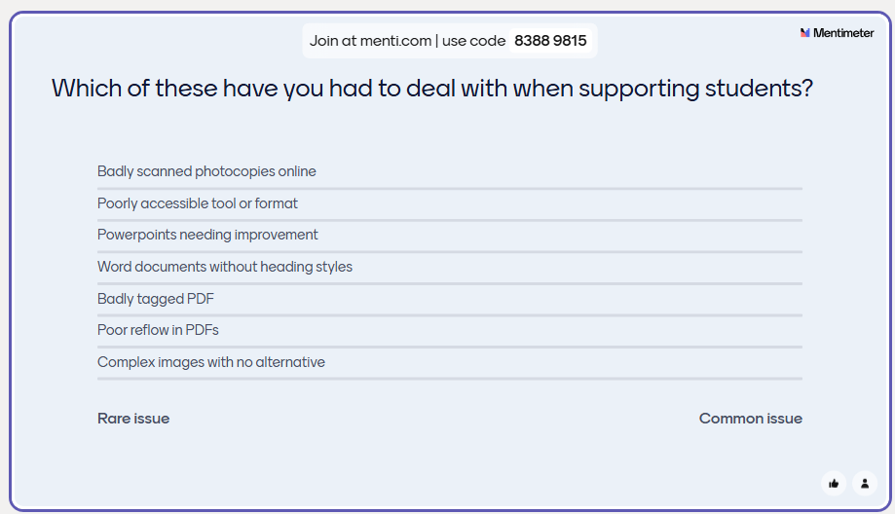
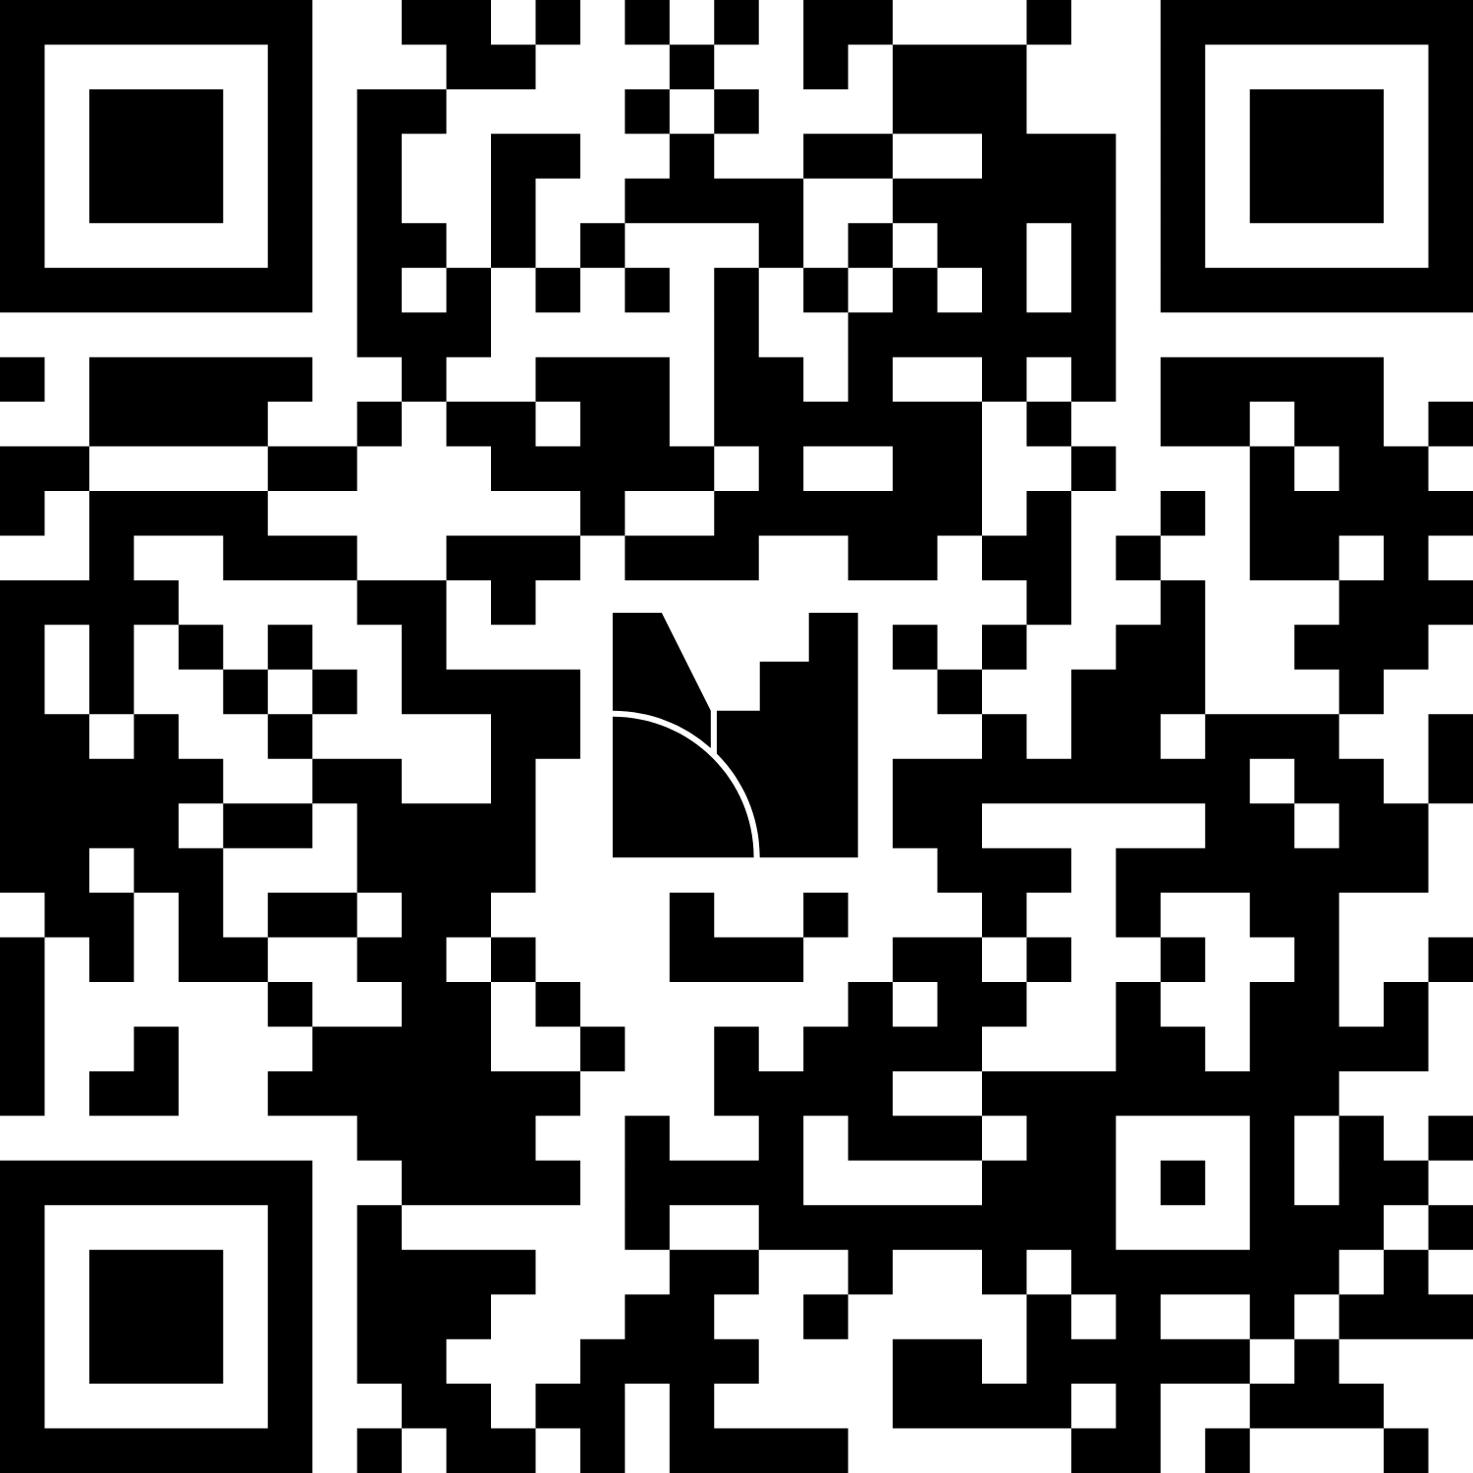
Your examples
Menti.com
838 898 15
Notes:
https://www.menti.com/al537vvrvaga
https://www.mentimeter.com/app/presentation/al5seqxdt2ci7fd5uzg63s2diu8pja72/edit?source=share-modal
https://www.mentimeter.com/app/presentation/al5seqxdt2ci7fd5uzg63s2diu8pja72/edit?source=share-invite-modal

Slide 13
The First Fairy Godmother
S.I. No. 358/2020 - European Union (Accessibility of Websites and Mobile Applications of Public Sector Bodies) Regulations 2020
Web Content Accessibility Guidelines and Irish Statute
Version 1.0 (1999) 65 total checkpoints (all levels, A, AA and AAA)*
Version 2.0 (2008) 61
Version 2.1 (2018) 78 (50)
Version 2.2 (2023) 87 (56)
Each level is divided into a hierarchy
A – Too basic (better than nothing!)
AA – accessibility requirement
AAA – accessibility enhancement

Slide 14
The Second Fairy Godmother
The European Accessibility Act – June 28th 2025
Compliance authorities have power to issue directions to comply
Individual consumers can take an action against businesses in Irish courts where consumer believes the business is not complying with the Regulations.
Individuals can bring proceedings directly (and be supported by interest groups).
See summary by Mason, Hayes and Curran

Slide 15
Cinderella suddenly matters - 1
Consequences of non-compliance:
Summary conviction: fine (€5,000) or imprisonment up to 6 months or both.
Conviction on indictment: (significant non-compliance, large impact on consumers, repeat offending): fine up to €60,000 or imprisonment of up to 18 months or both.
Personal impact: Companies, directors, managers, secretaries and other officers can be found guilty of an offence under the Regulations.
History matters: Ability to prove due diligence and all reasonable precautions to avoid the offence could be used as a defence.

Slide 16
Cinderella suddenly matters - 2
HEIs are now legally accountable for the accessibility of their digital content with real and personal penalties for non-compliance.
Includes all aspects of digital services/products (as well as some non digital products eg hardware – library self service kiosks).
Learning Materials: Presentations, PDFs, videos, e-books must be accessible.
Learning Management Systems (LMS): Platforms like Moodle or Blackboard must comply with accessibility standards.
Examinations and Assessments: Online assessments must be accessible to students with disabilities.
University systems: Libraries, e-commerce systems, timetabling, room booking, admissions, registration, authentication etc.

Slide 17
The Glass Shoes
Glass shoes represent uniqueness and transparency.
Assistive technologists do not have to be experts in the Web Content Accessibility Guidelines to know that disabled AT users experience barriers.
Your mission (should you choose to accept it) is to communicate issues clearly and transparently.

Slide 18

A change of job title?
“I used to be the irritant that annoyed the Senior Leadership Team. Now I’m the consultant who keeps them out of prison”.

Slide 19
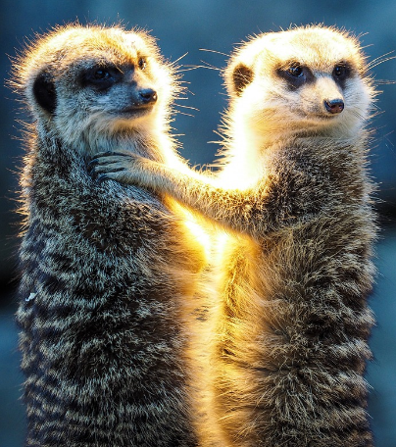
Is UDL really an Ugly Sister?
No. UDL is an excellent framework for inclusive practice BUT it doesn’t guarantee compliance.
“Multiple means of representation” might involve a lecturer sourcing an inaccessible PowerPoint, FlipBook and PDF.
Three compliance failures for the price of one!

Slide 20
Any tips for Cinderellas?
Consider the whole student life cycle – “mystery shopper” journeys are very informative!).
Define AT widely. Keep up to date with mainstream developments in Google ecosystems , Microsoft ecosystems and Apple ecosystems.
Explore some of the plugins that help with the hardest testing – for example Navigate like a screen reader (helps all users).
Advocate for automated testing results to be acted on – eg Blackboard ALLY scores or Brickfield Accessibility Tool.

Slide 21
Questions?
(Easy ones preferred) ☺
Alistair McNaught Consultancy
Email: enquiries@alistairmcnaught.co.uk
Twitter: @Alistairm
More info: https://tiny.cc/amcnltd

