Slide 1


AHEAD ARK Platform
+Online Courses
gATher 2025

Slide 2

ARK Platform
Documents on key web accessibility legislation→ what the web accessibility directive means in practice
Links to lots of valuable AHEAD and external resources to continue your accessibility journey
6 7 free role-based short courses for FE and HE staff that be embedded into your institution’s VLE!

Slide 3

Introducing Ark - Video

Slide 4

ARK in Numbers
3,000+ | Total Completions
1,156+ | Completed in 2024 alone!
776 | Introduction to Digital Accessibility for Educators
651 | Digital Accessibility, a Whole Institution Approach
281 | Developing a Web Accessibility Statement
248 | Designing Course Layouts for Learner Success
864 | Introduction to UDL
371 | Disability 101

Slide 5
Ireland
Going global!
Notes:
Erica

Slide 6

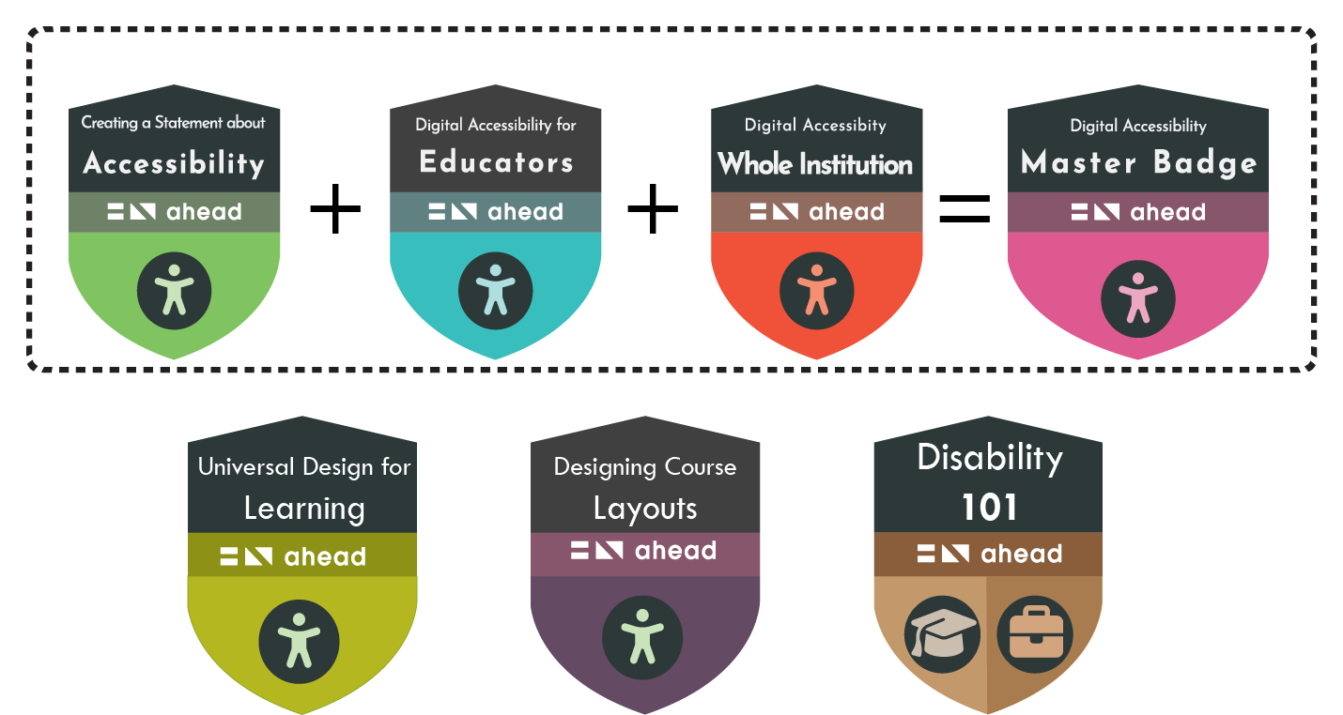
ARK Badges

Slide 7

New badge!

Slide 8
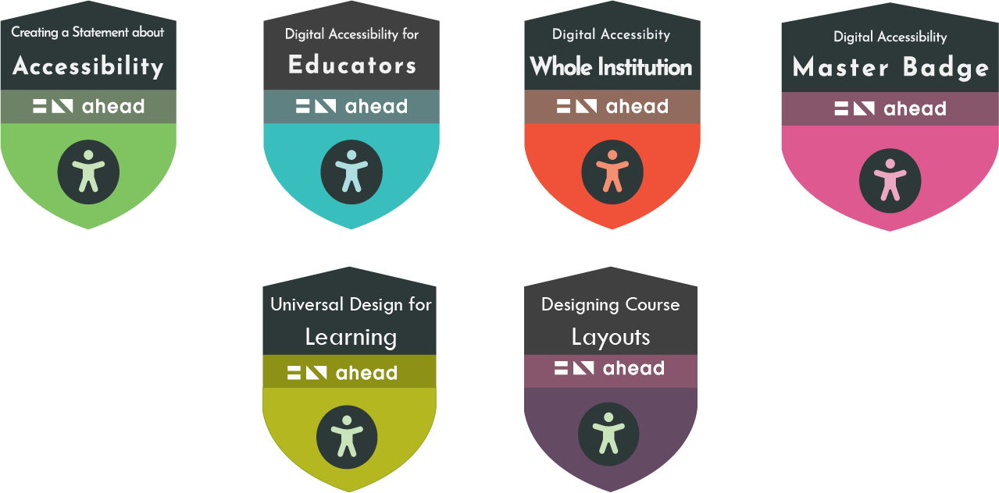
Creative Commons
All course materials freely available
eLearning files can be uploaded to internal LMS/VLE
Notes:
Danielle
Learning Management System / Virtual Learning Environment

Slide 9
A sneak peek..

Slide 10
Thank you
Any questions?
Notes:
Danielle

