Slide 1

Assistive Technology Cafés:
Culture change with coffee & cakes
Brendan Ryan
& Liese Gubbins

Slide 2

Table of Contents
TEL Café Overview
TEL Café - Assistive Technology
  Who was involved?
  Why Collaborate on Assistive Technology?
  TEL Café Resources
Learning Support Use Case – NotebookLM
Feedback

Slide 3
TEL Café Overview
Why?
Tutors highlighted time constraints as a barrier to upskilling.
Our Approach:
Monthly, drop-in sessions at rotating campuses (with online options).
Relaxed sessions with tea, pastries, and natural, peer-driven conversations.
Flexible timing – join or leave as needed.
Impact:
Tutors have discovered new technologies in a supportive, informal setting.
Fostering a more connected Technology Enhanced Learning (TEL) community.
TEL Café Poster

Slide 4
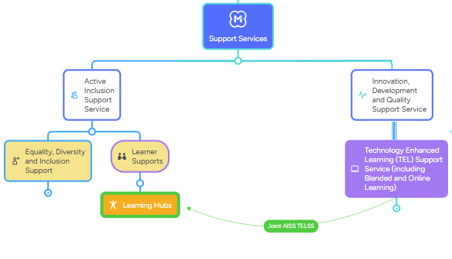
TEL Café - Assistive Technology
Who was Involved?
A collaboration between:
TEL Support Service – (tutor facing) Supporting staff use of educational technology
The Learning Hubs and our Active Inclusion Support Service (AISS) (learner-facing)
Focus on learner support, promoting equity & diversity and improving the learning experience for all learners

Slide 5
Why Collaborate on Assistive Technology?
To promote the appropriate and effective use of assistive technology by sharing knowledge and experiences of AT potential and use
  'approach is not 'technology-led' but instead we believe that the use of technology in teaching should be approached critically. We promote reflective practice and the contextualised evaluation of technologies'
Critical now as AI is transforming the AT landscape
Part of an ongoing collaborative process focused on the strategic promotion and use of AT and the inclusive use of technology.

Slide 6








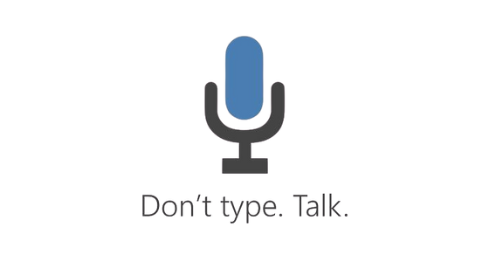




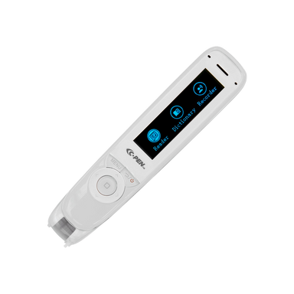
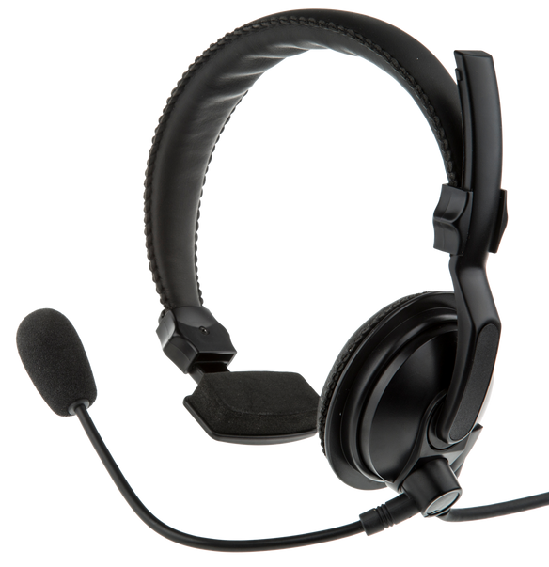

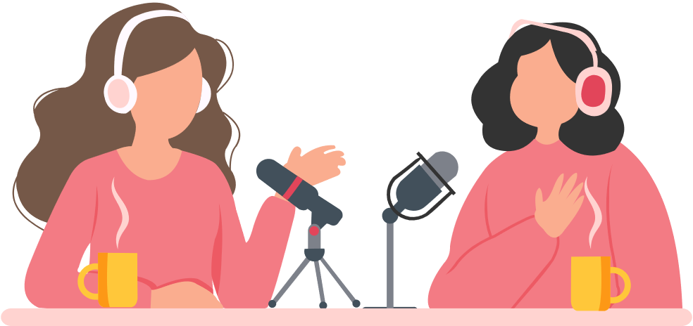


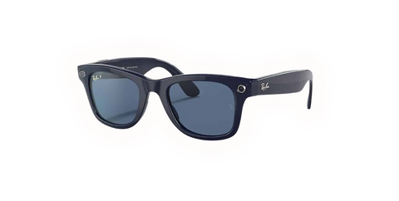

ASSISTIVE TECHNOLOGY
Click on image icons to access further resources
GOOGLE & MS LENS
JAM CARD
MICROSOFT ACCESSIBILITY FEATURES
BRICKFIELD
Image & text recognition tools
JAM Card allows people with a hidden disability like autism or communication barrier tell others they need ‘Just A Minute’ discreetly and easily.
Accessibility adjustments in Moodle
Speech to text and assistive reader tools
ACCESSIBILITY ICONS
HARDWARE
NOTEBOOK LM
ALT TEXT GENERATION
Adjust accessibility settings on websites
Reader pens, Headset, etc.
Make AI generated Podcasts
Generate alt text for images

Slide 7

Learning Support Use Case – NotebookLM

Slide 8
Feedback
“The informality of the session makes it more relaxing and easier to participate. The ability to come and go to parts of the session makes it very welcoming and the content is very interesting.”
“I enjoyed that they were light-hearted, short and not too detailed that it gave you a taste for the subject but wasn't overwhelming.”
“I now feel more confident applying new learning to my practice”
“Introducing NotebookLM and AI-generated podcasts to my class has been a great addition to the course”
“The informal friendly approach of delivery. Not a formal all-day event. Could stay for as long as was needed. No pressure”

Slide 9
Contact Information
  Brendan Ryan – TEL Officer, Limerick & Clare ETB
  Brendan.ryan@lcetb.ie
  Liese Gubbins – TEL Support Worker, Limerick & Clare ETB
  Liese.gubbins@lcetb.ie

