Slide 1
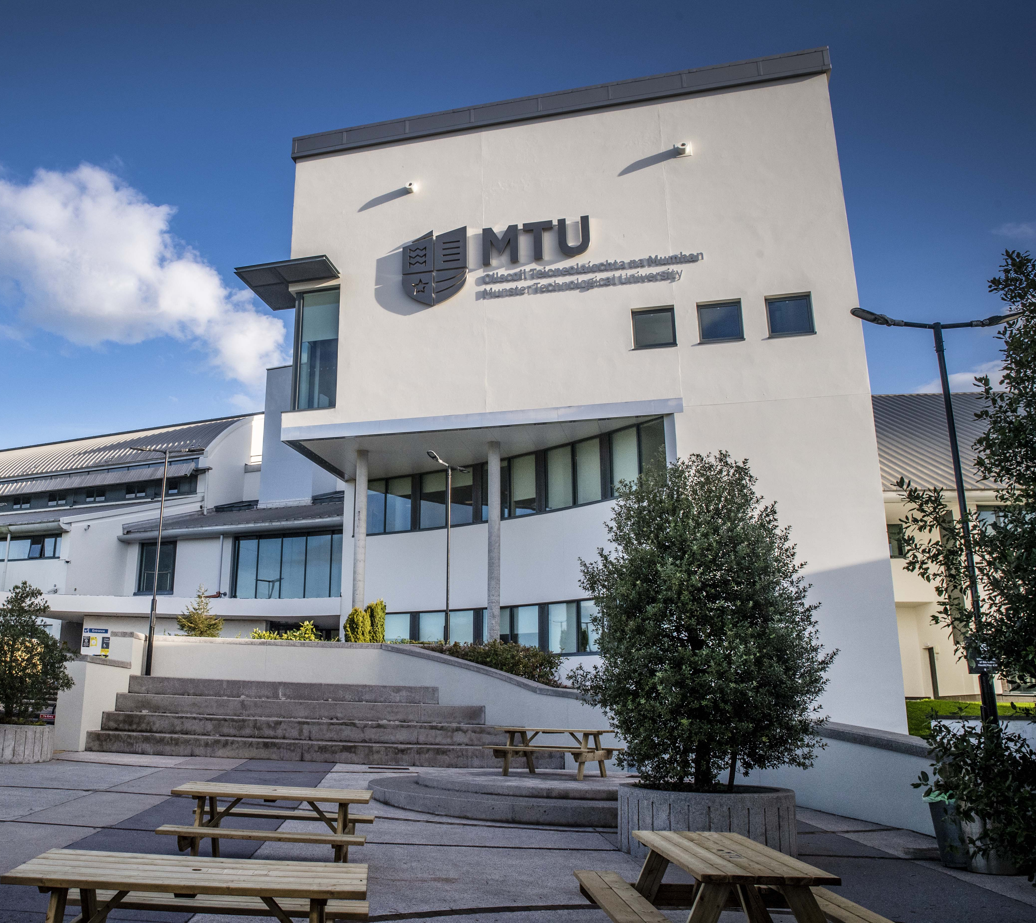

Build Your Digital Toolkit – a first-year induction workshop
Jane Brennan
Study Guidance Facilitator
Munster Technological University, Tralee, Co. Kerry, Ireland
Notes:
Mtu – new uni – itt and cit. 3500 students in Kerry so some crossover in roles.
Me – academic skills but also incl AT
Session – work done on guidance around digital tools. Short presentation then sharing of experiences

Slide 2
Contents
Pre-tech information retrieval
Pre-tech editing of writing
Technology for academic reading and writing
‘Assistive’ technology for students with literacy-impacting disabilities
Blurring of distinction between AT and general tech
So what’s the problem?
Evolving approach to tech guidance at MTU in Kerry
Build Your Digital Toolkit – Aims
Workshop content 1 – reading tools
Workshop content 2 – writing tools
Workshop content 3 – other tools
BYDT delivery 2024/5
Feedback received
Next steps

Slide 3
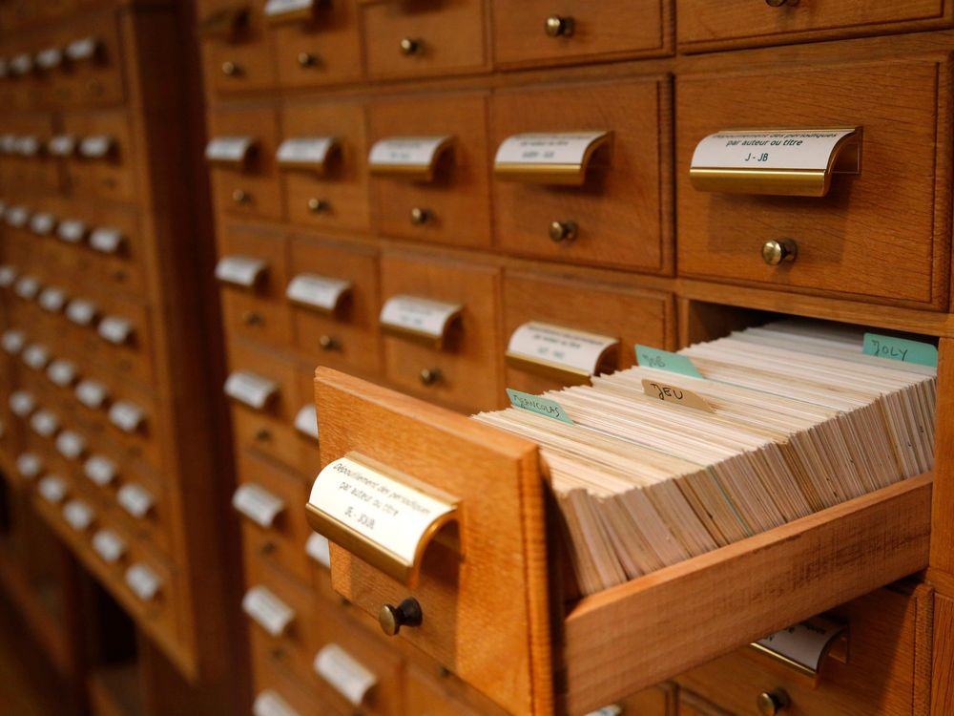
Pre-tech information retrieval
Notes:
Information retrieval technology from my undergrad. Subject index and author index. All hard copy materials physically present in the library. Interlibrary loans by post

Slide 4
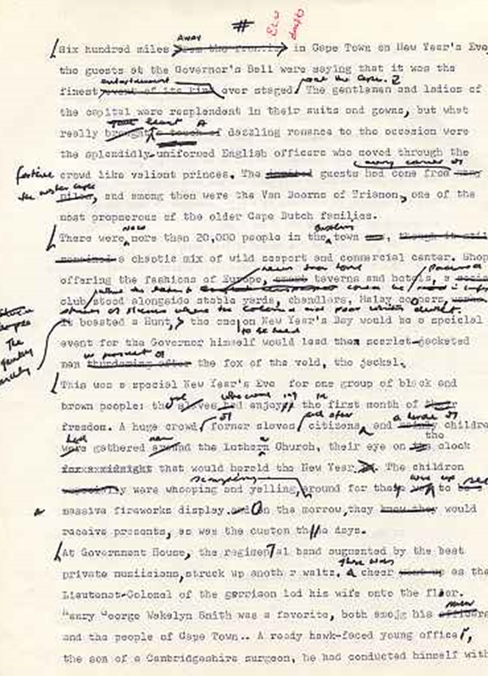
Pre-tech editing of writing
Notes:
Editing – scribble over draft then write out again. Repeat until sick

Slide 5

Technology has made academic reading and writing faster and more efficient for all of us
Information search and retrieval
Information availability
Word processing
Proofreading
Referencing
Notes:
Retrieval – exponentialy more powerful, volume of info mind bending

Slide 6


‘Assistive’ Technology has changed the landscape for students with literacy-impacting disabilities
Text-to-speech
Speech-to-text
Line focus
Screen tinting
Immersive reader

Slide 7

And the distinction between ‘assistive’ and general technology is more and more blurred
Notes:
Once AT clunky, heavy, different. Now apart from very specialist, most is small, portable or simply digital app/software esp for literacy support. Big crossover – AT for general use eg TTS, STT, General tech for SwD. School research – WP instead of handwriting single biggest improvement for SEN ss. V positive – more accessible, less stigmatising

Slide 8

So what’s the problem?
Changing needs on starting and progressing through university
Individual student differences – profile, background, needs, preferences
Lack of awareness of what is available
Overwhelm with what is available
Poor understanding of integration of tools with learning processes and most effective use
Lack of understanding of limitations of tools

Slide 9
Evolving approach to tech guidance for students at MTU
Assistive technology assessment and training only for students with disabilities
One to one technology guidance available for referred and non-referred students as part of Study Guidance service
Elective workshop – ‘Build your Digital Toolkit’ aimed at first years
BYDT offered to lecturers as embedded workshop for first-year classes

Slide 10
Build Your Digital Toolkit: Aims
Raise awareness of what is available and what is likely to be most immediately relevant
Raise awareness of follow-up options and Study Guidance service in general
Non-stigmatising support for students with disabilities including those who may be undisclosed or undiagnosed
Better understanding of effective use of tools and integration into learning processes
Open lines of communication with academic staff

Slide 11

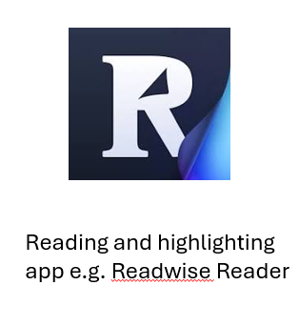
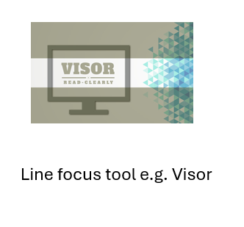
General workshop content Tools to support academic reading
Notes:
TTS – many options but NR works nearly anywhere. Free. Grown up looking interface. Useful for all. Available on all platforms and as mobile app – syncs easily. Online exams during covid
Visor – Chrome extension. V simple. Screen tinting and line focus

Slide 12




Tools to support academic writing process

Slide 13



Other tools
Basic advice on skilful and ethical use of AI chatbots
4. Other relevant tools depending on the group, e.g.
Note-making apps
Flashcard, quizzing and tutorial apps

Slide 14
BYDT Delivery 2024/5
Veterinary nursing
Electrical apprentices
Ag Science
Nursing
Hotel Management
Pharmacy Admin
Health and Leisure
Engineering
Event Management

Slide 15
Feedback
Mentimeter polls ‘The session was relevant and helpful to me’ – average score of 4.5
Repeat bookings from academic staff and requests for follow-on workshops for more senior groups
Show of hands – who has seen something new and useful? Usually 100%

Slide 16
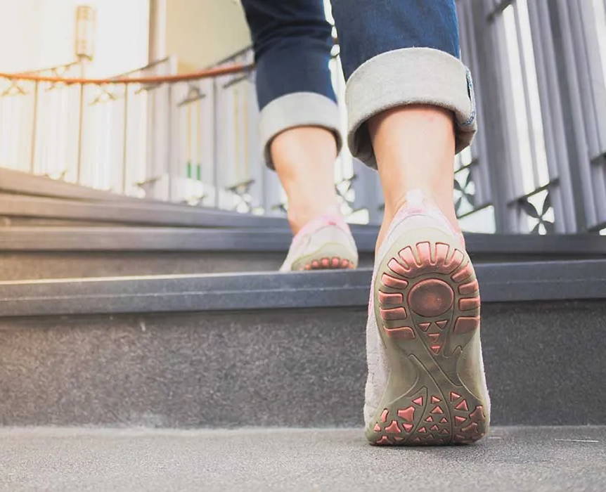
Next steps
CPD session for academic staff on talking to students about digital tools
Follow-on workshops for more senior students

Slide 17
Over to you...
Any questions/comments?
How do you provide guidance on digital tools?
Are there other key tools that you would include?

Slide 18
Contact me
Jane.Brennan@mtu.ie
087 9518369

