Slide 1


DAT Day at National Learning Network, Park House

Slide 2

Introduction
National Learning Network: Education and Training Division of Rehab Group
54 centres nationwide
Diverse student body
Culture of inclusivity and mutual respect
DAT Central: Rehab Group's Digital and Assistive Technology Service
Enables access to AT
3 categories of AT
6 functional areas

Slide 3
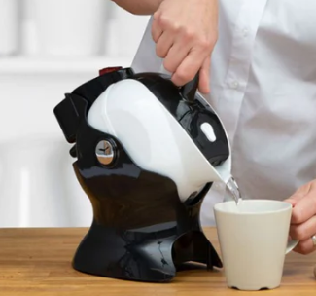
09:00 Morning Coffee
Tilt-to-pour kettle
James is blind and for safety reasons, often asked other students to make his morning coffee.
His goal was to have the same morning experience as others.

Slide 4

10:00 Retail Skills
Microsoft Accessibility Suite
Laura is a student on the Retail Skills course. Laura doesn’t write by hand and wanted to increase her typing speed while completing work.

Slide 5
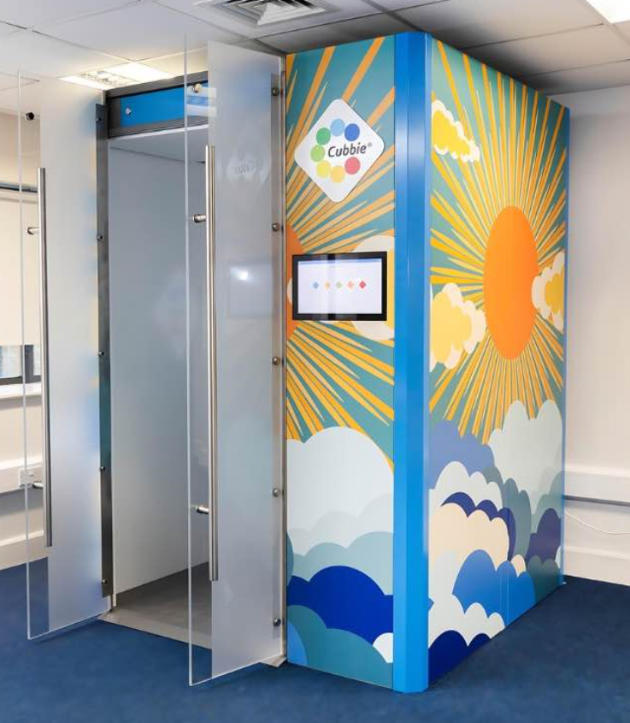
11:00 Sensory Break
Cubbie Sensory Pod
Luke has anxiety who often feels overwhelmed after a busy morning navigating unreliable public transport.

Slide 6
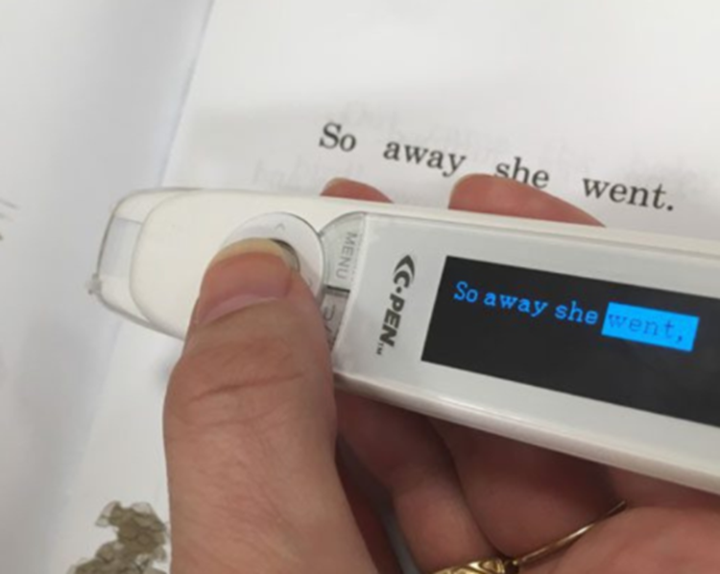
11:30 Horticulture
C-Pen
Emma is a student with Dyslexia who was finding it difficult to read, interpret and complete assignments independently.
She expressed an interest in Assistive Technology that would enable her to understand exam questions without the additional support from an instructor.

Slide 7
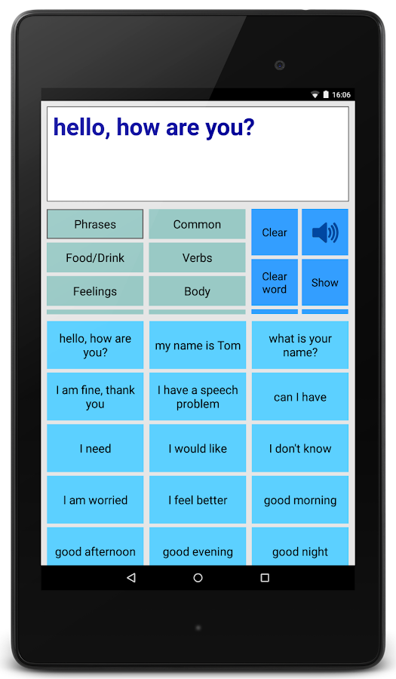
12:30 Lunchtime
Joe does use his voice to communicate but is not always fully understood by people who don’t know him very well.
He expressed an interest in something that would support him, like at lunchtime in a busy canteen.

Slide 8
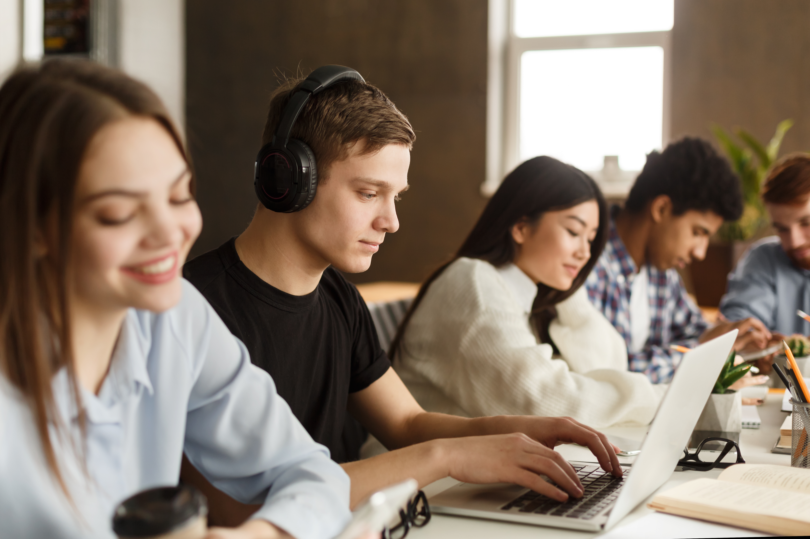
13:30 Artlink
Alex is a student on the Artlink course in Park House.
He often finds the classroom environment overwhelming and distracting. He asked if there were any supports available that could help him to self-regulate while in class.

Slide 9

14:30 Home
James, the student we met for his morning coffee, also wanted to be able to able to tell the time without having to ask someone else. He received a talking watch and can now keep track of the time throughout the day and make sure he gets his bus at the end of the day. This piece of AT also encouraged James’ independence.

Slide 10
Conclusion
Mainstream and assistive technologies can be used to:
Reduce barriers
Foster independence
Promote inclusion
Through multiple means of:
Engagement
Representation
Action and expression

