Slide 1

Assistive Technology for Dyslexia
Supporting Dyslexic Adults in Education and the Workplace
29th of May, 2025

Slide 2
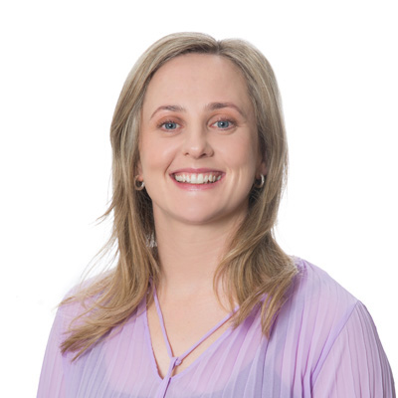

Your Presenters
Aoife is the
Adult Literacy Coordinator with Dyslexia Ireland
Caoimhe is Senior
Adult Dyslexia Coordinator
with Dyslexia Ireland
Aoife O’Leary
aoifeoleary@dyslexia.ie
Caoimhe O’Malley
comalley@dyslexia.ie

Slide 3

What kind of technology is helpful for dyslexic adults?

Slide 4
Is there a big difference between paid literacy software and the free inbuilt tools on most devices?

Slide 5
Why don’t Dyslexia Ireland recommend specific products or software for dyslexia?

Slide 6
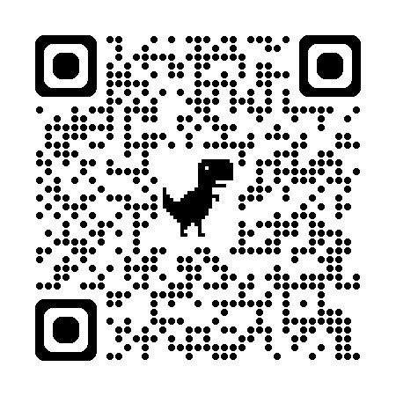
Are reading pens/C-Pens helpful?
Find your local library

Slide 7
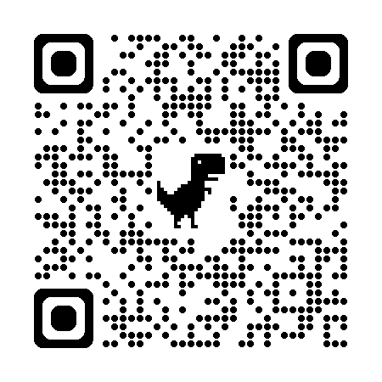
Does Dyslexia Ireland have AT resources?
Check out our
Adult Dyslexia Hub

Slide 8
Thank you
Questions and discussions

Slide 9





Connect with Dyslexia Ireland
@DyslexiaIreland
@DyslexiaIrelandDAI
Dys&Dat podcast
@dyslexia_Ireland
@dyslexiaireland

Slide 10

Dyslexia Ireland is 25%* funded by
* As of 2024 audited accounts
© Dyslexia Ireland (2025)

