Slide 1
speechless, but not voiceless
Fiacre Ryan

Slide 2
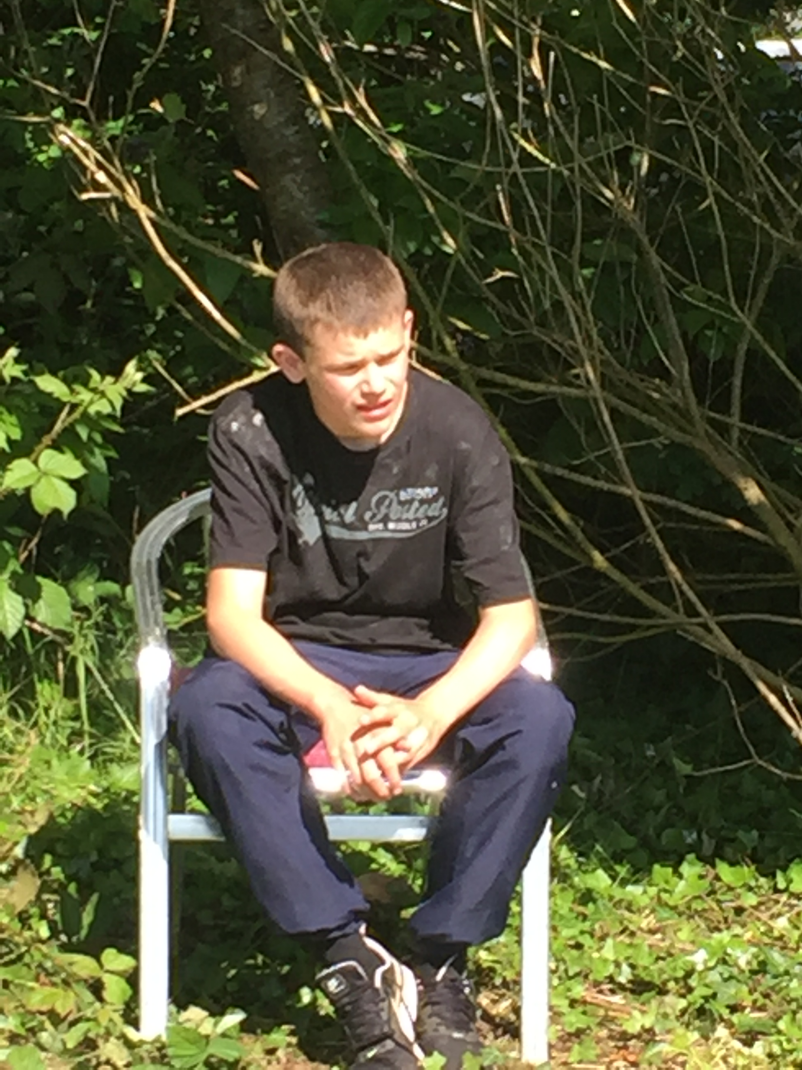
Introduction
“There once was a boy who tried to speak. No words joined him, so he stopped trying.”
Good morning everyone. My name is Fiacre Ryan, I am 23 years old and I come from Castlebar, Co. Mayo. I am a non-speaking autistic. I use an alphabet letterboard to communicate, and to articulate my thoughts.

Slide 3
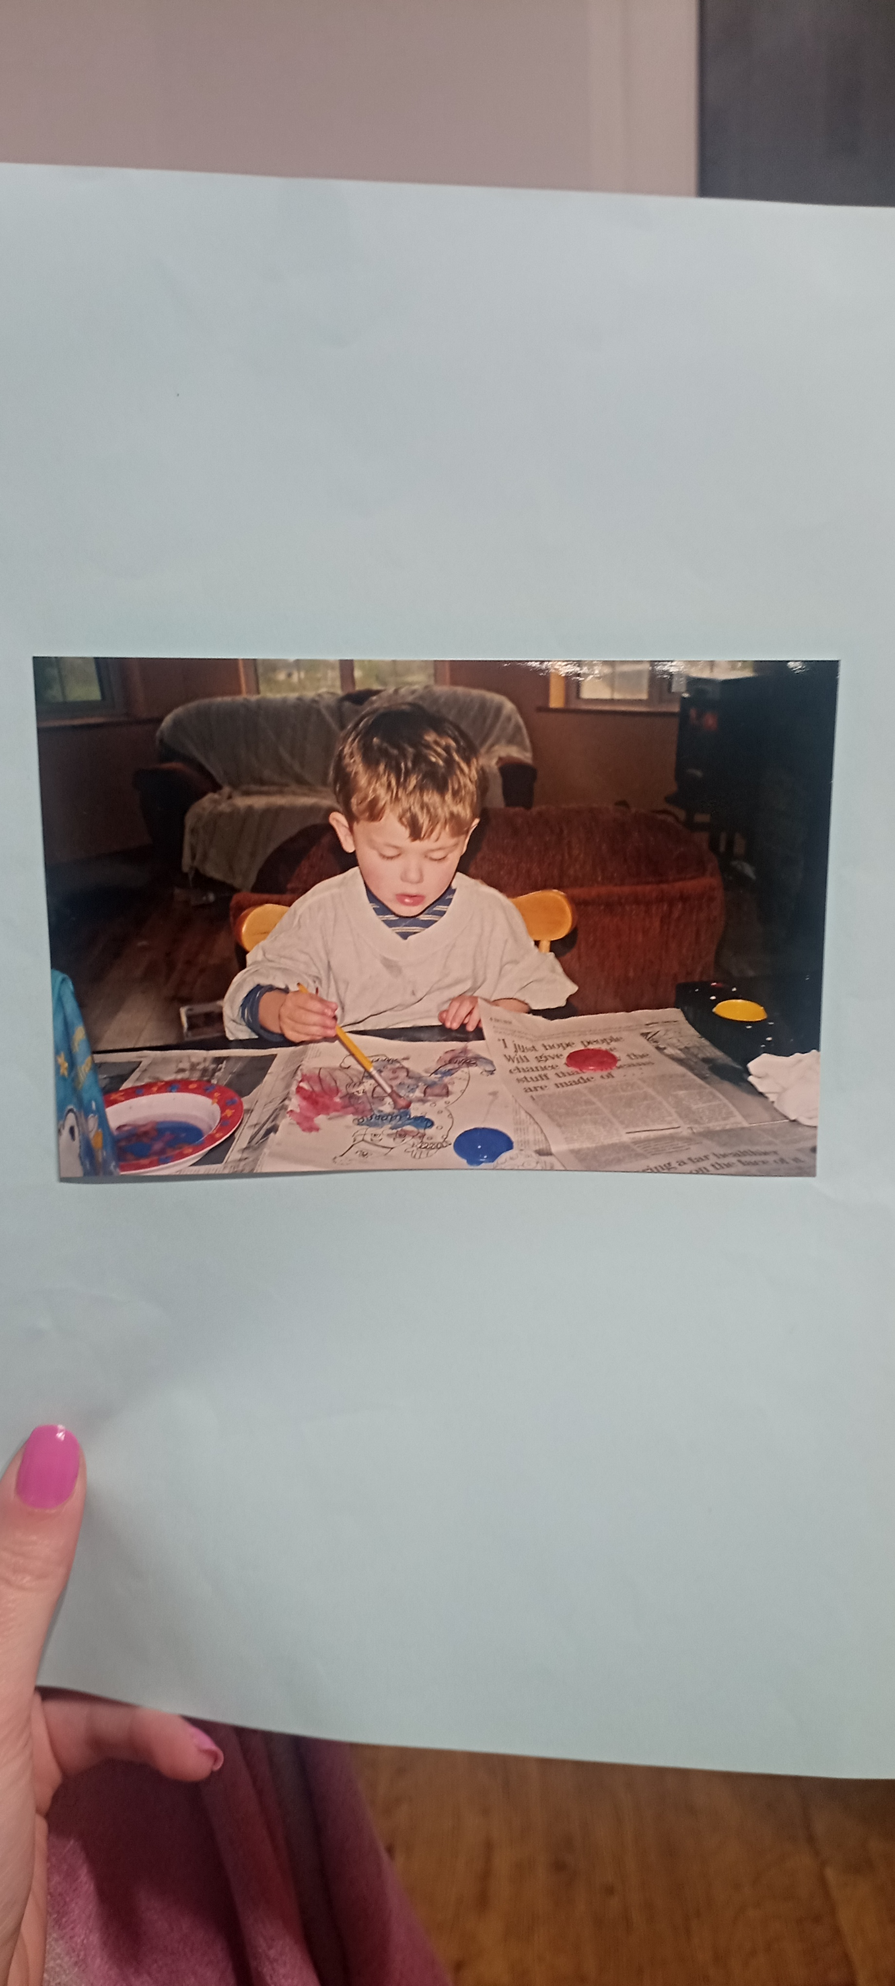
Early Education
I was diagnosed with autism when I was around 3 years of age, after my parents noticed that I was not speaking or socialising like my sisters, or other children the same age as me. After years of therapies and interventions my speech had still not developed and I was diagnosed with non- verbal autism, a mild to moderate learning disability, and ADHD.

Slide 4
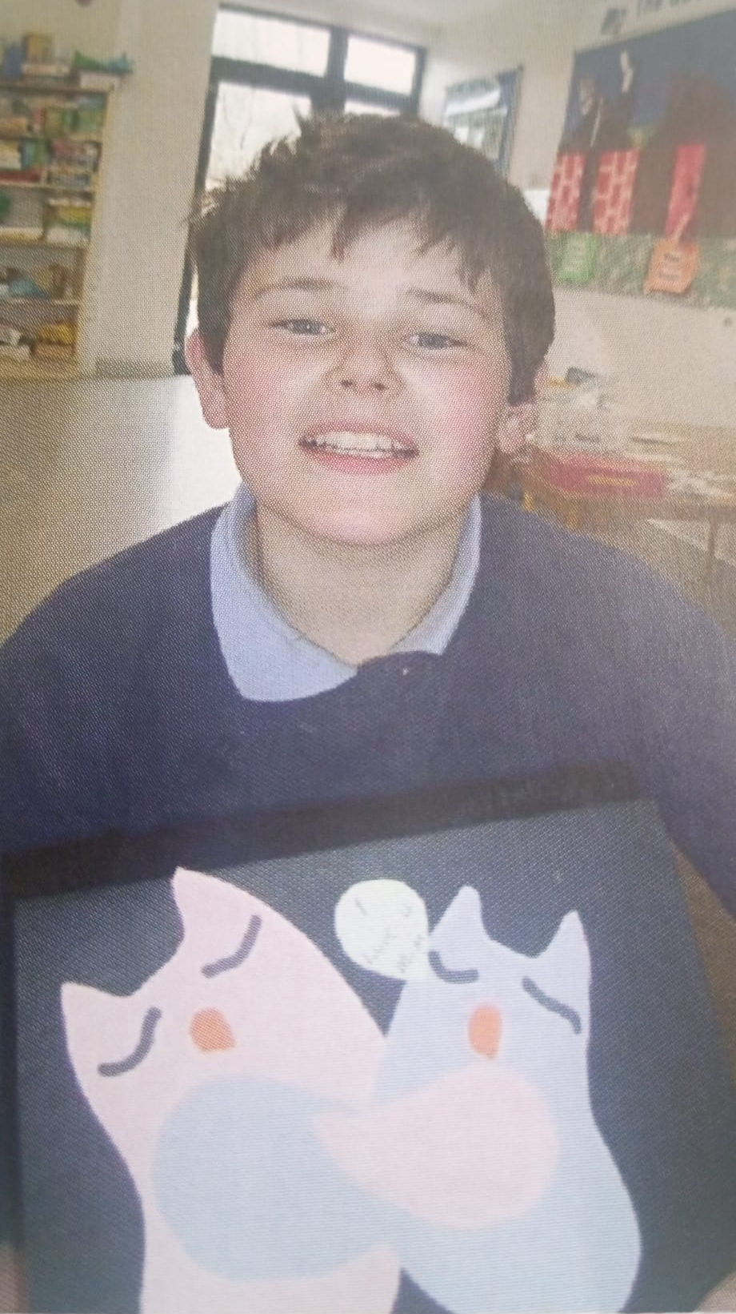
Primary School
“Education is about being taught, and I was steeped in knowledge. Teach us appropriately and everyone can learn”.
I attended a mainstream school about 10 kilometres from my home, in a small autism class. My teacher Bríd had endless patience, and she certainly needed it for me! She always believed that I was listening and learning, and included me in all the lessons, even when I was bouncing around on a therapy ball. However, I still had no way to show how much I knew.

Slide 5

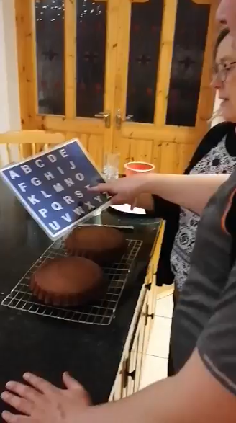
“My life is totally transformed since I learned to communicate”
I started letterboard training at 11 years of age, after many other therapies didn’t work for me. My parents and a group of other autism parents paid for a tutor to come to Ireland from the US, to work with 6 students and their families on a new method of communication RPM. It hasn’t been easy, with daily spelling practice and many obstacles to overcome, but it has been life changing for me and my family. I started to access age-appropriate lessons and enjoyed having books read aloud for me each evening.

Slide 6
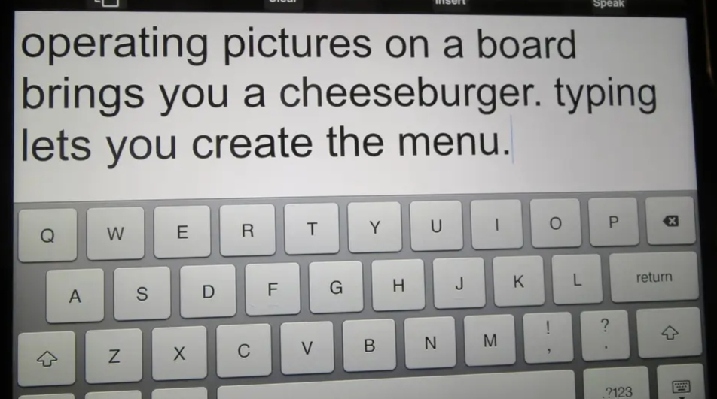
Difference with typing
I saw this image on social media, and it sums up the difference learning to type is making in my life. I am still learning to type independently, with one pointing finger, but I am slowly developing this skill with daily practice, generating my own text in my poetry and writing.

Slide 7
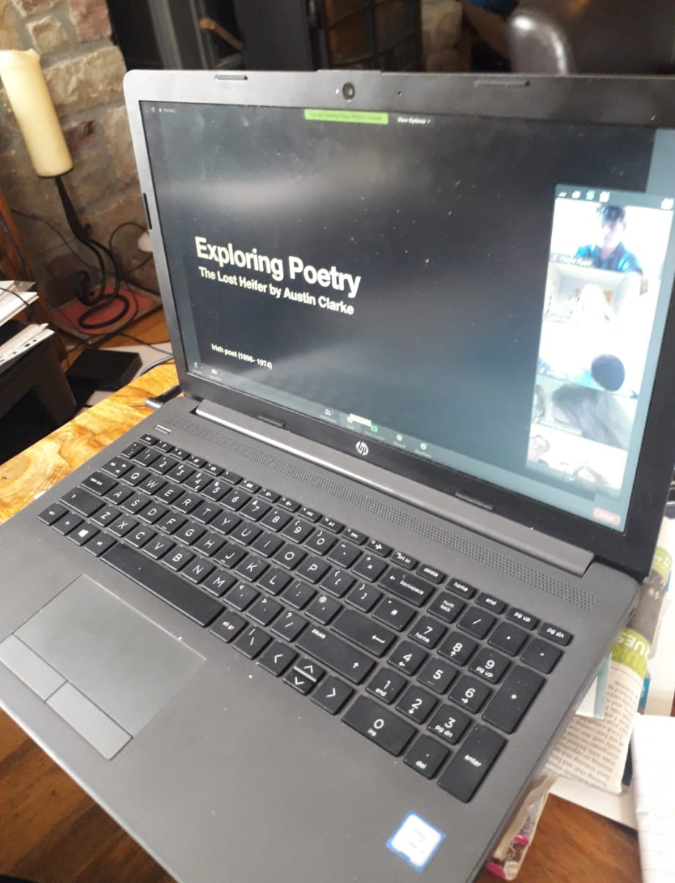
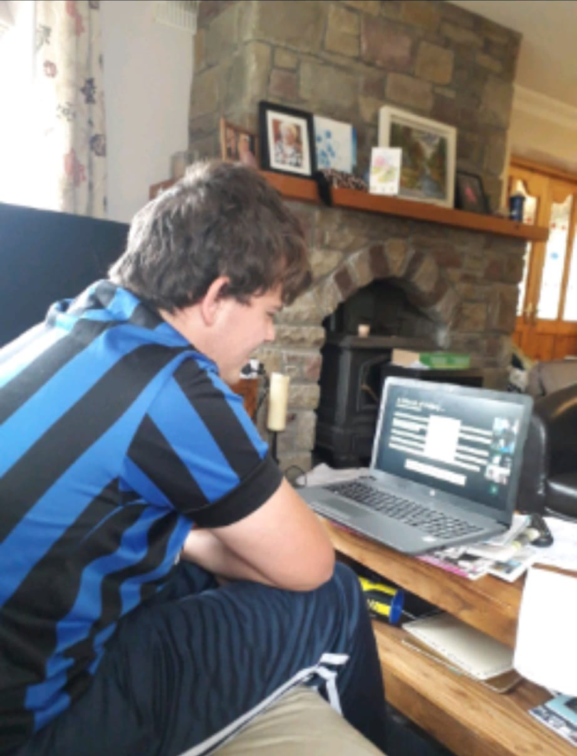
Learning to type

Slide 8
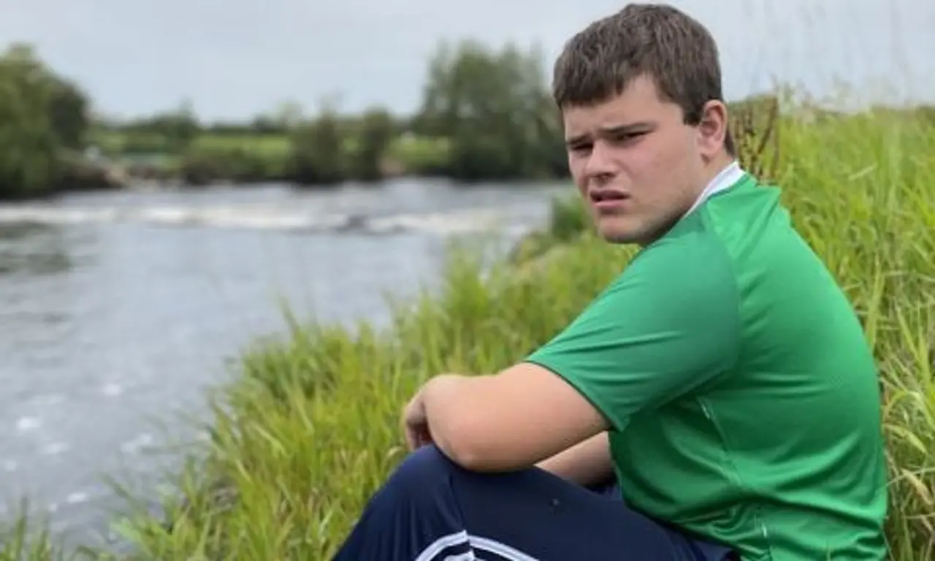
“Autistics like me do not usually stay in school”

Slide 9
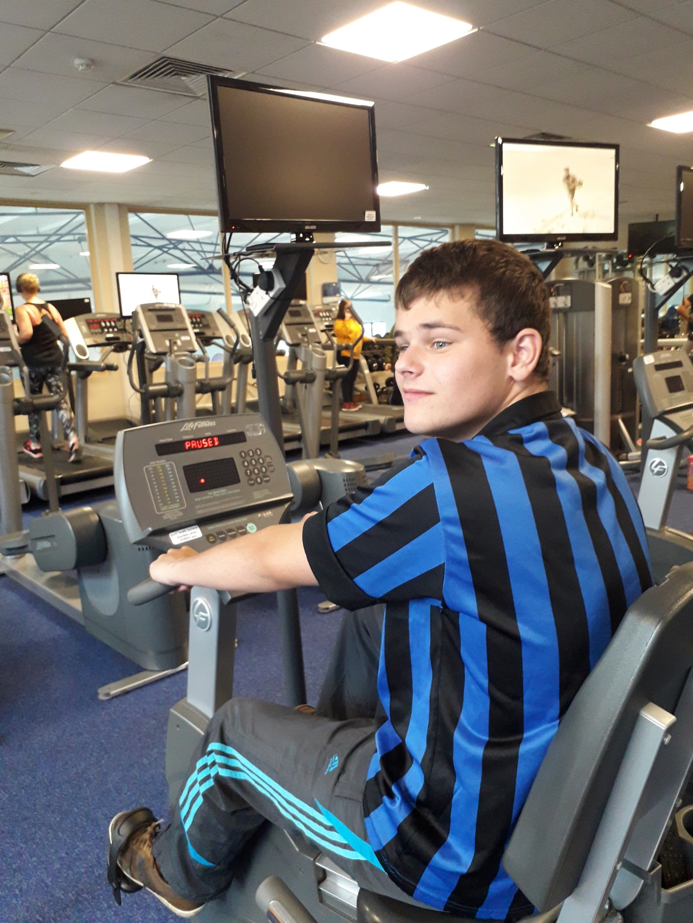
“Narrow minds behind wide doors”
In second level school, when I wanted to do state exams, my parents had to fight for my right to sit the exams.
I later successfully completed my Leaving Cert with the support of the exam accommodations of a reader and a scribe, the first non-speaking student in Ireland using a letterboard and AAC, an achievement that I am very proud of today.

Slide 10
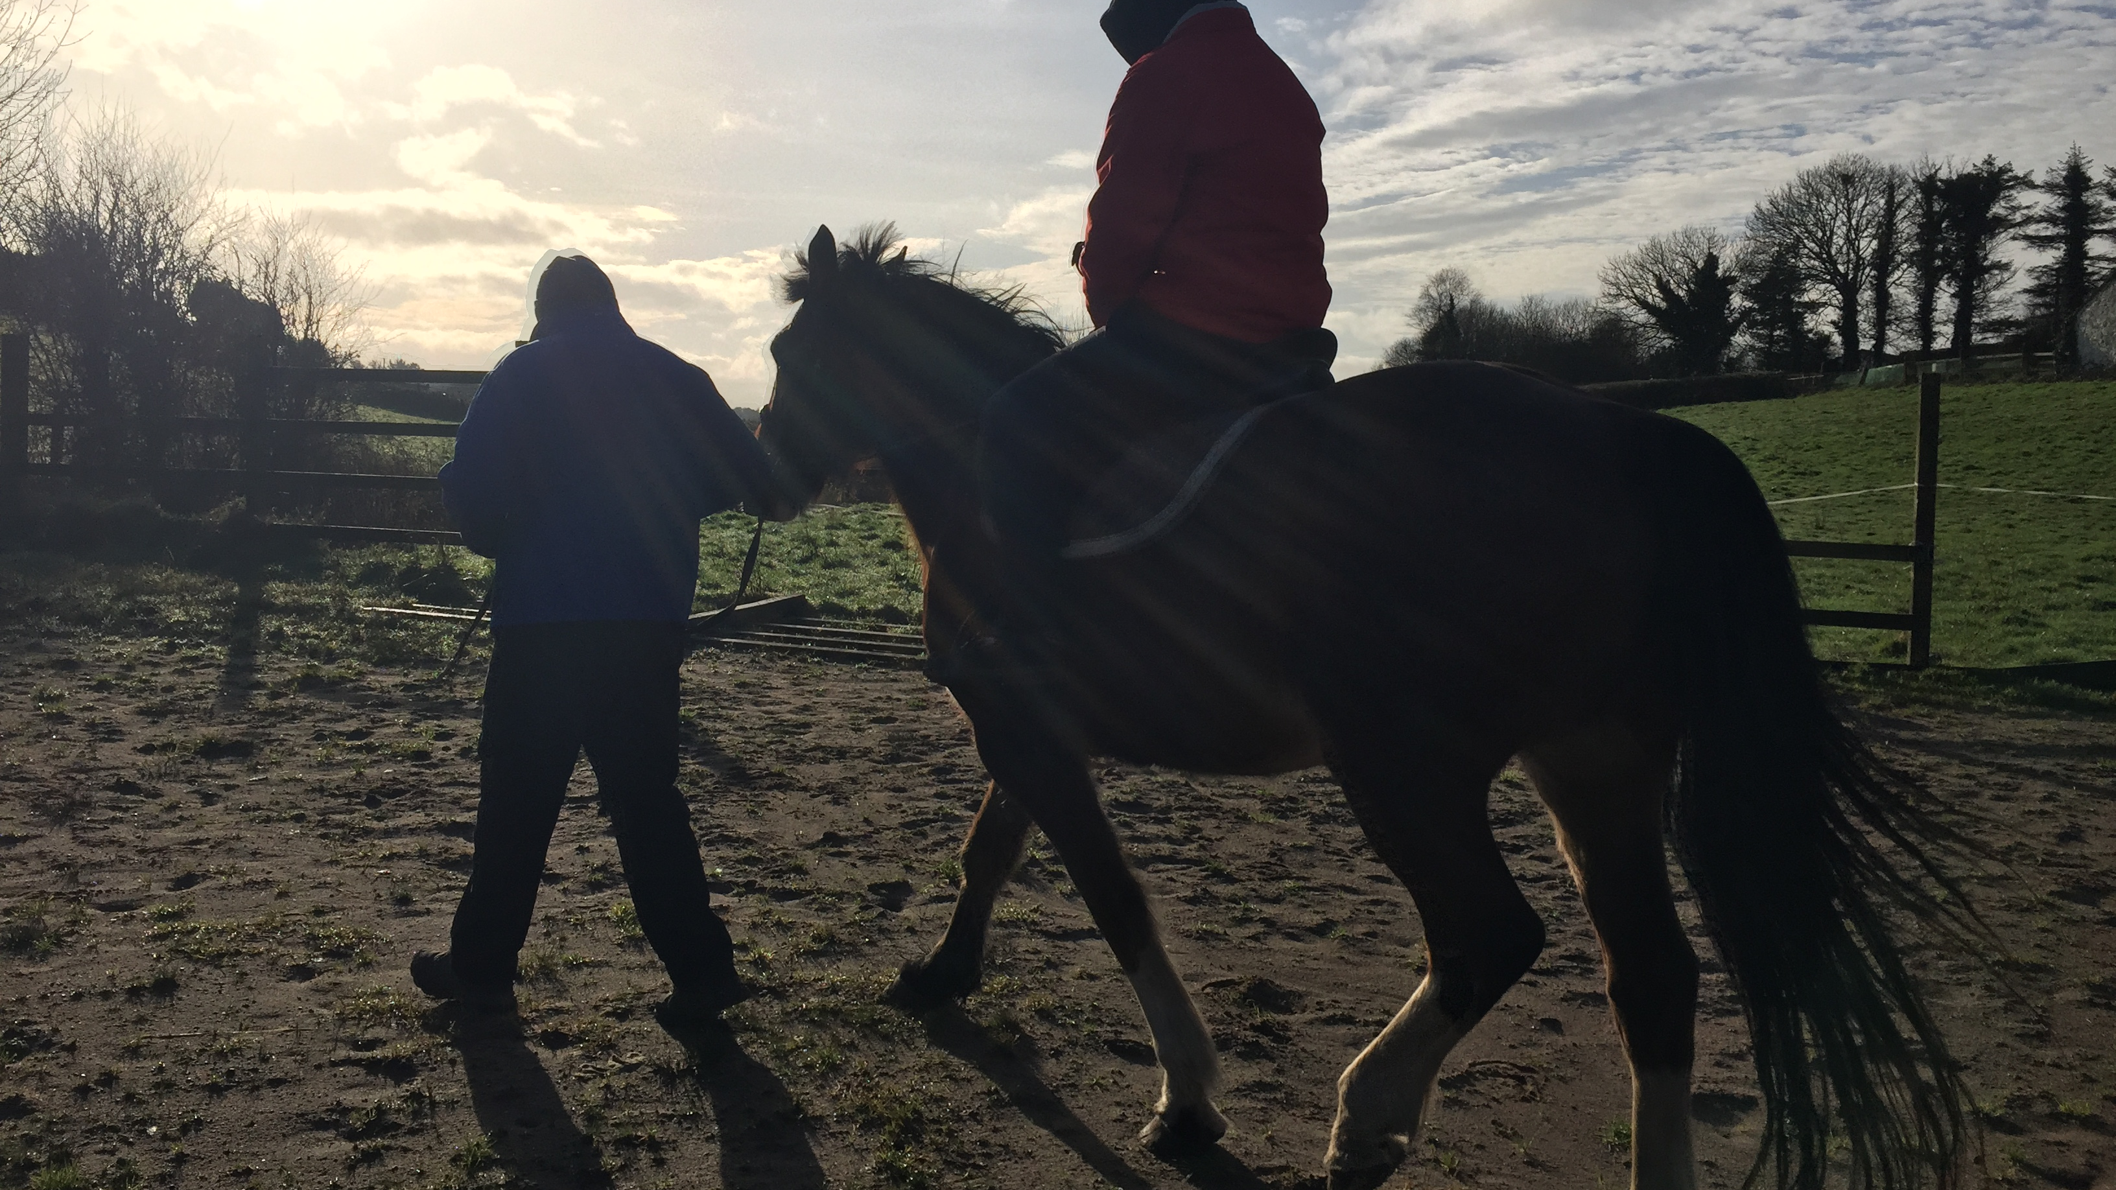
“I am challenged to fit into a world with no rest”

Slide 11
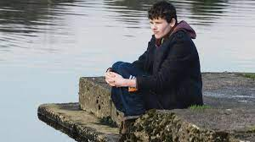
“BELIEVE THAT NATURE RESTORES MY WEARY SOUL”
I love being in nature, because there I can rest in just “being”. Nature is my friend, and I love walking on the beach, hiking, swimming and horse riding. My interests are the same as any teenager or young adult – going bowling or to the cinema, going to football matches, helping on the farm or in the garden, and listening to music.

Slide 12
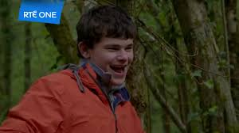
TV Documentary - Speechless
I was asked to take part in a fly on the wall documentary about living with autism, and this award winning programme was filmed over 8 years, which I scripted myself with my own writing and poems. It tells the story of our family and how we all cope in individual ways of living with autism.

Slide 13
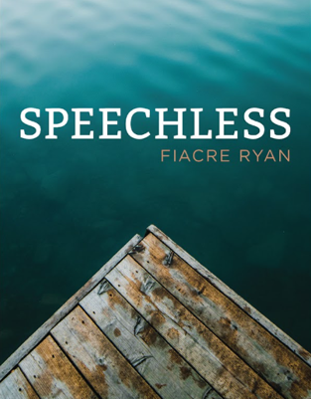
“A life ambition can be achieved, dare to dream”
My struggles, my hopes, dreams, challenges and ambitions are documented in the book “Speechless - Reflections from my Voiceless World”. I was asked by Merrion Press to write my life story, and my ambition was to communicate my intellect, my thoughts and my life reflections in my writing and poetry. My book “Speechless” was nominated for Best Newcomer at the An Post Irish Book Awards. I have continued my writing, with a poem highly commended in the Allingham Poetry competition and a winning short story in the Christopher Finnes UK Creative Writing Competition.

Slide 14
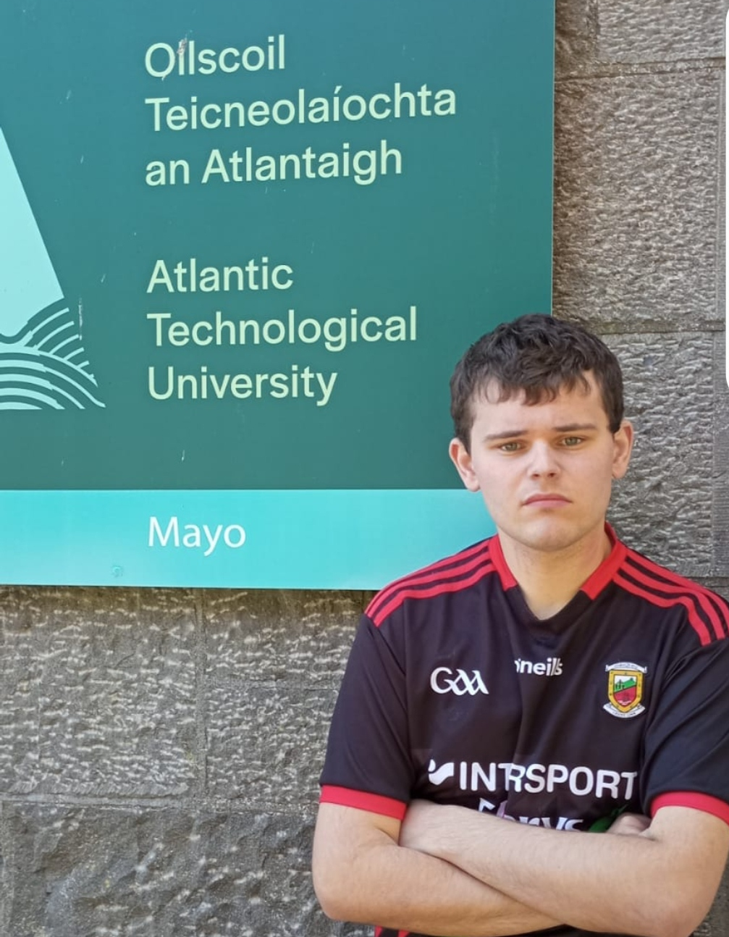
A new challenge – atu mayo
My pathway to third level education.
I applied to go to college after my Leaving Cert. The course of my choice was Creative Writing, and I was promptly refused, which turned out to be ironic when I became a published writer the following year! Meanwhile I heard about a special admission scheme in ATU Mayo in Castlebar. I had to show what I had studied and achieved, and then we discussed how I could access the course. I was thrilled to be offered a place on the History and Geography course. This produced a new set of challenges for me, but with supports I have just completed my certificate exams.

Slide 15
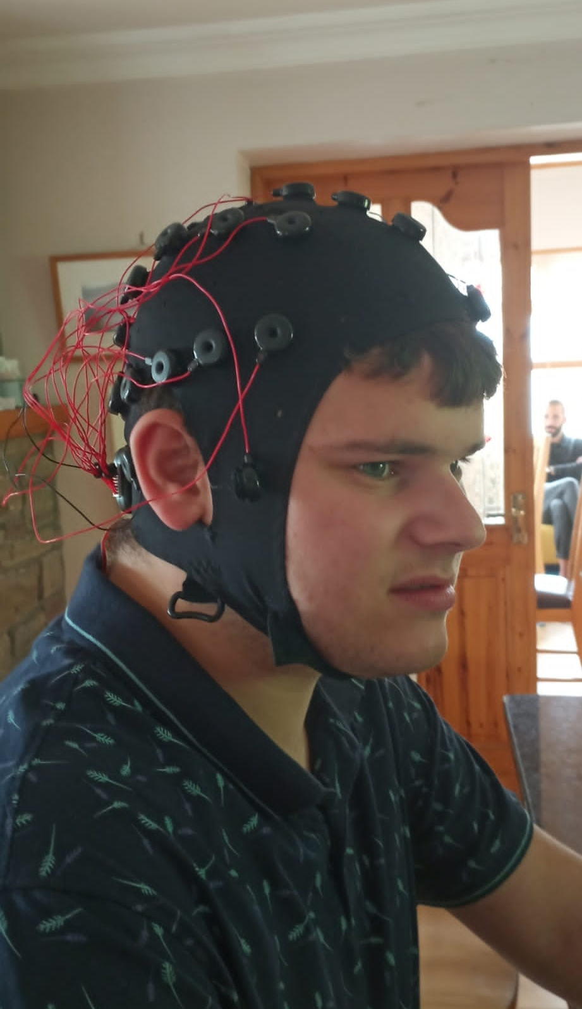
New Research on autism
There are a number of current research studies into autism using technology in new methods of assessment.
As you can see in the picture, I have taken part in a research study from Cambridge University (Hidden Cognitive Abilities in Non Speaking Autism) using brain imaging to measure language processing in non speaking autistic students. Dr. Alex Woolgar, lead researcher, has informed me that the study will be completed later this year, and a subsequent study using brain imaging to measure responses while listening to a podcast or audio is being developed.

Slide 16
- A message from Michael J. Fox, who has Parkinsons.
This message is so simple, yet it gets forgotten. The people living with the condition are the experts
– Michael j. fox

Slide 17
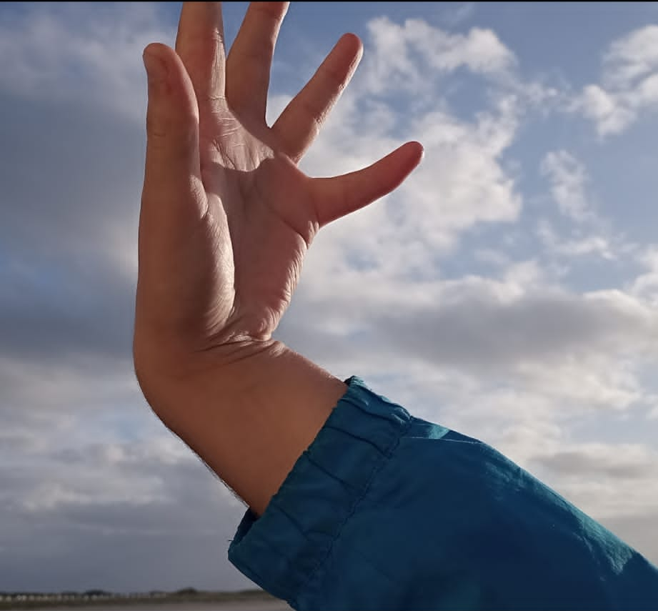
Thank you for listening, Fiacre Ryan AAC user.
I still have autism, but it no longer defines me. I am now defining my own life, changing attitudes O N E L E T T E R A T A T I M E.

