Slide 1


Trevor Boland
Assistive Technology
Officer
Trevor.Boland@DCU.ie

Slide 2
The AT Continuum:
The AT gaps and the AT maps that we need to consider so AT awareness is addressed.

Slide 3
Inclusion

Slide 4
Inclusion 2
Primary
Secondary
Tertiary

Slide 5



Accessibility and AT Drivers
EU Accessibility Directive - National Disability Authority (NDA)
Web Content Accessibility Guidelines(WCAG)
Universal Design for Learning (UDL)

Slide 6
Profile of Students in DCU DLSS (2024-25)
ADHD
Dyslexia
ASD
Mental Health
Illness
Dysgraph
Phys
Neuro
Hearing
S & L
Sight
367
167
163
148
123
87
73
45
31
20
5

Slide 7





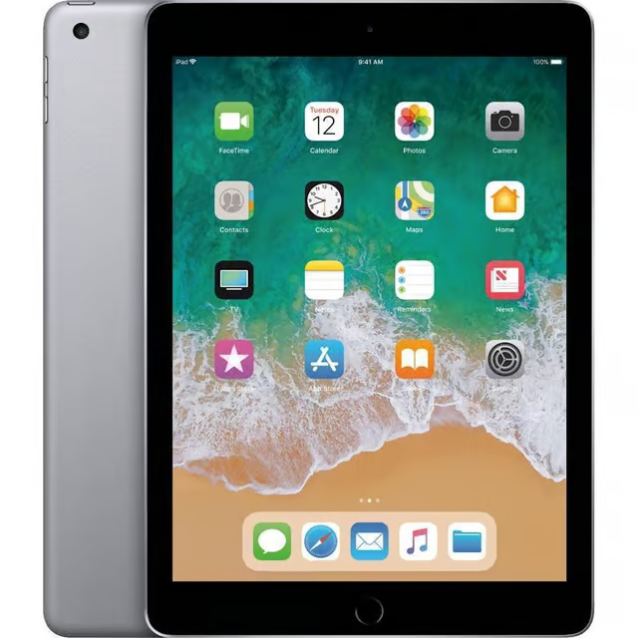



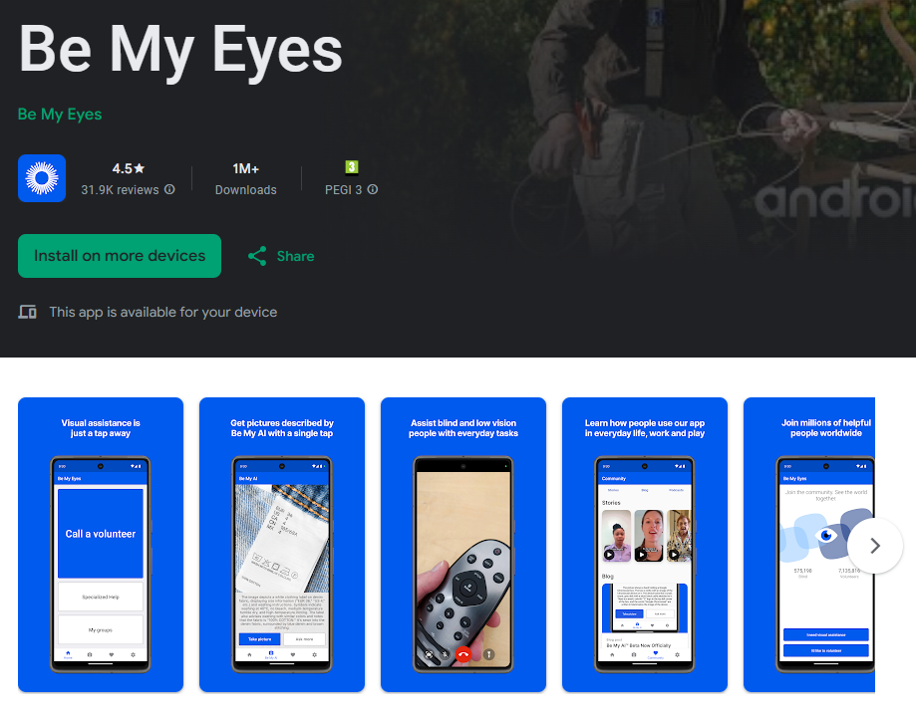


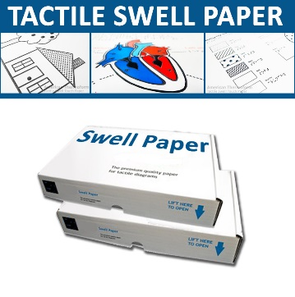
Our Blind/ VI students (Fictional)
Val
Low Vision
Aideen
Blind
Rogerio
Blind and
Autistic
Eric
Blind from birth
Justine
Blind and ADHD
iPad - no accessibility skills
Optiverso
multi skilled - Vision Ireland
Notes:
AT has come a long way from Egyptian times
As I read these examples I am remebering these types of students and the convesations

Slide 8
Groupwork
Aideen
Blind
Sharing a Document / Presentation.
An Accessible shared Document.
Who makes it accessible?
Where do students get the training?
Who delivers the training?
How do we embed Accessibility?
Notes:
AT has come a long way from Egyptian times
As I read these examples I am remebering these types of students and the convesations

Slide 9

Procurement
Aideen
Blind
Lengthy Procurement process
Agile student support vs procurement
Embedding of VPATS in process
Staff Awareness sessions
Who delivers the training?
How do we embed Accessibility?
Notes:
AT has come a long way from Egyptian times
As I read these examples I am remebering these types of students and the convesations

Slide 10

State Exams
Aideen
Blind
State exams - image exemption
Transition to HE - image exemption?
AT Support
AT in curriculum
AT awareness (Primary / Secondary)
How do we embed Accessibility?
Notes:
AT has come a long way from Egyptian times
As I read these examples I am remebering these types of students and the convesations

Slide 11
Today's session
The House of Accessibility
Keeping your Accessibility House in order.

Slide 12






HOUSE acronym
Headings and Structure – Laying out information
Ornamental or Description – Alt-Text for Images
URLs and Links – Creating links with descriptions
Sans Serif and Readability – Font considerations
Evaluate Accessibility – The Accessibility Checker

Slide 13

AT in Strategies?
More guidance and advice on pedagogical strategies for using assistive technology with learners who have special educational needs (SEN) and managing devices in the classroom for these learners with SEN rather than just focussing on tools was called for.
Notes:
AT has come a long way from Egyptian times
As I read these examples I am remebering these types of students and the convesations

Slide 14
Rubric - Embedding Accessibility
 | Component 1 | Component 1 | Component 1 | Component 1 | Component 1 | Component 1
GRADE | Gantt Chart | RACI & Risks | Budget | Scoping | Group | Accessibility
Minimum <50% | <60 individual task entries No hierarchy of tasks. Poor/no linking, low quality. Not aligned to other project elements (e.g. RACI). No owners/resources. Does not cover all phases, or phases are weak/missing. | <40 RACI elements Not aligned to elements of the Project Project Risk <500 Words or <6 Risks Risks focus on the Event and/or are not relevant to the project delivery. Risks have no rationale for the mitigation plan or no mitigation plan. No Analysis. | Poor granularity. No/low evidence/quotes and/or not dated. No/incorrect PERT. Use of zero-cost activities. Does not meet project criteria. | Word Count <900 Limited/unclear Rationale Obvious gaps. Doesn’t make sense, or not aligned to Project elements. No Analysis. Doesn’t make objective SMART and measurable. No proposed metrics or control. | Limited Trello usage. Presentation: No Branding. Limited project analysis/understanding. Obvious gaps. No graphics, copy and pasted images or text heavy. Focused on event, not project plan. Poor delivery. Graphics are not bespoke. | Headings Styles ALT Text in Visuals Appropriate links Accessible Tables Accessible Colours Accessible Font Accessible Lists
Median 50% to 65% | 60 – 120 Task Entries, correctly aligned to project delivery with logical hierarchy and subtask grouping. Linked tasks, milestones and resources. Minimal gaps. Some errors and/or padding/irrelevant tasks. High Quality overall that covers all phases of the project in detail. | 40 - 60 RACI Elements Documented Analysis. Loosey aligned to the Project Plan Elements. Project Risks 500 Words, 10 Key/Top Risks. Mitigation and Rationale Provided with some omissions. | Good granularity – covers most costs. Some omissions. Not all budget criteria is met. Evidence not dated and/or clear. PERT estimates are correct. Variable contingency accounted for. Evidence is tabulated in referenced Tabs in Excel. | Word Count 900-1200 Includes Detailed Rationale for what is in/out of scope. Covers most elements, with some omissions. Aligned to RACI for key legal and project responsibilities. Use of other PM methodologies (e.g. Fishbone, Stakeholder Analysis, etc.) for analysis and control. | Good Trello usage that covers all main tasks, with some gaps. Presentation: Uses Infographics & Graphs. Branded and aligned to charity. Clear Rationale. Can explain every decision. Professional delivery. Properly times with seamless handover. | Headings Styles ALT Text in Visuals Appropriate links Accessible Tables Accessible Colours Accessible Font Accessible Lists
High Quality 65% + | 120+ task entries As above plus: Flawless Planning (no errors or padding/irrelevant tasks) With linked tasks, milestones and resources Perfectly aligned to other Plan elements. Zero gaps in plan. Excellent Quality overall, every phase is detailed and present. | 60+ RACI Elements As above Plus: Fully Aligned to other Project Plan elements. Full Stakeholder Analysis done separately. Clear RACI Horizontal/Vertical Analysis. Project Risks 500+ Words, 10+ Key/Top Risks, Detailed Mitigation and Flawless Rationale Provided. Excellent Quality overall. | As above plus: Logical rationale provided for costs; detail/granularity is excellent. Estimates are quoted and dated and clearly appendixes. Clear Layout. Clearly aligned to other Plan elements. Excellent Quality overall. Rationale is provided for all elements, especially contingency. | Word Count 1200+ As above plus: Includes Detailed Rationale for every decision. Rationale is based in evidence. Noting omitted, all bases covered. Clearly aligned to other Plan elements. Excellent Quality overall. Varied & detailed use of other PM methodologies (e.g. Fishbone, Stakeholder Analysis) for analysis. | As above plus: Exceptional detail in the Trello, good use of tasks and management over life of assessment. Presentation: Professional Branding & Design. Tailored and Bespoke Graphics. Clear Rationale Flawless professional delivery. Excellent Quality overall. | Headings Styles ALT Text in Visuals Appropriate links Accessible Tables Accessible Colours Accessible Font Accessible Lists

Slide 15

Global Accessibility Awareness Day
Accessibility as a lifelong skill
Accessibility for the future workplace
Accessibility in your assignments
Accessible PhDs
Accessible Articles
Accessible Reports

Slide 16
Our Blind and VI students
Val
Low Vision
Aideen
Blind
Rogerio
Blind and
Autistic
Eric
Blind from birth
Justine
Blind and ADHD
iPad - no accessibility skills
Optiverso
multi skilled - Vision Ireland
Notes:
AT has come a long way from Egyptian times
As I read these examples I am remebering these types of students and the convesations

Slide 17


https://www.dcu.ie/students/house-accessibility

