Slide 1
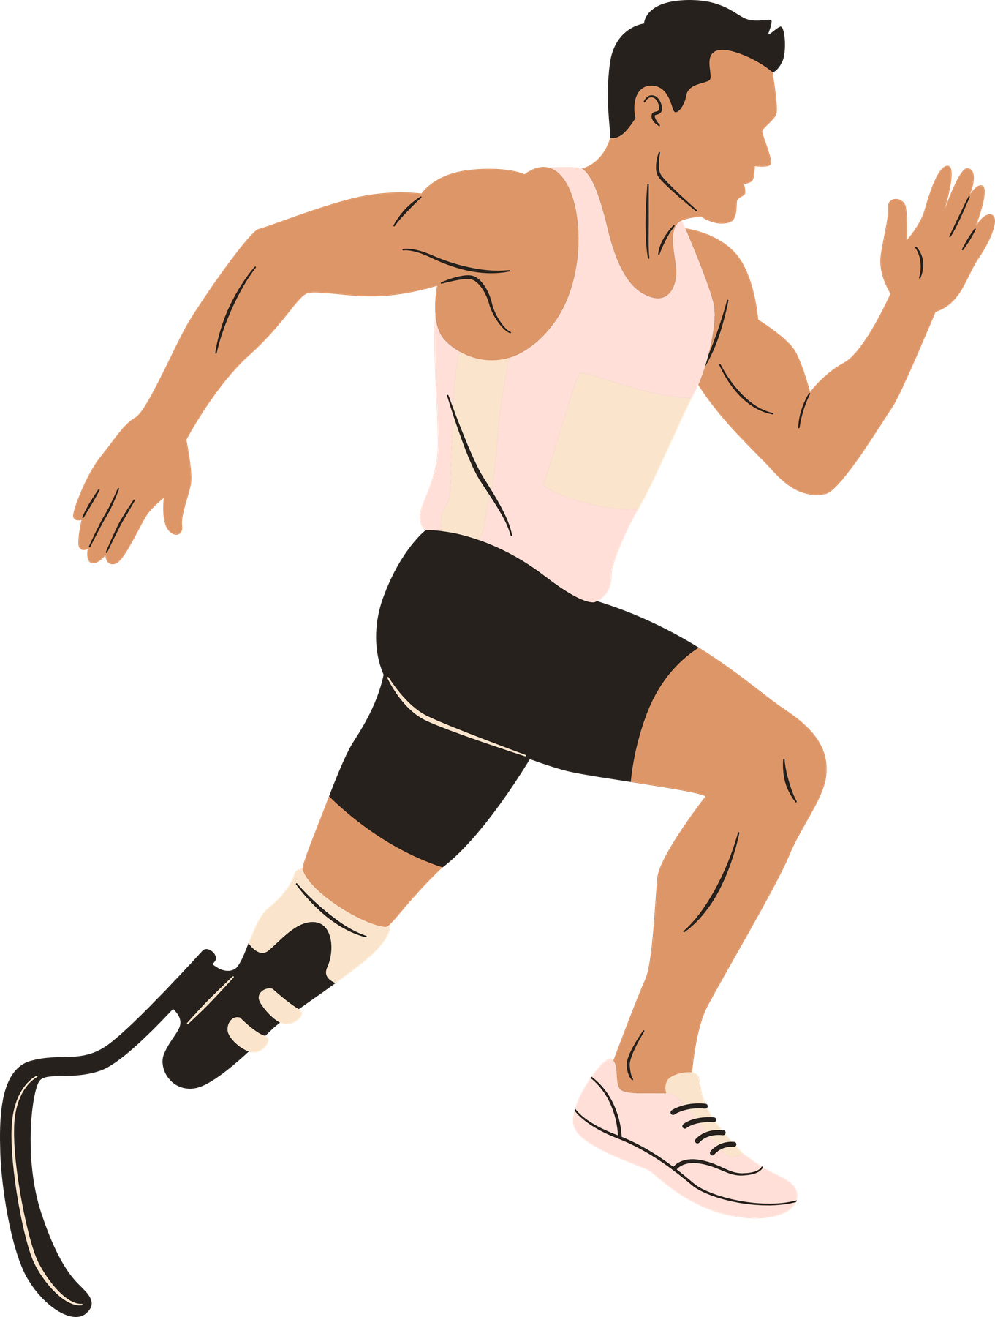

ASSISTIVE TECHNOLOGY & SPORT PARTICIPATION
The Role of Everyday Assistive Technology Supporting Sport Participation
Ana Geppert​
PhD Candidate
Maynooth University
Notes:
My Name is Ana Geppert and I am a PhD Student at Maynooth University and my research focuses on Assistive Technology & Sport Participation. ANd today I would like to talk about
The Role of Everyday Assistive Technology Supporting Sport Participation

Slide 2

AGENDA
01.
Introduction
02.
Defining the Scope
03.
Study 1: Survey of 50 Assistive Products
04.
Study 2: Policy Analysis
05.
Study 3: Photovoice – Lived Experiences
06.
Integrating the Three Studies
07.
Implications for Practice and Policy
08.
Conclusions

Slide 3

WHY SPORT MATTERS IN HIGHER EDUCATION & EMPLOYMENT
Sport is not separate from education or work — it can be a bridge between them.
Why we’re talking about sport
One of the most inclusive tools for engagement, skills development, and social mobility
Directly supports the goals of access, retention, wellbeing, and employability
Sport and education
Opens access for underrepresented students
Builds belonging, motivation, and retention
Supports holistic development: wellbeing, confidence, resilience
Sport and employability
Develops core graduate skills:
leadership • teamwork • discipline • resilience • accountability
Provides experiences of responsibility and professional behaviour
Opens employment pathways (coaching, health, data, marketing, events, community)
Notes:
Just before we get into it I would like to tlak about Why are we talking about sport in a conference about higher education and access to employment?
Importance of engagement in Sport:
- Whether they are in higher education
-Whether they are living in a community
Sport matters to educational environments/setting and to students and why it matters to develop skills for employment.
Tying together sport with education and employment.

Slide 4
INTRODUCTION
Everyday assistive technology (AT) is foundational to inclusive sport participation, yet it’s often invisible in policy, research, and public imagination.
Physical, mental, and social benefits of Sport
Participation rates remain low due to barriers, stigma, and limited access
Everyday AT is a key facilitator but overlooked
Notes:
As we’ve just heard, spatial accessibility is a precondition for participation — but it is not, in itself, a guarantee of participation.
Even when facilities meet formal accessibility standards, many people with disabilities still experience difficulties engaging in sport.
These difficulties are often linked to assistive technology: whether appropriate equipment is available, whether it fits the activity context, and whether users feel supported — socially and institutionally — in using it.
In this sense, assistive technologies are not simply technical devices. They operate within social relationships, organisational routines, and expectations about who belongs in sporting spaces.

Slide 5
DEFINING THE SCOPE
Broad definition of sport: Intentional physical activity at all levels—recreational, community, non‑elite.
What counts as “everyday assistive technology”:
Not just specialized sport equipment.
Includes mobility devices, communication tools, environmental controls, personal care tech, transport aids, etc.
Why “everyday” matters: These technologies shape the entire participation journey, not just performance.
Notes:
As we’ve just heard, spatial accessibility is a precondition for participation — but it is not, in itself, a guarantee of participation.
Even when facilities meet formal accessibility standards, many people with disabilities still experience difficulties engaging in sport.
These difficulties are often linked to assistive technology: whether appropriate equipment is available, whether it fits the activity context, and whether users feel supported — socially and institutionally — in using it.
In this sense, assistive technologies are not simply technical devices. They operate within social relationships, organisational routines, and expectations about who belongs in sporting spaces.

Slide 6


Intro to Study 1
STUDY 1
SURVEY OF 50
ASSISTIVE PRODUCTS
Everyday AT often determines whether participation is possible at all
Notes:
To address these questions, we deliberately adopted a participatory research approach, inspired by the framework of the International Collaboration for Participatory Health Research.
Participatory research understands participation not as a method, but as a research paradigm — one that challenges traditional hierarchies of knowledge and recognises lived experience as a legitimate and necessary form of evidence.
This is particularly relevant in disability research, where experts often define problems and solutions without fully understanding everyday realities.

Slide 7

SURVEY OF 50 ASSISTIVE PRODUCTS
STUDY 1
Purpose: To map how everyday AT supports participation before, during, and after sport.
Key findings structured around the participation timeline:
Before sport:
Travel and transport (wheelchairs, ramps, etc).
During sport:
Communication devices for coaching and teamwork.
Stability, mobility, and safety supports.
Sensory aids facilitating engagement.
After sport:
Recovery supports (pressure relief mattress).
Hygiene and changing aids (chairs for shower/bath/toilet)
Notes:
To address these questions, we deliberately adopted a participatory research approach, inspired by the framework of the International Collaboration for Participatory Health Research.
Participatory research understands participation not as a method, but as a research paradigm — one that challenges traditional hierarchies of knowledge and recognises lived experience as a legitimate and necessary form of evidence.
This is particularly relevant in disability research, where experts often define problems and solutions without fully understanding everyday realities.

Slide 8

POLICY ANALYSIS
STUDY 2
Purpose: How rights‑based frameworks shape access to AT.
UN Convention on the Rights of Persons with Disabilities (CRPD):
Emphasizes participation, inclusion, and access to enabling technologies.
Frames AT as a right, not a luxury.
National AT policies:
Variation in funding, provision timelines, and eligibility.
Delays or gaps in provision directly limit sport participation.
Policies rarely mention sport explicitly, but they shape the conditions for participation.
Policy implementation determines whether everyday AT is available when needed—making it a structural factor in inclusive sport.
Notes:
How rights based frameworks shape access to AT.
• UN Convention on the Rights of Persons with Disabilities (CRPD):
o Emphasizes participation, inclusion, and access to enabling technologies.
o Frames AT as a right, not a luxury.
• National AT policies:
o Variation in funding, provision timelines, and eligibility.
o Delays or gaps in provision directly limit sport participation.
o Policies rarely mention sport explicitly, but they shape the conditions for participation.
• Takeaway: Policy implementation determines whether everyday AT is available when needed—making it a structural factor in inclusive sport.

Slide 9
LIVED EXPERIENCES:
PHOTOVOICE
STUDY 3
Method
Participants use photography to document how AT supports their sport participation.
Themes emerging from user perspectives
AT as empowerment and independence.
AT as a social connector—allowing communication, belonging, and team identity.
AT as a barrier when unavailable, unreliable, or poorly designed.
Creativity and adaptation: users repurpose everyday tech in innovative ways.
Why Photovoice matters
Centers user expertise.
Highlights the emotional and relational dimensions of AT.
Makes invisible supports visible.
Notes:
Methodologically, we work with a range of participatory methods, but today I am going to be speaking about our experience with Photovoice, a participatory approach in which participants photograph situations that represent their experiences — in our case, experiences of sport participation involving assistive technology.
Participants then discuss these photographs in in depth interviews, allowing them to define what is important, what enables participation, and what constrains it.
In addition, our project is supported by an advisory board consisting of disability sport organisations and persons with disabilities, helping us to reflect on power relations, relevance, and ethical responsibilities throughout the research process.

Slide 10
INTEGRATING THE THREE STUDIES
Synthesis
Survey → shows the breadth of everyday AT across the participation journey.
Policy analysis → shows the structural conditions that facilitate or restrict access.
Photovoice → shows lived realities and user-defined priorities.
Everyday AT is not peripheral—it is foundational to inclusive, sustainable sport participation worldwide.
Notes:
Video Reflections:
This account highlights several aspects that are difficult to capture through expert assessments or standardised instruments alone.
First, it shows that assistive technology cannot be evaluated independently of context. The same device may enable participation in one situation and restrict it in another.
Second, assistive technology emerges here as something relational — shaped by interactions with coaches, peers, institutions, and physical environments.
Finally, the video illustrates the added value of participatory research: it allows experiences to surface that might otherwise be considered too subjective, too complex, or too marginal — yet are crucial for understanding participation.

Slide 11
IMPLICATIONS FOR PRACTICE AND POLICY
For sport organizations:
Recognize everyday AT as part of the sport ecosystem.
Improve venue accessibility, communication systems, and staff training.
Include AT considerations in program design.
For policymakers:
Ensure timely, equitable AT provision.
Align national policies with CRPD commitments.
Expand definitions of sport-related AT beyond specialized equipment.
For researchers:
Broaden focus beyond elite sport technologies.
Use participatory methods to capture user expertise.
Notes:
At the same time, participatory research is not without limitations.
Participation does not automatically eliminate power asymmetries, nor can individual experiences be taken as representative of all assistive technology users.
Methods like Photovoice also raise questions about interpretation, visibility, and whose perspectives ultimately inform policy or practice.
In this sense, participatory research does not resolve tensions — but, as the symposium contributions together show, it makes these tensions visible and open to critical reflection.

Slide 12
CONCLUSIONS
Everyday assistive technology is the backbone of inclusive sport participation.
Call to action:
Recognize it.
Fund it.
Integrate it.
Listen to the people who use it.
When everyday AT is visible and supported, sport becomes accessible—not just for some, but for everyone.
Notes:
To conclude, our study underscores three key points:
First, assistive technology plays a central role in enabling equitable access to sport beyond elite contexts.
Second, participatory approaches are essential for understanding how participation actually works in everyday life.
And third, lived experience should be understood as strengthening — not weakening — the methodological rigor of participatory action research.
Together with the other contributions in this symposium, we hope to advance a more reflexive, inclusive, and practice relevant approach to participatory research in adapted physical activity.

Slide 13

PHOTOVOICE
STUDY
We are still looking for Participants for our
If you are interested:
Scan the QR code or reach out to
ana.geppert.2023@mumail.ie
Notes:
Thank you for your attention

