Slide 1
Normalising Assistive Technology Through Community-Based Digital Inclusion
Presenter: Ashling Johnston
Organisation: An Cosán
Format: 15-minute Lightning Session

Slide 2
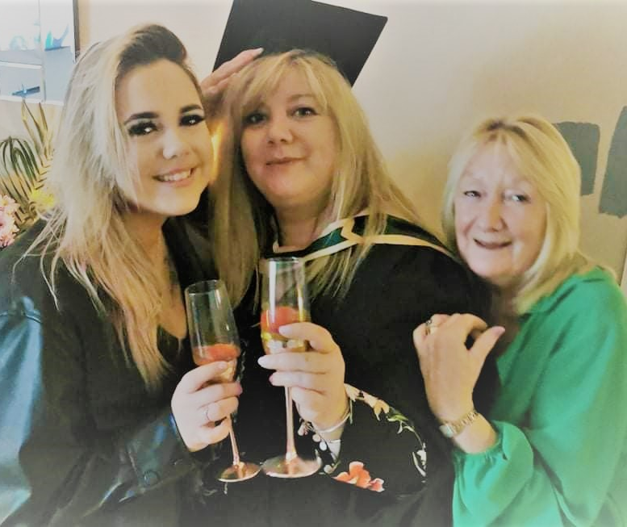
Ashling Johnston
Digital Skills Tutor @ An Cosán
Digital Skills Tutor An Cosán and Adult Learner
Bachelor of Arts (B.A.) in Anthropology and Sociology
Higher Diploma (HDip.) in Adult and Further Education
Masters (M.Ed) in Adult and Community Education
Qualifications in:
Business Admin and IT
Plain Language Communication
Universal Design for Learning
Joined An Cosán in 2018 and facilitated, ELC level 5 &6 WP L 5 and Spreadsheets L5

Slide 3
What is assistive technology?
Assistive Technology is not just specialist equipment
it includes the everyday digital tools already available on our phones, tablets and laptops that help people participate in education, work and community life.

Slide 4
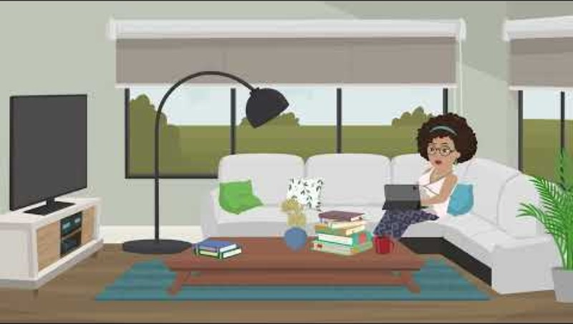
Assistive Technology through a digital inclusion lens.
When we think of Assistive Technology, we often think of specialist tools.
But many learners are already using AT in their everyday activities, sometimes without even realising it.
This short animation from our Get Yourself Online module shows what this can look like in practice.
Identifying Needs & Technological Responses - Get Yourself Online

Slide 5
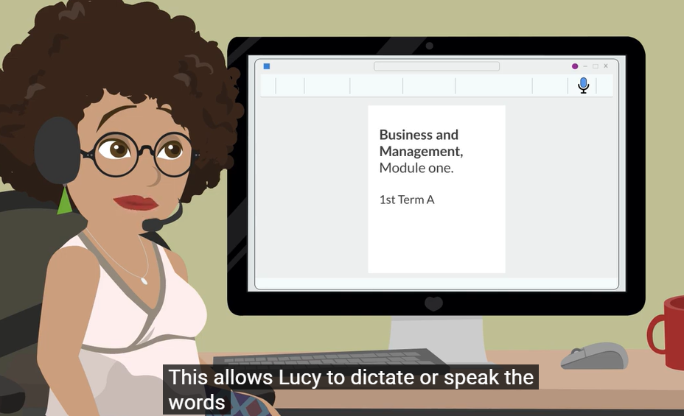
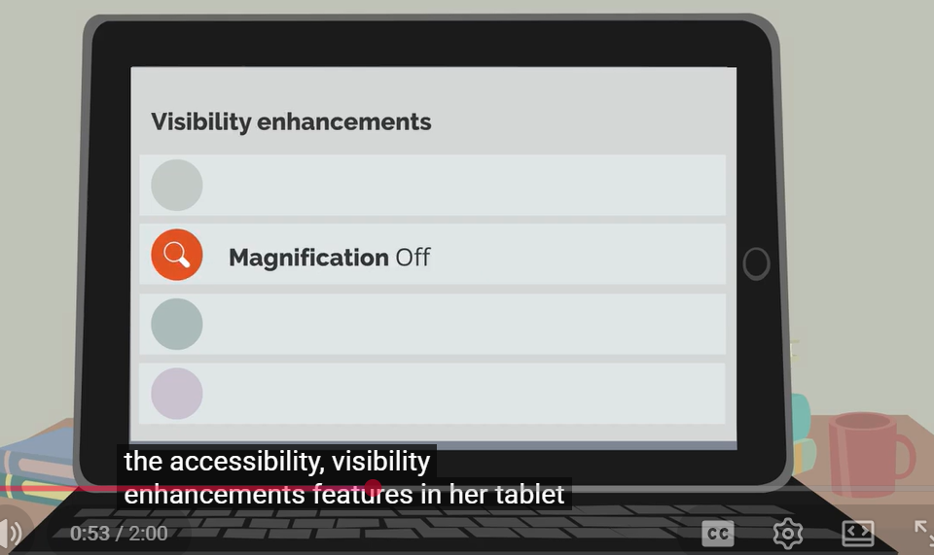
Lucy Case Study
Lucy is not using highly specialised technology.
She is using built-in tools already available on mainstream devices:
captions, dictation, magnification and text-to-speech.
These small supports can have a huge impact on confidence, participation and learner success.

Slide 6
These are not add-ons - they are essential supports for participation.

Slide 7
Types of Support
Captions → support comprehension
Zoom → support visual access
Text-to-speech → support literacy
Dictation → support writing

Slide 8
An Cosán’s digital inclusion approach

Slide 9
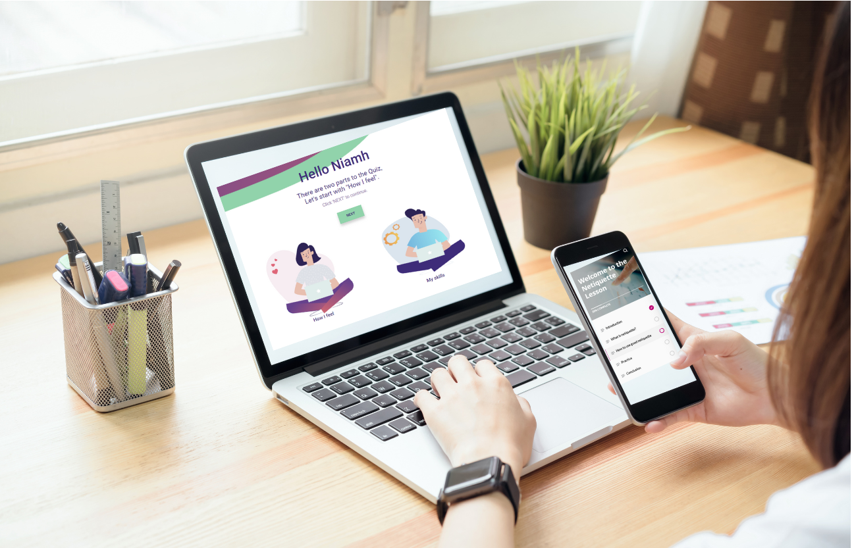
An Cosán’s approach
help people identify their needs
build confidence to use these tools in meaningful ways to participate in education, employment and community life.
Learners as co-creators and peer supports
Encourage dialogue, trust and shared learning
Co Designed with, not for…
Embed digital literacy (assistive technology) supports into curriculum planning and development from the start (Access Further and Higher Ed)

Slide 10
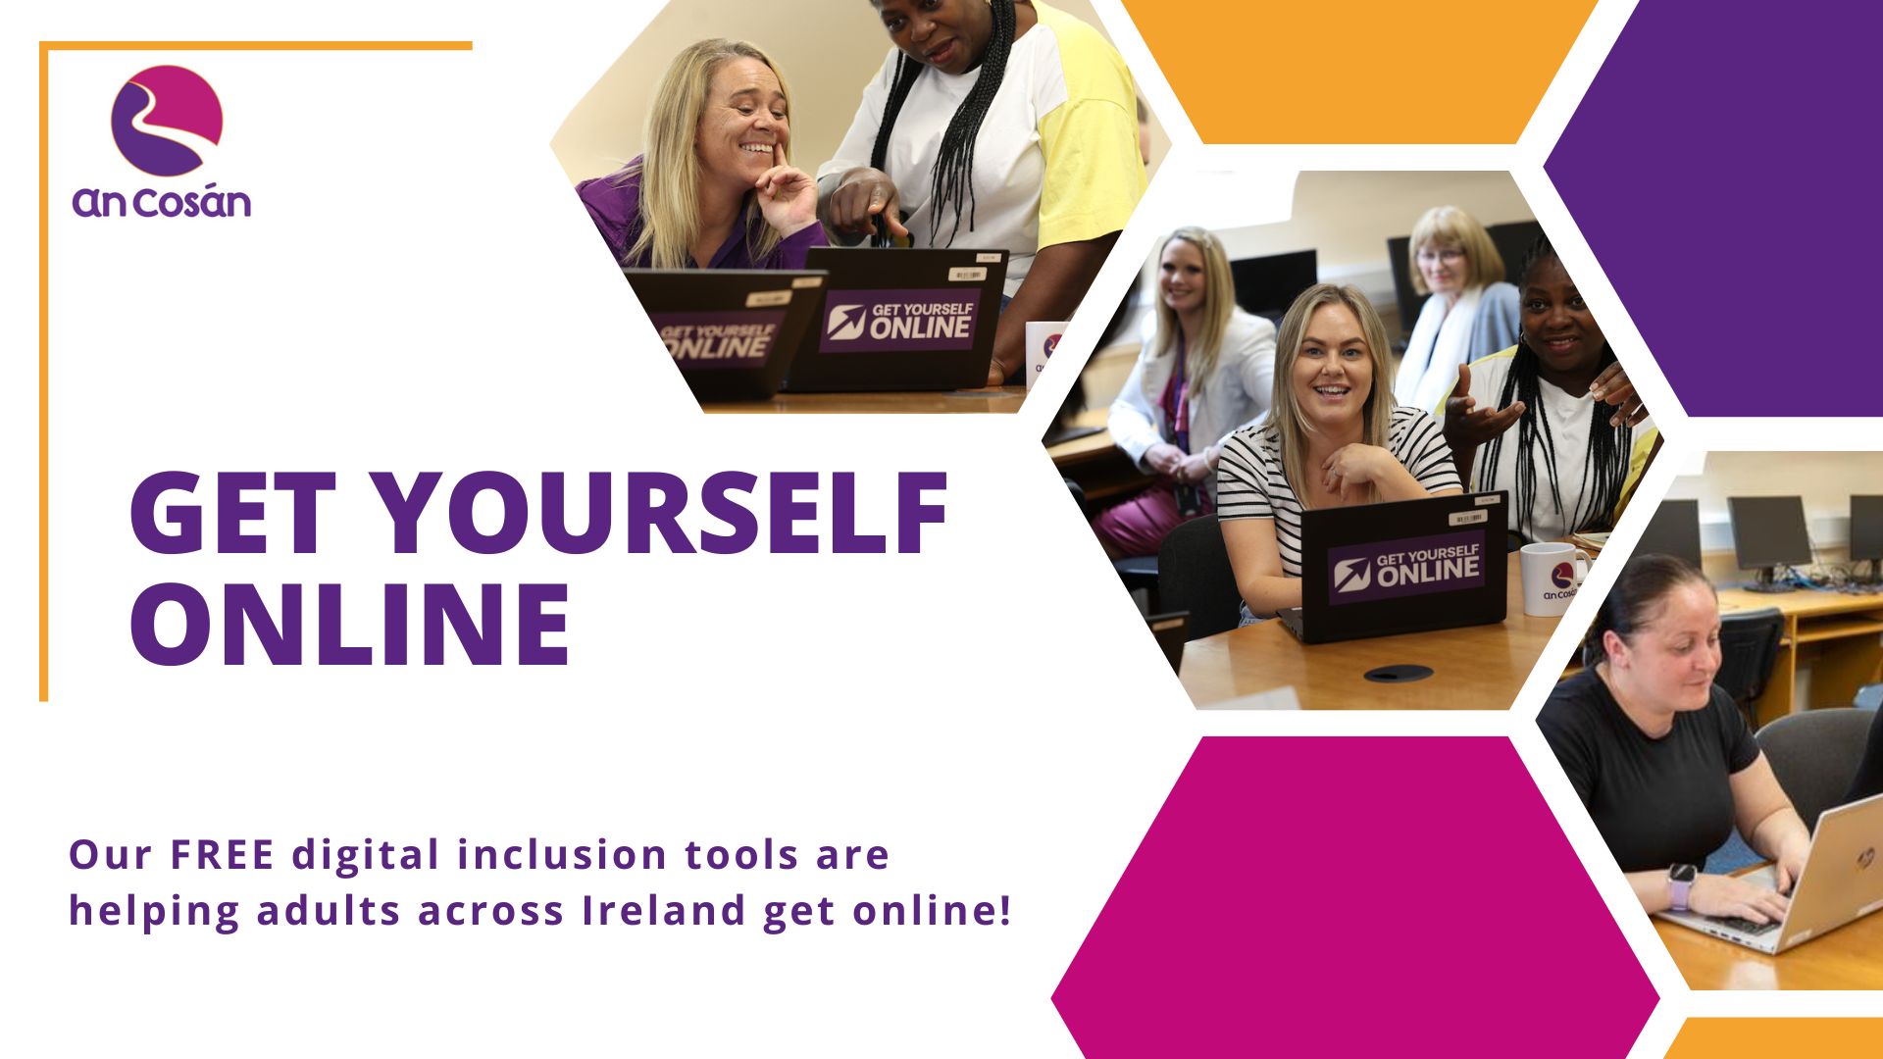
Get Yourself Online

Slide 11
A Community-Based Digital Inclusion Model
What is GYO?
A national digital inclusion campaign developed by An Cosán to support adults with digital confidence, skills and participation.
Includes:
Digital Stepping Stones self-assessment tool
21 DigComp-aligned eLearning modules
Accessible animations & plain language content
Digital literacy awareness resources
Everyday Assistive Technology supports
Embedded Across:
Access programmes
Further Education
Community education
Digital literacy initiatives

Slide 12
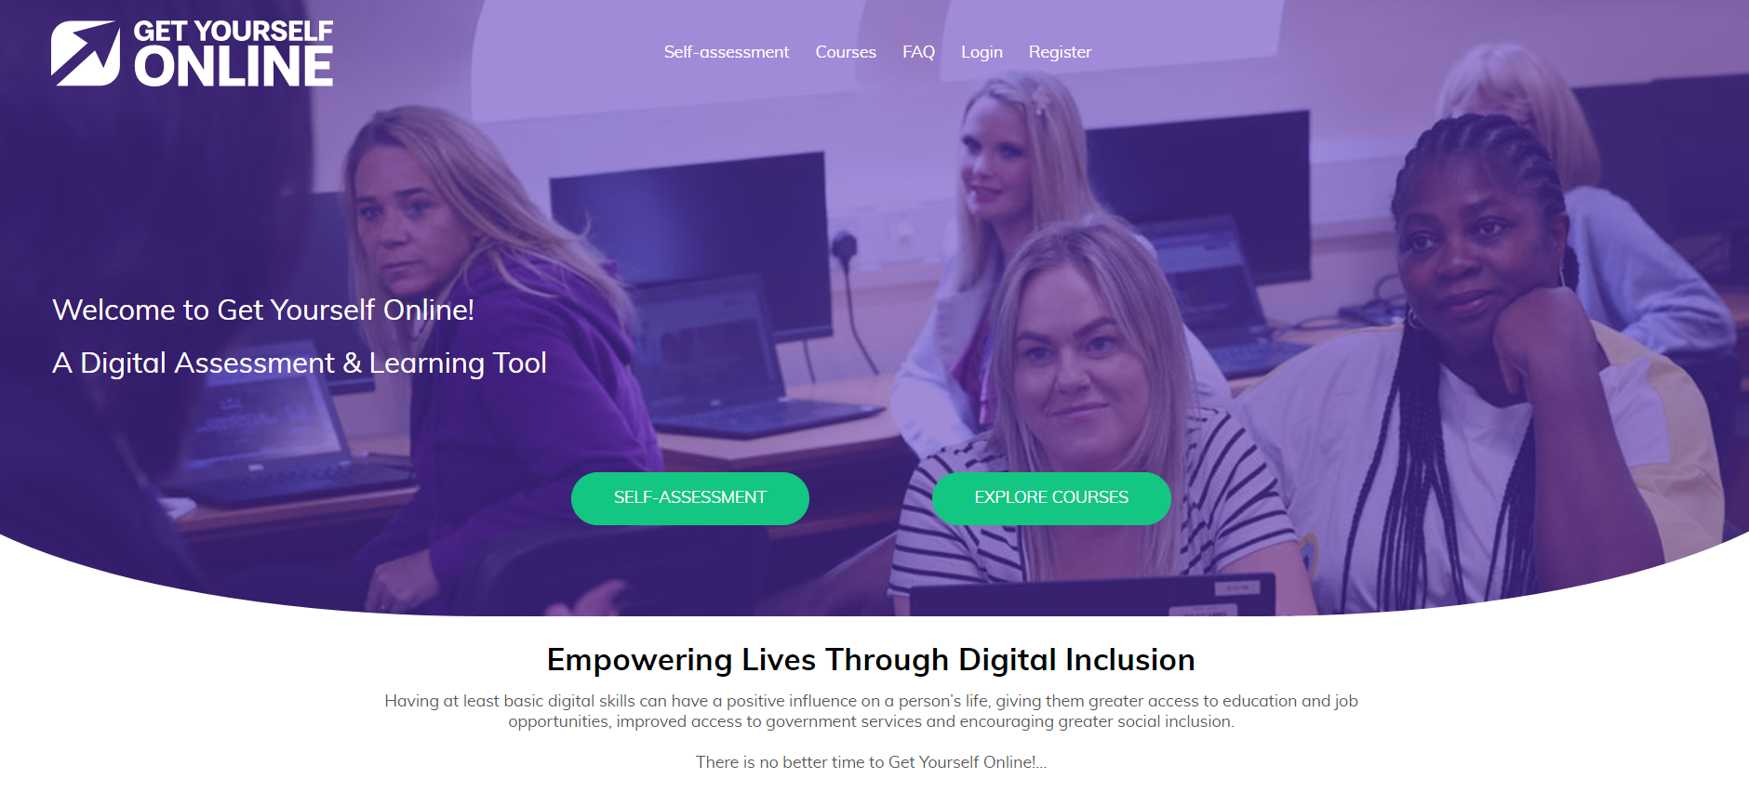
Get Yourself Online Platform

Slide 13
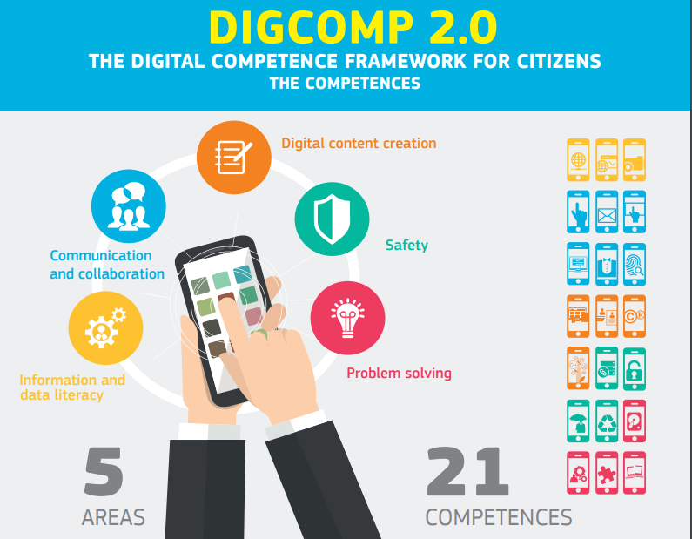
Tools designed from DigComp Framework
The ‘European Digital Competence Framework for Citizens’, also known as DigComp, was developed to offer a framework to improve citizens’ digital competence.
There are five different areas encompassing 21 different skills which create the framework for understanding the digital skills needed for life, work and learning.
https://publications.jrc.ec.europa.eu/repository/bitstream/JRC106281/web-digcomp2.1pdf_(online).pdf

Slide 14
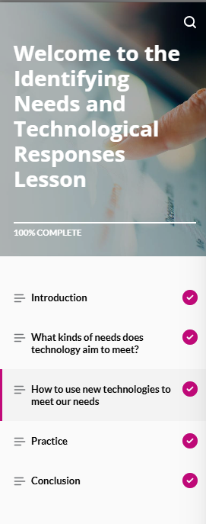
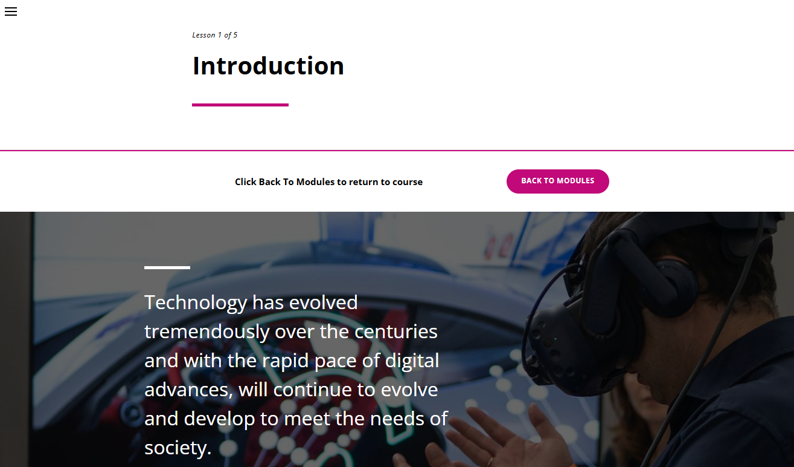
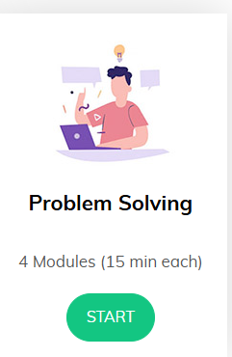
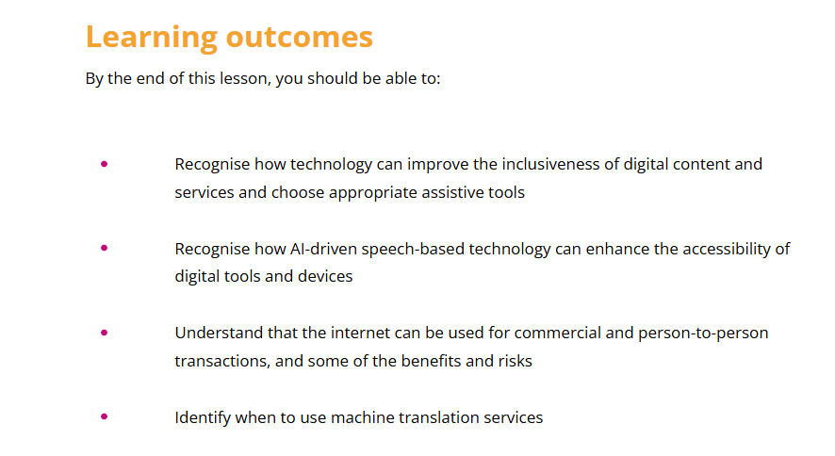
Online Resources

Slide 15
Digital Champion Initiative

Slide 16
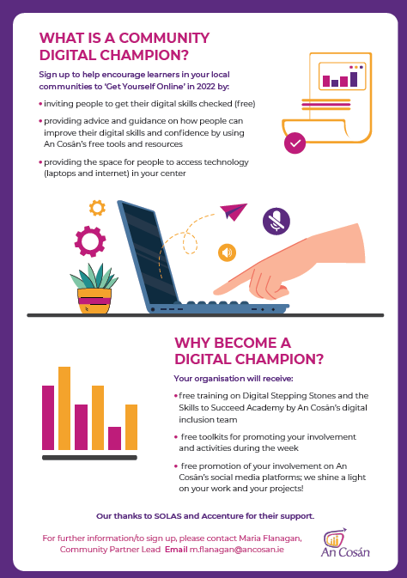
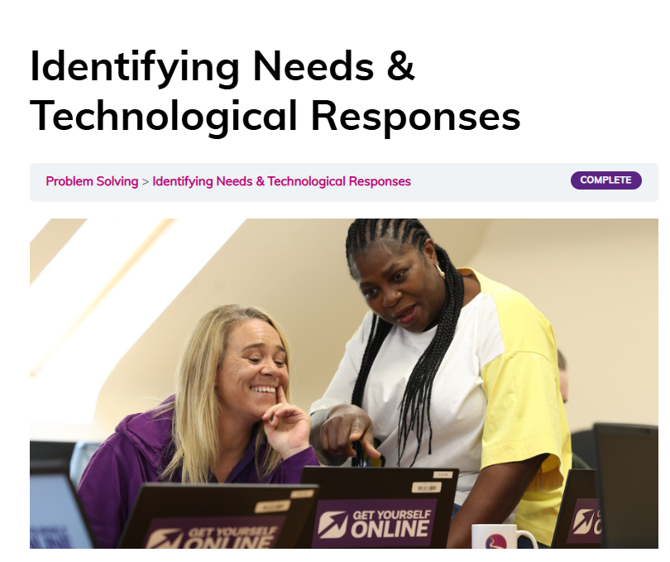
An Cosán Digital Champions

Slide 17
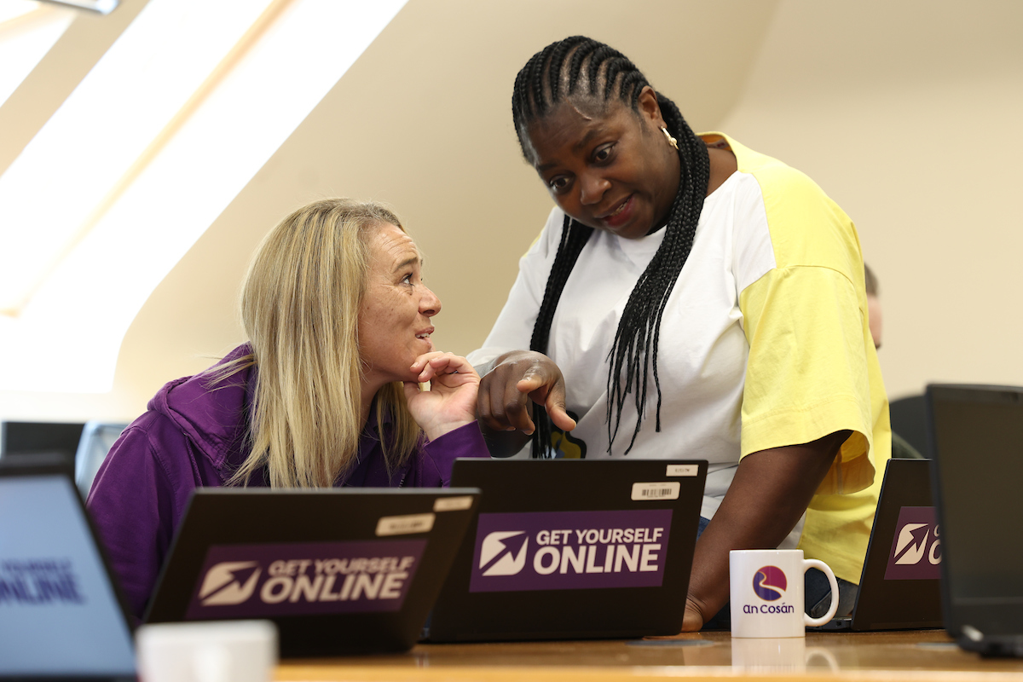
Train-the-Trainer / Digital Champions
Get Yourself Online is equipping community organisations and community educators to deliver digital skills training to adults
to build their confidence and capacity to use the digital tools and embed them in their practice
supporting adult learners, tutors and citizens in lifelong learning, active citizenship, employability and social inclusion

Slide 18
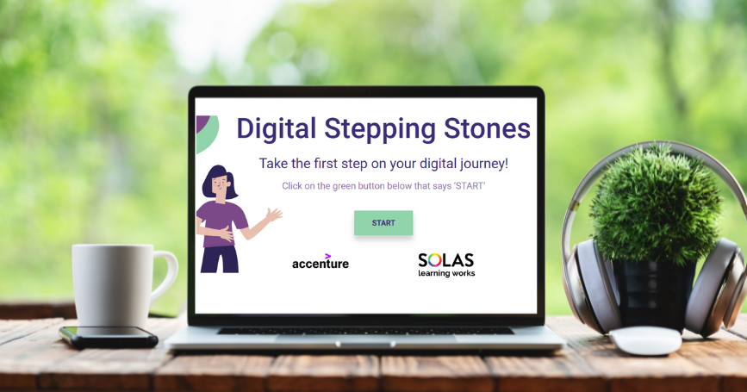
What does a Digital Champion do?
Encourage learners in your local communities to Get Online using our Digital Inclusion Tools and eLearning Courses
Invite citizens to have their digital literacy skills checked
Provide a space for people to access the technology necessary to improve their digital literacy skills
Provide advice and guidance on how to improve their digital literacy skills using our tools
Incorporate digital literacy tools into their practice – Workshops – programmes – Courses

Slide 19
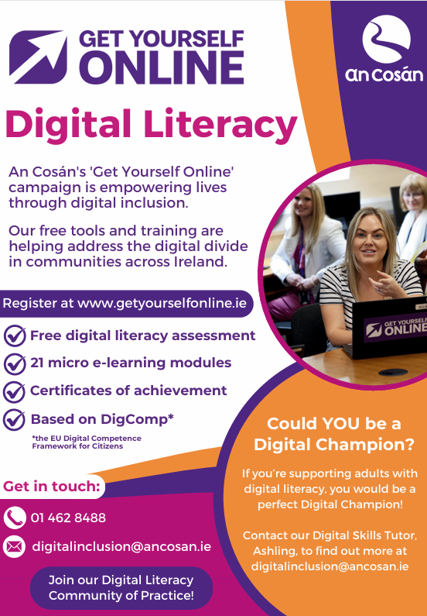
Get Yourself Online Poster
Notes:
Promotional flyer for An Cosán's 'Get Yourself Online' digital literacy campaign offering free tools and trainings, including digital literacy assessments, micro e-learning modules, and certificates of achievement. Includes a call for people to become a Digital Champion for supporting adult digital literacy and contact details including email digitalinclusion@ancosan.ie

Slide 20
Developing Ireland’s First
Digital Literacy Community of Practice

Slide 21
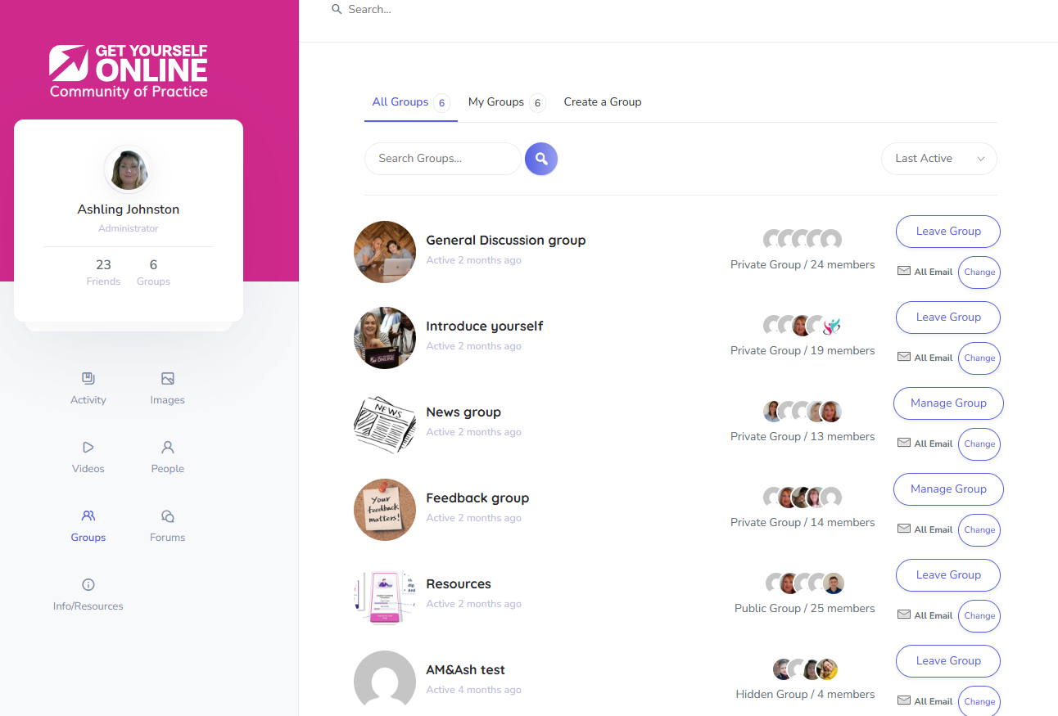
Digital Literacy Community of Practice

Slide 22
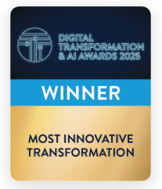
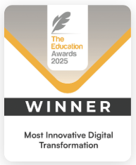
Two Huge Accomplishments – One Powerful Mission!
Driving Digital Inclusion Across Ireland

Slide 23
Contact information and Links to Courses
Email- digitalinclusion@ancosan.ie
Get Yourself Online | A Digital Assessment & Learning Tool
Digital Stepping Stones | Digital Skills Self-assessment
Presentation Animation: https://www.youtube.com/watch?v=U_4gw5U-b7E

Slide 24

Any questions?...

Slide 25


Thank you!

