Slide 1

UCD Access and Lifelong Learning
Disability Support & Assistive Technology
Aundrea Hubble
Assistive Technology Coordinator
aundrea.hubble@ucd.ie
Notes:
How the AT allocation wors in UCD.

Slide 2
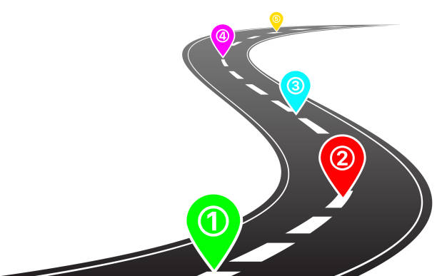
Presentation Overview
Brief overview of the AT service at UCD
Grammarly and the GDPR process
Future plans for AT service at UCD

Slide 3
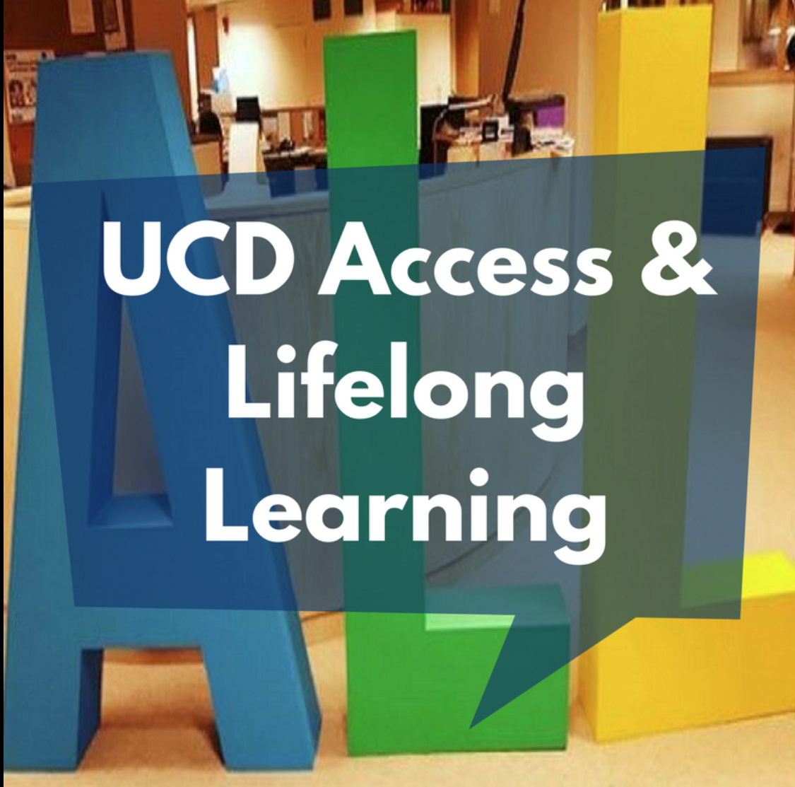
Background Information
I have been in this role for roughly 1 year which all began with attending AHEAD’s GATHER event last year.
UCD’s Access and Lifelong Learning Disability Support Team has supported over 3700+ students this academic term, increase of approximately 10% from last year.
My role as the assistive technology coordinator falls within the Disability Support Team.
Students must register with the disability service for one-to-one AT support.

Slide 4

Mainstream AT- Ally
Ally in Brightspace
Ally is the accessibility checker tool integrated within Brightspace that helps faculty create and maintain accessible teaching materials. It checks course content for accessibility issues, provides feedback and guidance on how to fix these issues, and offers alternative formats for students to engage with learning materials in ways that best suit their needs.

Slide 5

Mainstream AT- Sensus Access
SensusAccess
SensusAccess is a file conversion tool which uses a simple webform. SensusAccess allows the conversion of files into the format which is most accessible and useful to you. This might be lecture notes into an mp3 to listen to on the go, scanned book pages into searchable PDFs to be used with text to speech software, or lecture slides into text to be read and adjusted on an E-Reader. SensusAccess supports text in multiple languages and can be a great resource for language learning.

Slide 6
Mainstream Assistive Technology at UCD
Supporting Students to Leverage Built in Accessibility Features
It can be challenging to introduce new technology on top of a full student workload. Where possible, I try to leverage built in accessibility features for devices the student is already using.
Built in screen readers (VoiceOver, TalkBack, Narrator).
Magnification and Zoom
Display Adjustments
Voice Control and Dictation
Focus Modes
Reading Modes (Safari/Edge)
Other Software: Genio, Read & Write, Natural Reader, Grammarly, Equatio, Dragon, Fusion, ZoomText, JAWS.

Slide 7

Grammarly
Since starting in this role, Grammarly has been a major topic.
Students were frequently requesting it more than any other AT or software.
When I started this role, UCD did not have an active license with Grammarly.
I began to investigate this further, to understand any GDPR concerns and if it would be possible to get Grammarly for our students.
The following slides will outline the steps taken.
The aim of this presentation is to provide insight, clarity
and guidance.
This process took roughly 6 months to complete.

Slide 8
Departments Involved
Like any major task, this was a multidisciplinary approach which required the support of many people and departments.
Data Protection Office (DPO)
Legal Advisors
Information Technology (IT)
Procurement Team
Grammarly (legal, tech engineers and management team)

Slide 9
Key Documents And Steps
Transfer Impact Assessment (TIA)
Security Cloud Checklist (IT)
Data Protection Impact Assessment (DPIA, reviewed by DPO)
Privacy Notice (reviewed by DPO)
User Guidelines (reviewed by DPO)
DPA (Data Processing Agreement, between UCD and Grammarly (SuperHuman)

Slide 10
Transfer Impact Assessment (TIA)
Under GDPR, personal data cannot leave the EU to another country unless that county has proven to have protections as strong as the EU.
The EU-U.S. Data Privacy Framework (DPF) provides an Adequacy Decision meaning the EU considers certified U.S. companies safe. However, if a company is not certified under this framework, there is a legal gap that must be filled.
The TIA is a mandatory risk assessment which must be conducted. In this case, as Grammarly was part of the DPF we concluded the TIA was not necessary.
A key part here was that Grammarly uses end to end encryption.
Further information on TIA

Slide 11
Security Cloud Checklist (IT)
UCD specific IT Services checklist based on IT and GDPR guidance.
This checklist outlined key security requirements for adopting cloud services, focusing on GDPR compliance, data protection and risk management.
This checklist was sent to Grammarly and reviewed by our IT team where they offered further guidance and recommendations.
IT Guidance on Cloud Servers and International Data Transfers

Slide 12
Data Protection Impact Assessment (DPIA)
A DPIA is a tool designed to identify risks arising out of the processing of personal data. Its objective is to minimise these risks as far, and as early, as possible by introducing risk reducing measures.
This was a document we completed and shared with the Data Protection Office (DPO) for their feedback.
Some key pieces of feedback included the completion of a Privacy Notice, User Guidelines and reviewing Grammarly’s sub processors.
As we were not using the AI feature, this reduced the sub processors
requiring review.

Slide 13
Privacy Notice For Students
All students must confirm they have read both the privacy notice and user guidelines before being issued with a Grammarly account. The privacy notice outlines:
Data Controller (UCD) and Data Processor (Grammarly) status.
Types of Data Collected/Processed
Our legal basis for using Grammarly
No AI training of Grammarly’s models/algorithms.
Outlining the international data transfer to the U.S. and where the data is stored.
Retention and deletion
Data protection rights
Contact information for questions/concerns

Slide 14
User Guidelines For Students
The user guidelines outline:
Students must turn off Grammarly when working with sensitive/special categories of personal data. This includes but is not limited to health data, biometrics and genetic data and more.
Laptop/Desktop use only
Avoid using with high risk emails
Use built in alternatives for any sensitive work
Steps for temporarily disconnecting Grammarly
Important note: Not for staff use

Slide 15
DPA (Data Processing Agreement)
The contract.
Between Grammarly (SuperHuman) and UCD.
Took the longest time to complete of any sections discussed.
A lot of back and forth to ensure legal compliance with EU law and GDPR.

Slide 16
Additional Points
In the current political climate, agreements and rules can change at anytime and must be monitored.
AI feature, can be turned off to protect academic integrity.
Authorship (currently not active on UCD account as it is related to AI features)
Students have use of proofreading software as a support.
Some lecturers request that students put a line at the start of their assignment stating they have used Grammarly, similar to our Spelling and Grammar waiver.
We will be collecting feedback over the summer.
Grammarly has been in place since January 2026

Slide 17
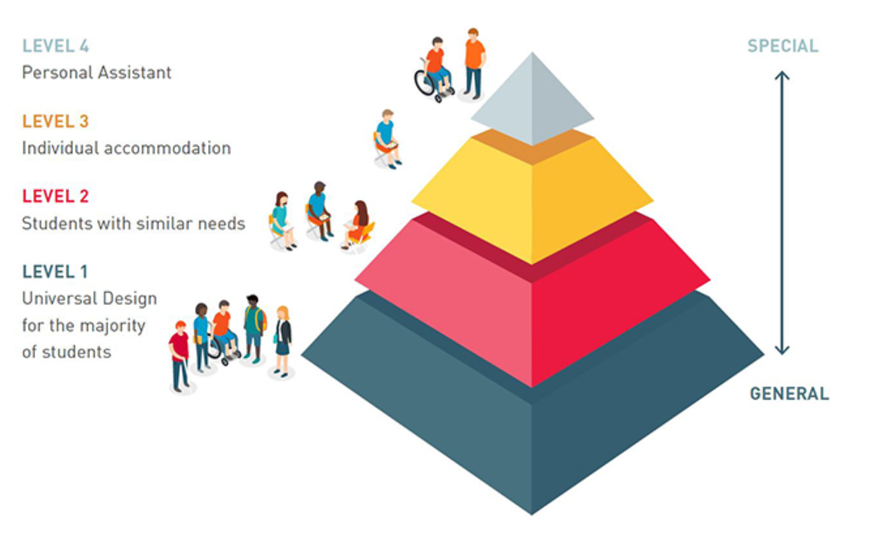
Future AT Plans For UCD
Now that I have completed one academic year at UCD, I would like to continue to build the service with accessibility and sustainability in mind.
Currently there is a high demand on the AT service so this approach is key to successfully managing AT going forward.
To explore AT further through the lens of Universal Design.
My goal for this summer is to explore further mainstreaming of software.

Slide 18
Access and Lifelong Learning’s Mission and Vision
Vision: Our vision is that UCD will be a University for All, where all students, regardless of background or circumstances, feel welcome, belong and are valued. In doing so, all students can undertake their studies, participate fully in the life of the University, and realise their academic, professional, career and personal goals.
Mission: UCD Access & Lifelong Learning work to enable the University to fully realise its ambition to be a University for All, where access and inclusion is everyone’s business.

Slide 19
Questions?
Aundrea Hubble
aundrea.hubble@ucd.ie

