Slide 1



World Day for
Assistive Technology
2026

Slide 2
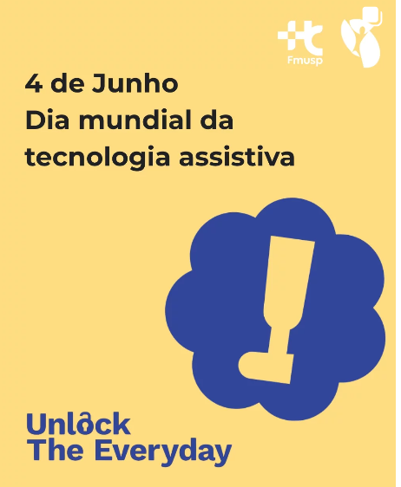
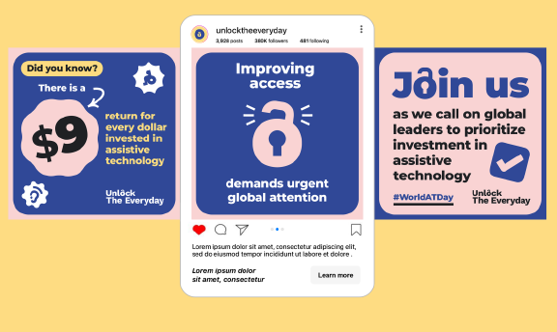
What is World Day for Assistive Technology?
World Day for Assistive Technology was launched on June 4, 2024 as part of the Unlock the Everyday campaign.
It is the perfect opportunity for global stakeholders to come together and champion the importance of assistive technology.
The goal is to increase access and raise awareness, especially in low- and middle-income countries.
We share a variety of assets:
Animated GIFs & Carousels
Static & Photo Assets
Editable Quote Cards (EN, FR, ES)
Multi-platform Social Banners
Notes:
total of 33 assets, all social media assets were accompanied by suggested social copy templates, which partners could adapt for their own channels. Alt text was also provided.
2025 highlights included the launch of the #MeAndMyAT challenge and a refreshed campaign website featuring an interactive event map, toolkits, videos, merchandise, printable materials available online and the small grants programme!

Slide 3
Key results and impact in 2025
trending_up
Hashtag Performance (via UNOPS Talkwalker)
#UnlockTheEveryday + #WorldATDay (May & June 2025)
+22,200% increase in results
+12,700% increase in engagement
public
Potential Reach (2025)
42+ million
Up from 2.3M in 2024 for #WorldATDay — a 18x growth in audience exposure

Slide 4


Content Highlights
Posts Shared (May-June 2025)
346 Total on IG, Facebook & X
→ 3 posts per platform, 9 daily
Media & Formats
Videos & Reels
#MeAndMyAT challenge
Blog Posts & Articles
Podcasts & Interviews
Quotes & Messages
Press Statements
Campaign Assets
Multilingual Reach
Campaign content shared in 11 languages across platforms:
English, Italian, French, Portuguese, Georgian, Spanish, Arabic, Indonesian, Croatian, Bengali, German
Notes:
content was shared in 11 languages1
346 total posts shared across Instagram, Facebook, and X

Slide 5
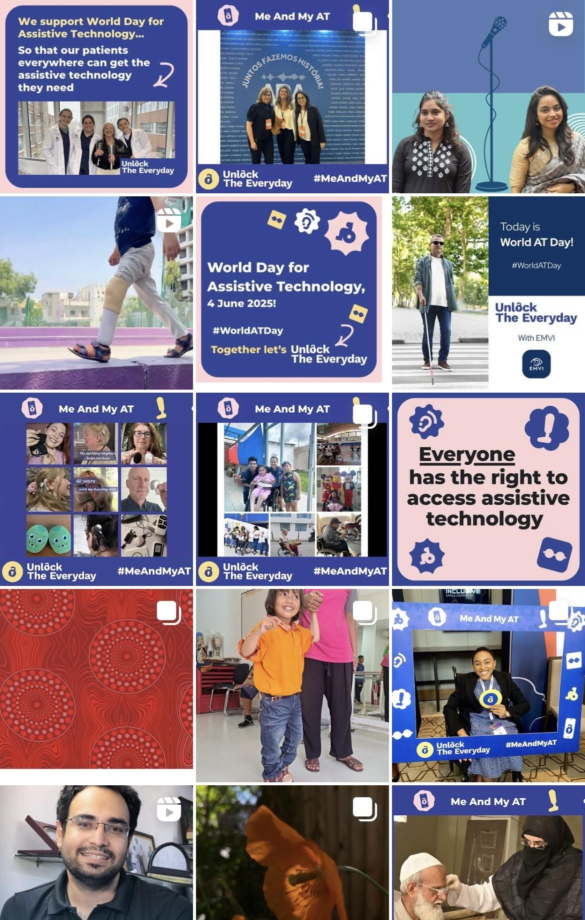

Posts, Mentions & Tags
Around the Day | 4 June 2025
150+
Instagram Stories
Tagging campaign partners & users
30
Collaboration Posts
50+
Tags on Instagram
60+
Facebook Tags
180+
LinkedIn Posts

Slide 6

What worked well? Successes to build upon
#UnlockTheEveryday
The core message reached over 42M+ potential people globally.
#MeAndMyAT Challenge
A user-centric audiovisual success with 200+ active participants.
Global Partnerships
High engagement from UNICEF, UNOPS, WHO, and key influencers.
National Participation
The small grants programme and engagement of partners in country successfully ensured wide national involvement.

Slide 7
Key activities for 2026
Global digital media
repurpose huge selection of assets
Me and My AT challenge
continue the successful challenge
In country events
identifying champions & assets
collecting new audio-visual assets from wider regions: SE Asia, South Asia, Latin America, and Africa
Consider organising a community event such as public gatherings, rallies or exhibitions

Slide 8
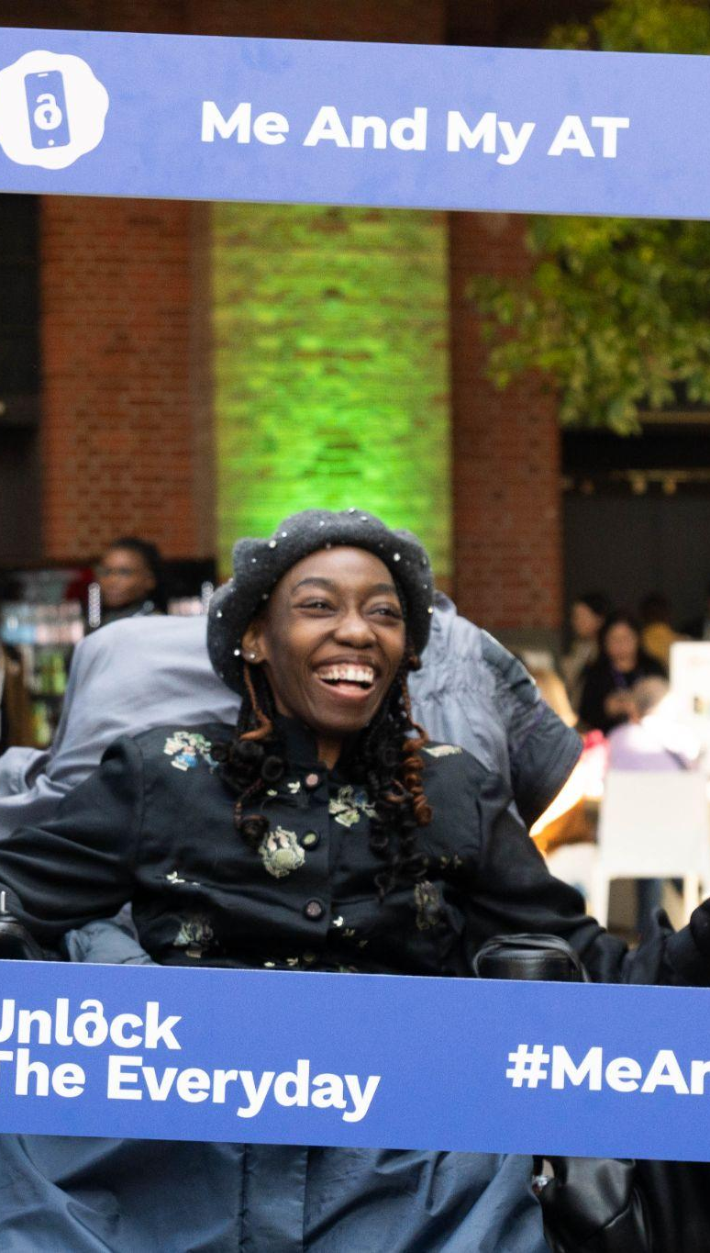
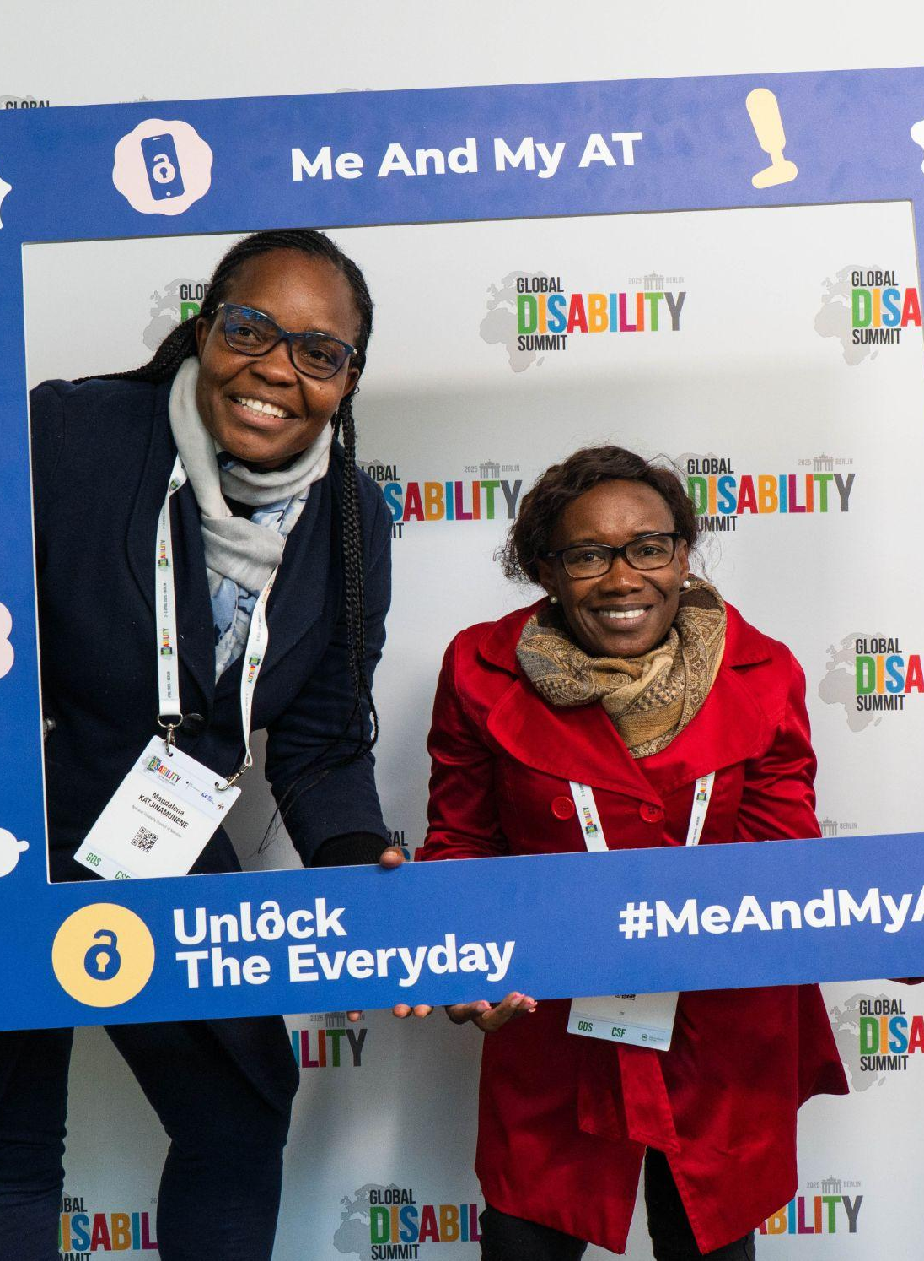
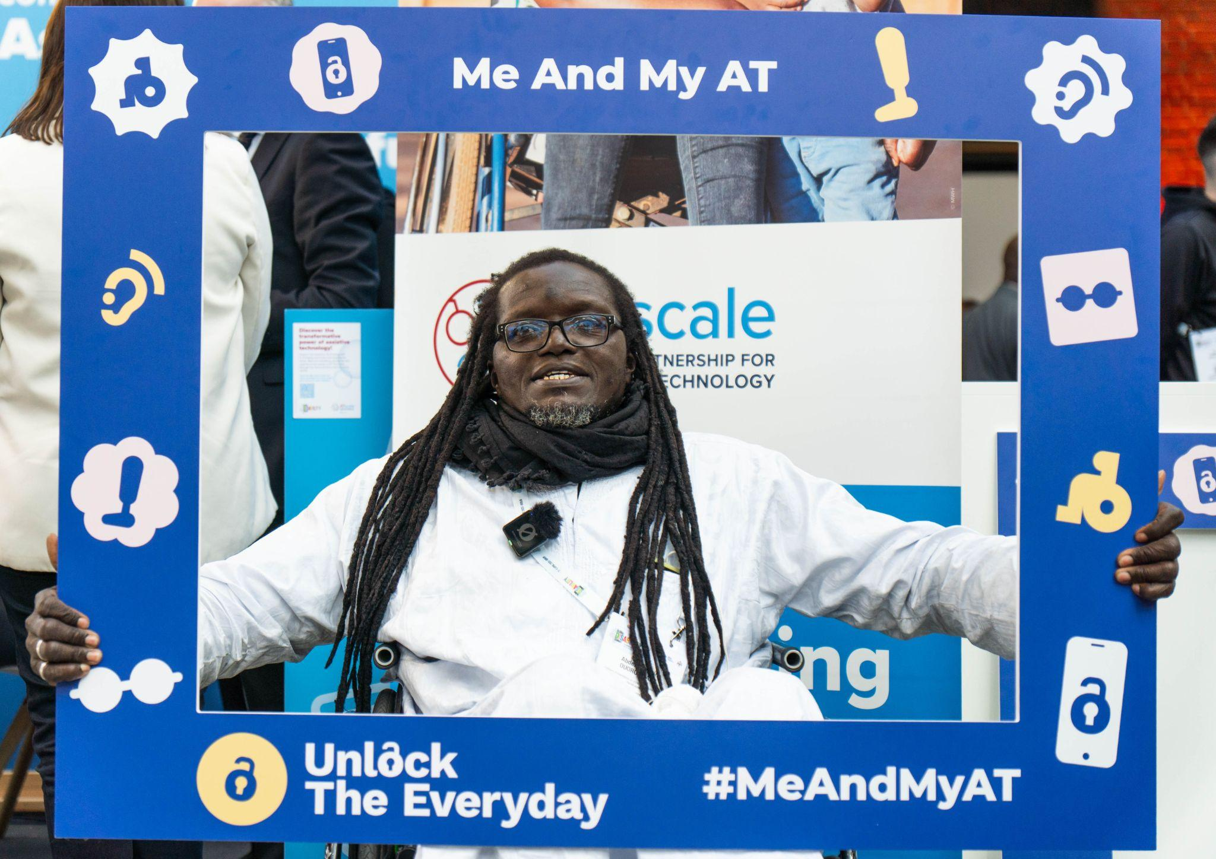
Me and My AT challenge
As a key new element of the 2025 campaign, the Me and My AT challenge was soft launched at GDS in Berlin (April 2025).
It invited AT users to share photos and videos showing how AT unlocks their everyday lives, building momentum for World AT Day.
🖼️ Digital Frames: Participants used easy-to-apply frames to highlight their assistive products.
📲 Clear Guidance: Instructions on how to tag pages and which hashtags to use.
🌍 Global Reach: Amplified user voices and stories on June 4.

Slide 9
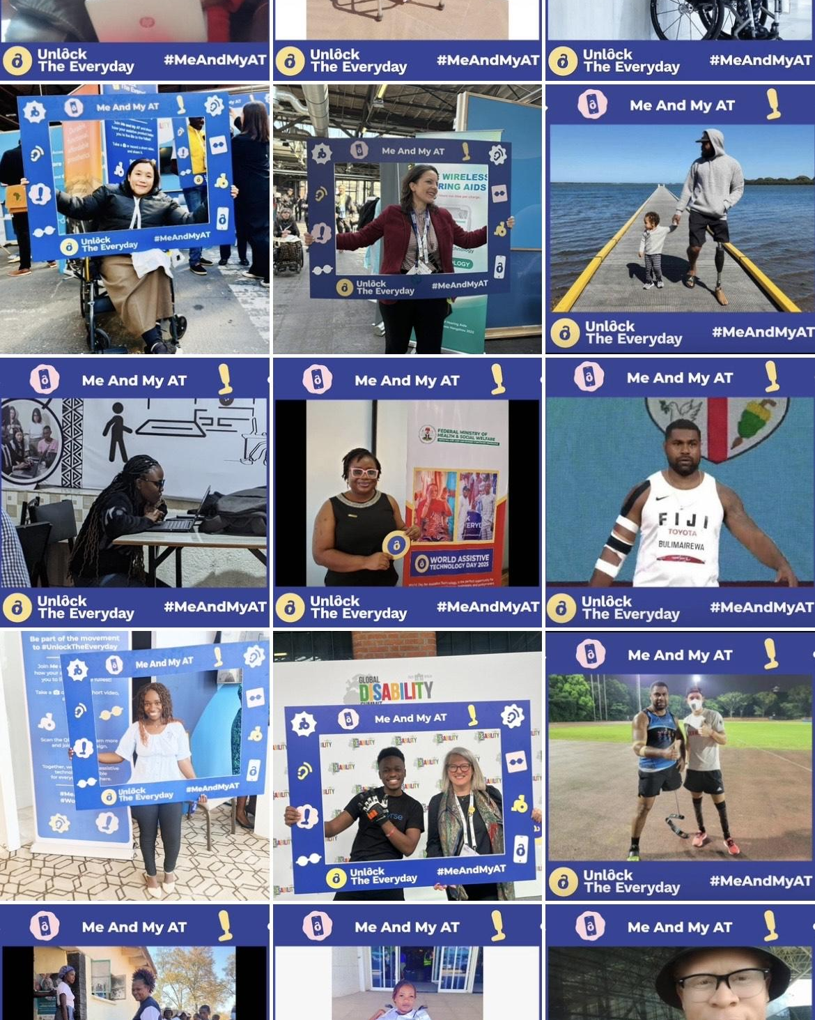
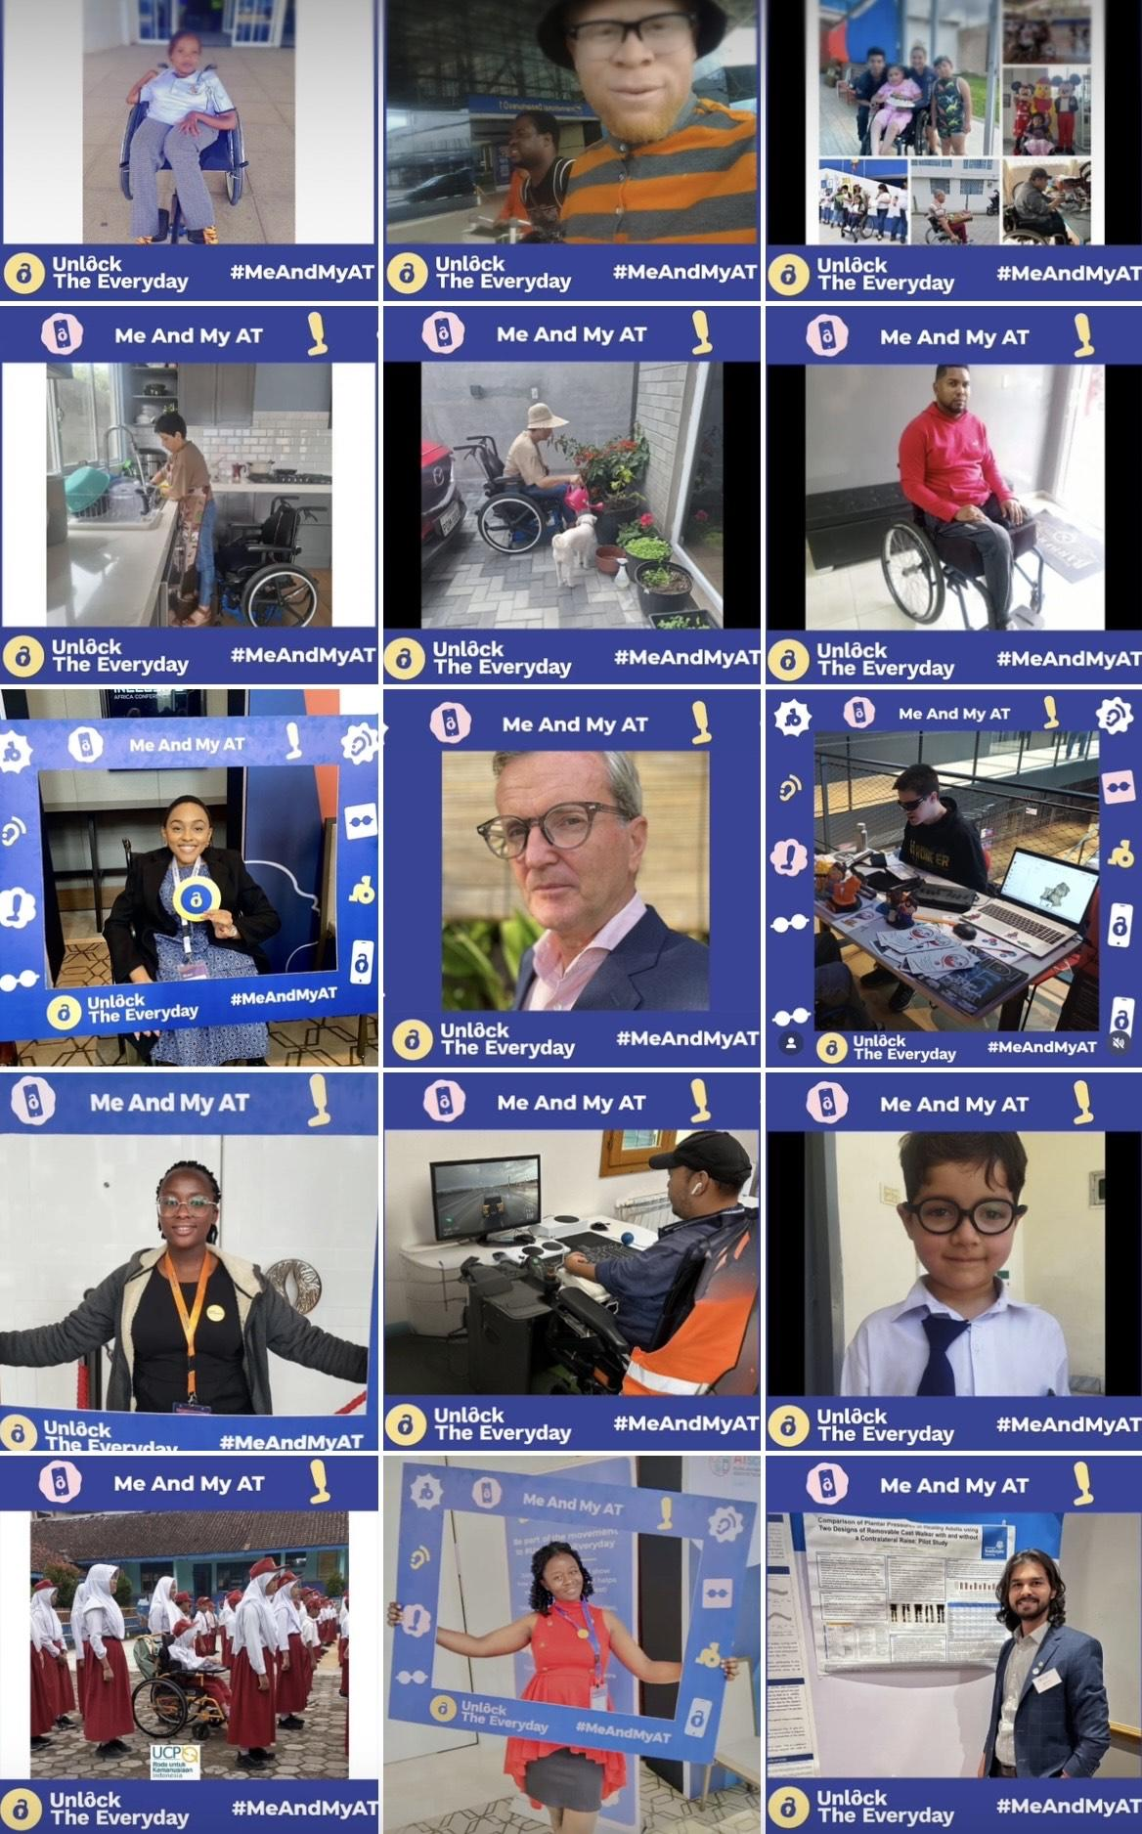
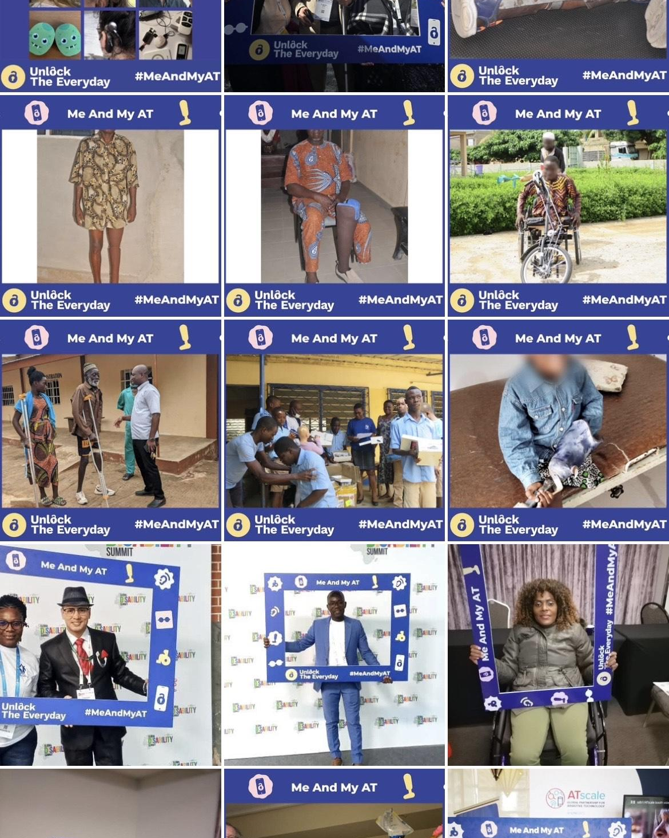
Me and My AT challenge (2)
More than 200 AT users took part in the Me and My AT challenge.
See all the photos in the Flickr gallery

Slide 10
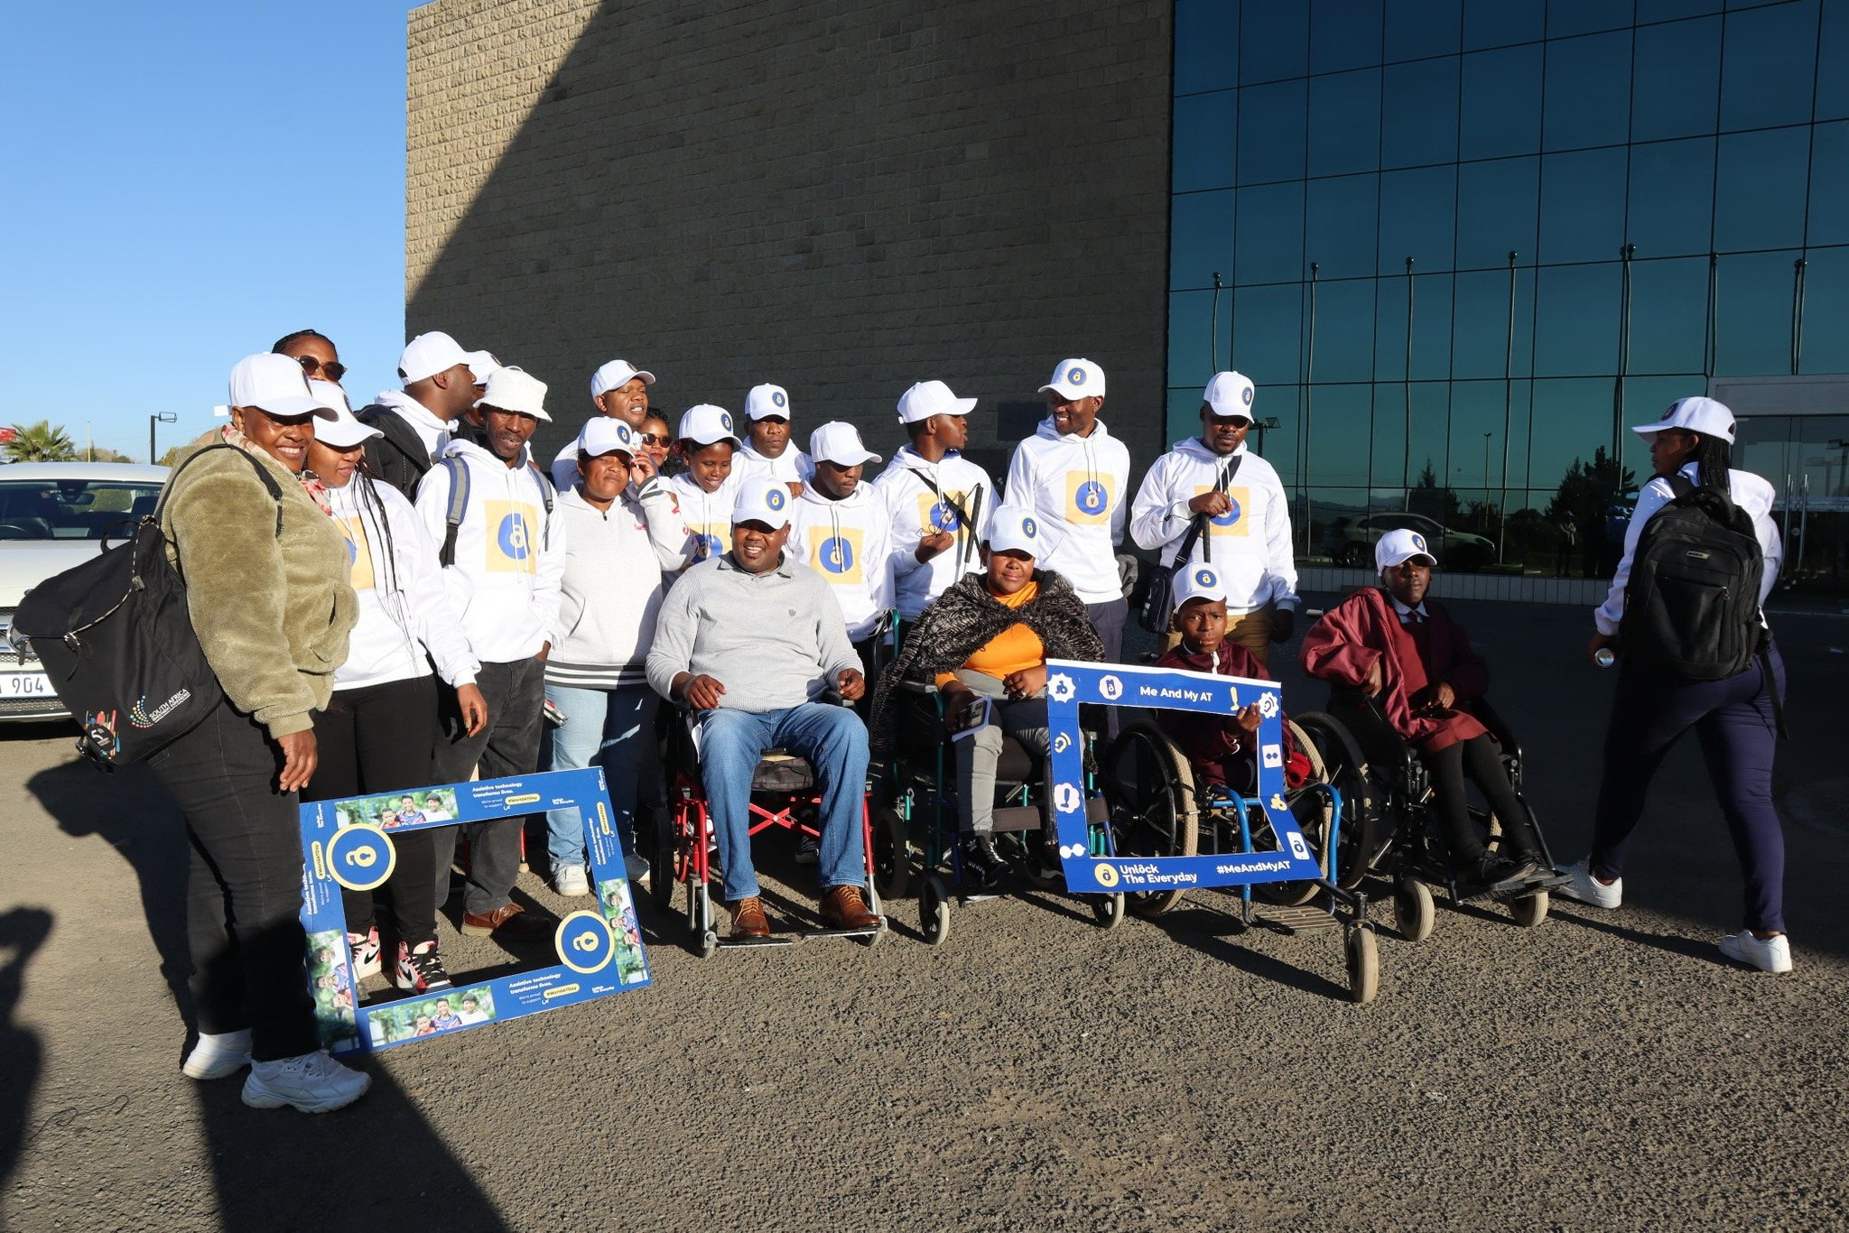
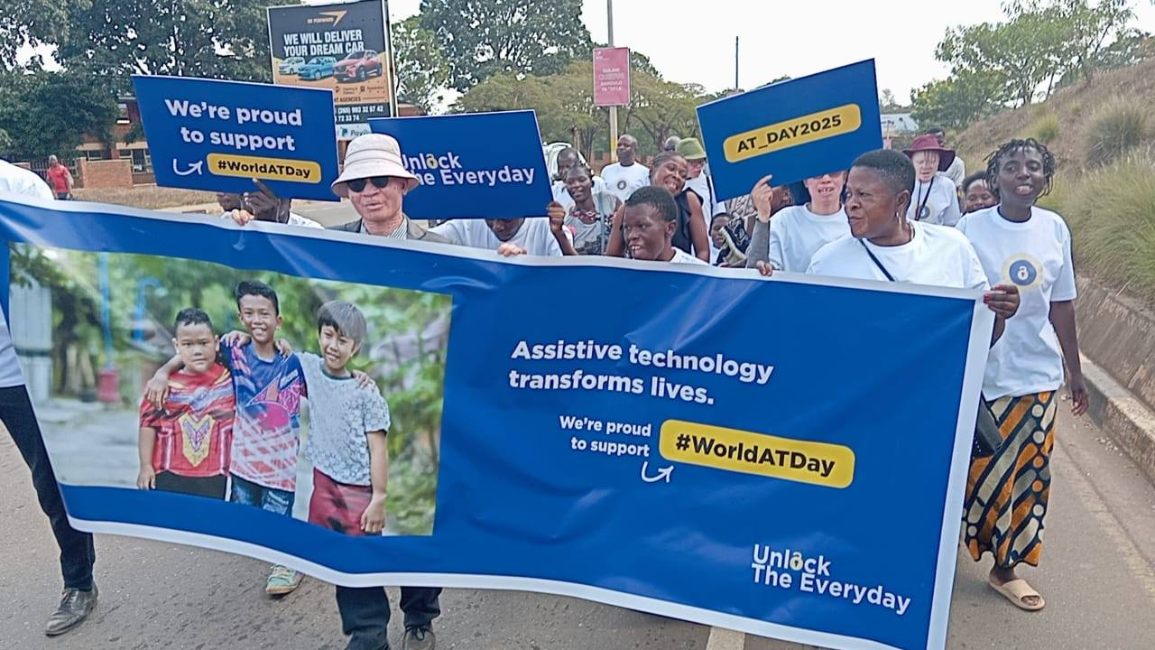
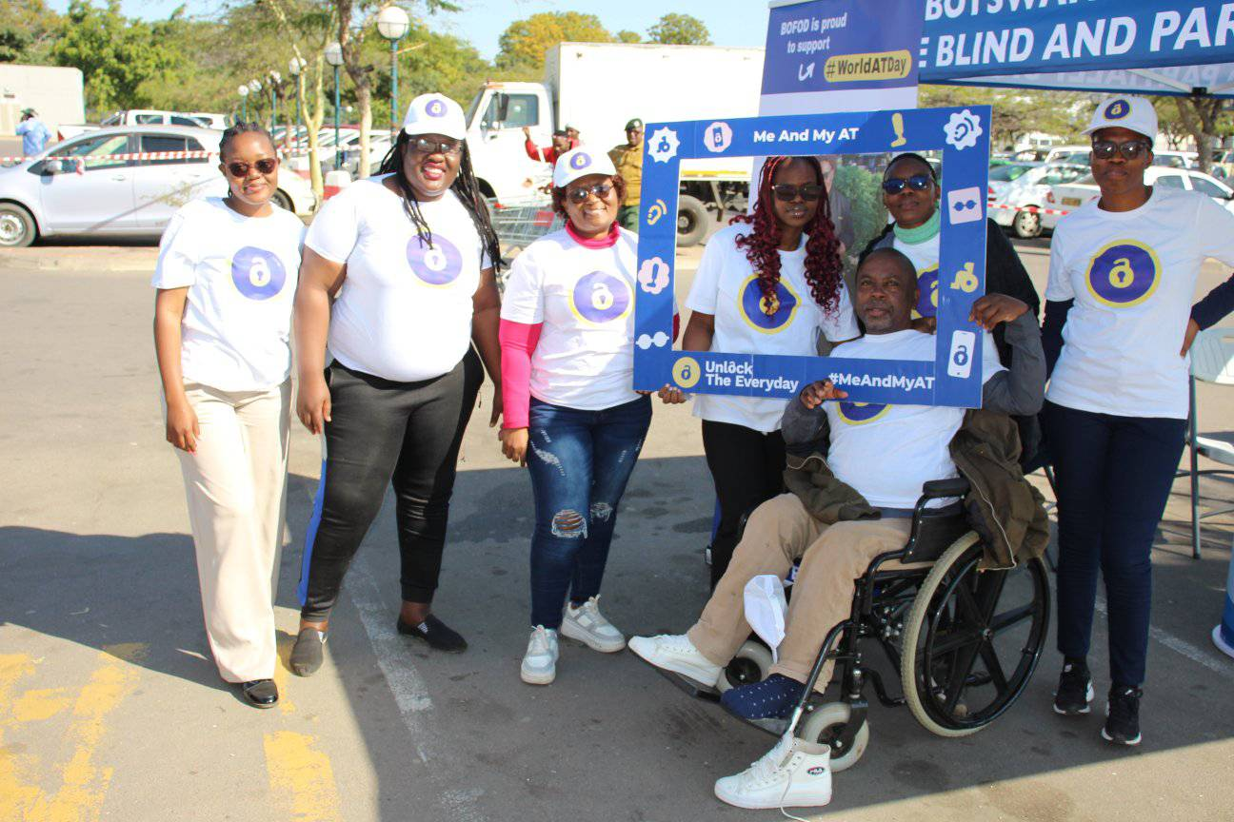
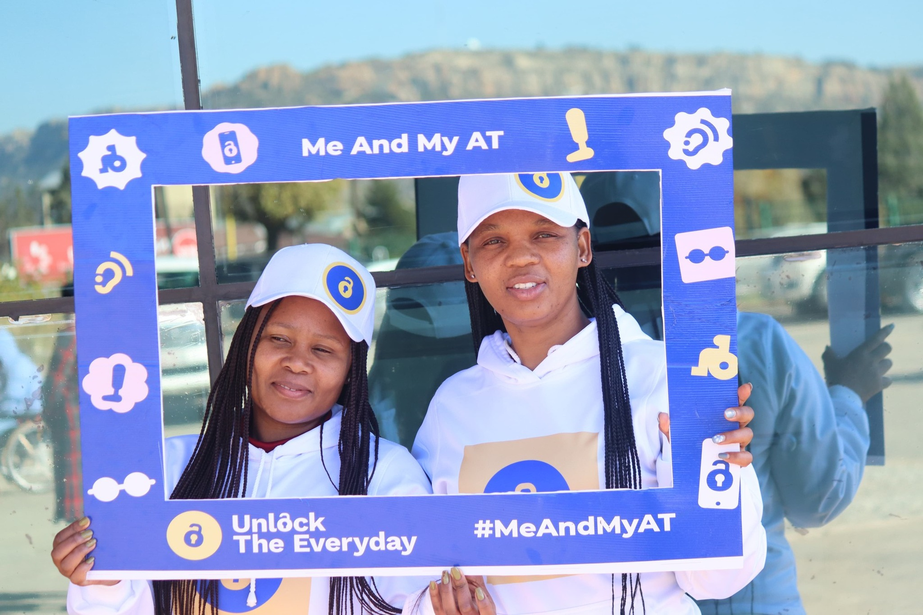
World AT Day 2025 - small grants
On World Day for Assistive Technology 2025 the below organizations celebrated awareness campaign across radio, TV, social media and in events such as a multi stakeholder ‘pop up’, panel discussions, public dialogues, an awareness walk, podcasts, a documentary and demonstration workshop
Union Nationale des Associations des Personnes Handicapées du Tchad
Adama Women with Disability Association
Rehab Health and Kyaro Assistive Tech
Zambia federation of Disability Organizations -ZAFOD
VILOLE
FEDERATION OF DISABILITY ORGANIZATIONS IN MALAWI - FEDOMA
National Federation of People with Disabilities in Namibia -NFPDN
Disabled People South Africa - DPSA

Slide 11

Can you engage national champions in the campaign?
The Goal
Identify and engage high-profile National Champions to represent Unlock The Everyday and World AT Day (4 June).
How champions add value
Reach the public, media, and policymakers to prioritize AT.
Who to look for:
Lived experience: Public figures & community leaders who use AT.
Sports & Culture: Olympic messengers, celebrities, influencers.
Political: Ministers & policy leaders.
Technical: Professional assoc. & experts.
Donors: Corporate & philanthropic leaders.

Slide 12
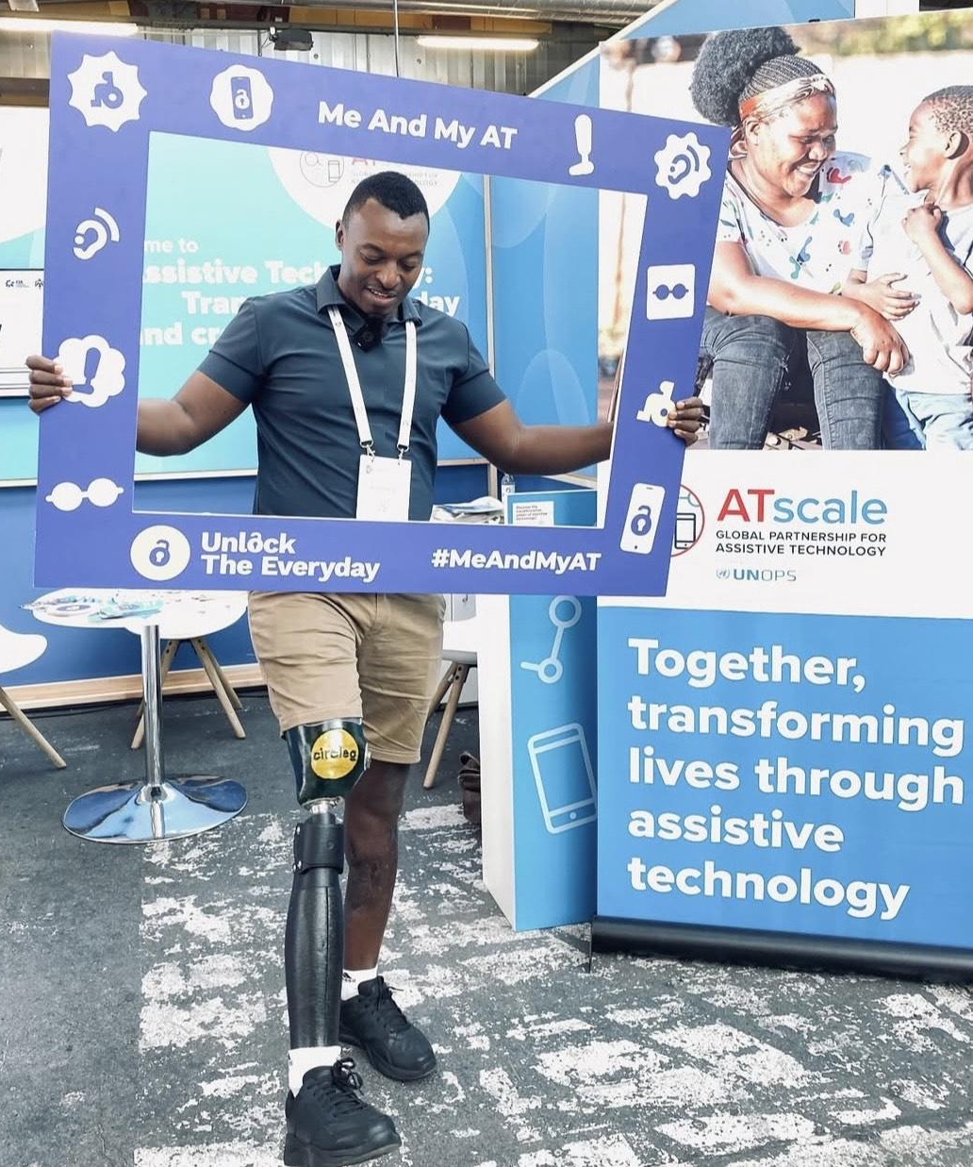
The champion’s role: simple actions
Engagement is designed to be simple and voluntary.
#MeAndMyAT:
Participating in the photo frame challenge.
Social sharing:
Posting the official film on 4 June.
Media outreach:
Quotes or interviews for national TV/radio.
Local impact:
Promoting AT at events & conferences.
How to support them:
• Provide the World AT Day Toolkit.
• Brief them on key messages.
• Help customize messages for their audience.

Slide 13
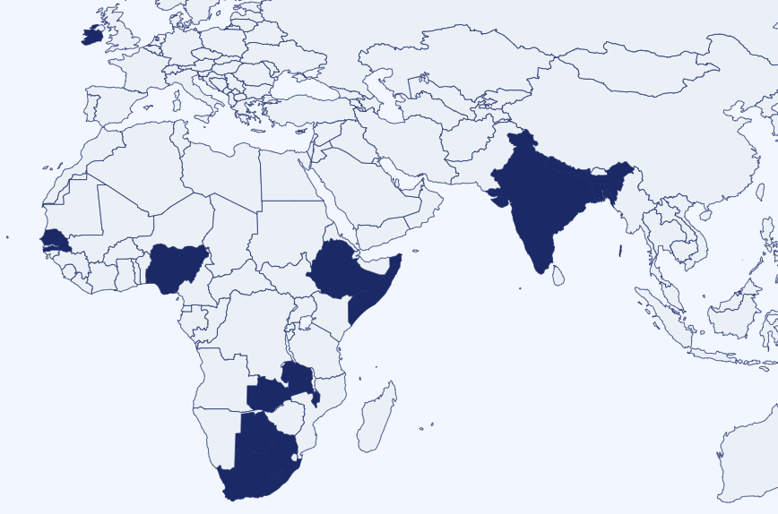
Organize an event and report it on the website
Whatever you do – however big or small – let us know
unlocktheeveryday.org/world-at-day/#organize-event
! #WorldATDay @UnlockTheEveryda

Slide 14
Expected Outcomes for 2026
Building on the success of 2025's 42+ million reach and the success of the #MeAndMyAT challenge, in 2026:
Engagement Growth
More campaign champions, ambassadors, businesses, and AT users are engaged in the day.
Increased Awareness
Global and local reach through advocacy events, social media, and traditional media coverage.
Measurable Impact
Achieving impact on the key messages, including increased political engagement or financing; more countries engaging

Slide 15
Website
Youtube
Facebook
Instagram
X
Useful Resources
Trello
Flickr

