Slide 1
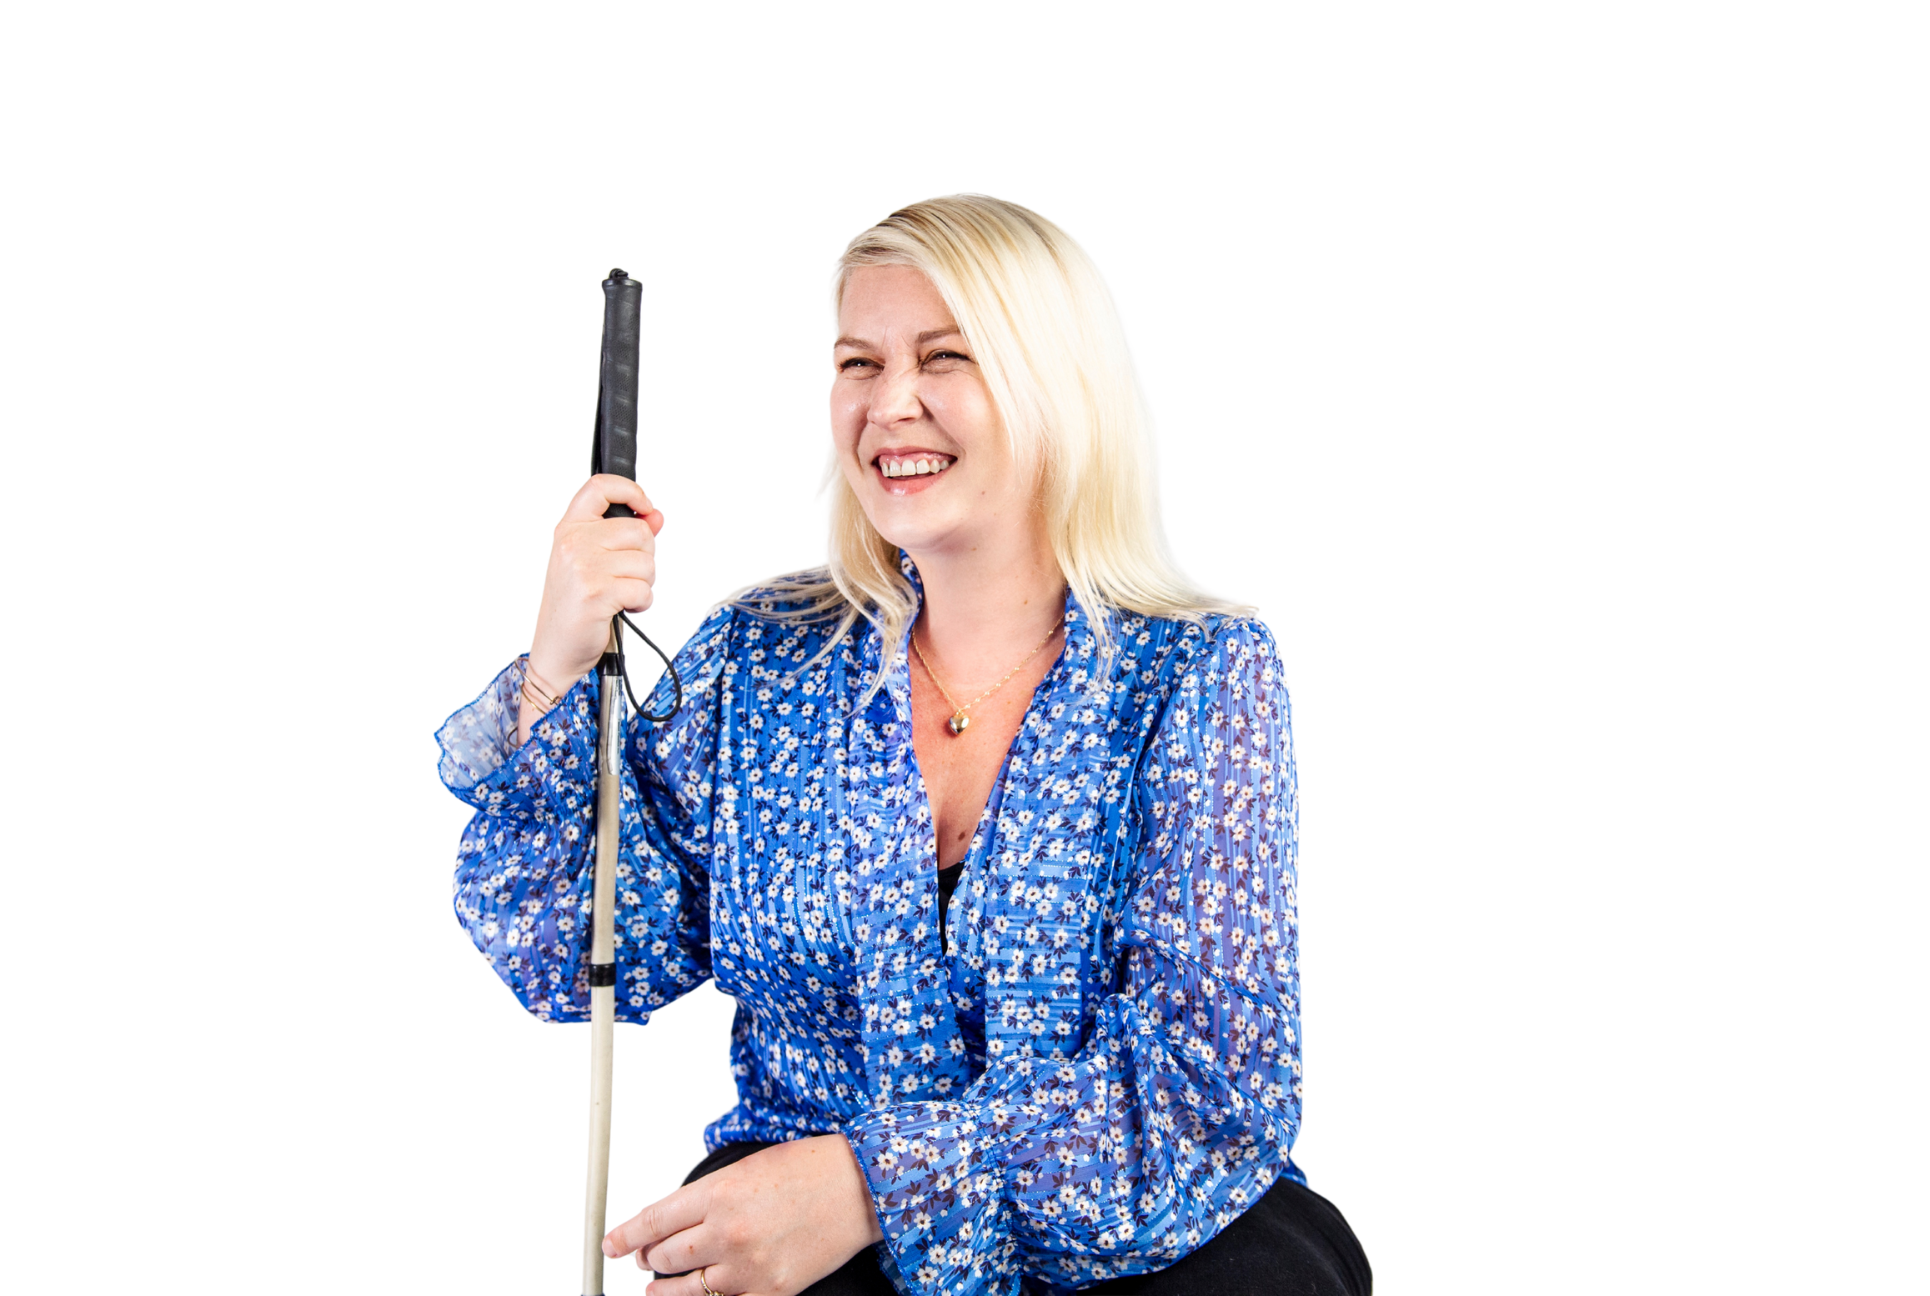

vi.ie
1800 911 110
info@vi.ie

Slide 2

From Assistive Wearables to AI Smart Glasses
An Evolution
Dorian Salzmann Technology Trainer
Notes:
Vision Ireland is Ireland’s national sight loss charity dedicated to supporting people who are blind or vision-impaired to live confidently, independently and fully in society.
Vision Ireland Labs is the technology-focused arm of Vision Ireland that helps people who are blind or vision-impaired to learn about, access and use technology to live independently.

Slide 3
What I’ll Cover Today
What “wearable vision tech” really means
The first wave of smart glasses
OrCam MyEye and specialist assistive wearables
Aira and live remote assistance
What makes Meta glasses different
Real-life use cases
The reality check: O&M still matters
Where Vision Ireland fits in
Notes:
Here’s the structure of the talk.
First, I’ll briefly define what we mean by wearable vision technology, because that term gets used in different ways.
Then I’ll talk about the early wave of smart glasses — the first attempts to bring computing into eyewear.
After that, I’ll focus on specialist assistive devices like OrCam MyEye, which was one of the most recognisable wearable assistive products for many years.
Then I’ll talk about services like Aira, which introduced a different model — not AI, but remote human assistance through wearable cameras.
Then we’ll jump forward to today, and I’ll explain what makes Meta’s approach different.
I’ll also share real-world examples, because the real value of assistive technology is not the marketing — it’s how people actually use it day to day.
And finally, I’ll finish with a reality check: no matter how advanced wearable technology becomes, Orientation and Mobility skills remain the foundation of safe independent travel.
And I’ll also mention Vision Ireland’s services and how people can access them.

Slide 4
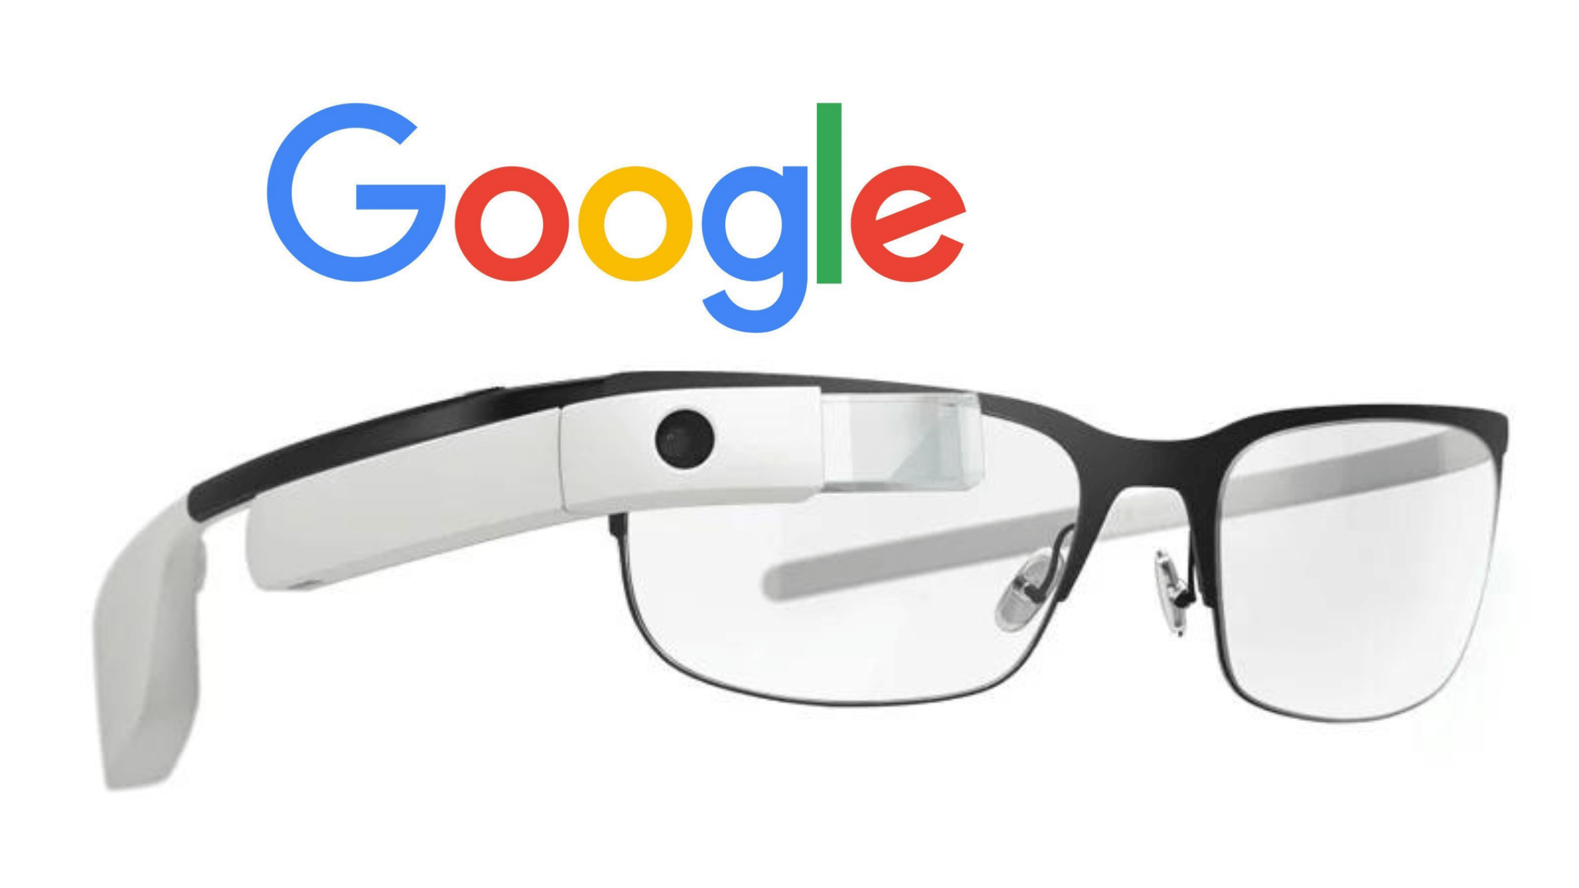
Early Smart Glasses Big Promises, Limited Reality
Early consumer smart glasses tried to do too much
Problems included:
Poor battery life
High cost
Limited accessibility support
Social stigma / bulky design
But they introduced the concept of wearable computing
Notes:
Now, wearable technology isn’t new.
The first wave of smart glasses — things like early Google Glass-style devices — promised a future where you could have information floating in front of you, where your glasses could record video, take photos, give directions, and act like a wearable computer.
For blind and low-vision users, there was immediate interest.
Because people thought:
“If this can show information visually for sighted users, maybe it can speak information for blind users.”
But the reality was that these early devices had serious limitations.
Battery life was often poor.
The devices were expensive.
They were bulky.
And accessibility was often not a priority.
Even if the technology was impressive, the software and user interface wasn’t always usable for blind users.
Also, socially, these glasses were very obvious.
You didn’t look like you were wearing glasses — you looked like you were wearing a computer on your face.
And for many people, that created stigma or discomfort.
But even though this wave didn’t fully succeed, it laid the groundwork.
It proved that wearable computing was possible.

Slide 5
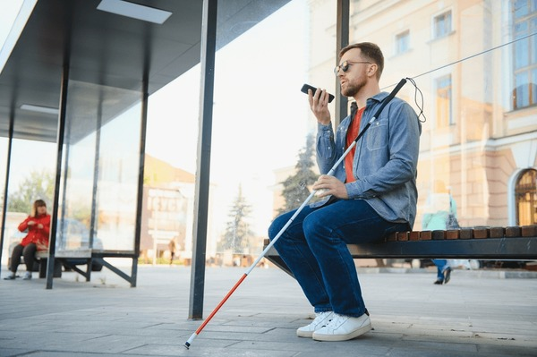
Why Wearables Matter
Phones are powerful… but not always practical
Wearables allow:
Hands-free access
Faster “in-the-moment” information
More independence in public spaces
Notes:
So first: why do wearable devices matter at all?
If we think about the last 15 years, smartphones have become one of the greatest assistive technology tools ever created.
They have screen readers, magnification, OCR, navigation apps, object recognition, and even AI assistants.
But smartphones have a practical limitation.
You have to hold them.
You have to take them out of your pocket or bag.
You have to point the camera correctly.
And in many real-life situations — like walking through a busy street, carrying shopping, using a cane, or holding someone’s arm — using a phone isn’t always convenient or safe.
That’s where wearables come in.
Wearables aim to make access to information:
faster
more discreet
and hands-free
Instead of pulling out a phone and opening an app, wearable tech ideally allows you to simply ask:
“What am I looking at?” “What does this sign say?” “Which item is this?”
And get an answer immediately.
But it’s important to say this early:
Wearables are not meant to replace independence skills.
They are support tools.
And in the best cases, they reduce effort and increase confidence.

Slide 6
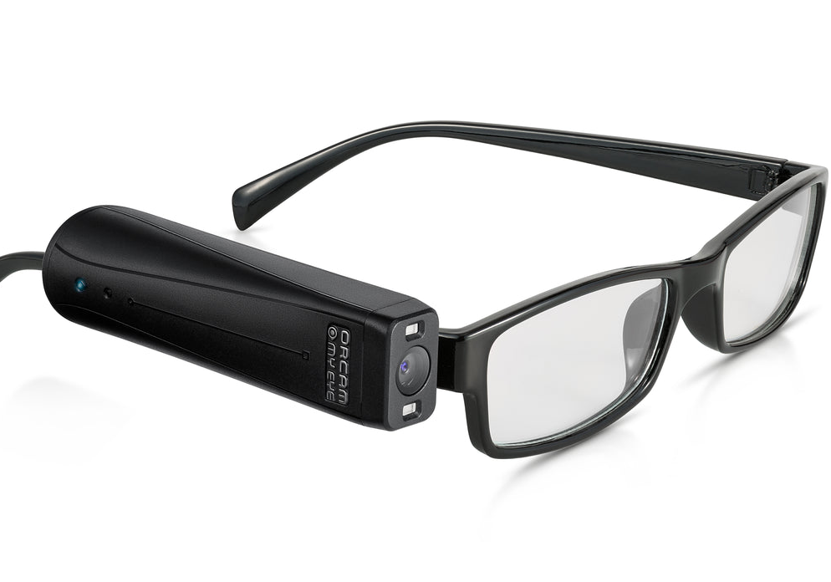
Specialist Wearables OrCam MyEye
Designed specifically for People who are Blind or Visually Impaired
Key features:
Text-to-speech reading
Face recognition
Product recognition
Money recognition
Notes:
So the next big step was the rise of specialist assistive wearables.
And the most well-known example here is OrCam MyEye.
OrCam was specifically designed for blind and low-vision users, and it attached to the side of a pair of glasses.
It had a camera, a speaker, and onboard processing.
And it focused on a few core tasks:
reading printed text aloud
recognising faces
recognising products
recognising money
and identifying objects
And for many people, this was genuinely life-changing.
Because for the first time, you could walk into a room, point your head at something, and hear:
“Milk.” “Cornflakes.” “Twenty euro note.” Or even “John is in front of you.”
And for someone with sight loss, those are meaningful pieces of information.
OrCam’s big strength was that it was designed as assistive technology first.
It wasn’t a general consumer gadget.
It was built with the blind user in mind.
But there were also real-world limitations.
The first one was cost.
These devices were expensive, and that immediately made access difficult.
The second was learning curve.
It required training and practice to use effectively.
It wasn’t just “put it on and it works”.
And the third limitation is one we still see today with all AI and recognition tools:
real life is messy.
Lighting conditions vary.
People move.
Packaging changes.
Background noise interferes.
And the device could sometimes be wrong, slow, or inconsistent.
So OrCam represented a major step forward, but it also highlighted the ongoing reality:
assistive wearables can be incredibly helpful, but they are not perfect.

Slide 7
Specialist Wearables 2 OrCam MyEye
Limitations:
Cost €3,500
Battery Life < 2 Hours
Not always reliable in real-world environments
‘Aesthetics’
Notes:
So the next big step was the rise of specialist assistive wearables.
And the most well-known example here is OrCam MyEye.
OrCam was specifically designed for blind and low-vision users, and it attached to the side of a pair of glasses.
It had a camera, a speaker, and onboard processing.
And it focused on a few core tasks:
reading printed text aloud
recognising faces
recognising products
recognising money
and identifying objects
And for many people, this was genuinely life-changing.
Because for the first time, you could walk into a room, point your head at something, and hear:
“Milk.” “Cornflakes.” “Twenty euro note.” Or even “John is in front of you.”
And for someone with sight loss, those are meaningful pieces of information.
OrCam’s big strength was that it was designed as assistive technology first.
It wasn’t a general consumer gadget.
It was built with the blind user in mind.
But there were also real-world limitations.
The first one was cost.
These devices were expensive, and that immediately made access difficult.
The second was learning curve.
It required training and practice to use effectively.
It wasn’t just “put it on and it works”.
And the third limitation is one we still see today with all AI and recognition tools:
real life is messy.
Lighting conditions vary.
People move.
Packaging changes.
Background noise interferes.
And the device could sometimes be wrong, slow, or inconsistent.
So OrCam represented a major step forward, but it also highlighted the ongoing reality:
assistive wearables can be incredibly helpful, but they are not perfect.

Slide 8
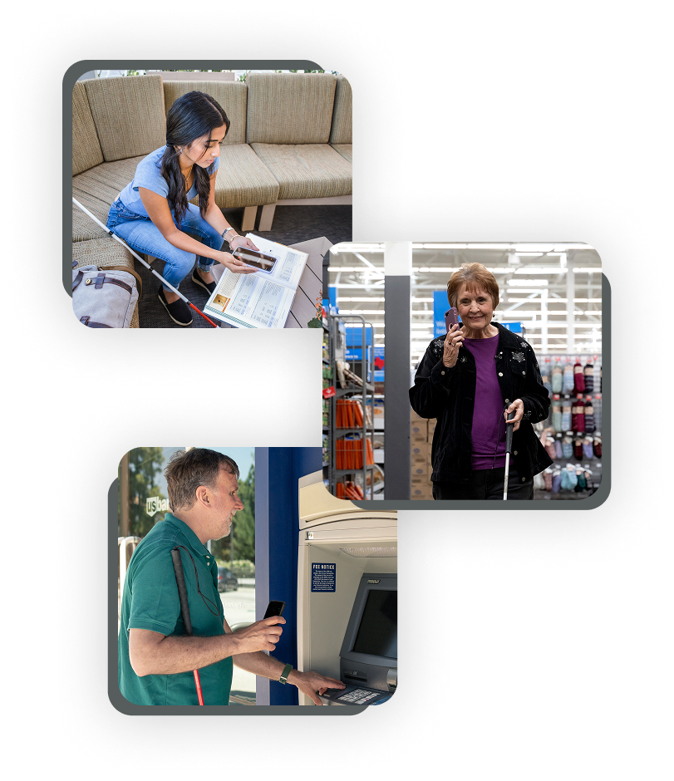

Live Human Help Aira (and Similar Services)
Aira introduced a different idea
Remote human assistance through a camera feed
Strengths:
Human judgment
Navigation support
Complex situations
Notes:
Now, alongside AI-based devices like OrCam, we also saw a different model emerge.
And the best example is Aira.
Aira introduced a service where blind users could wear a camera — sometimes in glasses, sometimes on a phone — and connect to a trained remote agent.
That agent could see what the user was seeing and provide real-time help.
This was a big shift because instead of relying on computer recognition, it relied on human judgment.
So the agent could describe complex scenes, answer questions, guide someone through an unfamiliar environment, help with travel, or read unusual information that AI might struggle with.
The major strength of Aira and similar services is flexibility.
Humans can interpret situations in ways AI often can’t.
They can respond to uncertainty.
They can handle context.
And they can give confidence.
But there were limitations too.
The service typically required a subscription.
It depended on internet connectivity.
And availability varied by country.
So while this was a powerful solution, it wasn’t always accessible to everyone.
But Aira showed something important:
the camera and the audio link mattered just as much as the intelligence behind it.

Slide 9
Live Human Help Aira
Limitations:
Subscription costs
Connectivity needed
Not always available in every region
Notes:
Now, alongside AI-based devices like OrCam, we also saw a different model emerge.
And the best example is Aira.
Aira introduced a service where blind users could wear a camera — sometimes in glasses, sometimes on a phone — and connect to a trained remote agent.
That agent could see what the user was seeing and provide real-time help.
This was a big shift because instead of relying on computer recognition, it relied on human judgment.
So the agent could describe complex scenes, answer questions, guide someone through an unfamiliar environment, help with travel, or read unusual information that AI might struggle with.
The major strength of Aira and similar services is flexibility.
Humans can interpret situations in ways AI often can’t.
They can respond to uncertainty.
They can handle context.
And they can give confidence.
But there were limitations too.
The service typically required a subscription.
It depended on internet connectivity.
And availability varied by country.
So while this was a powerful solution, it wasn’t always accessible to everyone.
But Aira showed something important:
the camera and the audio link mattered just as much as the intelligence behind it.

Slide 10

What Changed AI at Consumer Level
AI image recognition becoming mainstream
Accessibility shifted from “specialist add-on” to expected feature
Notes:
Now we come to the turning point.
Over the last decade, mainstream technology has caught up in a huge way.
We now have:
much better cameras in small devices
better microphones
faster processing
better battery performance
and far better connectivity through mobile networks
But the biggest shift has been AI becoming mainstream.
Computer vision is no longer rare.
OCR is now common.
Image recognition is now built into everyday apps.
And voice assistants have improved dramatically.
We’ve moved from a world where assistive technology needed its own special hardware, to a world where mainstream devices already contain many of the core building blocks.
And that’s what leads us to Meta.

Slide 11
What Changed 2 AI at Consumer Level
But also:
Faster mobile networks
Better cameras
Better microphones
Better battery technology
Notes:
Now we come to the turning point.
Over the last decade, mainstream technology has caught up in a huge way.
We now have:
much better cameras in small devices
better microphones
faster processing
better battery performance
and far better connectivity through mobile networks
But the biggest shift has been AI becoming mainstream.
Computer vision is no longer rare.
OCR is now common.
Image recognition is now built into everyday apps.
And voice assistants have improved dramatically.
We’ve moved from a world where assistive technology needed its own special hardware, to a world where mainstream devices already contain many of the core building blocks.
And that’s what leads us to Meta.

Slide 12
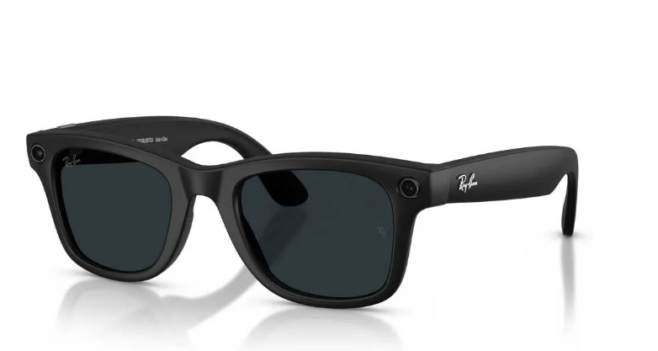
Meta Smart Glasses Why They’re Different
Consumer Design Aesthetic
RayBan & Oakley
Open-ear audio
Built-in camera
Voice interaction
Notes:
So let’s talk about Meta smart glasses.
What makes Meta’s approach different isn’t that it invented the idea of smart glasses.
It’s that Meta brought smart glasses into the mainstream with a consumer design.
These glasses look like normal Ray-Bans.
That matters.
Because it reduces stigma.
It increases adoption.
And it makes the user feel like they are wearing something socially normal.
The glasses include:
a built-in camera
open-ear speakers
microphones
and voice interaction
And where available, Meta AI features can allow users to ask questions like:
“What am I looking at?” “Read this sign.” “What does this label say?” “Describe this room.”
And the key difference is this:
OrCam was built as assistive technology and marketed to disability.
Meta smart glasses are built as a mainstream consumer product.
Blind users are benefiting because accessibility is now piggybacking on mainstream innovation.
This is similar to what happened with smartphones.
The iPhone wasn’t designed only for blind people.
But it became one of the most powerful tools for blind people.
And that’s the pattern we’re now seeing again.
However, we do need to be realistic.
Meta smart glasses are not a replacement for a guide dog, a cane, or mobility training.
They’re useful for quick tasks.
But they’re not consistent enough for high-risk decision-making.

Slide 13
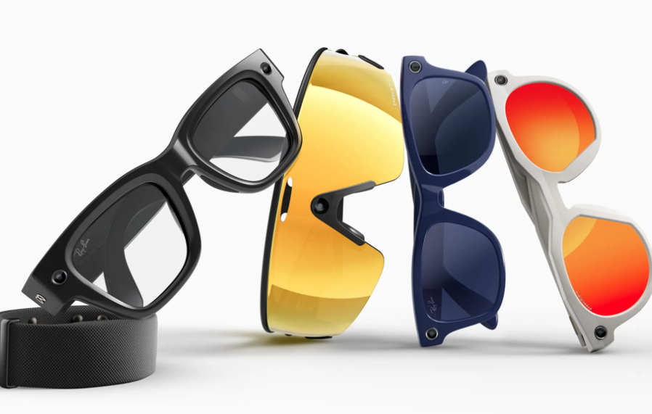
Meta Smart Glasses 2 Why They’re Different
AI features:
Identify objects
Read short text
Describe surroundings
Mainstream product with access benefits
Notes:
So let’s talk about Meta smart glasses.
What makes Meta’s approach different isn’t that it invented the idea of smart glasses.
It’s that Meta brought smart glasses into the mainstream with a consumer design.
These glasses look like normal Ray-Bans.
That matters.
Because it reduces stigma.
It increases adoption.
And it makes the user feel like they are wearing something socially normal.
The glasses include:
a built-in camera
open-ear speakers
microphones
and voice interaction
And where available, Meta AI features can allow users to ask questions like:
“What am I looking at?” “Read this sign.” “What does this label say?” “Describe this room.”
And the key difference is this:
OrCam was built as assistive technology and marketed to disability.
Meta smart glasses are built as a mainstream consumer product.
Blind users are benefiting because accessibility is now piggybacking on mainstream innovation.
This is similar to what happened with smartphones.
The iPhone wasn’t designed only for blind people.
But it became one of the most powerful tools for blind people.
And that’s the pattern we’re now seeing again.
However, we do need to be realistic.
Meta smart glasses are not a replacement for a guide dog, a cane, or mobility training.
They’re useful for quick tasks.
But they’re not consistent enough for high-risk decision-making.

Slide 14
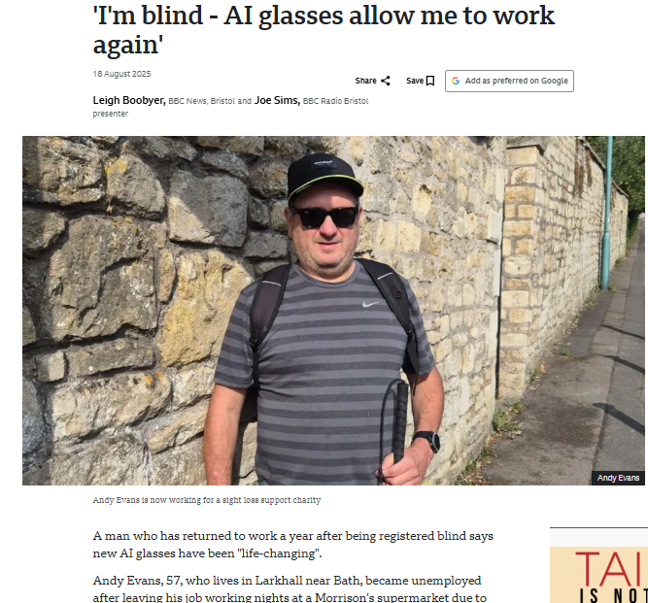
Real-Life Use Cases What People Actually Do
Reading quick information:
Labels
Menus
Signs
Notes:
Now let’s look at how people actually use these glasses in real life.
Because what’s interesting is that most people don’t use them constantly.
They use them in short bursts, for quick information.
For example:
A person might be cooking and want to confirm a tin.
Instead of pulling out a phone, they can simply ask:
“What is this?”
Or they might be in a café and want to read a menu board.
Or they might be shopping and want to check a price label.
Or they might be walking through a building and want to confirm:
“Is this the right door?”
Another common use is confidence in social settings.
If someone struggles with recognising faces, glasses-based tools can sometimes assist with identification — though that’s also an area that raises privacy questions and is not always reliable.
Another practical use case is reading quick text like receipts or labels.
And what I often hear from people is this:
they don’t want to replace their phone.
They want something that reduces friction.
They want less effort.
Less stopping and starting.
Less awkward camera pointing.
And in that sense, wearable glasses can be extremely helpful.
But again, we must be honest.
AI can misread text.
It can misidentify objects.
It can misunderstand the environment.
And that brings us to the most important point.

Slide 15
Real-Life Use Cases 2 What People Actually Do
Notes:
Now let’s look at how people actually use these glasses in real life.
Because what’s interesting is that most people don’t use them constantly.
They use them in short bursts, for quick information.
For example:
A person might be cooking and want to confirm a tin.
Instead of pulling out a phone, they can simply ask:
“What is this?”
Or they might be in a café and want to read a menu board.
Or they might be shopping and want to check a price label.
Or they might be walking through a building and want to confirm:
“Is this the right door?”
Another common use is confidence in social settings.
If someone struggles with recognising faces, glasses-based tools can sometimes assist with identification — though that’s also an area that raises privacy questions and is not always reliable.
Another practical use case is reading quick text like receipts or labels.
And what I often hear from people is this:
they don’t want to replace their phone.
They want something that reduces friction.
They want less effort.
Less stopping and starting.
Less awkward camera pointing.
And in that sense, wearable glasses can be extremely helpful.
But again, we must be honest.
AI can misread text.
It can misidentify objects.
It can misunderstand the environment.
And that brings us to the most important point.

Slide 16
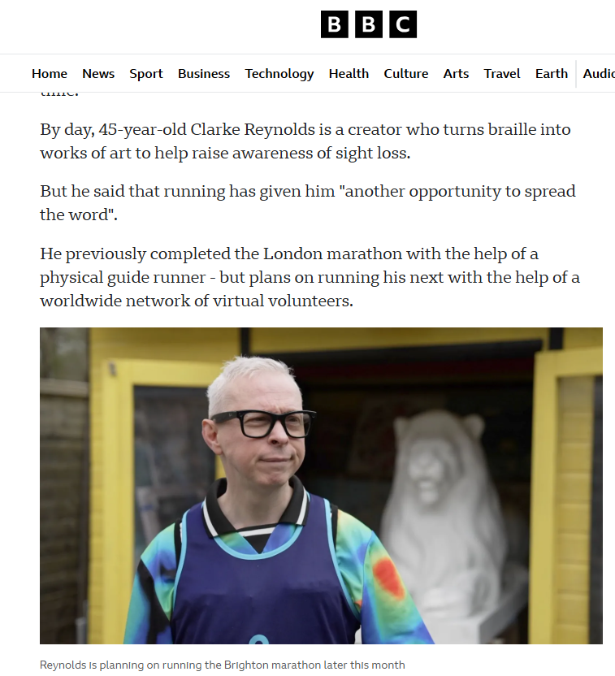
Real-Life Use Cases 3 What People Actually Do
Independence in public spaces:
Checking bus numbers
Receipts
Prices
Notes:
Now let’s look at how people actually use these glasses in real life.
Because what’s interesting is that most people don’t use them constantly.
They use them in short bursts, for quick information.
For example:
A person might be cooking and want to confirm a tin.
Instead of pulling out a phone, they can simply ask:
“What is this?”
Or they might be in a café and want to read a menu board.
Or they might be shopping and want to check a price label.
Or they might be walking through a building and want to confirm:
“Is this the right door?”
Another common use is confidence in social settings.
If someone struggles with recognising faces, glasses-based tools can sometimes assist with identification — though that’s also an area that raises privacy questions and is not always reliable.
Another practical use case is reading quick text like receipts or labels.
And what I often hear from people is this:
they don’t want to replace their phone.
They want something that reduces friction.
They want less effort.
Less stopping and starting.
Less awkward camera pointing.
And in that sense, wearable glasses can be extremely helpful.
But again, we must be honest.
AI can misread text.
It can misidentify objects.
It can misunderstand the environment.
And that brings us to the most important point.

Slide 17
Real-Life Use Cases 4 What People Actually Do
Notes:
Now let’s look at how people actually use these glasses in real life.
Because what’s interesting is that most people don’t use them constantly.
They use them in short bursts, for quick information.
For example:
A person might be cooking and want to confirm a tin.
Instead of pulling out a phone, they can simply ask:
“What is this?”
Or they might be in a café and want to read a menu board.
Or they might be shopping and want to check a price label.
Or they might be walking through a building and want to confirm:
“Is this the right door?”
Another common use is confidence in social settings.
If someone struggles with recognising faces, glasses-based tools can sometimes assist with identification — though that’s also an area that raises privacy questions and is not always reliable.
Another practical use case is reading quick text like receipts or labels.
And what I often hear from people is this:
they don’t want to replace their phone.
They want something that reduces friction.
They want less effort.
Less stopping and starting.
Less awkward camera pointing.
And in that sense, wearable glasses can be extremely helpful.
But again, we must be honest.
AI can misread text.
It can misidentify objects.
It can misunderstand the environment.
And that brings us to the most important point.

Slide 18
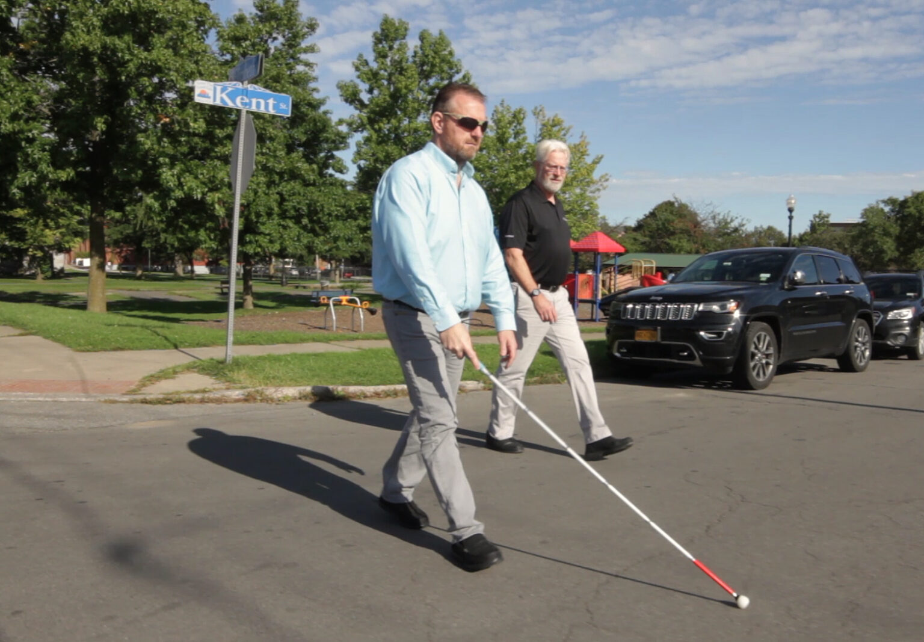
Real-Life Use Cases
But:
Not consistent enough for safely navigating
Notes:
Now let’s look at how people actually use these glasses in real life.
Because what’s interesting is that most people don’t use them constantly.
They use them in short bursts, for quick information.
For example:
A person might be cooking and want to confirm a tin.
Instead of pulling out a phone, they can simply ask:
“What is this?”
Or they might be in a café and want to read a menu board.
Or they might be shopping and want to check a price label.
Or they might be walking through a building and want to confirm:
“Is this the right door?”
Another common use is confidence in social settings.
If someone struggles with recognising faces, glasses-based tools can sometimes assist with identification — though that’s also an area that raises privacy questions and is not always reliable.
Another practical use case is reading quick text like receipts or labels.
And what I often hear from people is this:
they don’t want to replace their phone.
They want something that reduces friction.
They want less effort.
Less stopping and starting.
Less awkward camera pointing.
And in that sense, wearable glasses can be extremely helpful.
But again, we must be honest.
AI can misread text.
It can misidentify objects.
It can misunderstand the environment.
And that brings us to the most important point.

Slide 19

An Important Message Support Pathways
Wearables are helpful. But:
Orientation & Mobility skills remain essential
AI can be wrong, or unavailable
Notes:
So I want to finish with what I think is the most important message.
Wearable technology is exciting.
It’s improving rapidly.
And it is genuinely empowering for many blind and low-vision users.
But it does not replace Orientation and Mobility skills.
O&M training is still the most reliable and safest method for independent travel.
A cane does not crash.
A guide dog does not need Wi-Fi.
A well-trained traveller does not depend on battery life.
AI glasses can support someone, but they cannot be trusted as the primary tool for navigation or safety decisions.
So in the best case, we see these technologies as layered support.
You have your foundational skills first.
Then you add tools like smartphones.
Then you add wearable support like smart glasses, if appropriate.
And finally, I want to highlight Vision Ireland.
Vision Ireland provides services free of charge to people who are visually impaired, including:
technology training
low vision support
daily living skills
advice on assistive technology options
and support pathways for accessing equipment
And importantly: referrals can be made by anyone in the community.
It doesn’t have to be a specialist referral.
If someone is experiencing sight loss and needs support, they can be connected in.
So I’ll end with this message:
The goal of wearable technology isn’t to replace independence skills. It’s to enhance independence and reduce barriers.
Thanks very much for listening.

Slide 20
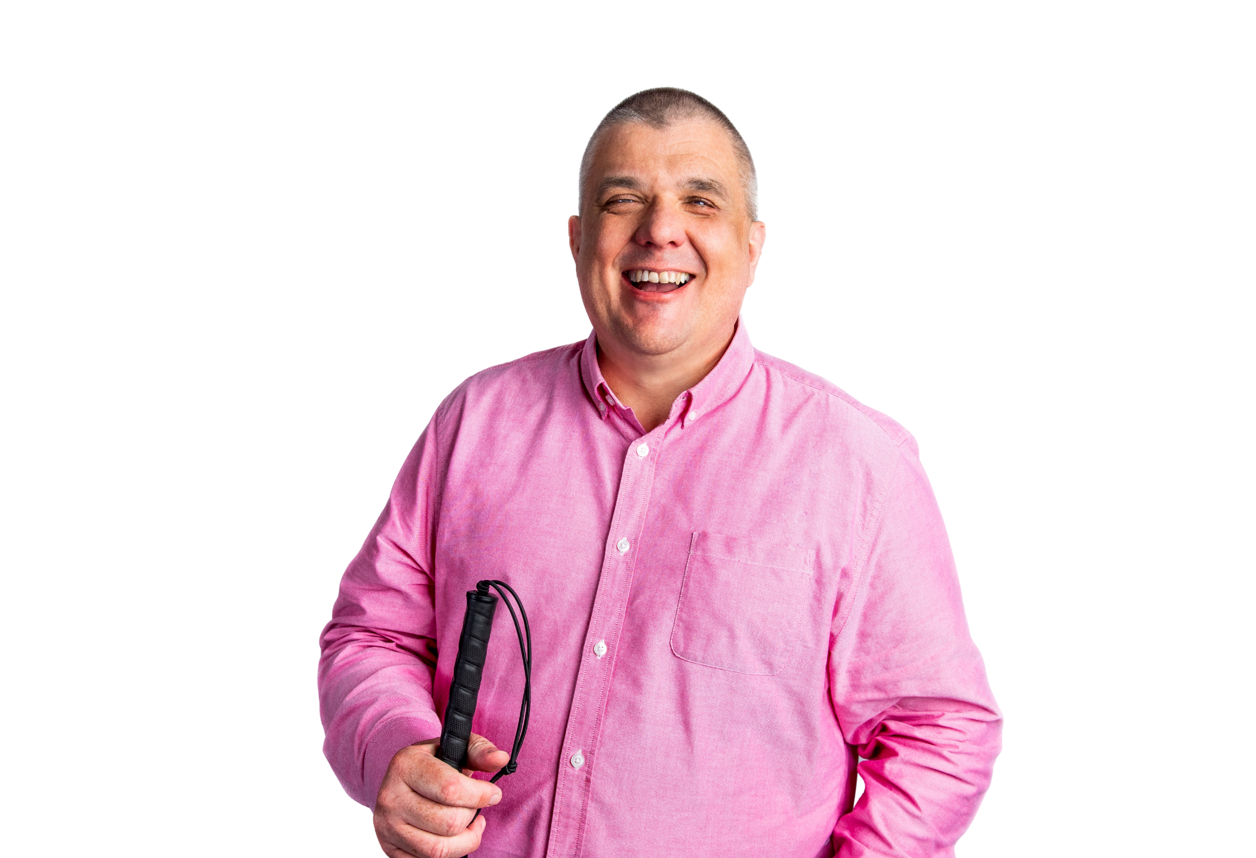
An Important Message 2 Support Pathways
Vision Ireland support:
Technology training
Low vision services
Independent living skills support
Referrals can come from anyone
Notes:
So I want to finish with what I think is the most important message.
Wearable technology is exciting.
It’s improving rapidly.
And it is genuinely empowering for many blind and low-vision users.
But it does not replace Orientation and Mobility skills.
O&M training is still the most reliable and safest method for independent travel.
A cane does not crash.
A guide dog does not need Wi-Fi.
A well-trained traveller does not depend on battery life.
AI glasses can support someone, but they cannot be trusted as the primary tool for navigation or safety decisions.
So in the best case, we see these technologies as layered support.
You have your foundational skills first.
Then you add tools like smartphones.
Then you add wearable support like smart glasses, if appropriate.
And finally, I want to highlight Vision Ireland.
Vision Ireland provides services free of charge to people who are visually impaired, including:
technology training
low vision support
daily living skills
advice on assistive technology options
and support pathways for accessing equipment
And importantly: referrals can be made by anyone in the community.
It doesn’t have to be a specialist referral.
If someone is experiencing sight loss and needs support, they can be connected in.
So I’ll end with this message:
The goal of wearable technology isn’t to replace independence skills. It’s to enhance independence and reduce barriers.
Thanks very much for listening.

Slide 21

Frequently Asked Questions
Do the glasses come in different styles?
What is the battery life?
How do people know when the glasses are recording?
How effective is the real time scene description for people with low or no vision?
How discreet is the technology for social comfort?
Are these glasses useful as mobility aids?
Can you get transition lenses or prescriptions lenses?
Are they compatible with all smartphones?
Notes:
1. Do the glasses come in different styles?
Ray-Ban Meta smart glasses styles include:
Wayfarer
Headliner
Skyler
Each style offers a distinct look, with variations in frame shape and color options.
They are also water resistant to light rain but not submersion
2. What is the battery life?
Active Use: 4-6 hours for standard activities like taking photos, listening to audio, or handling calls, with more intensive processes (streaming, video recording) resulting in shorter periods.
Standby Time: 14-19 hours when not actively using core features.
Charging Case: The case provides up to 36 hours of total use and can quickly recharge the glasses, with a full charge in 60-75 minutes and a 15-minute charge providing roughly 1 to 1.5 hours of use.
3. How do people know when the glasses are recording?
While recording a front-facing white capture LED lights up on the glasses during video recording or photo capture. This LED is designed to be visible to others.
For photos, both the capture LED and an inward-facing notification LED blink white once.
For videos, both LEDs stay solid white while recording. Additionally, the glasses may emit an audible sound to confirm photo capture, further signaling activity.
4. How effective is the real time scene description for people with low or no vision?
Scene Description and Object Recognition
The glasses use built-in cameras and Meta's AI to describe scenes and objects. Scene description is accurate for common settings and text reading with OCR (optical character recognition) works reliably for most printed materials.
5. How discreet is the technology for social comfort?
Almost identical to regular Ray-Ban models, avoiding the bulky or conspicuous look often associated with accessible tech.
The lightweight, traditional design helps users feel more included and confident, making them suitable for everyday social interactions.
The glasses are not constantly recording; speech and environment data are only stored after explicit activation, such as using the “Hey Meta” wake phrase.
An LED indicator on the glasses lights up whenever the camera is actively recording, designed to alert bystanders that photos or videos are being captured.
6. Are these glasses useful as mobility aids?
While they can give street names and identify obstacles, they do not offer continuous, real-time navigation or the reliability needed for use as dedicated mobility aids
7. Can you get transition lenses or prescriptions lenses?
The lenses in the Ray-Ban Meta glasses do come with an option for transition lenses that change tint in sunlight.
They automatically darken when exposed to UV light outdoors and return to clear indoors.
8. Are they compatible with all smartphones?
The glasses are compatible with smartphones running iOS 14.2 and above, or Android 10 and above. Note that some Samsung phones like the A16 are reported as not compatible.
The glasses require the Meta View app which must be downloadable on the phone for connectivity and use

Slide 22
Contact Info
vi.ie
1800 911 110
info@vi.ie

