Slide 1
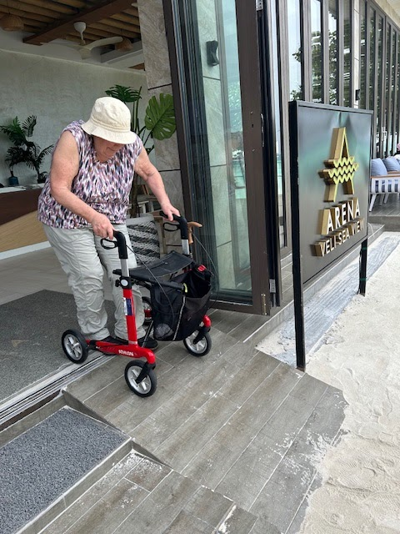

Personal Tips on Accessible Travel … or how to be more independent in an inaccessible world! Elizabeth M. Dalton, Ph.D. elizabethmdalton@gmail.com

Slide 2
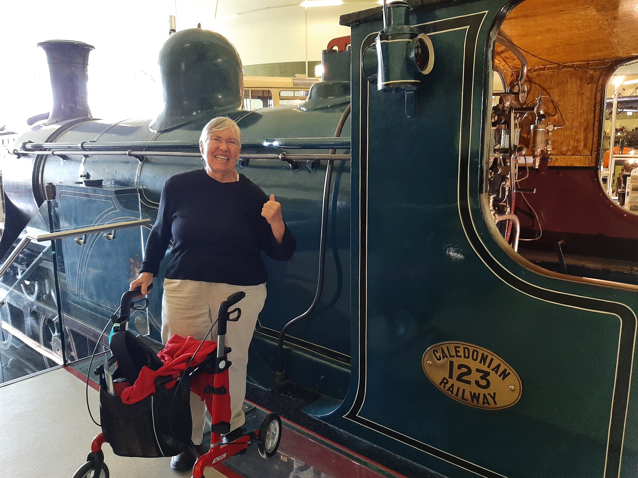
Who am I??
I have many identities…
70+ woman
Mother
Retired special education professor
Book & journal editor
Colleague and friend
Frequent traveler
Person with physical and mobility limitations
Transportation Museum. Glasgow, Scotland

Slide 3

What I think about…
Accessibility
Planning
Individual
Environment
Task
Tools
Based on SETT Framework (Zabala, 1990)

Slide 4
Universal Design
Equitable use
Size and space
Flexibility in use
Developed by
Ronald Mace, et al. (1997) at North Carolina State University, Center for Universal Design.
The purpose of the Principles is to guide the design of environments, products and communications.
Universal Design
Low physical effort
Simple intuitive use
Tolerance for error
Perceptible information

Slide 5
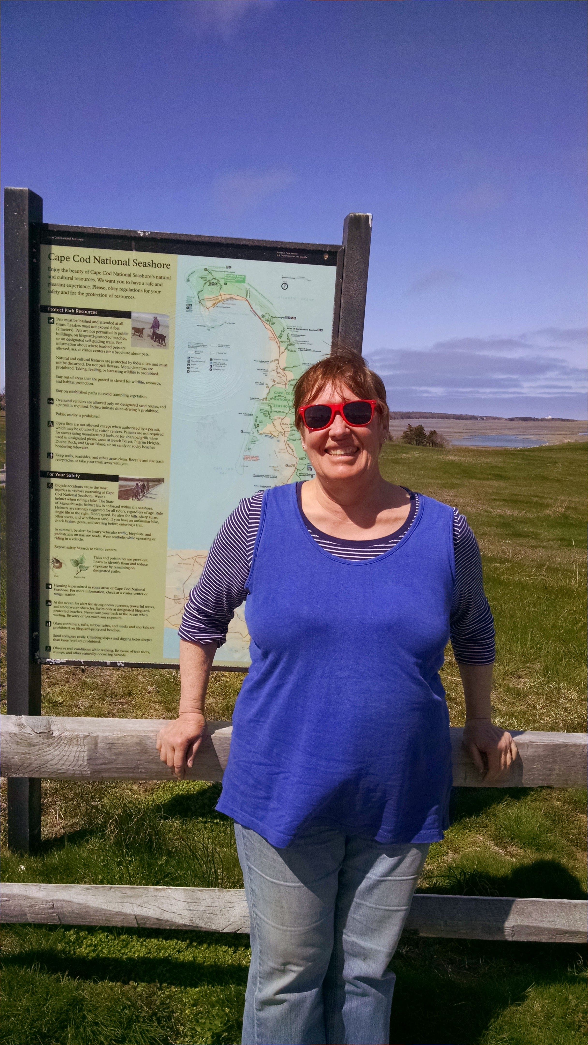
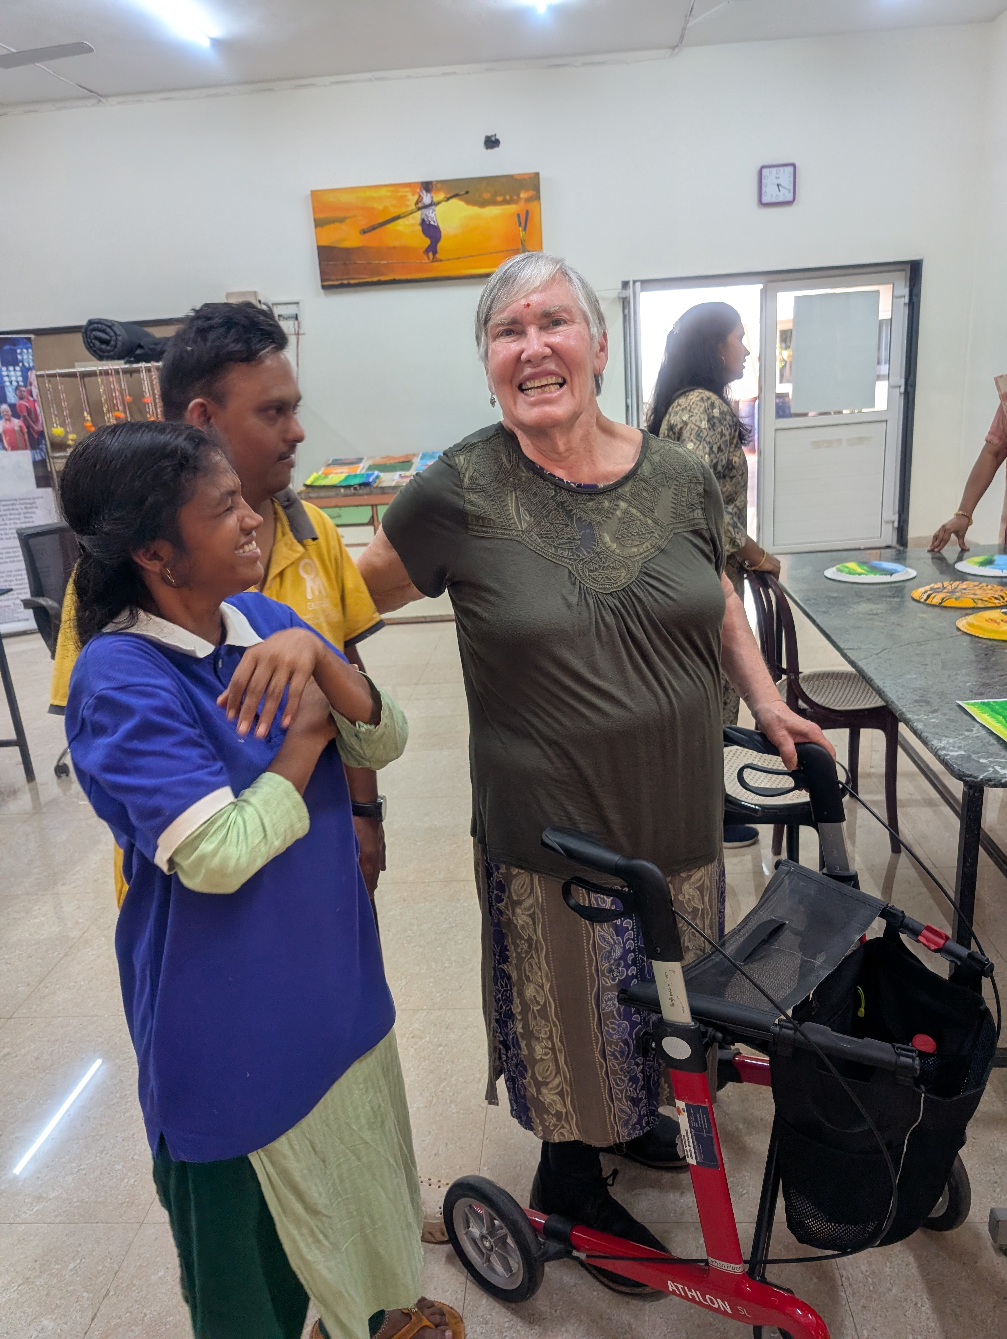
Life often changes…
Cape Cod
2015
Om Abode
2025

Slide 6
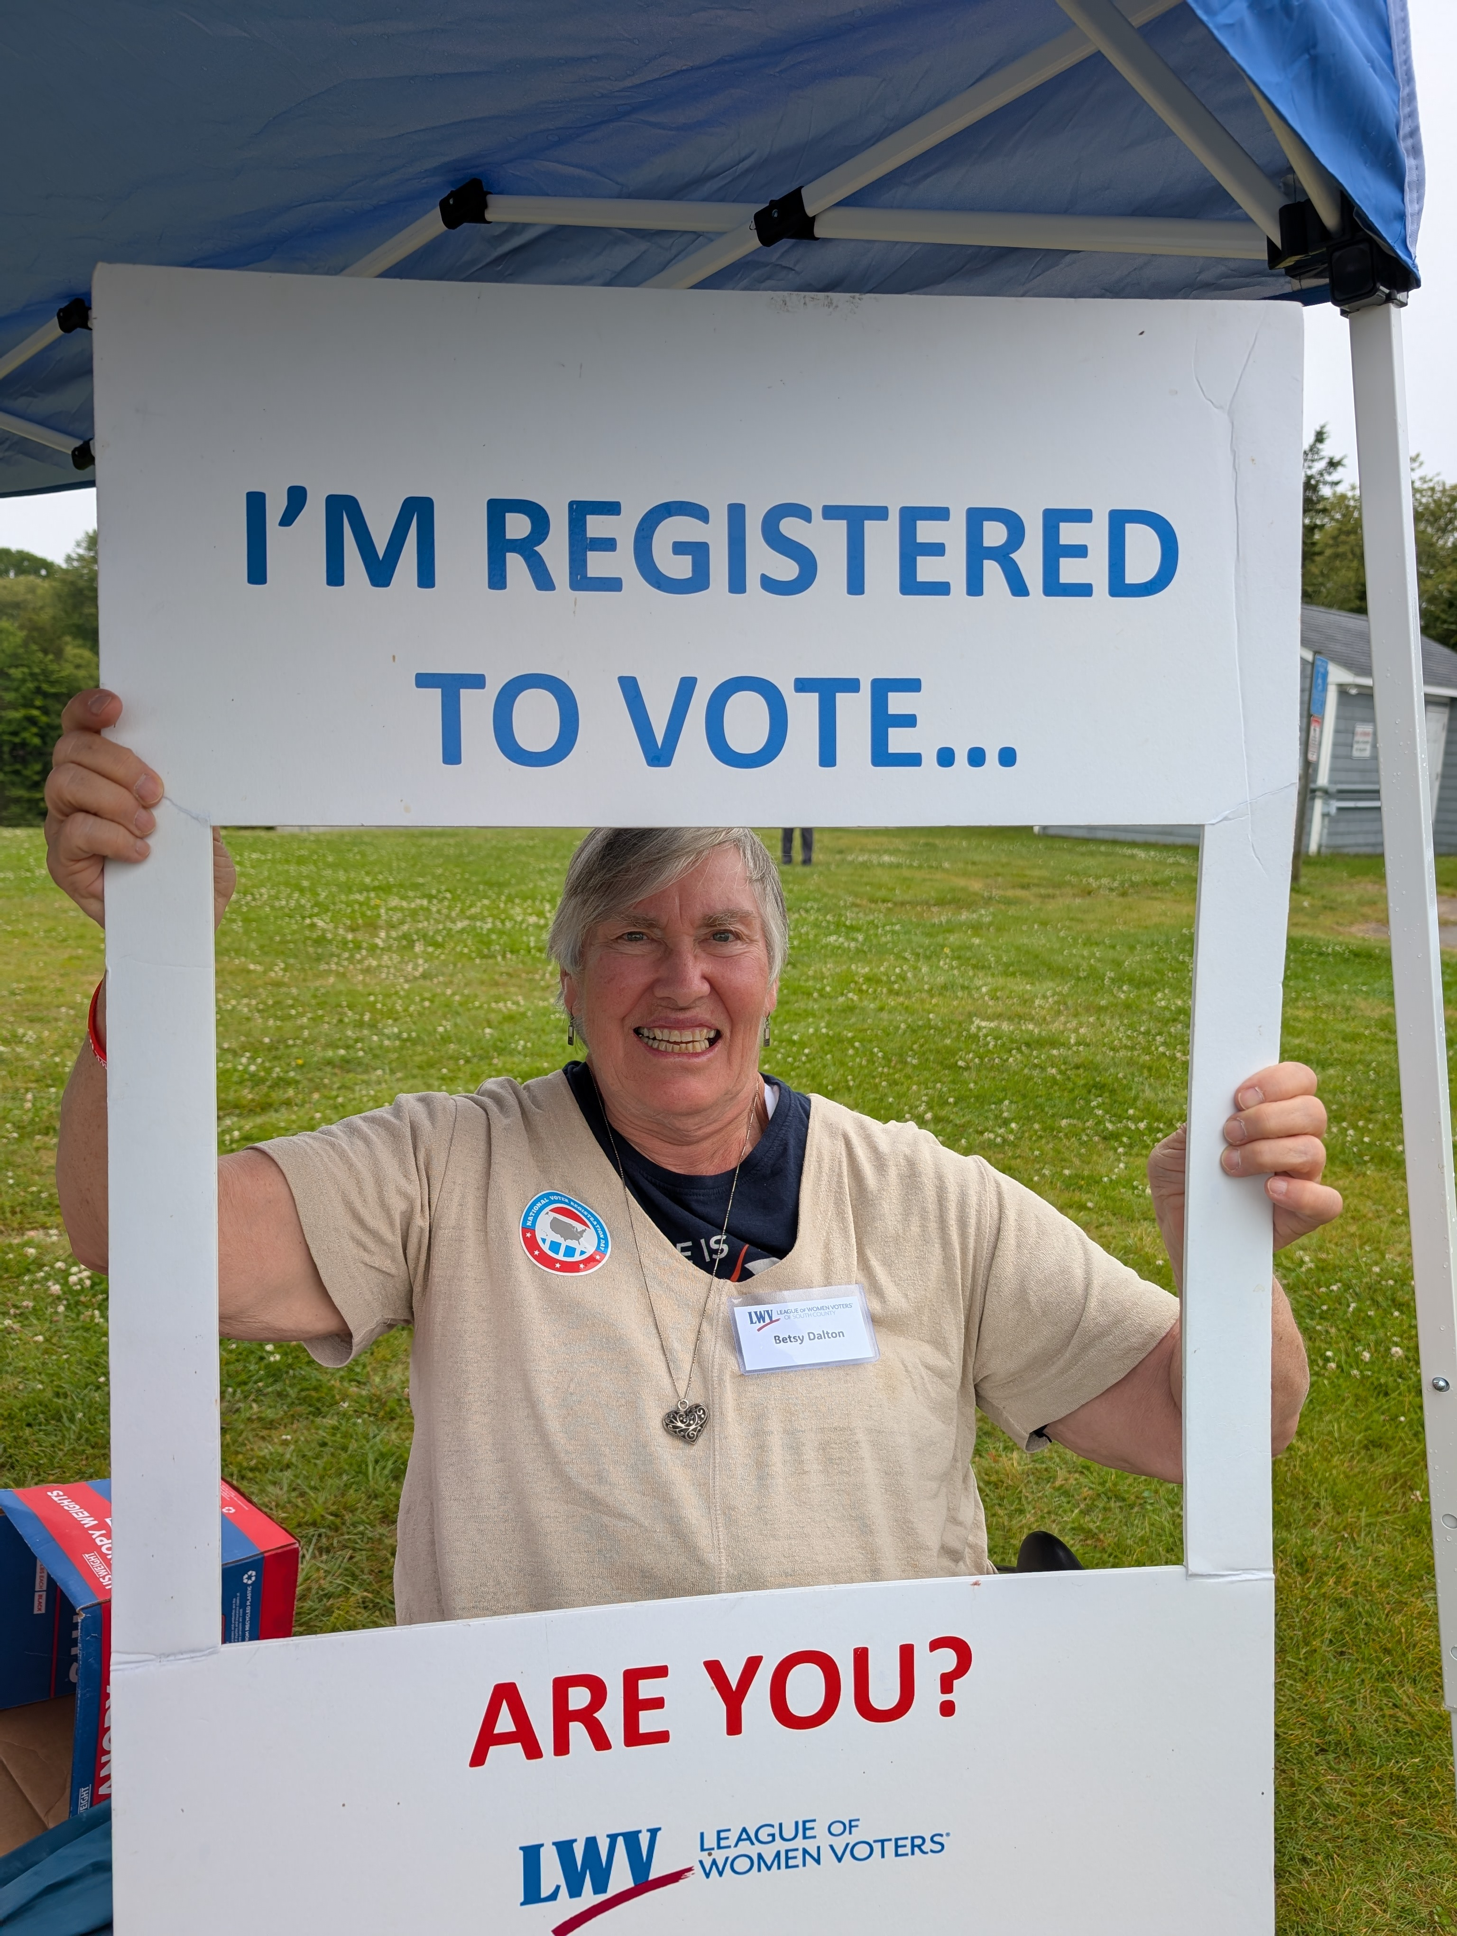
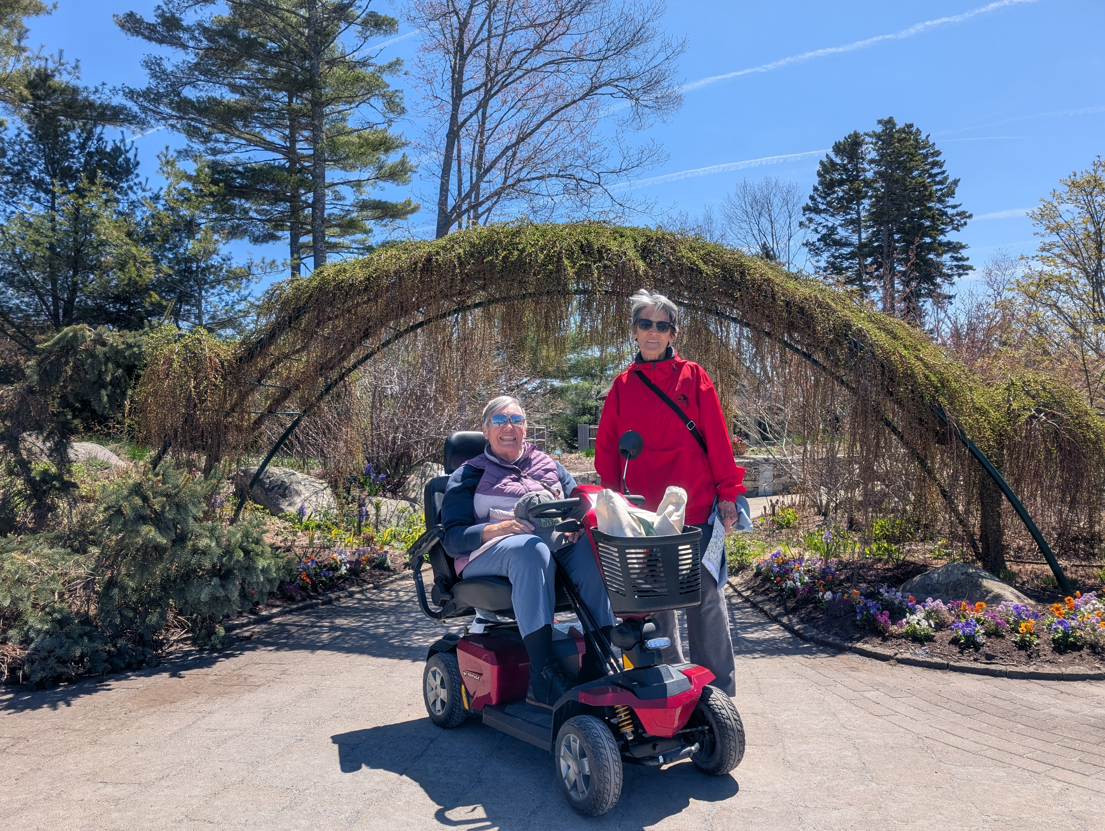
But our goals often are the same.
Here are some of mine…
To remain active
To meaningfully participate
To continue to grow, professionally
& personally
To keep traveling
To enjoy the life ahead!

Slide 7
Let’s talk about traveling…
Accessibility Planning – What do I know? What are my questions?
Individual – personal access needs
Walking support; carrying – light & heavy; stair assistance; accessible bathroom; etc.
Environment
Where will I travel? How will I be traveling? What are the internal and external environments? Who will be there with me, or will I be alone?
Task
What am I planning to do? What activities are involved? Access challenges?
Tools
What tools do I have? What else might be needed? Resources?

Slide 8
“Oh, the places I’ve been to…” (Dr. Seuss)
South Africa
Namibia
Tanzania & Zanzibar
India
Maldives
Australia & Tasmania
New Zealand
Japan, Brunei
Denmark, Sweden, Germany, Hungary, Austria, UK, Ireland, Spain
UAE, Kuwait, Qatar
And probably more…
In the United States…
Maine
Massachusetts & Cape Cod
Florida
New York & New Jersey
Alabama & Georgia
North Carolina
Colorado & Wyoming
Texas
California & Hawaii
And DEFINITELY MORE!

Slide 9
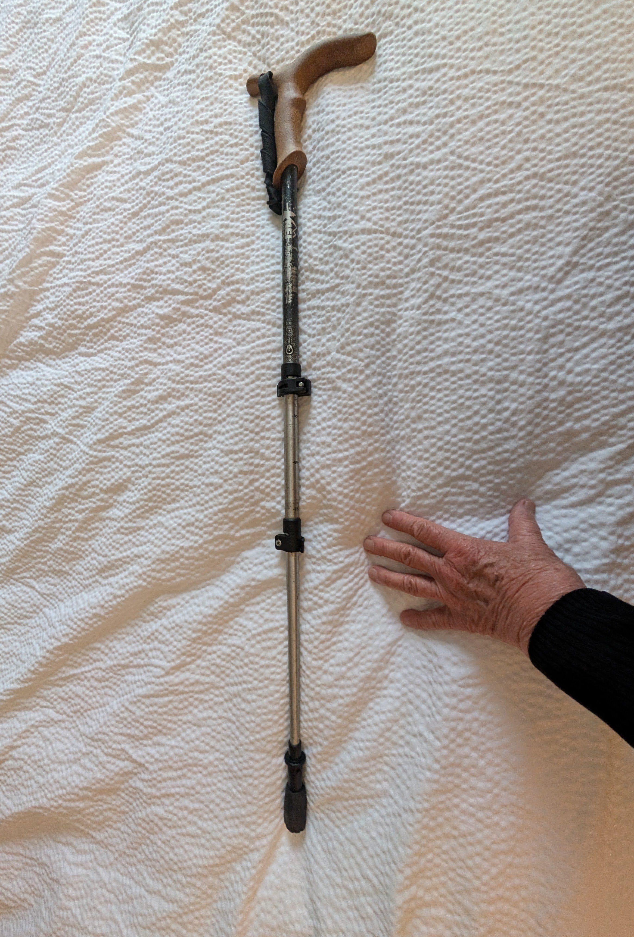
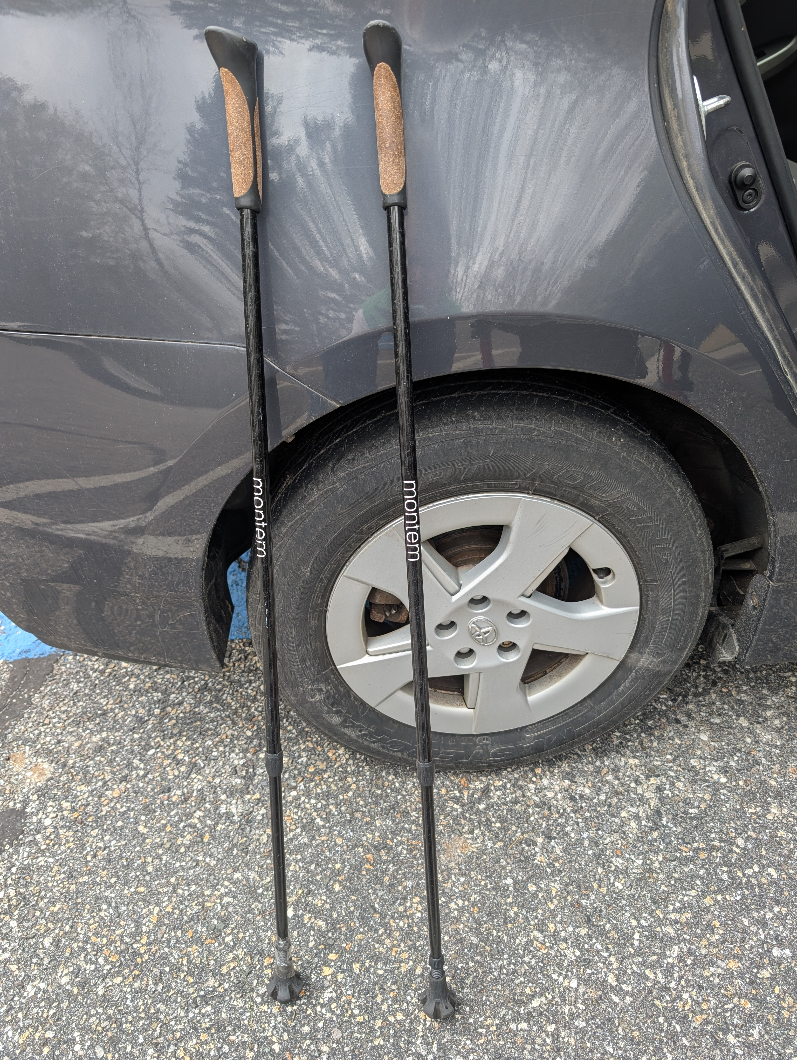
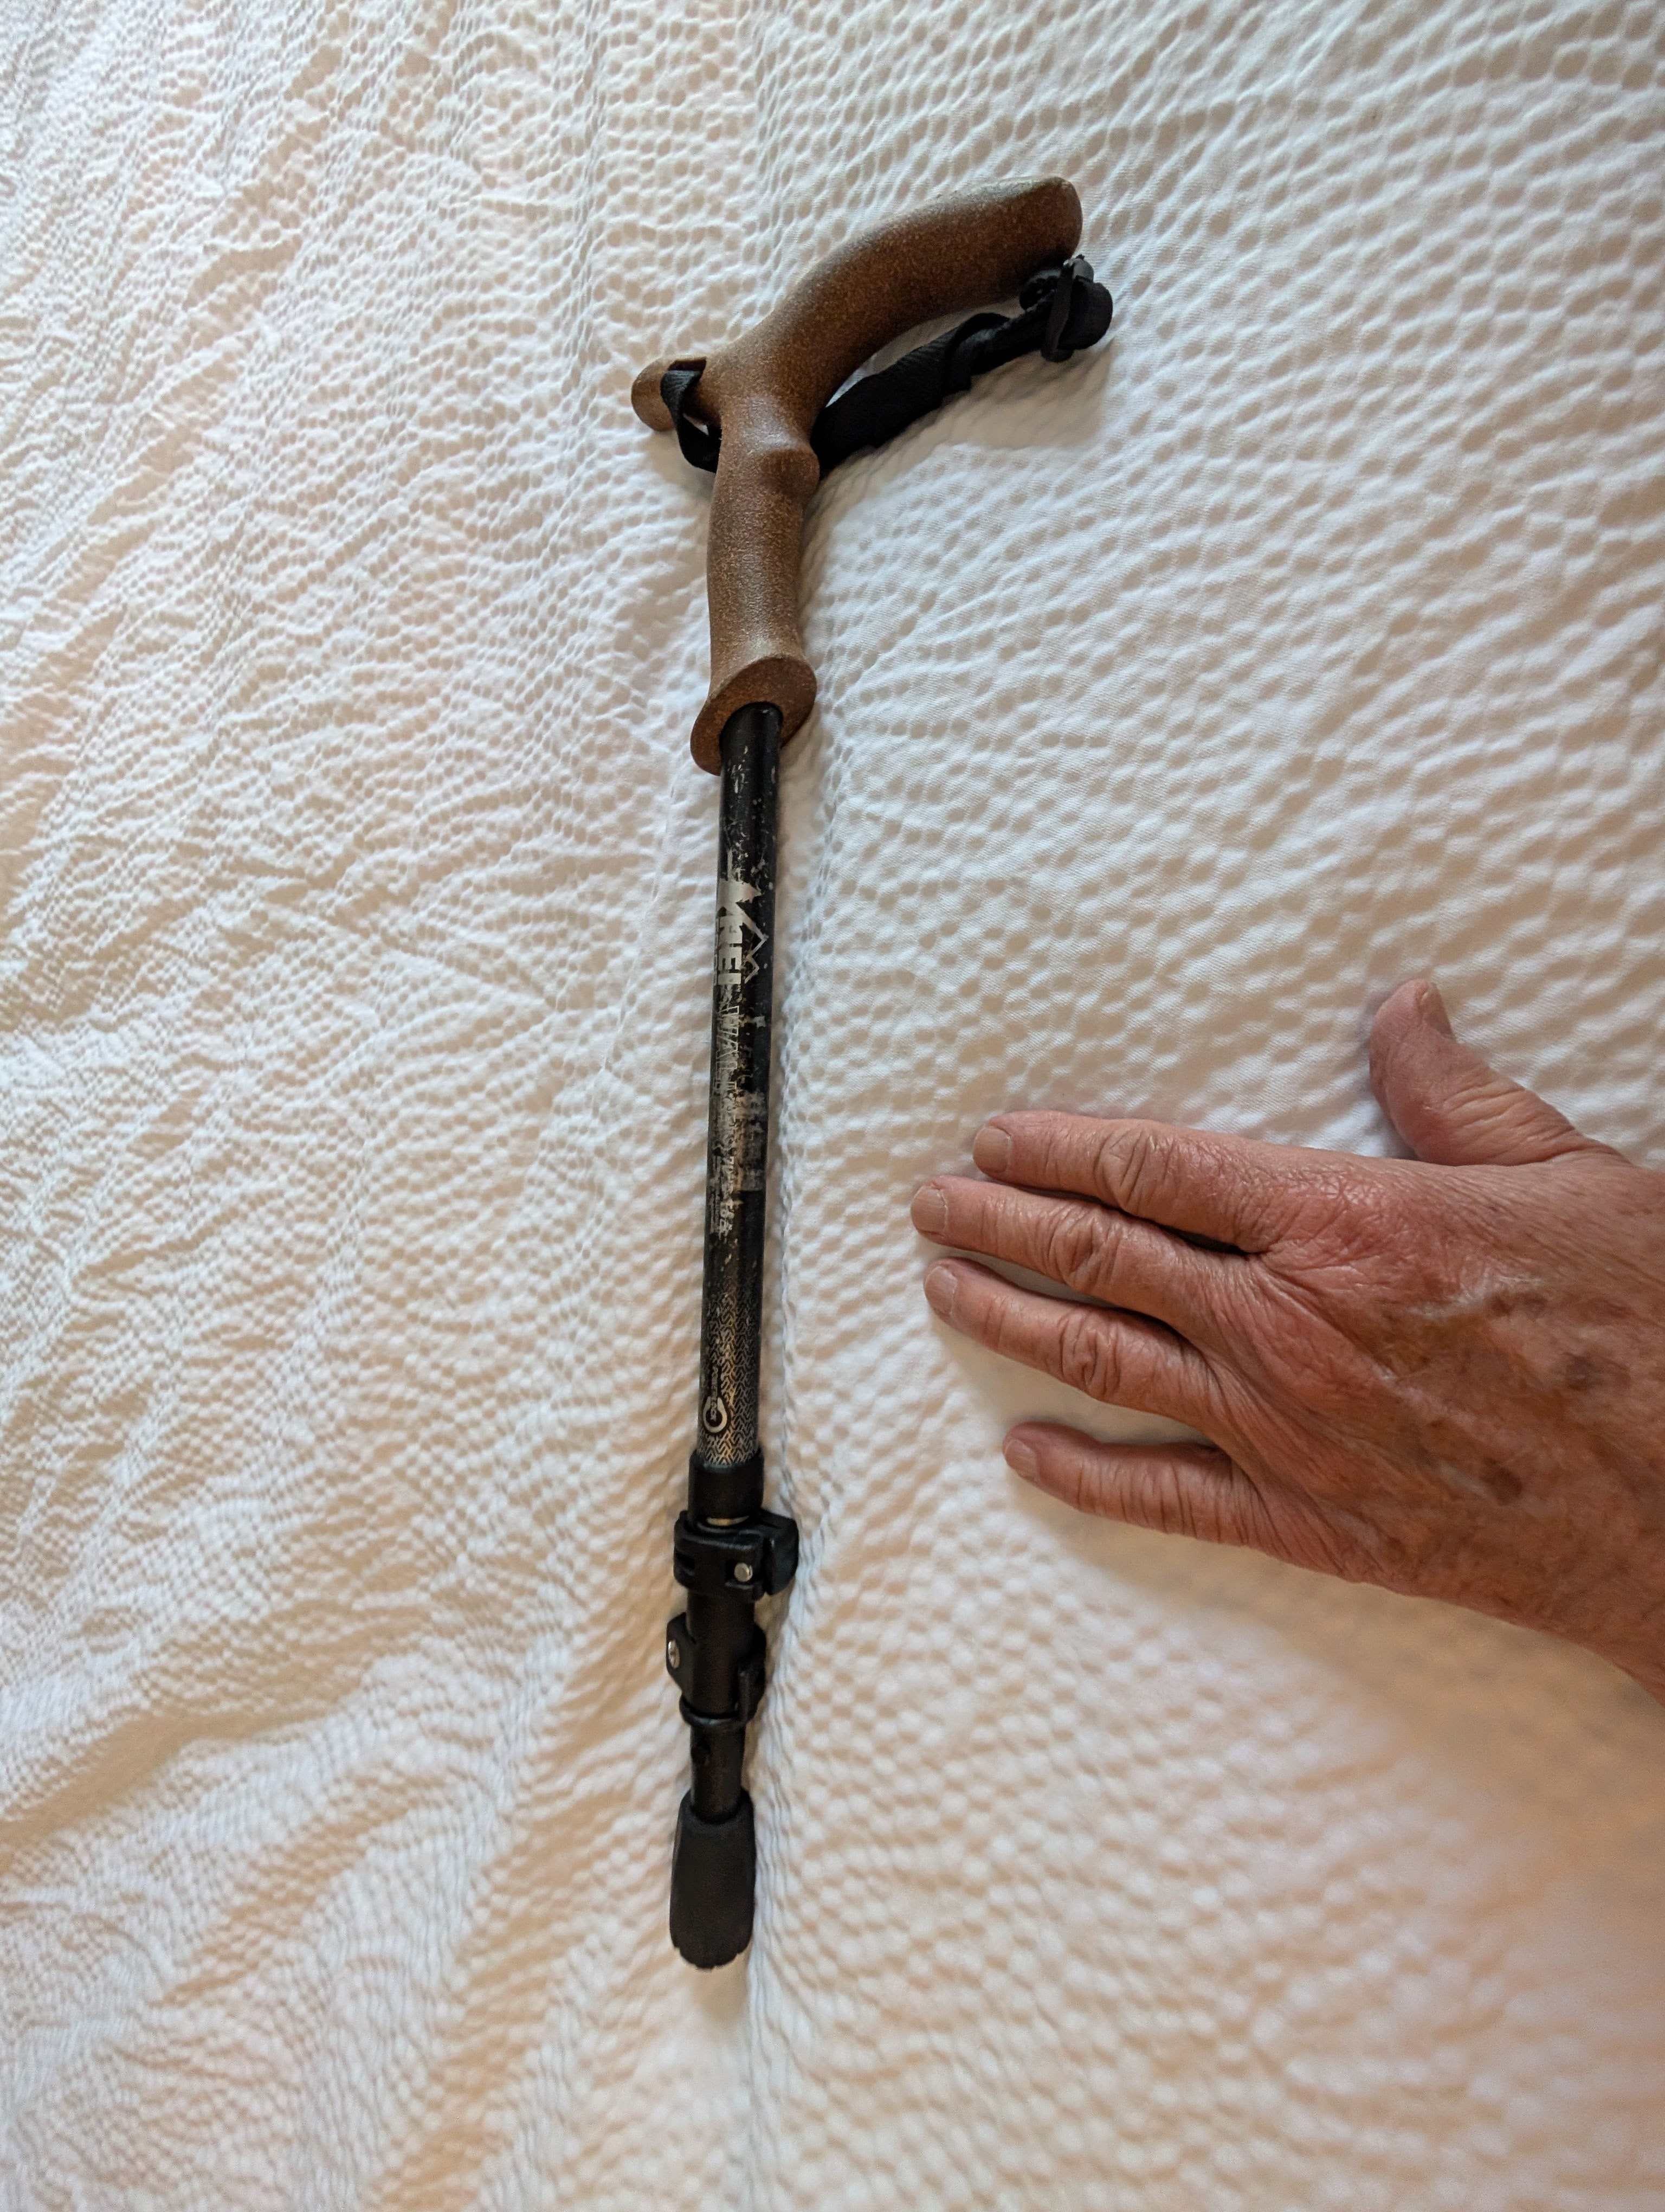
Mobility tips on good tools – Canes & Sticks

Slide 10
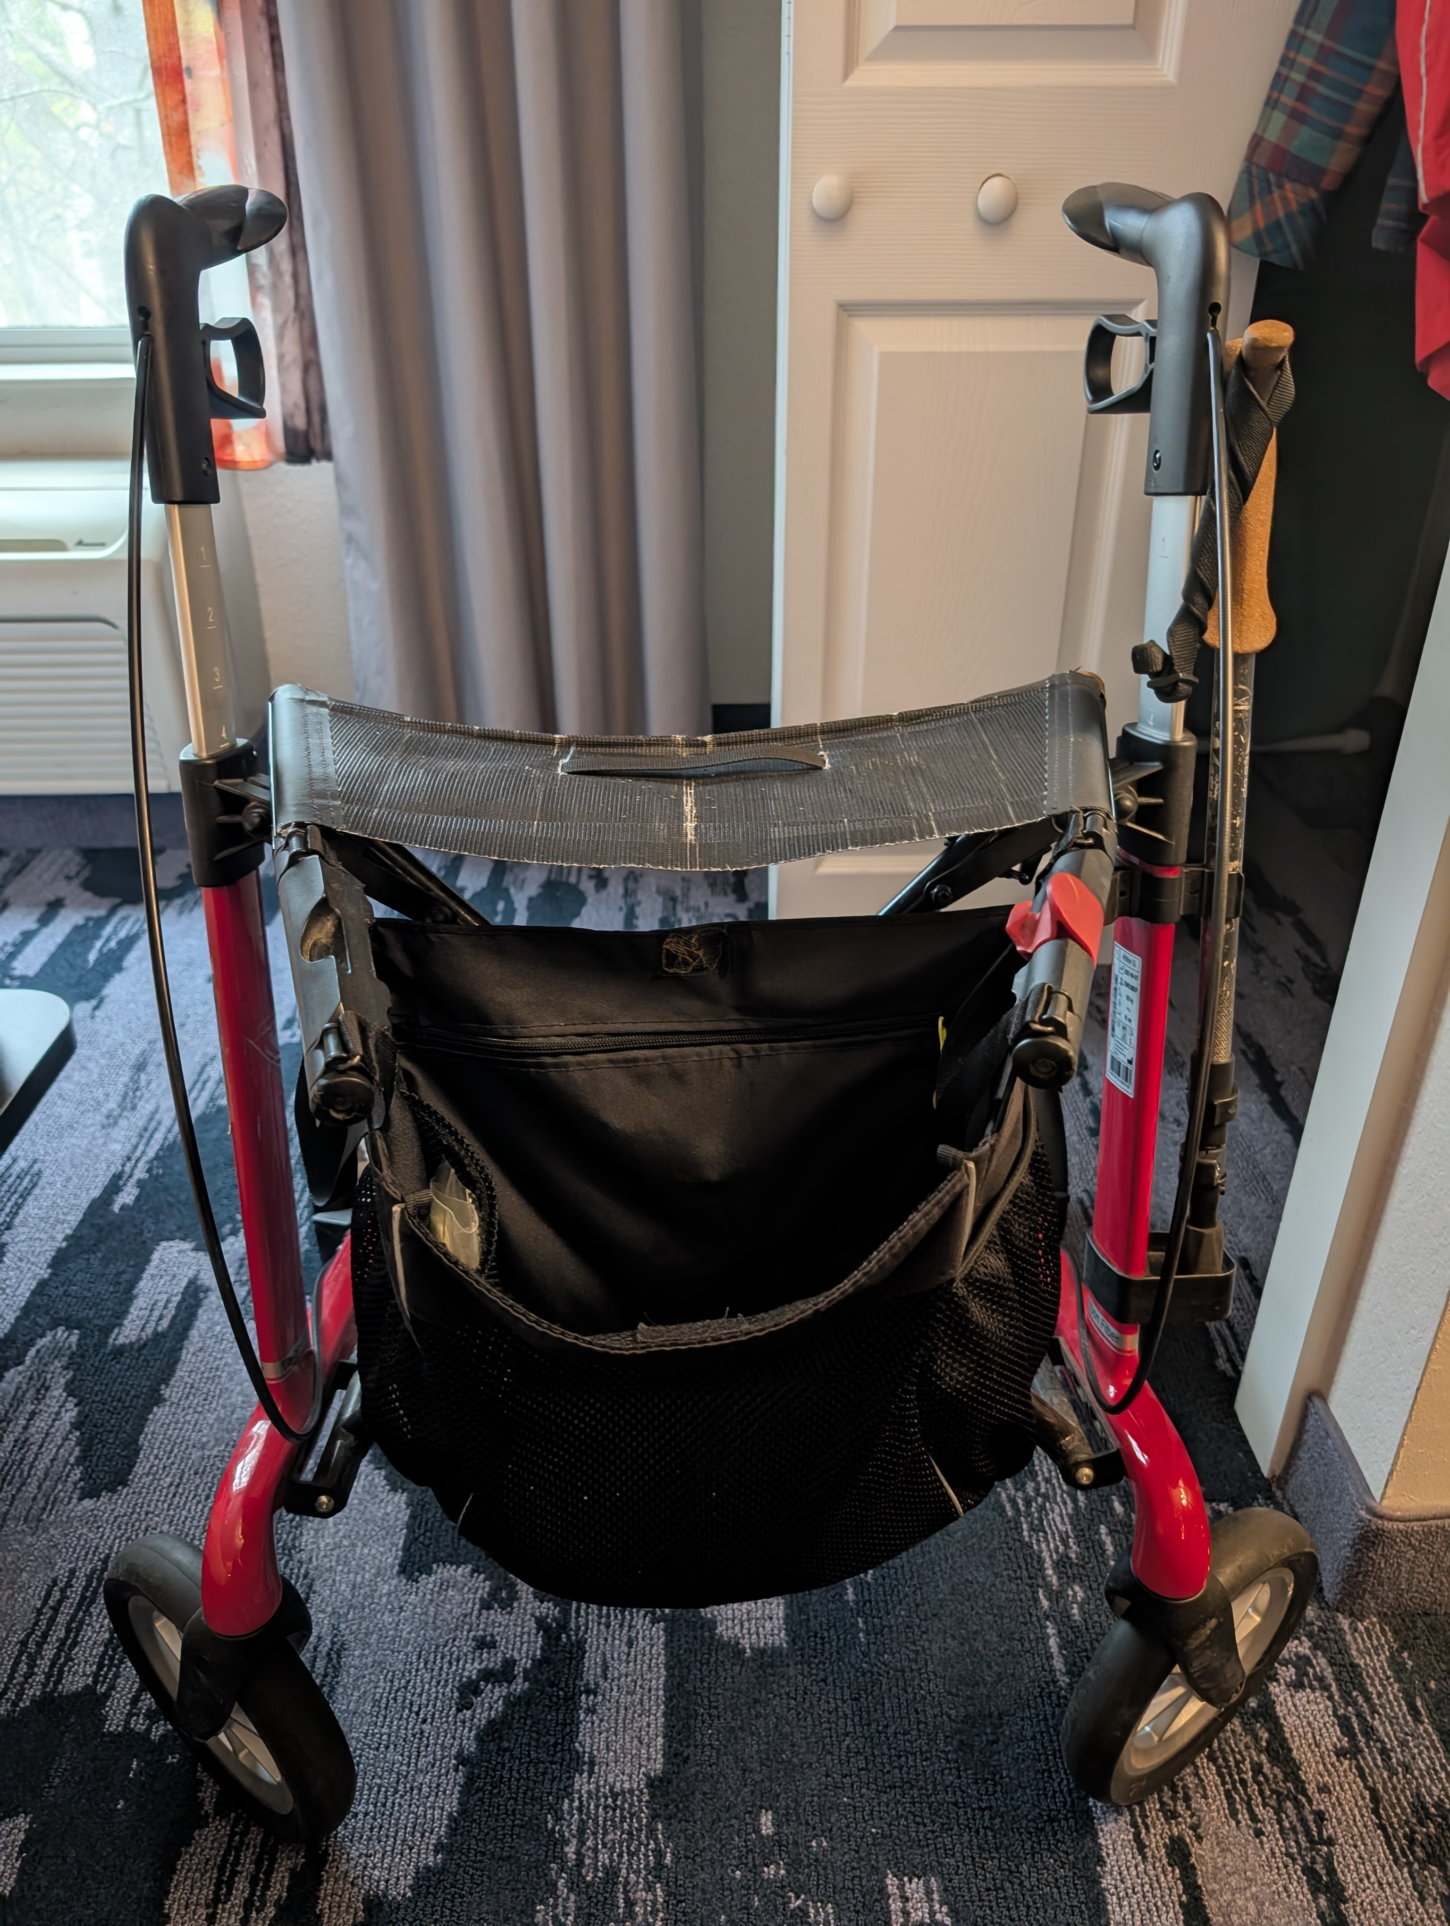
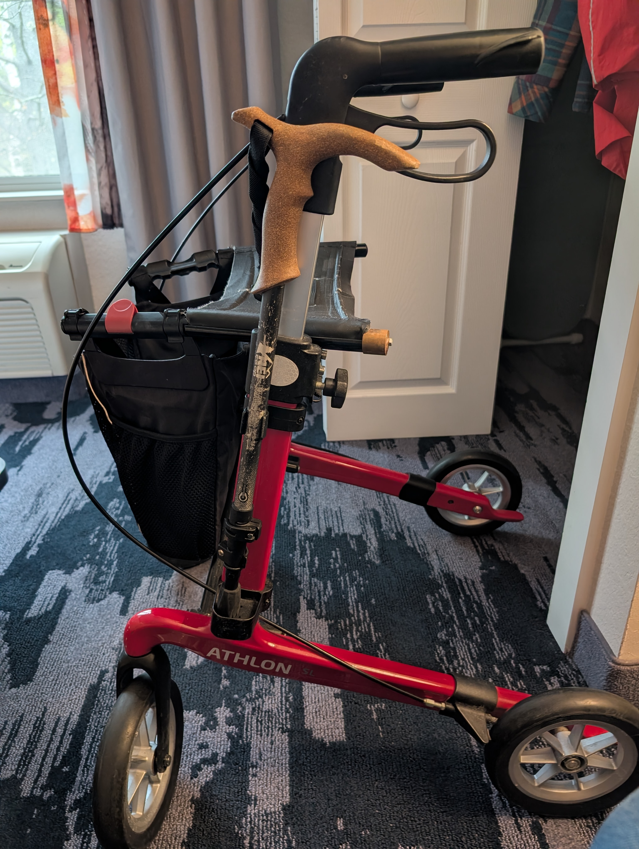
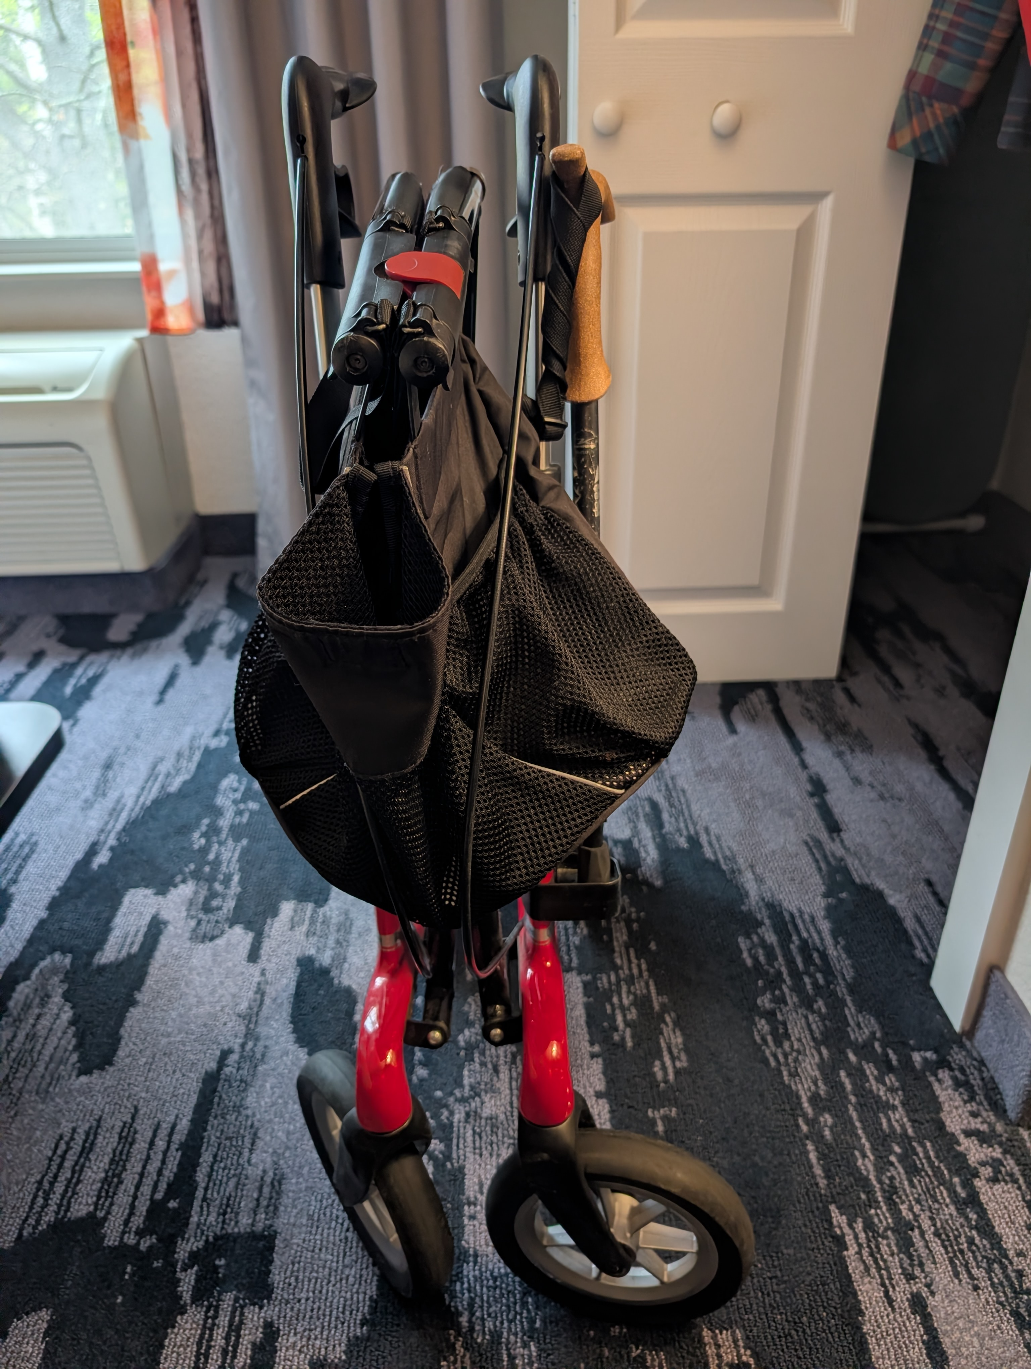
Mobility tips on good tools – Rollator

Slide 11
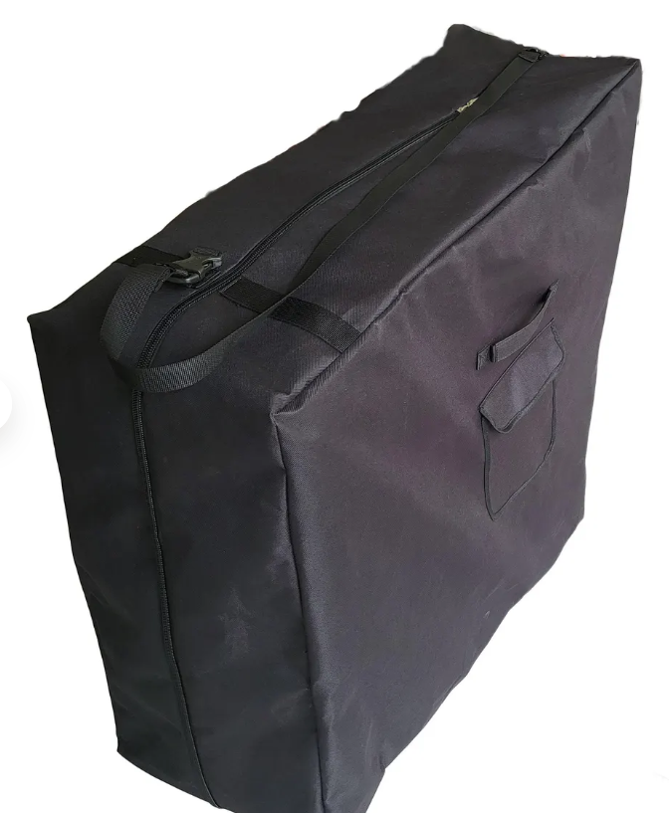
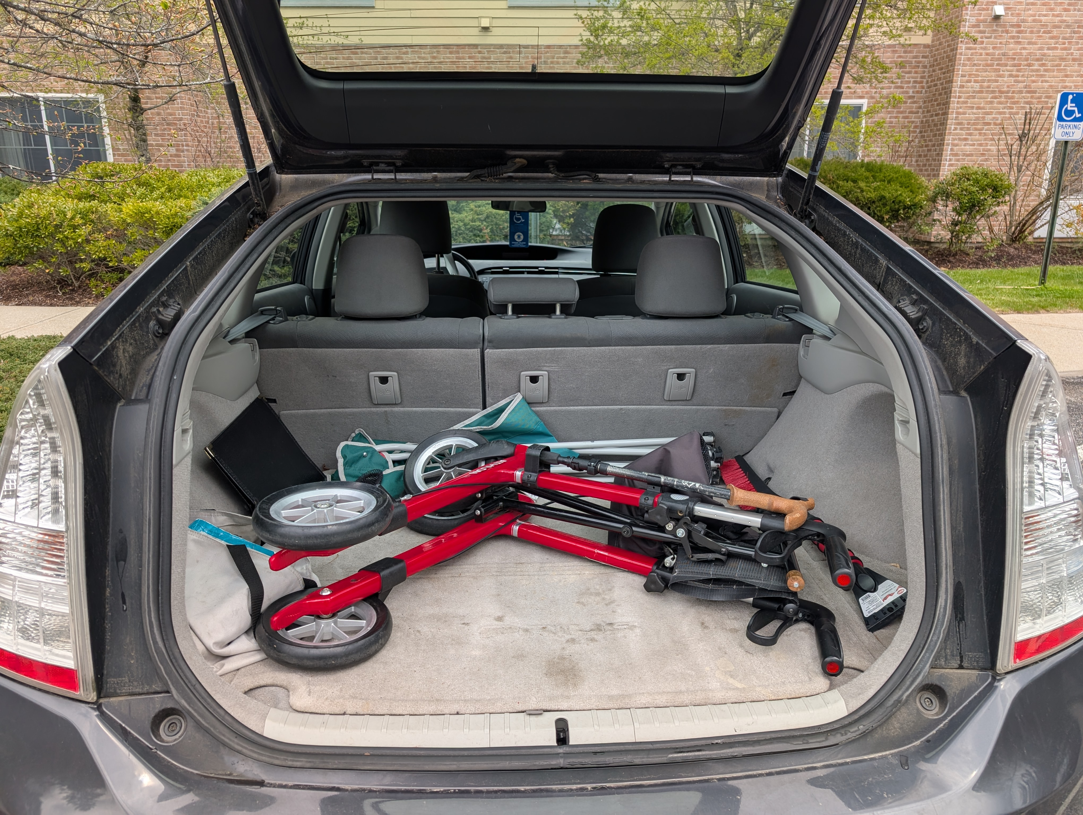
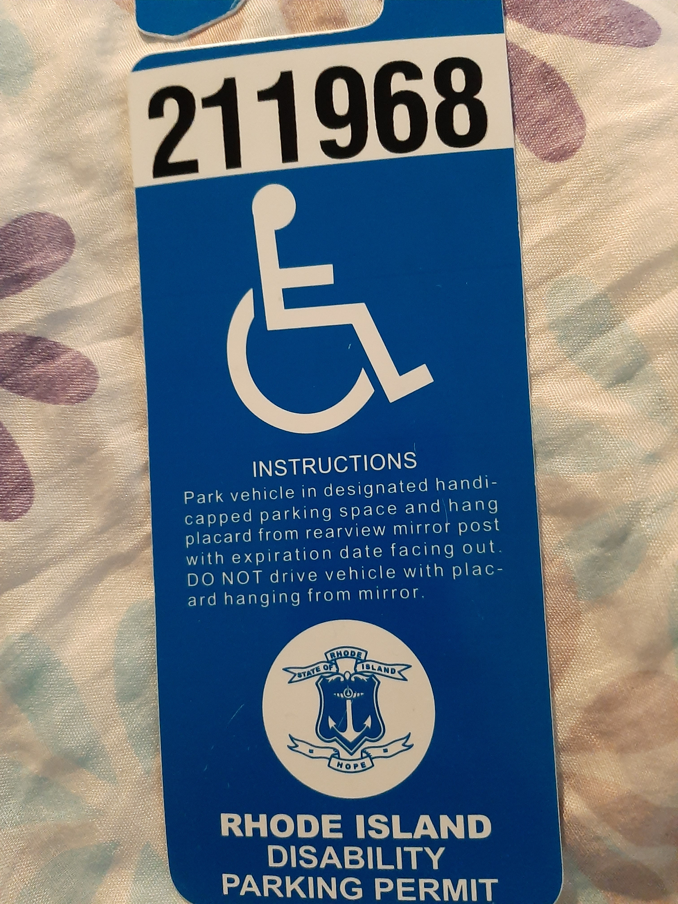
Traveling with the rollator

Slide 12
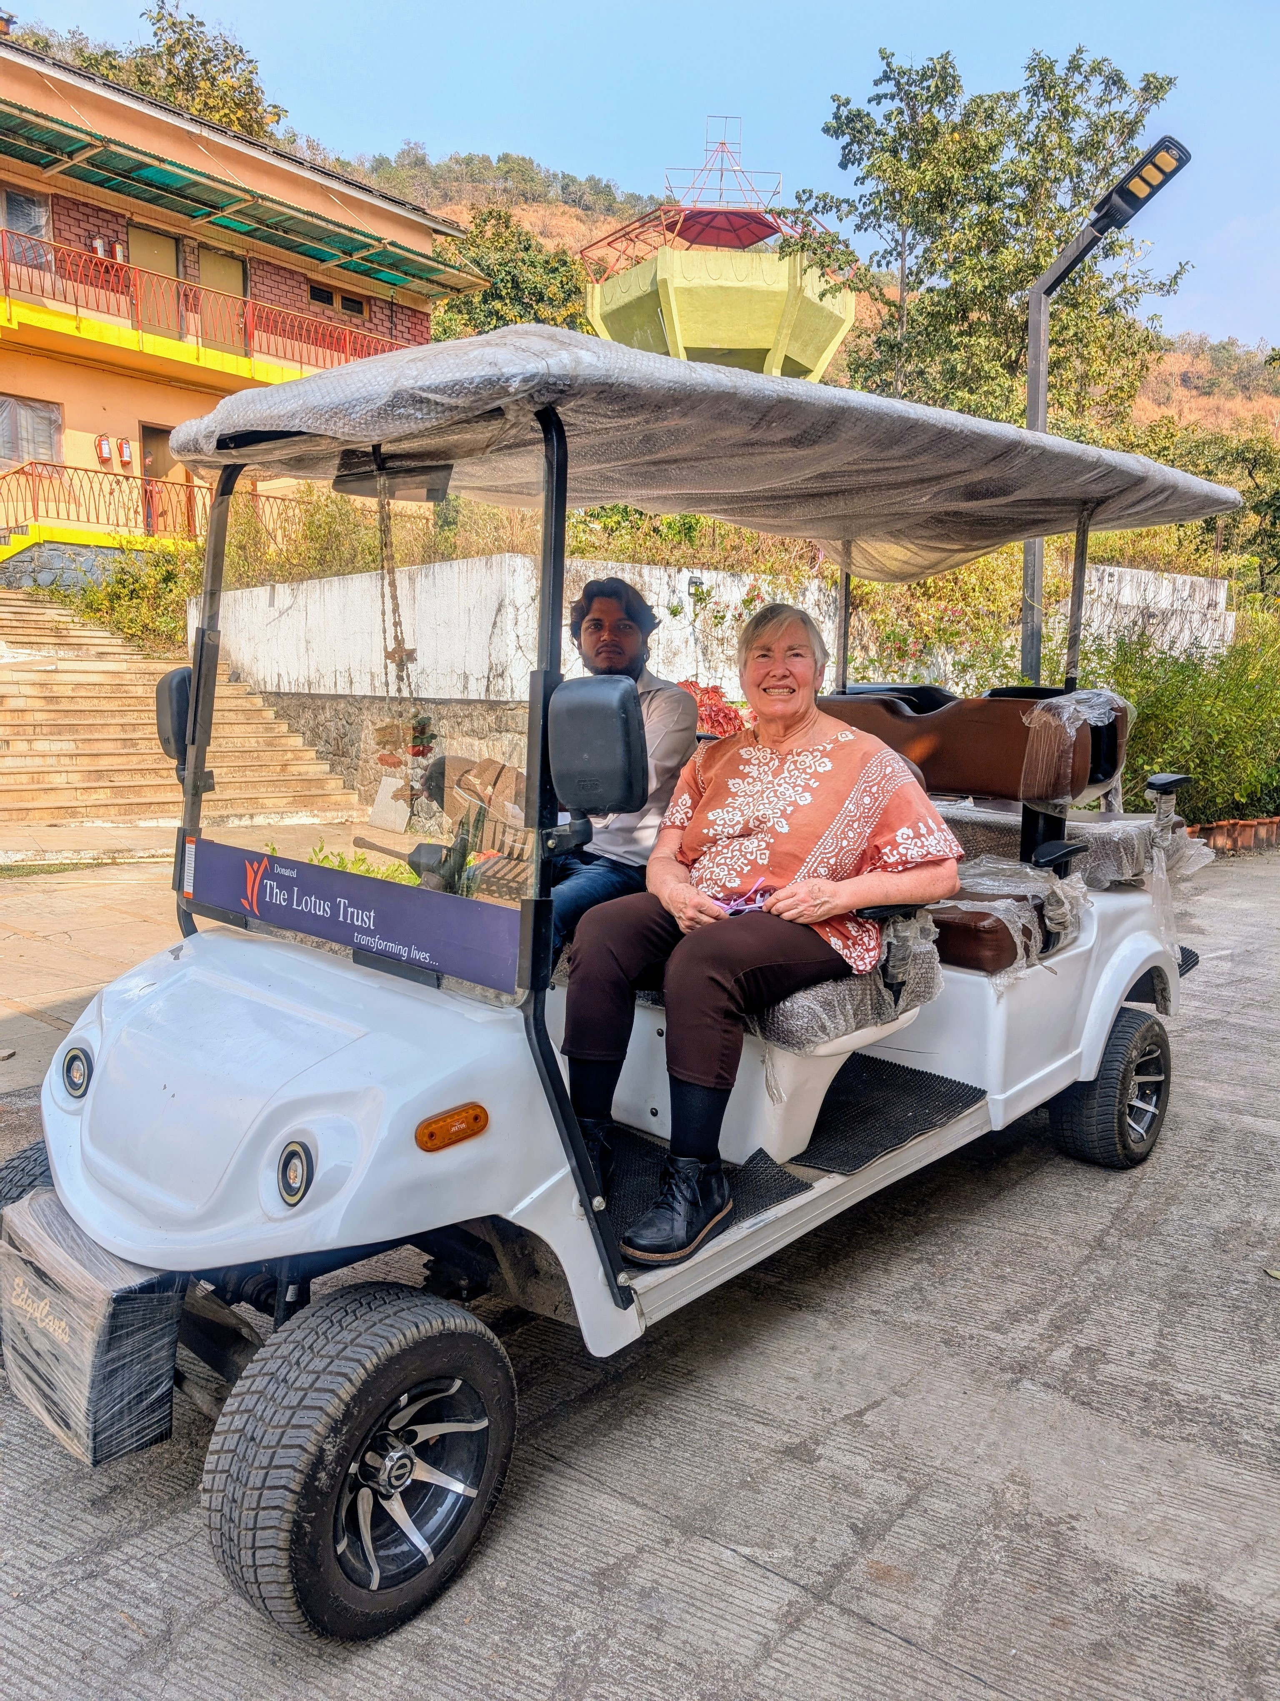
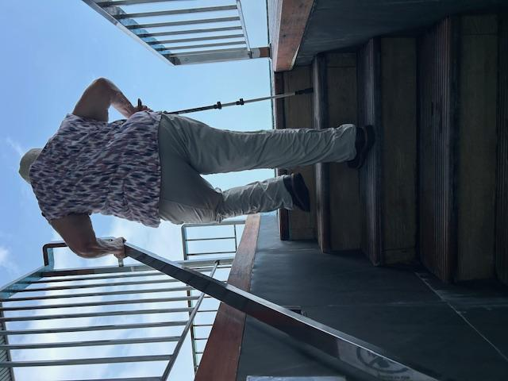
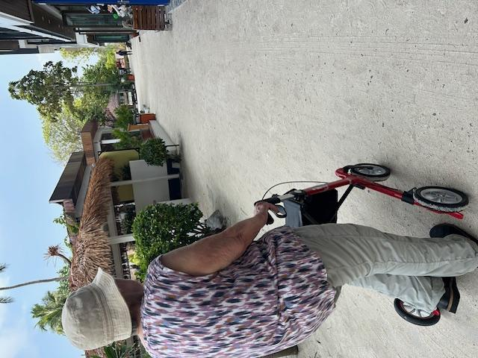
Mobility options – walk or ride
Maafushi, Maldives
Om Abode, 2025

Slide 13
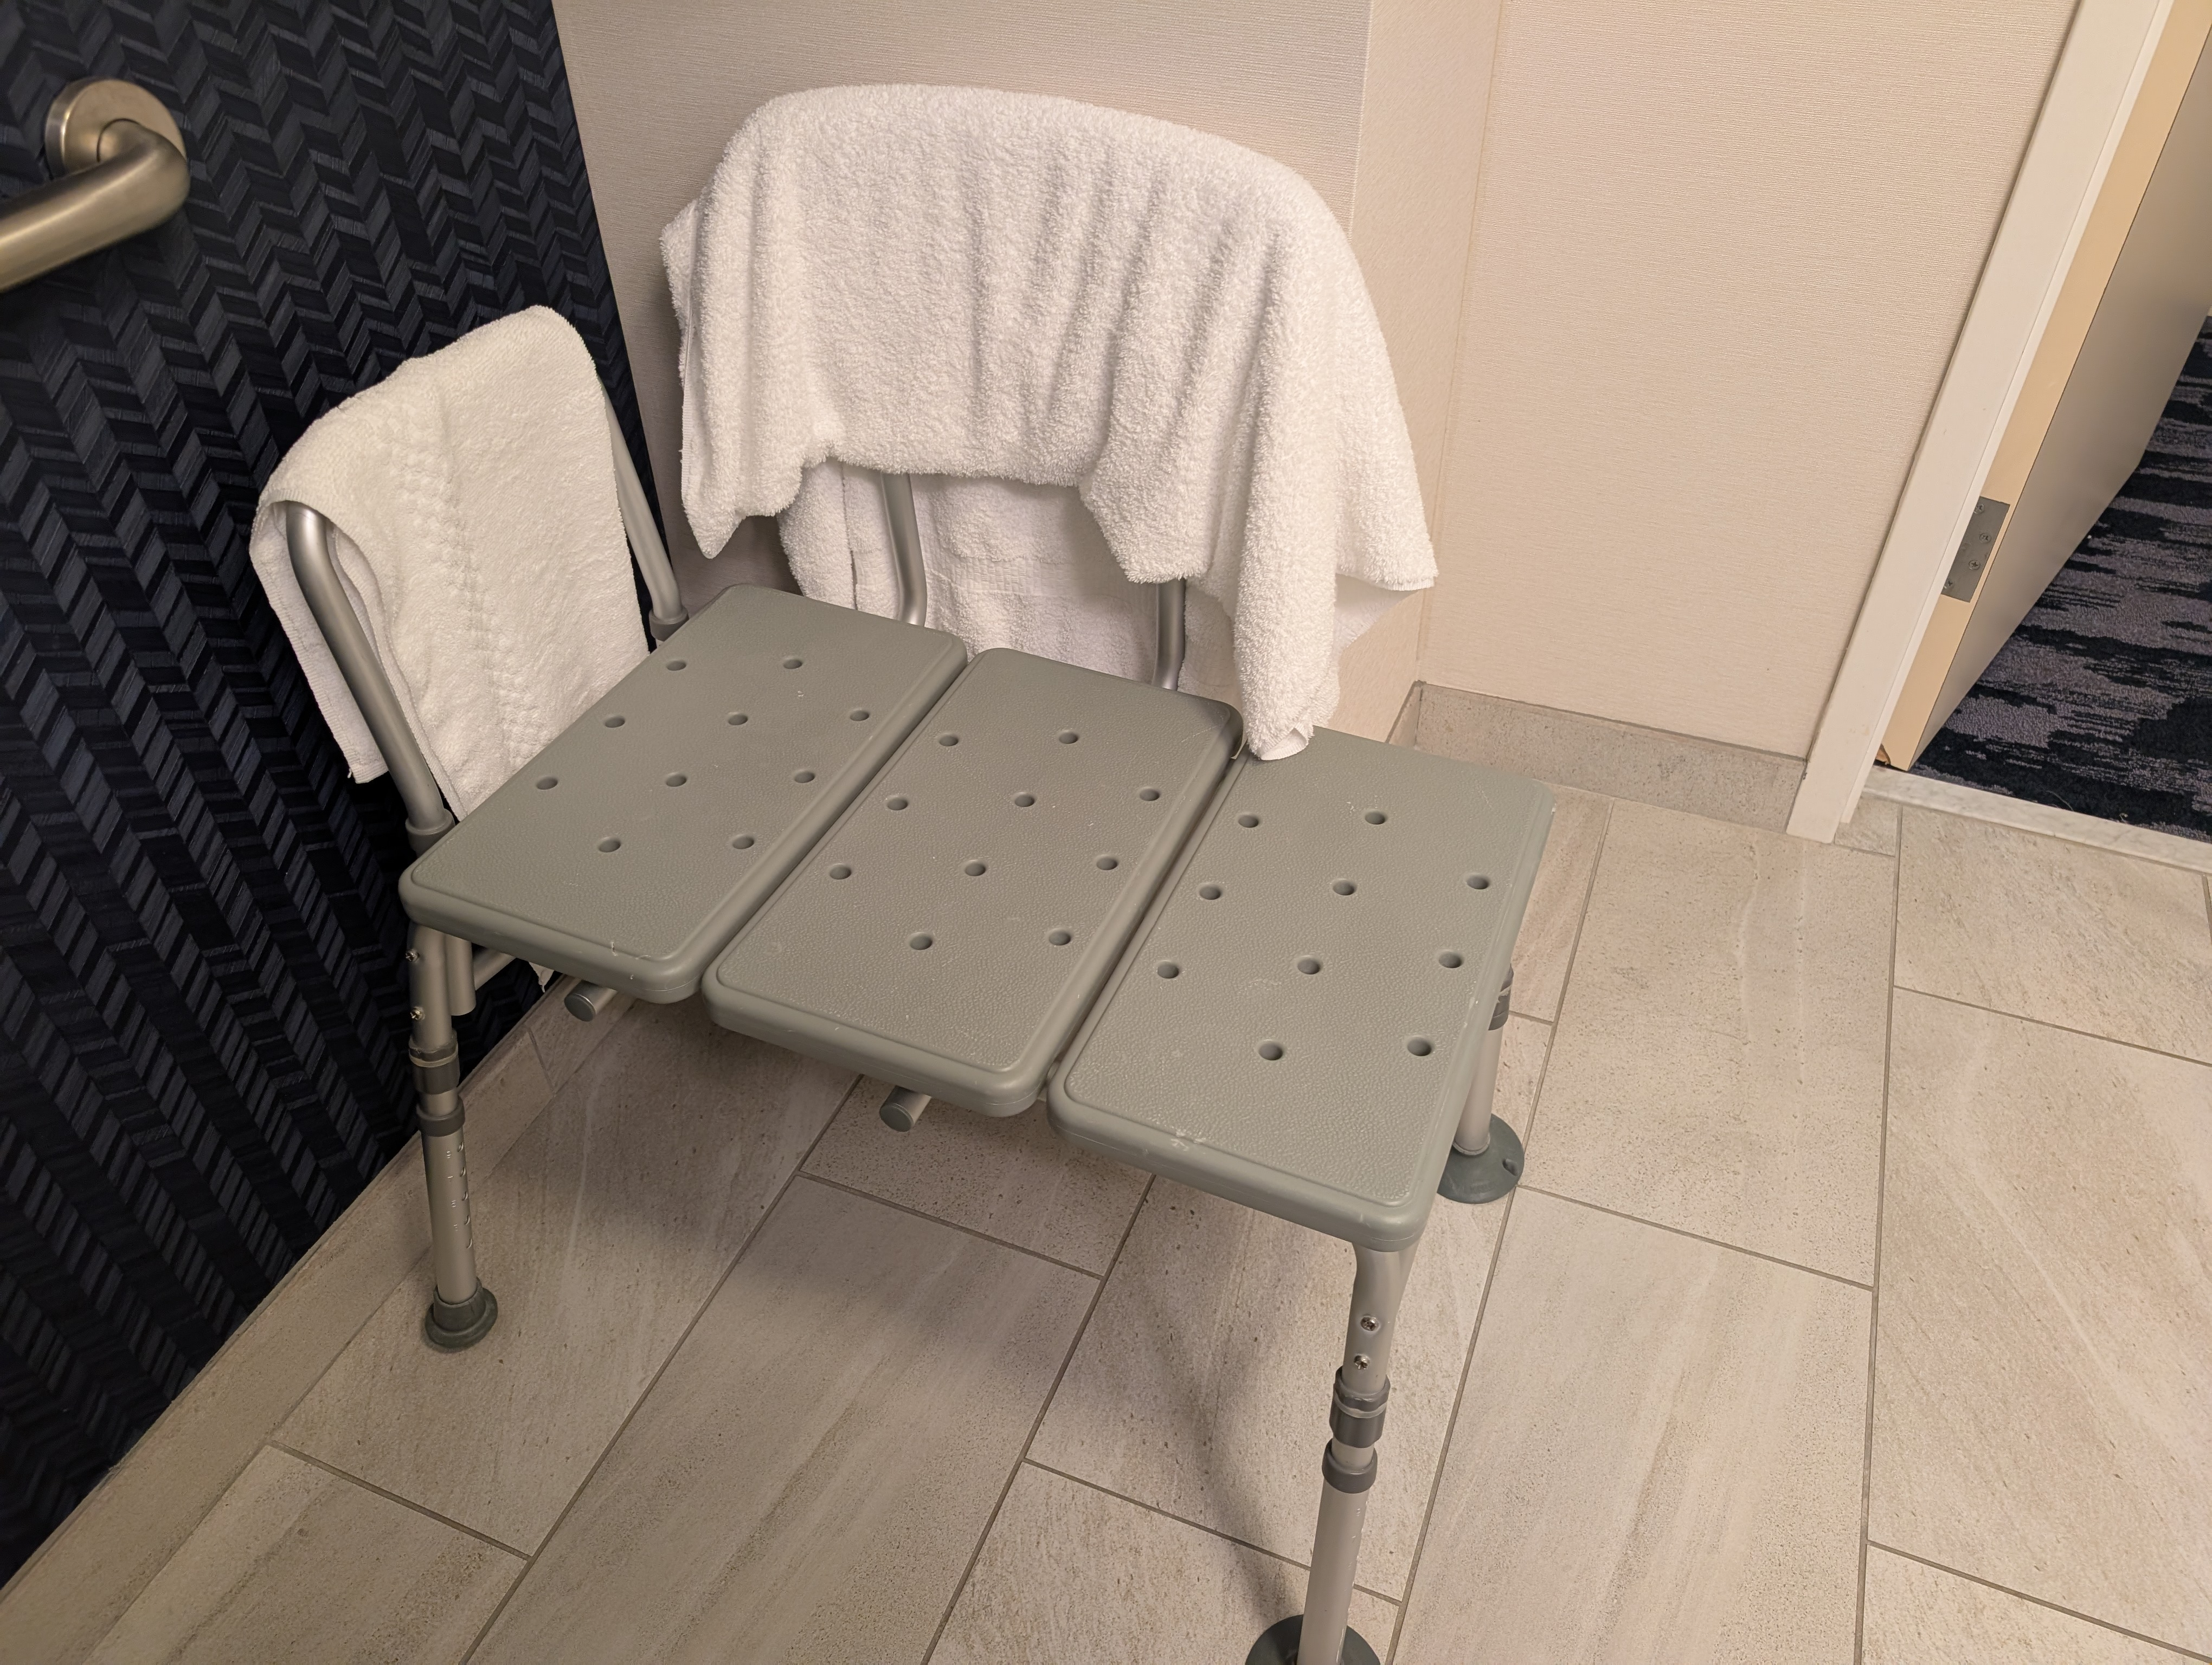
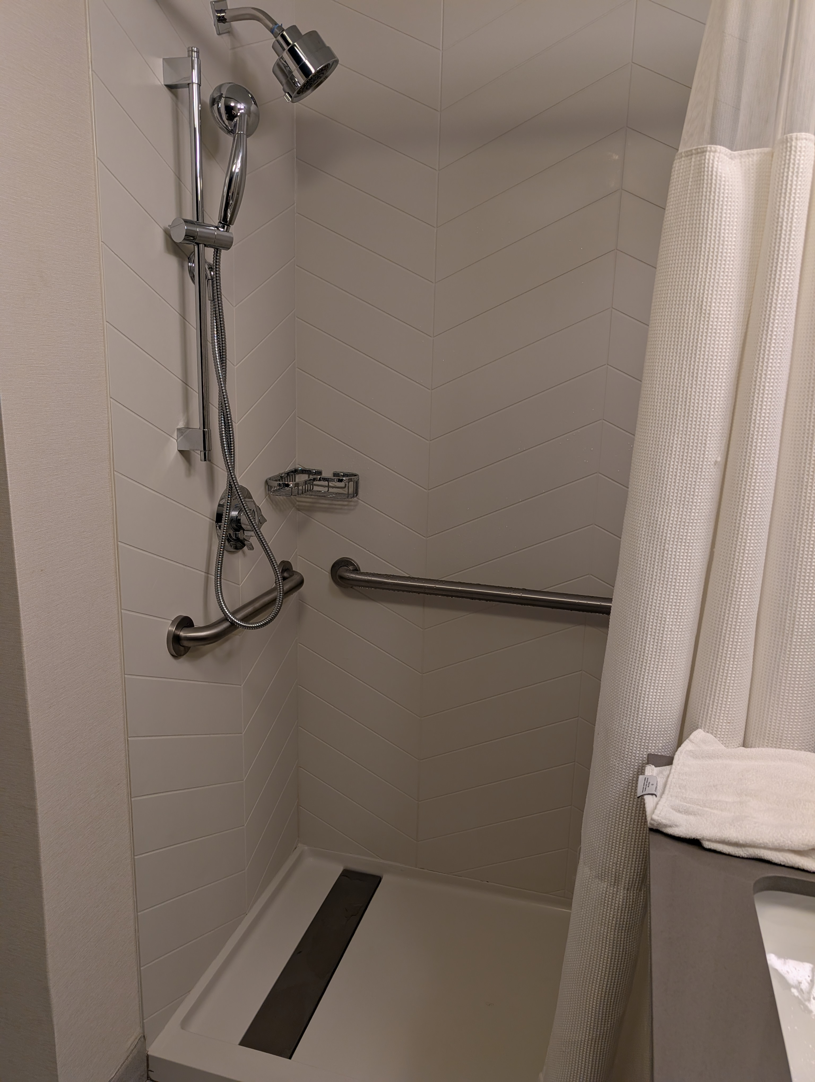
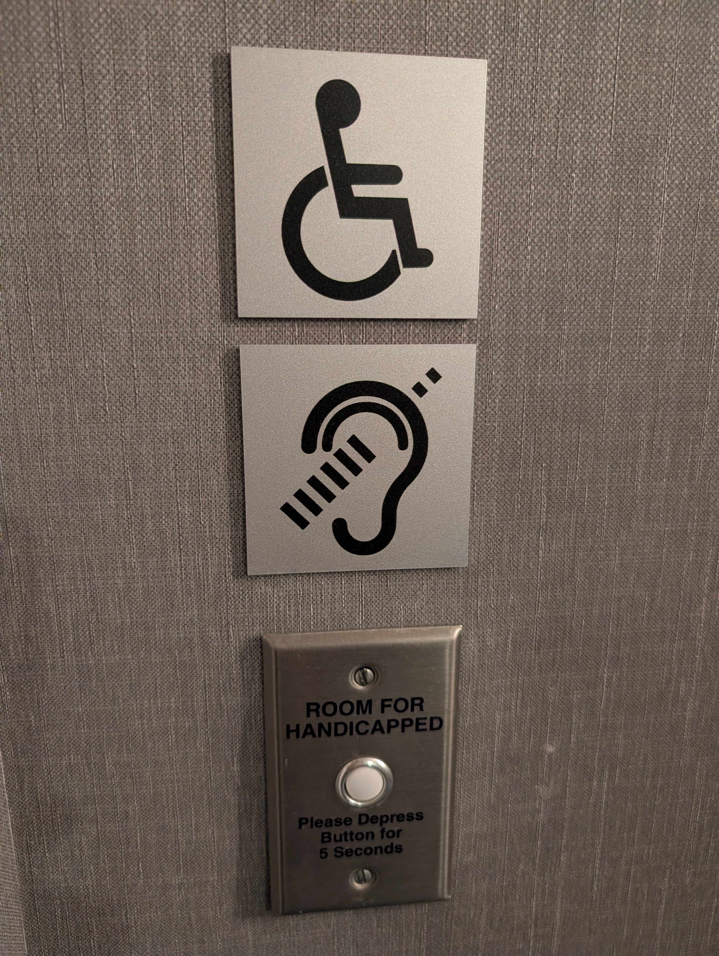
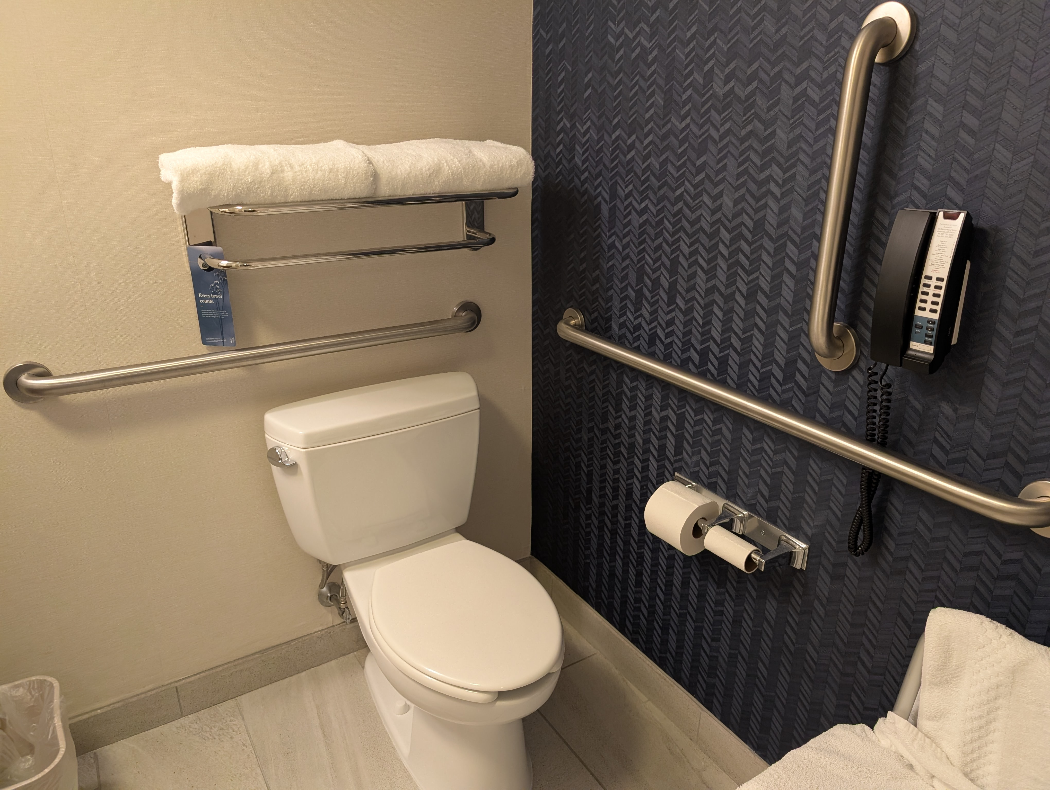
Personal care and safety

Slide 14

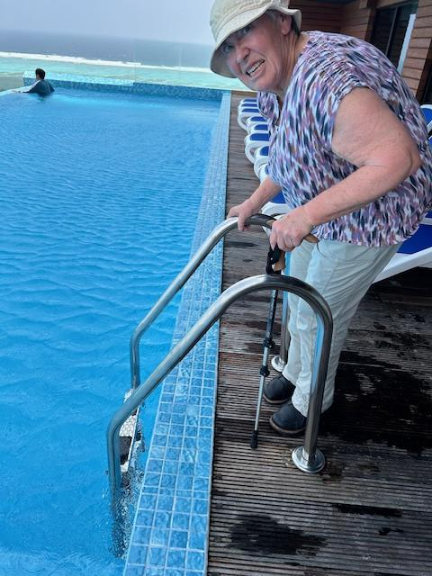
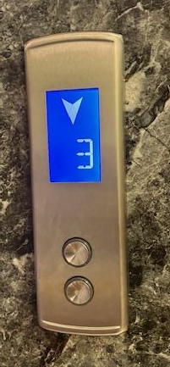
Recognize Barriers

Slide 15
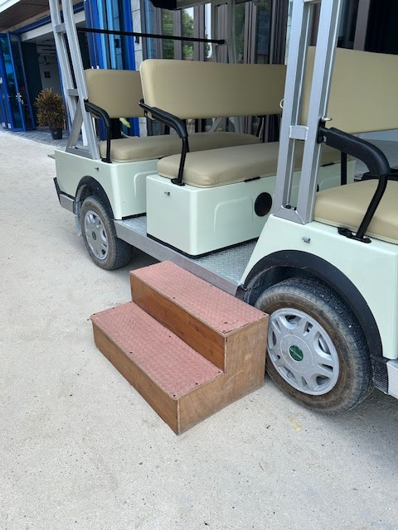
Develop Solutions

Slide 16
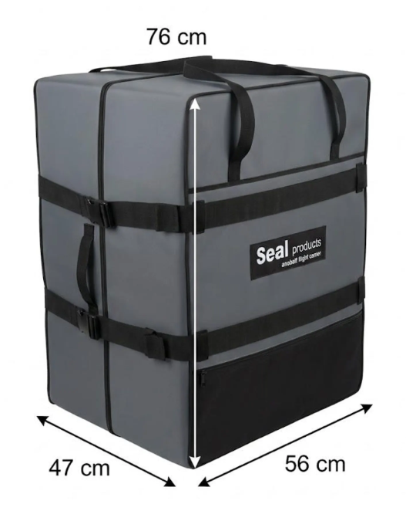
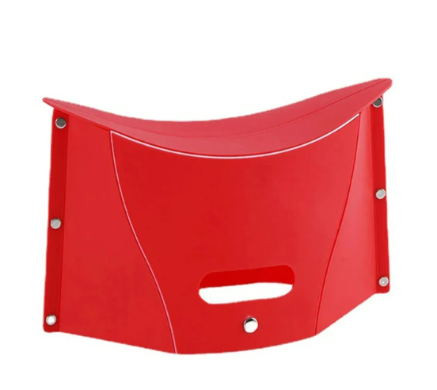
Planning Ahead… My next purchases
Folding step stool
Hard shell
Rollator carrier
And when the unexpected happens, people can always help. Just ask!

Slide 17
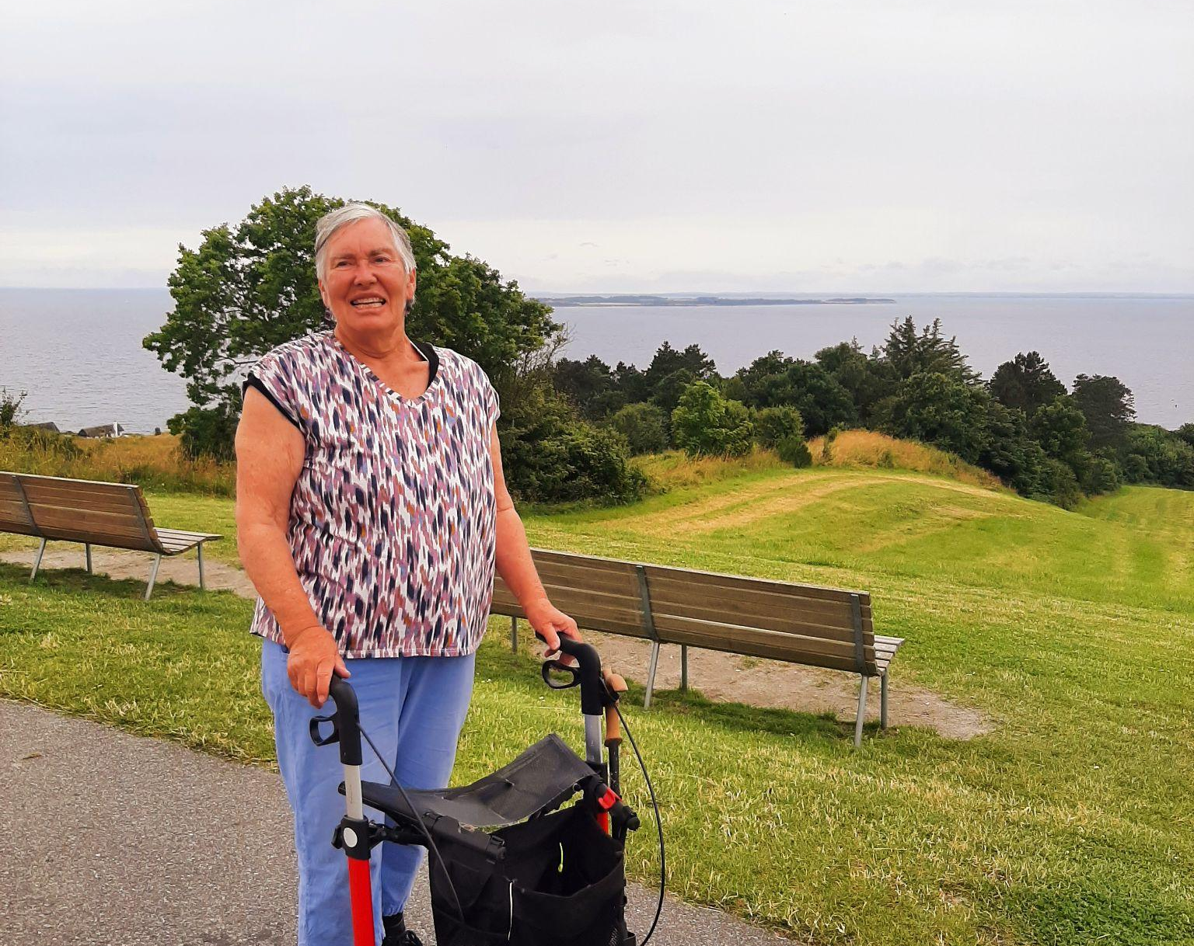
Thank you and happy travels!
Elizabeth M. Dalton, Ph.D.
elizabethmdalton@gmail.com

