Slide 1
Developing Inclusive and Resilient Assistive Technology Policies
Emma M. Smith
Associate Professor, School of Allied Health University of Limerick

Slide 2
Why AT policy matters
Notes:
Assistive technology enables participation across education, employment, health, civic life, and independent living.
The framework positions AT access as both a practical enabler and a human rights issue.ARISE-Framework-Final.docx
Assistive technology policy shapes who can access support, how decisions are made, and whether services remain effective when systems are under pressure. policy as the structure that determines whether access is equitable, timely, and sustainable.
Policy is not just a document; it structures who is included, who decides, and what happens when systems are stressed.
Frame the talk as a practical session on better policy design.

Slide 3


Assistive Technology in Ireland
Notes:
Why policy needs to improve
The ARISE document notes persistent barriers including fragmented definitions, restrictive regulation, weak service delivery pathways, financing gaps, workforce shortages, and poor cross-sector coordination.
It also highlights that many policy approaches remain insufficiently attentive to resilience during crises and emergencies.
This gives a strong rationale for a more comprehensive policy framework.

Slide 4

Session Roadmap
Inclusive and Resilient AT policy
The ARISE Framework Structure
Key Principles
11 Policy Components
How to use ARISE for policy evaluation

Slide 5
The policy problem
Many AT policies are fragmented across sectors.
Policy often fails when eligibility, procurement, workforce, funding, and user participation are not aligned.
Gap between policy intent and implementation reality.

Slide 6
Why does this matter now?
Rising demand, fiscal pressure, workforce constraints, and changing technologies increase system strain.
AT policy must work in stable periods and during disruption.
Position resilience as a core policy quality, not an optional extra.

Slide 7
What is ARISE?
ARISE is a practical policy development and evaluation framework
Supports resilient and inclusive AT policies and enabling environments.
Developed through participatory process with AT users, policy researchers, experts in AT
Usable across contexts and sectors.
Notes:
ARISE is designed as a practical framework and evaluative tool for strengthening AT policy and practice.
It is intended to be adaptable across different stakeholders and contexts, and to provide a snapshot of policy maturity rather than a full systems assessment.
It can support policy development, policy review, advocacy, teaching, and comparative analysis.

Slide 8
How ARISE understands policy
Policy/policies exist within a broader ecosystem
Legislation
Programmes
Schemes
Guidance
Organizational policies
Policy content, policy implementation, and service provision are not always aligned

Slide 9
Inclusive and Resilient Policy
Establishing comprehensive, integrated systems that guarantee timely access to appropriate AT as a human right, while building the flexibility and capacity to serve current and future users across changing contexts.

Slide 10













N
ARISE Policy Framework
Assistive Technology in Resilient and Inclusive Systems and Enabling Environments
Innovation, Research & Development
Rights-Based
Participatory
Policies should create environments fostering responsible innovation, while ensuring that innovation serves genuine user needs and reaches all populations.
Conceptualization
Policies should clearly and comprehensively define assistive technology.
Rights Protection and Advocacy
Governance & Leadership
Innovative
Sustainable
Policies should establish clear avenues for addressing violations of rights of access to, or use of assistive technology, support the capacity of AT users and their organizations to advocate for their rights, and implement measures preventing discrimination against AT users.
Policies should clearly lay out a coordinated governance structure and approach, with consideration for shared responsibility.
Service Delivery
Policies should reflect a commitment to a clearly articulated, evidence-based service delivery model addressing the entire AT access pathway and lifecycle.
Awareness & Information
Policies should establish mechanisms for information platforms which provide accessible, current, and comprehensive information about available assistive products and services, eligibility criteria, provision pathways, and funding mechanisms.
Financing and Affordability
Policies should clearly specify how AT is financed and resourced.
Emergency Preparedness & Resilience
Policies should integrate emergency preparedness, ensuring that AT systems and AT users are protected during crises and that humanitarian responses adequately address AT needs.
Policies should clearly address provider roles and competencies and workforce planning for AT provision.
Standards and Quality Assurance
Monitoring & Evaluation
Policies must establish clear quality and safety standards that protect users while remaining proportionate to actual risk and avoiding unnecessary barriers to market entry or product access.
Policies should establish comprehensive monitoring and evaluation systems addressing inputs, processes, outputs, outcomes, and impacts on broader system goals including equity, resilience, and sustainability.
Funded by the European Union’s Horizon 2020 research and innovation programme under the Marie Skłodowska-Curie grant agreement No. 101031940.
ARISE Policy Framework and Evaluative Tool available at https://doi.org/10.5281/zenodo.18964852
Notes:
Introduce the architecture: 4 key principles, 11 policy components, and an evaluative tool.
Explain that the principles are cross-cutting and embedded throughout the components and questions used in evaluation.

Slide 11
Four Key Principles
Rights-Based
Participatory
Innovative
Sustainable
Rights-based
Participatory
Innovative
Sustainable
Notes:
Good AT policy is not only about what areas are covered, but how they are governed and enacted.

Slide 12
Rights-Based
Access to assistive technology is a fundamental human right AND a pathway to the realization of other rights
Rights based approach requires
Universality of access
Equity and non-discrimination
Affordability and accessibility
Respect for dignity, autonomy, and informed choice

Slide 13
Participatory
Requires meaningful engagement of AT users at all levels
Development
Implementation
Evaluation
Emphasis on
Codesign
Shared decision making
User centred approaches
Adaptation to diverse needs (not one-size fits all)

Slide 14
Sustainable
Integrated and coherent AT systems
Withstand changing economic systems
Effective coordination across sectors
Includes
Efficiency
Viable financial and service models
Consideration for circularity and environmental impact

Slide 15
Innovative
Broad framing of innovation
Extends beyond products to…
Service delivery
Workforce development
Capacity building
Regulatory environments
Evidence generation
Help system adopt new solutions while maintaining
Safety
Quality
Responsiveness to real needs

Slide 16
From Principles to Components
11 components as core features in inclusive and resilient AT policy
Aspirational but important for comprehensive policy
Based on evidence and expert consensus

Slide 17
The 11 Components
Conceptualization
Governance and leadership
Service delivery
Financing and affordability
Assistive technology workforce
Standards and quality assurance
Innovation, research and development
Rights protection and advocacy
Awareness and information
Emergency preparedness and resilience
Monitoring and evaluation

Slide 18
Conceptualization
Policies should clearly and comprehensively define assistive technology.

Slide 19
Governance and Leadership
Policies should clearly lay out a coordinated governance structure and approach, with consideration for shared responsibility.

Slide 20
Service Delivery
Policies should reflect a commitment to a clearly articulated, evidence-based service delivery model addressing the entire AT access pathway and lifecycle.

Slide 21
Financing and Affordability
Policies should clearly specify how AT is financed and resourced.

Slide 22
AT Workforce
Policies should clearly address provider roles and competencies and workforce planning for AT provision.

Slide 23
Standards and Quality Assurance
Policies must establish clear quality and safety standards that protect users while remaining proportionate to actual risk and avoiding unnecessary barriers to market entry or product access.

Slide 24
Innovation, Research, and Development
Policies should create environments fostering responsible innovation, while ensuring that innovation serves genuine user needs and reaches all populations.

Slide 25
Rights Protection and Advocacy
Policies should establish clear avenues for addressing violations of rights of access to, or use of assistive technology, support the capacity of AT users and their organizations to advocate for their rights, and implement measures preventing discrimination against AT users.

Slide 26
Awareness and Information
Policies should establish mechanisms for information platforms which provide accessible, current, and comprehensive information about available assistive products and services, eligibility criteria, provision pathways, and funding mechanisms.

Slide 27
Emergency Preparedness and Resilience
Policies should integrate emergency preparedness, ensuring that AT systems and AT users are protected during crises and that humanitarian responses adequately address AT needs.

Slide 28
Monitoring and Evaluation
Policies should establish comprehensive monitoring and evaluation systems addressing inputs, processes, outputs, outcomes, and impacts on broader system goals including equity, resilience, and sustainability.

Slide 29
Who can use ARISE?
Policymakers
Advocates
Organizations of AT users
Researchers
Service Providers
Educators
Students
** Participatory use, with meaningful engagement of AT users

Slide 30
The ARISE Evaluative Tool
Structured to correspond to 4 principles and 11 components
Questions for each component, space for notes
Designed to assess policy maturity and identify gaps
Scores range from 0 (absent) to 5 (comprehensive and well-implemented policy)
No aggregate score

Slide 31
Summary
ARISE offers a practical way to review whether AT policy is
Rights based
Participatory
Sustainable
Innovative
Covers essential system components needed for equitable access
Links principles, policy content, and evaluative use in one framework

Slide 32
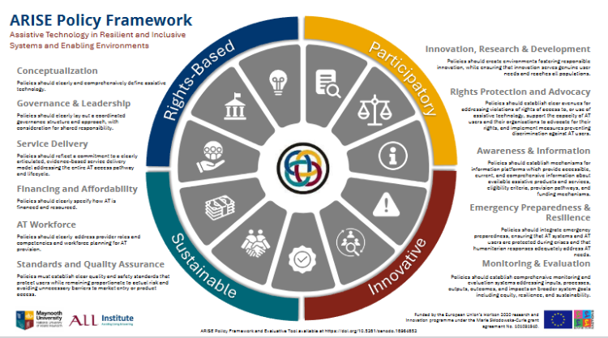
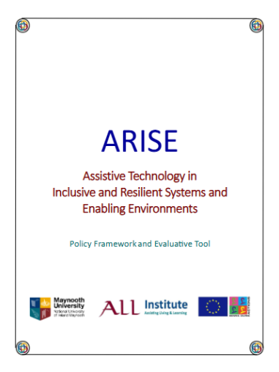

Thank you!
Emma.smith@ul.ie

