Slide 1
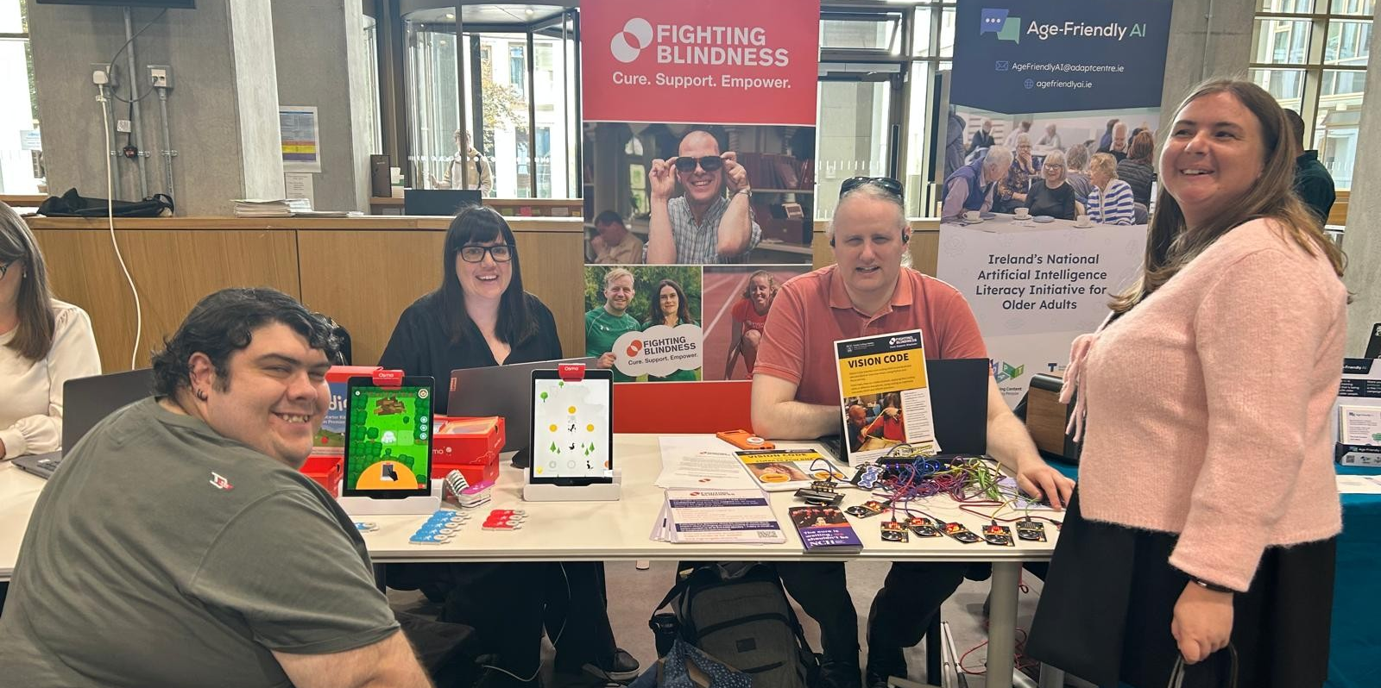
DigiCoaching
Embracing Technology Through Lived Experience
Katie and Sophie
Notes:
Patrick: we’re here to share the DigiCoaching story of how people with lived experience are leading digital inclusion. I’m Patrick, a DigiCoach with St John of God Liffey and Im here with Klara a DigiCoach tutor. I’m Jade, DigiCoach with Fighting Blindness, and We use and need Assistive Technology every day.

Slide 2
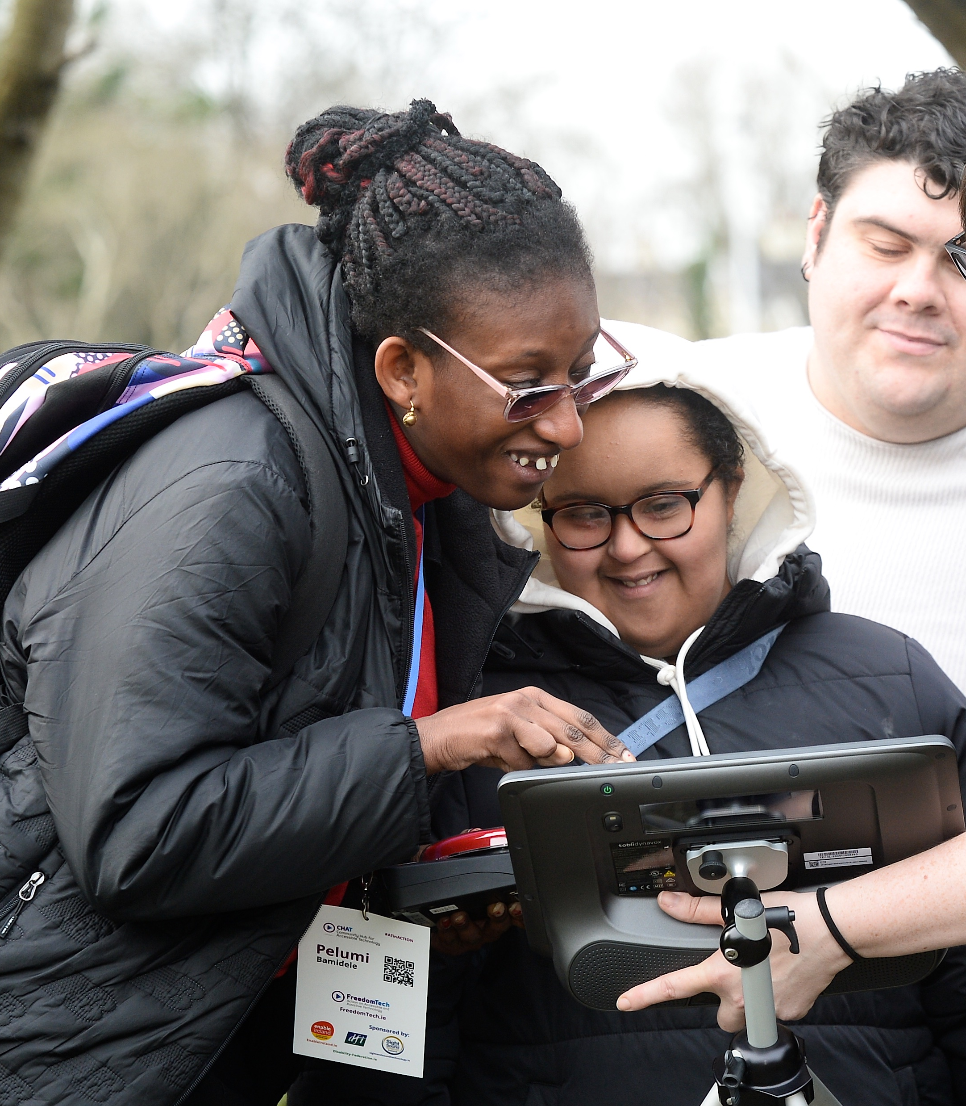
Why It Matters
People left behind
Barriers to communication
Limited access to work and education
Notes:
Patrick:
Digital Exclusion affects people every day. It can mean feeling left out, or not being able to communicate easily. It can also make it harder to access education, jobs or daily living. That’s why this work is so important.

Slide 3
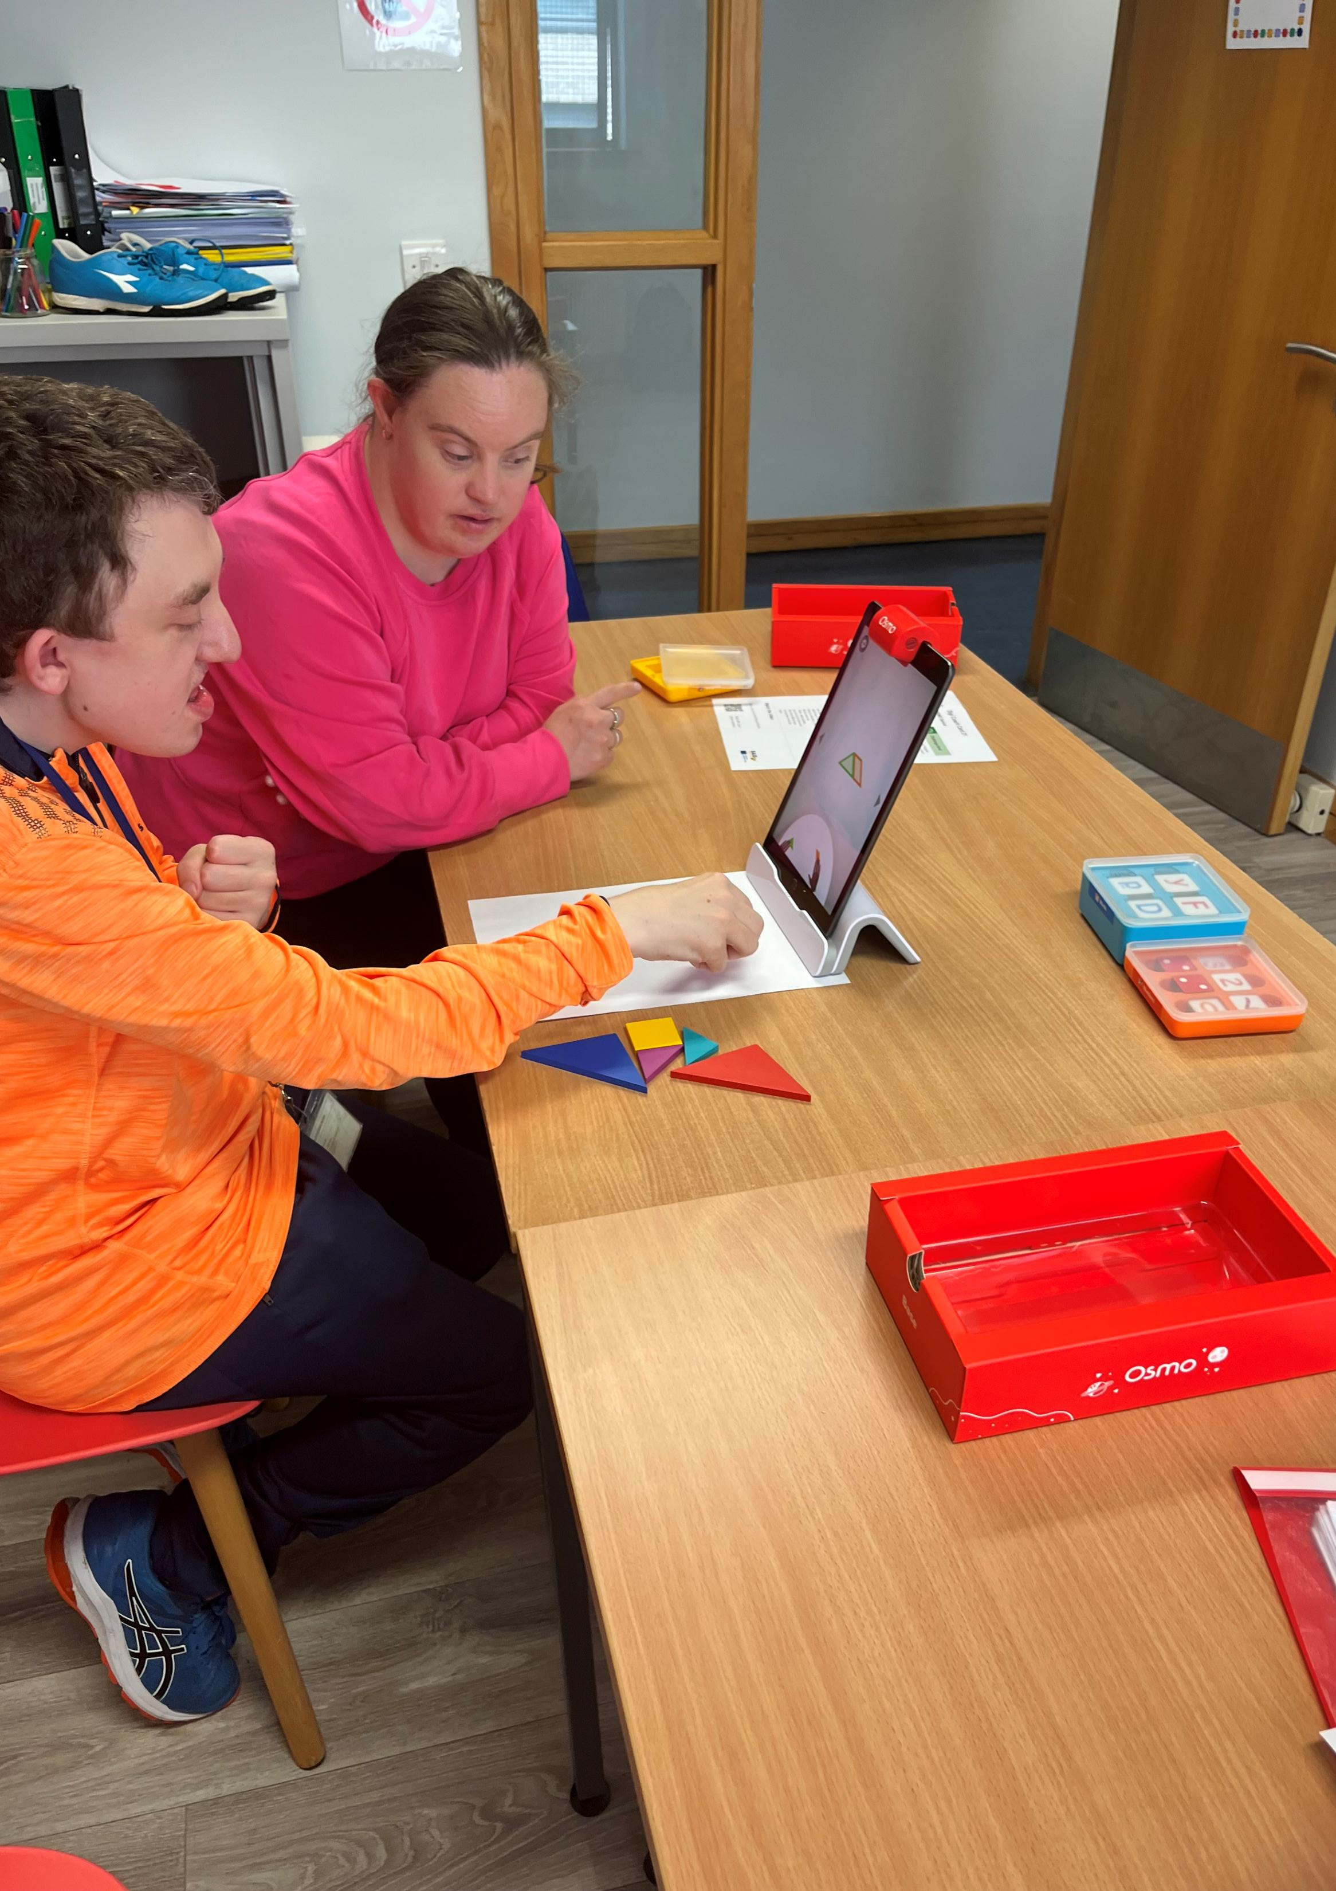
The Problem
Lack of awareness of assistive technology and digital accessibility
Gap in digital access
Limited job opportunities
Notes:
Patrick: We’re still seeing big gaps in digital accessibility. Many people don’t know what accessible tools are available. There are also very limited job opportunities for disabled people with digital skills. And overall, there’s still a gap between people and the technology they need to fully take part.

Slide 4
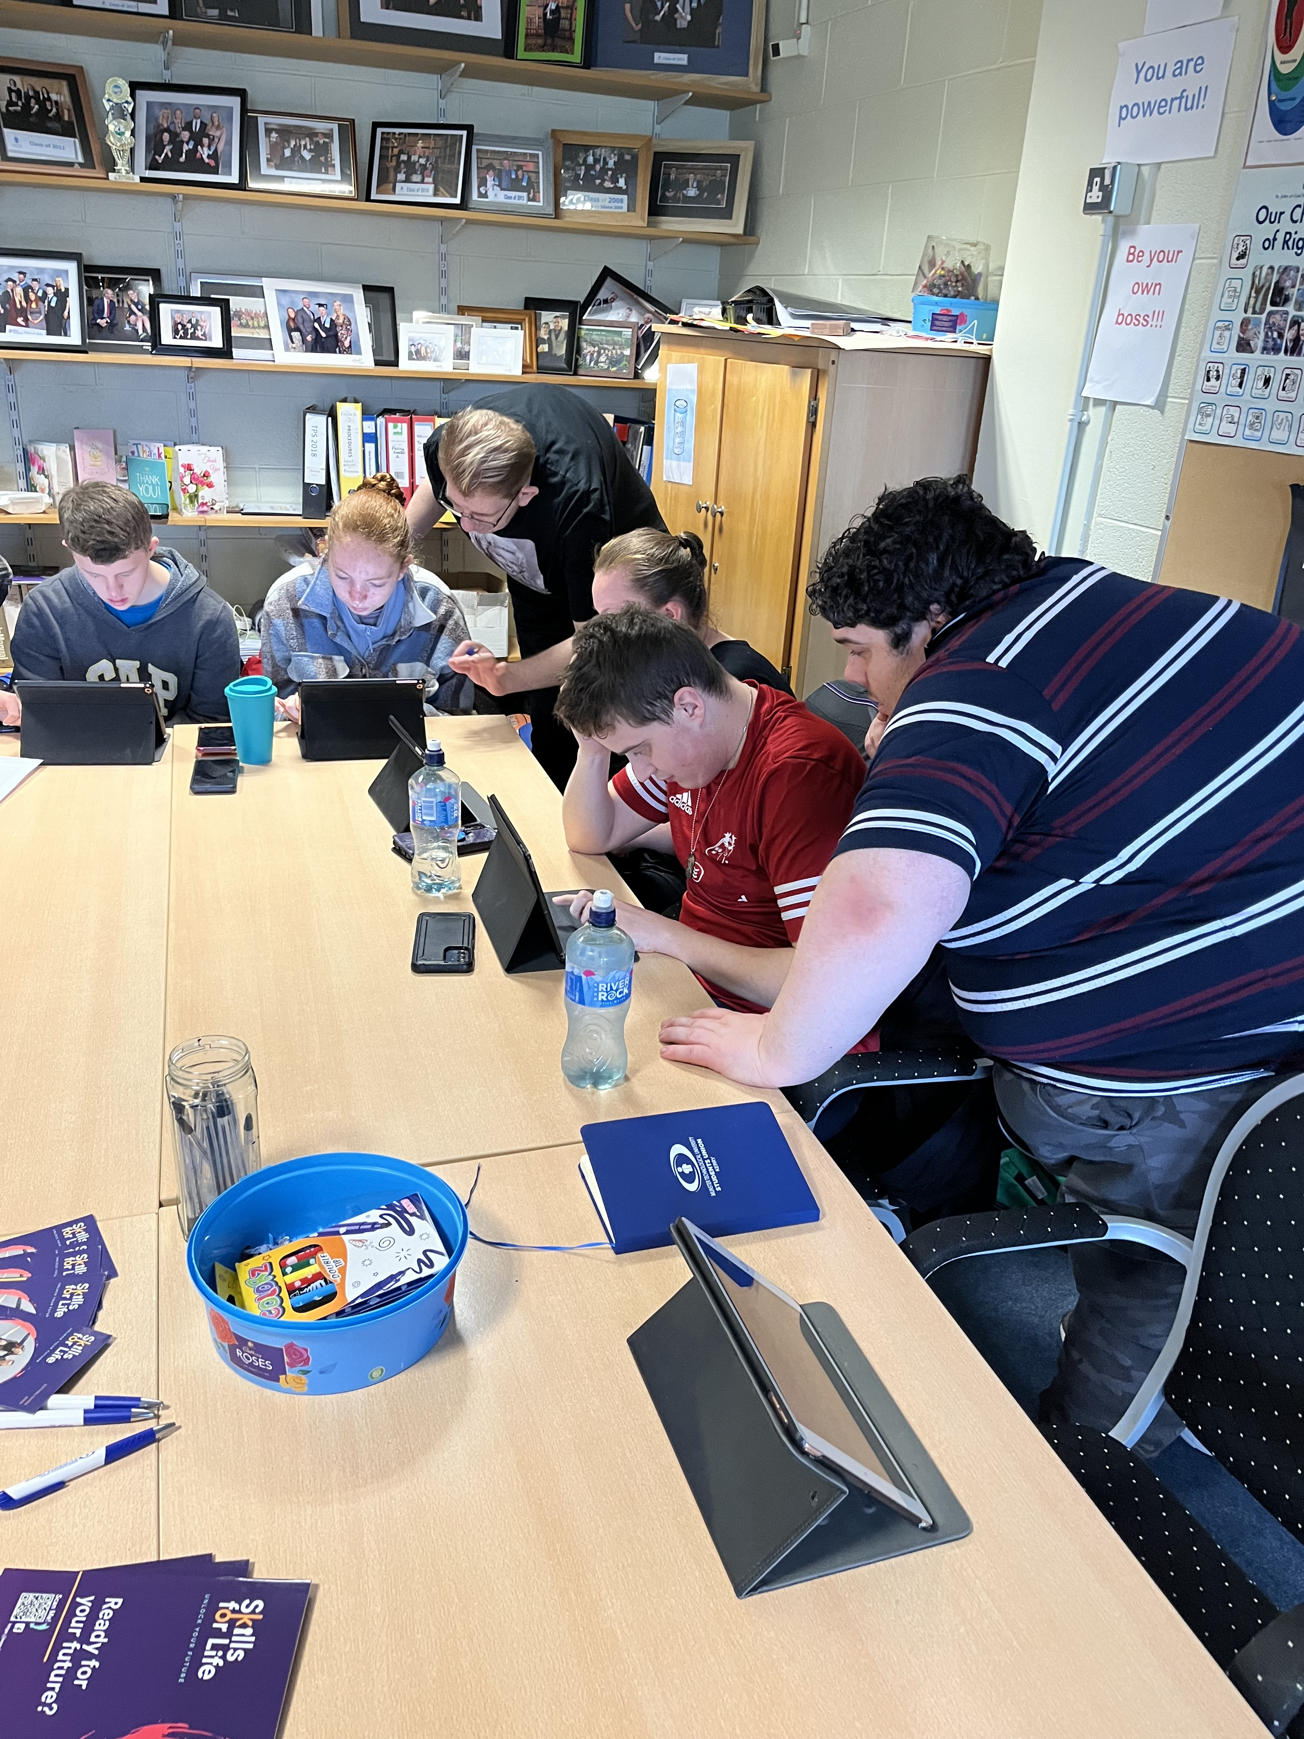
What is DigiCoaching?
Coaching approach
Working together
Everyone learns differently
Notes:
Patrick : DigiCoaching is our response to this. It’s not about traditional training, it’s about coaching. We work alongside people, showing and trying out tools together. And we support each person to find what works best for them.”

Slide 5
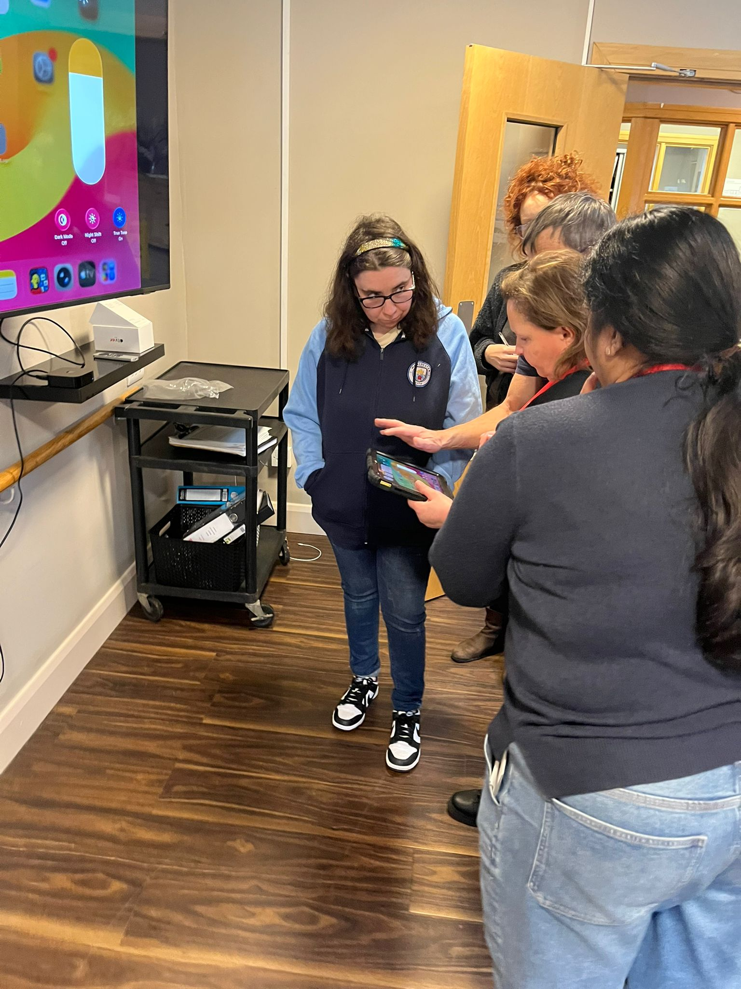
Coaching vs Training
Coaching is person-led
V’s Training is the same for everyone
Focus on individual journeys
Notes:
Klara: The key difference is that coaching is person-led. Training often gives the same steps to everyone. But DigiCoaching is different, we support each person’s own journey and how they learn best. People with Disabilities are natural problem solvers because they have to live in a world that is not designed with their needs in mind. That is why they make excellent DigiCoaches

Slide 6
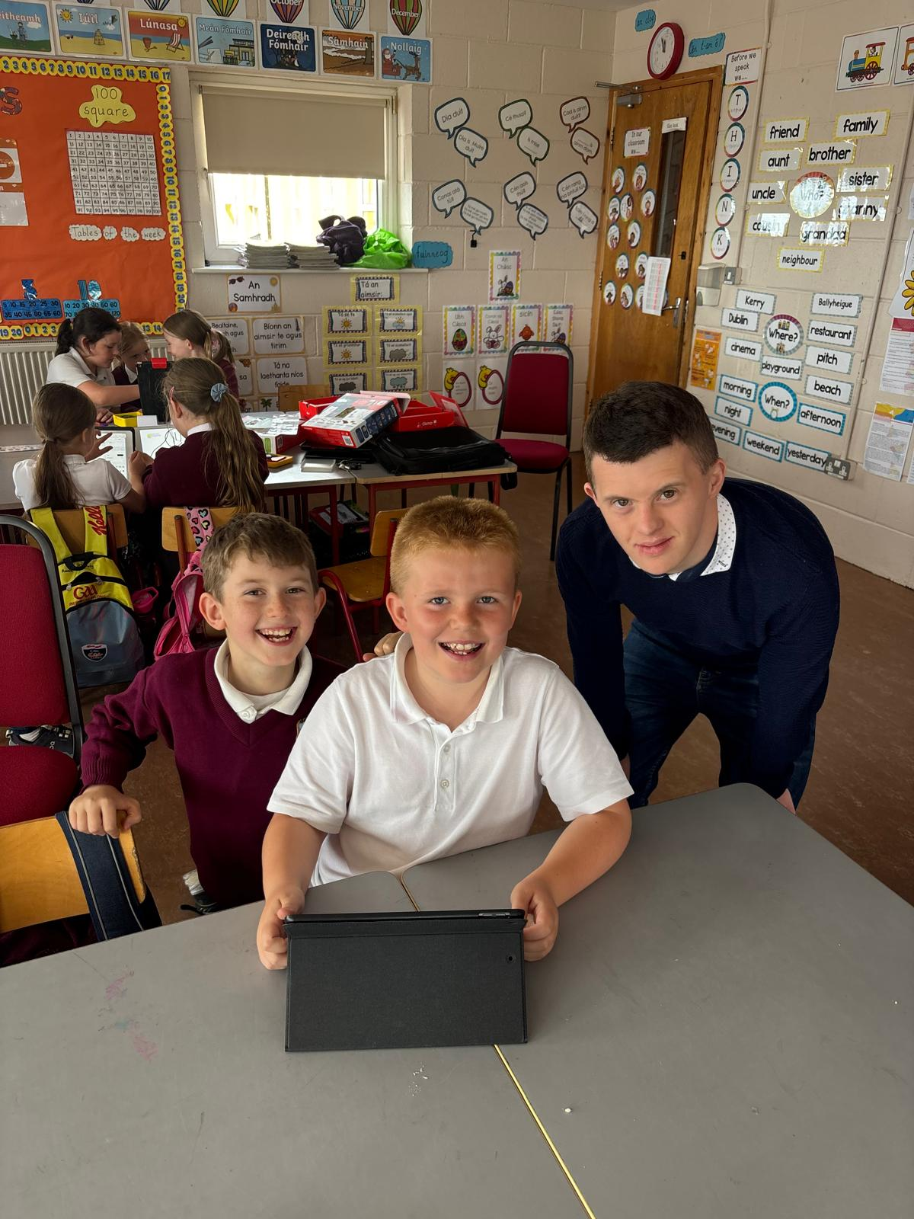
What Makes It Unique
Lived experience
Real-life use of tech
Peer learning approach
Notes:
Patrick : What makes DigiCoaching different is lived experience. We use this technology ourselves in our daily lives. So when we show someone a tool, it’s real we know it works. And that helps people feel more confident trying it. As DigiCoaches we do one – to one training, we run workshops in schools and we support teachers and disability staff to use assistive technology. We also run webinars to share with the public AT that we are using. Jade, can you share some of your experiences as a DigiCoach

Slide 7
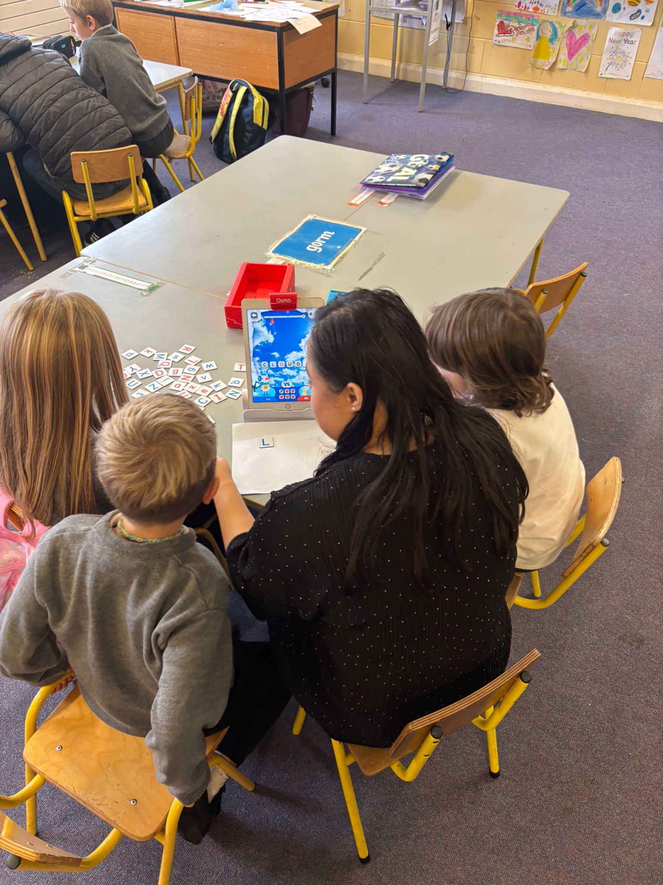
Real Experience
Everyone gets a turn
People enjoy learning
Don't be afraid to try
Notes:
Patrick; When I worked with children, I learned how important it is to give everyone a turn. I learned how to explain things clearly and in a way that makes sense. The students really enjoyed it, and everyone could take part.
We were also showing teachers new tools they can use every day.
For me, it showed that anyone can learn if the right support is there.”

Slide 8
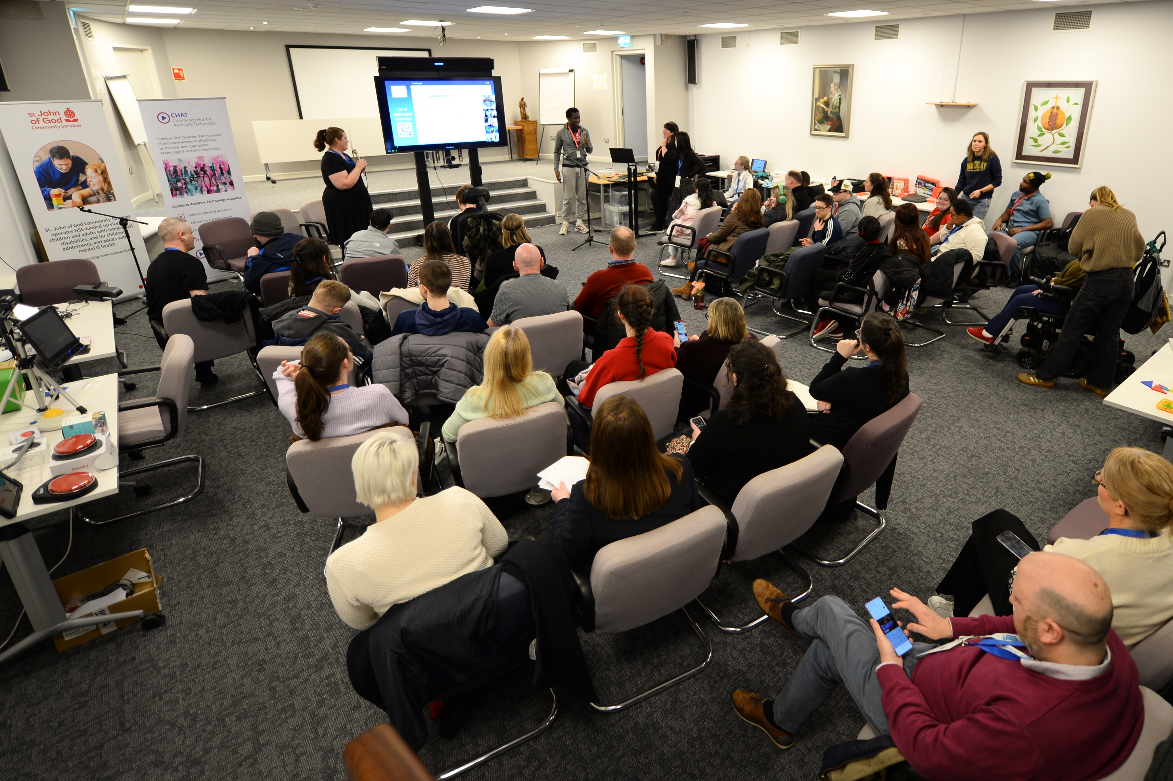
Our Impact
21 paid DigiCoaches
1200+people reached
Growing partnerships
Notes:
Klara: We have just hired new DigiCoaches, we will have 21 paid DigiCoaches working across Ireland next month. We have partnered with St John of God, fighting Blindness, Enable Ireland, Rehab National learning network, Muirosa and Corlann. To date we have reached over 1200 people through workshops, and built strong partnerships. But what’s really important is that these are paid roles, this is about real employment and real opportunities.

Slide 9
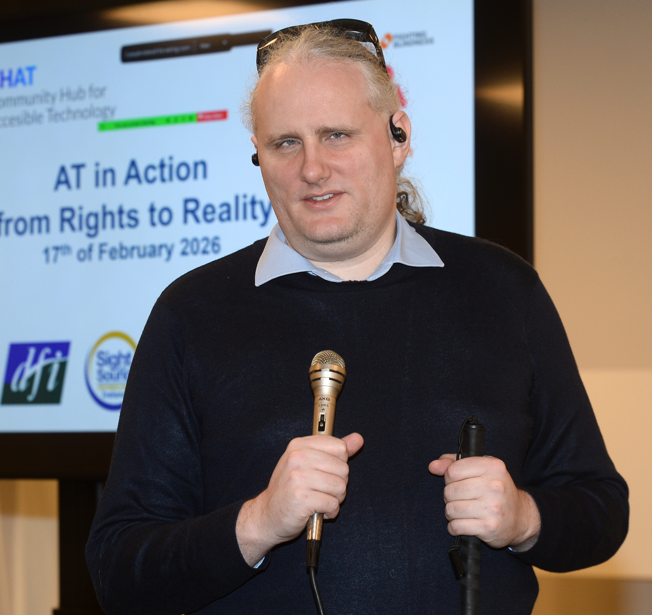
What’s Changing
Increased confidence
Peer learning
Real stories, real change
Notes:
Jade: We’re seeing real change happening. People are building confidence. They’re learning from each other through peer support. And we’re seeing real stories that show what inclusion can look like in practice.

Slide 10
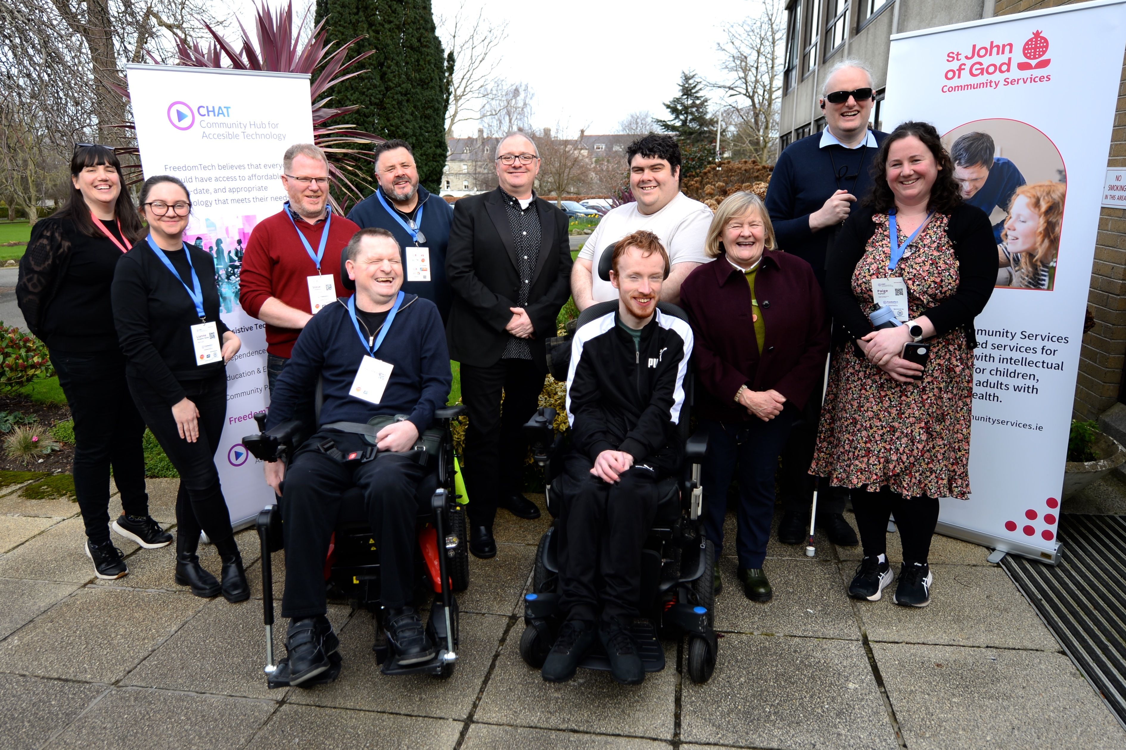
Looking Ahead
Grow DigiCoaching network
Create more opportunities
Support inclusive technology
Notes:
Patrick: This is just the beginning. We want to grow the DigiCoaching network, create more paid opportunities, and reach more people.
We’d love you to be part of that whether that’s partnering with us, supporting the work, or helping us scale this model.
Because digital inclusion should be led by the people who understand it best.”

