Slide 1

Facilitating Assistive Technology Use for Students with Literacy Challenges: Insights from Irish second-level teachers and implications for post-secondary institutions
Jane Brennan
Study Guidance Facilitator

Slide 2


SOAR Project Enabling Transitions Strand
Aim: Promote AT adoption for second-level students to facilitate transition to HE
Teacher training
Direct work with students and parents
Community-based work

Slide 3
‘Assistive’ Technology for Literacy Challenges
Text-to-speech
Speech-to-text
Page tinting and line focus
Proofreading support
But also:
Digital file sharing
Word processing

Slide 4
Can ‘assistive’ technology support a smooth transition from second level to HE for students with literacy-impacting disabilities?

Slide 5
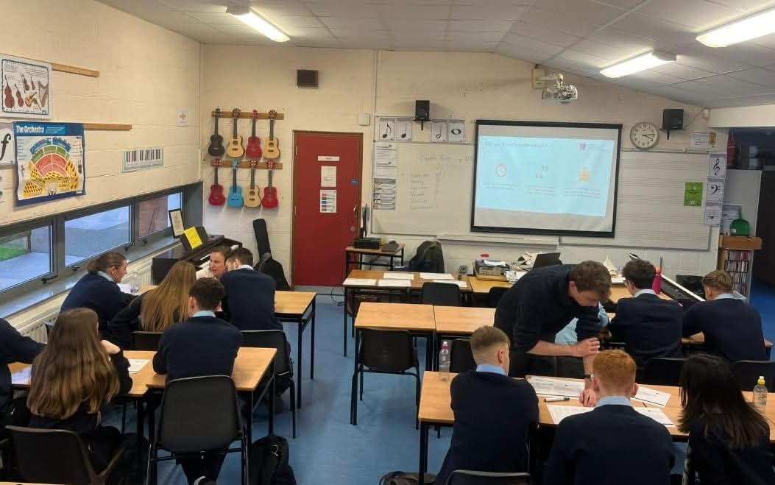
Feedback from Teachers
Enthusiasm for supporting students using technology
Varying degrees of skill and confidence with technology
Varying degrees of technological infrastructure
Range of constraints specific to the second-level school context

Slide 6

Qualitative Research Project
10 teachers (SEN and subject)
Semi-structured interviews
Experiences of facilitating AT use for students
Data analysis – Reflexive Thematic Analysis (Braun and Clarke, 2019)
Notes:
NB – teachers were top enthusiasts for AT – experienced and leaders in their schools

Slide 7
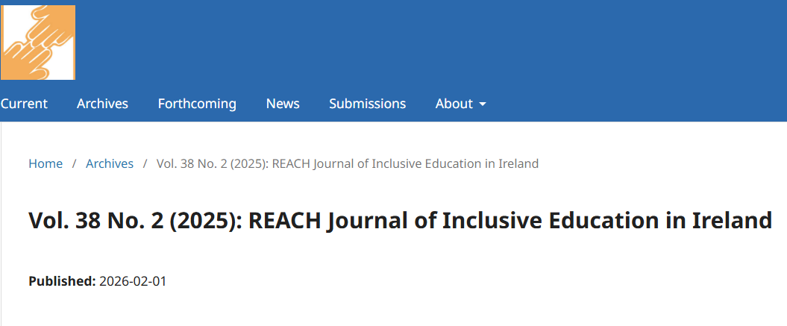
Research Journal Publication

Slide 8
Results – 3 Main Themes
Impact on Students
Teaching Strategies
Aspects of the Irish Second-level System

Slide 9
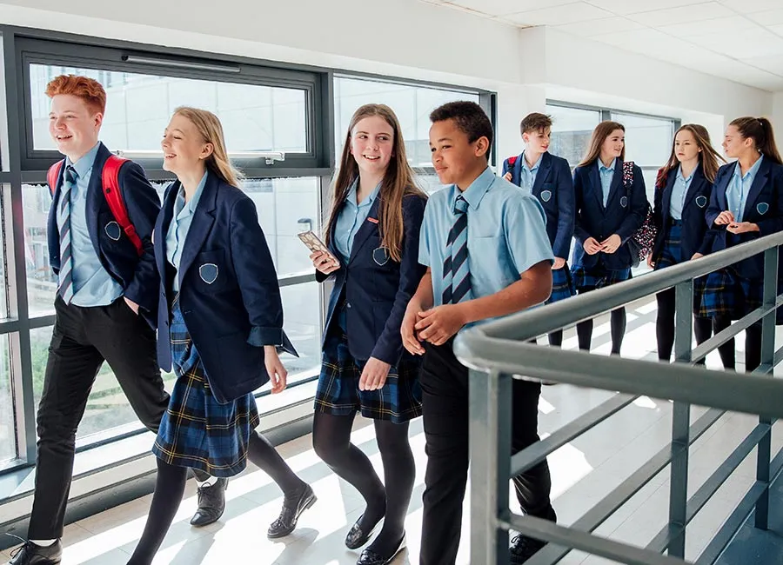
Impact on Students
Participation, achievement, motivation
Not wanting to stand out
Notes:
File sharing, word processing, fatigue, stamina, motivation, independence, success, homework, participation at all, IT skills
All participants, major issue, girls and younger students, friendships, stigma

Slide 10

Teaching Strategies
Managing attitudes to AT
Integrating learning strategies
Need for individual guidance
Notes:
Diplomatic, normalising language, colleagues, whole class work, peer mentoring
Guidance on integrating in learning strategies, modelling own use, teachers need support in this
Diverse students, previous bad experience – need time for individual support but not available. Networking parents and SNAs too but no time

Slide 11
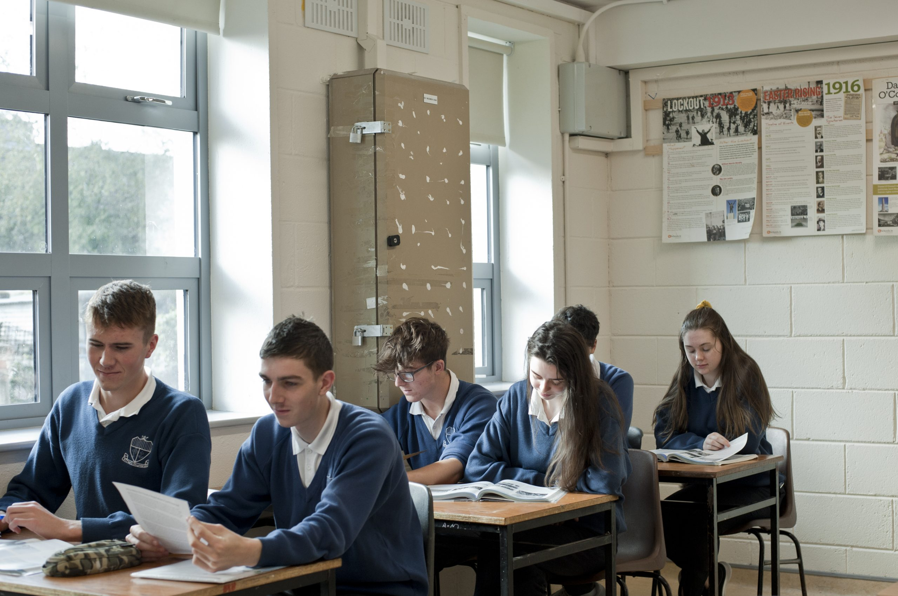
The Irish Second-level System
The school environment
Impact of State exams
Leadership
Notes:
Busyness, classroom changes, STT and TTS not feasible in mainstream, physical infrastructure, RACE delays
RACE delays, handwritten exam, focus on info rather than independent reading
School leadership – time, infrastructure, ethos, posts, Dept – need to support deeper developmental approach and guidance for teachers

Slide 12
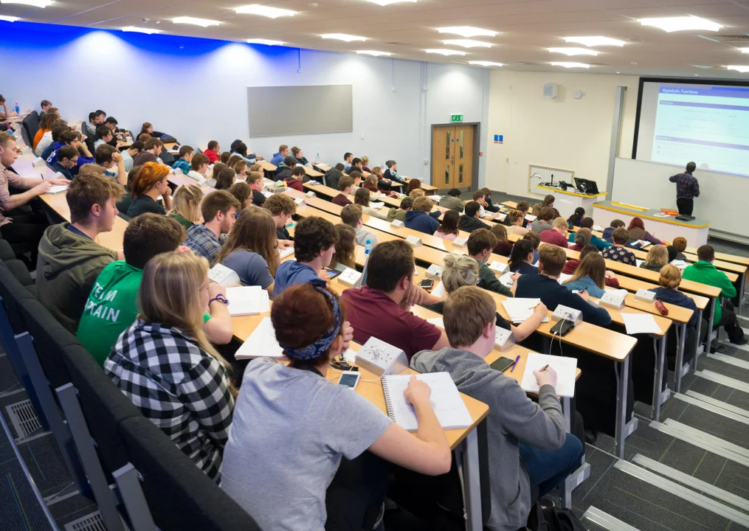
Implications for Higher Education
Expectations of AT skills of new first-years
Orientation and induction
Ongoing individual guidance

Slide 13
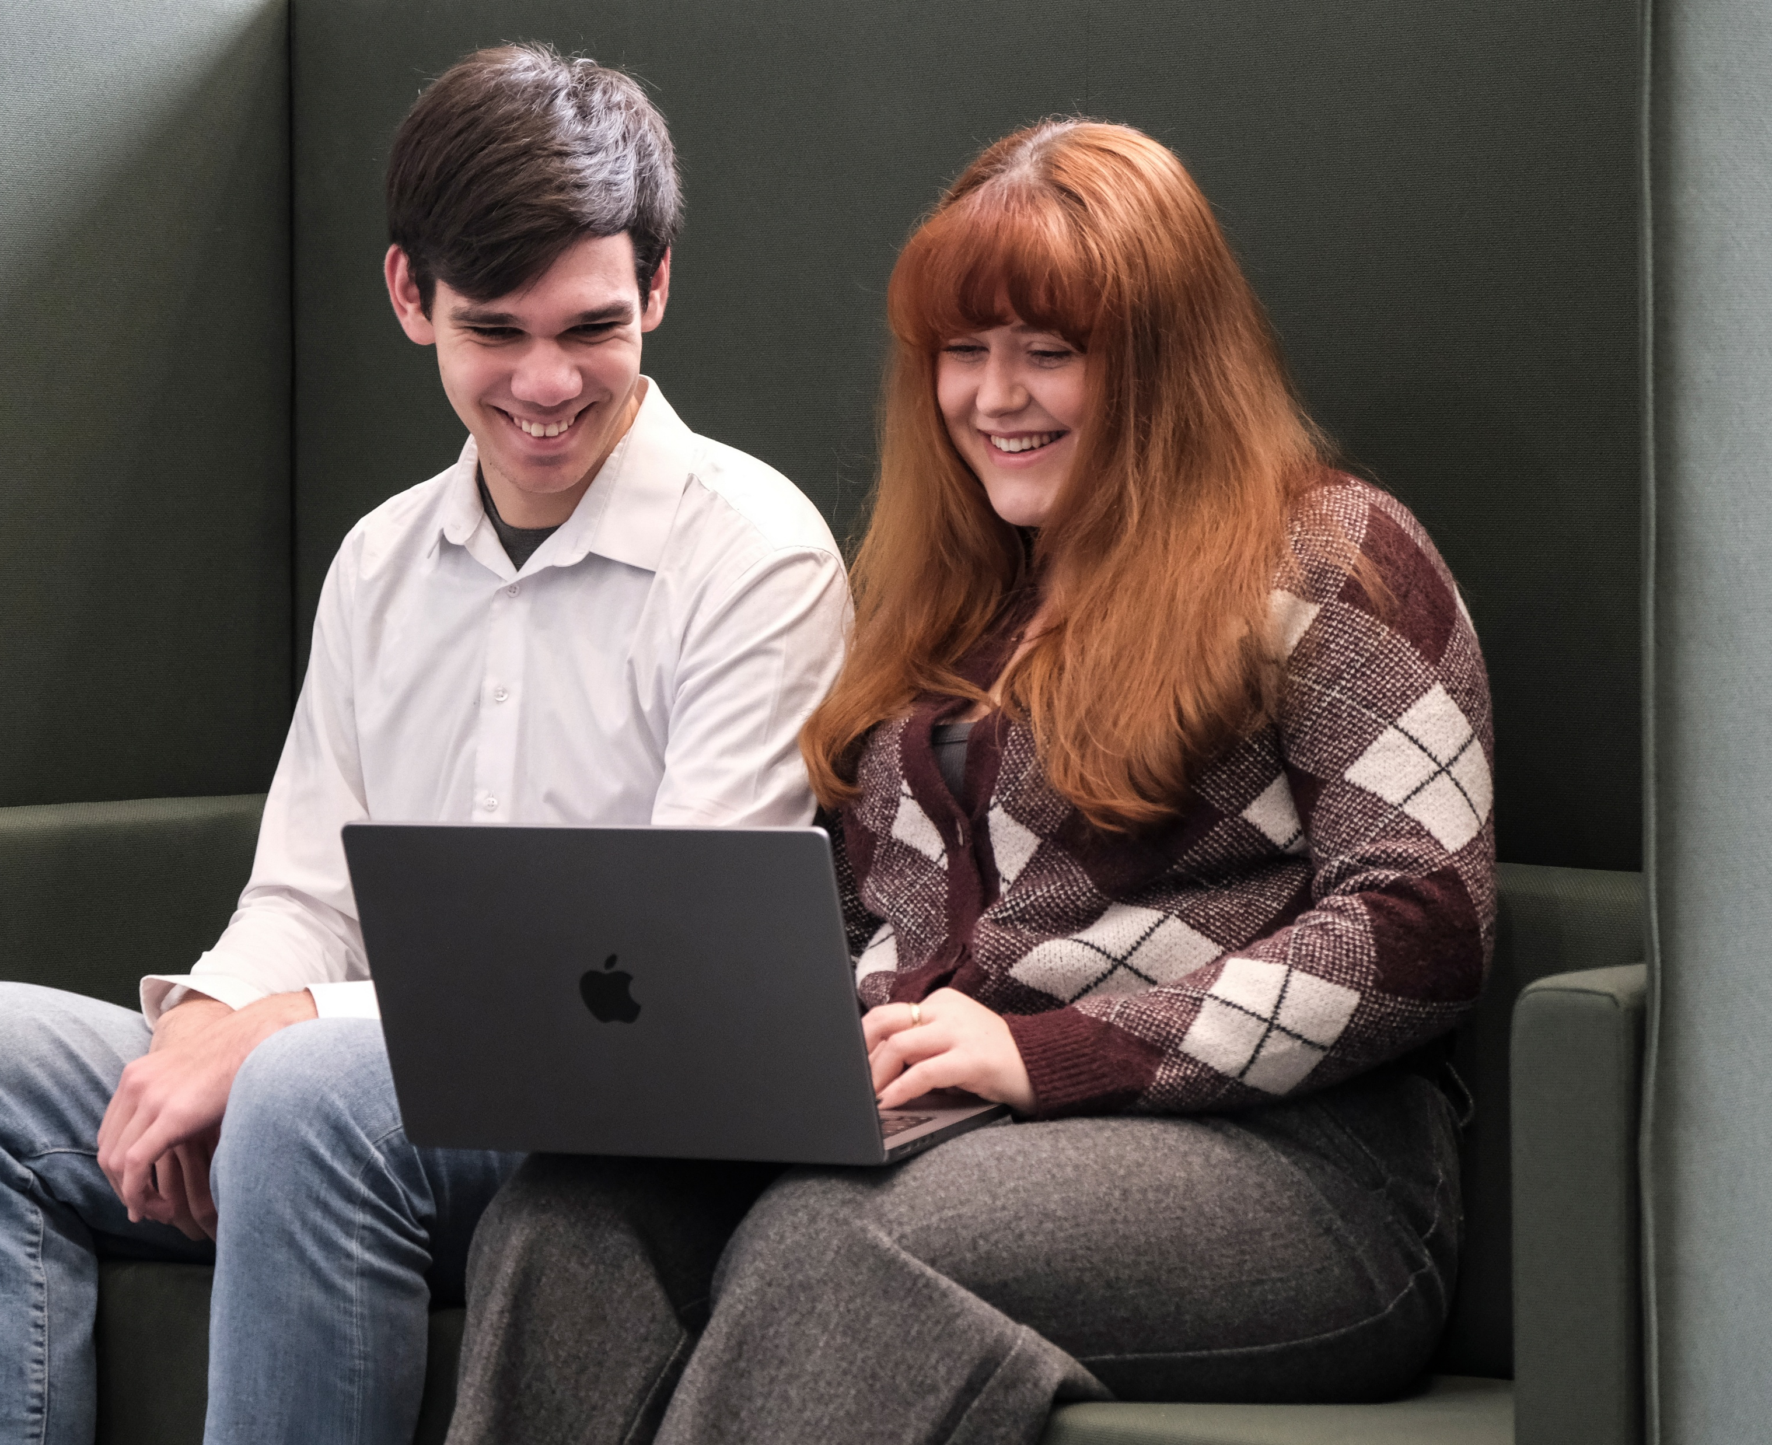
AT Transition Supports at MTU
Laptop loan scheme
Students with documented literacy challenges referred for one-to-one technology guidance
Universal awareness-raising workshop ‘Build Your Digital Toolkit’ provided for first-year class groups
Office 365 campaign planned for 2026-7

Slide 14

Priority needs for inclusive technology development
Ongoing liaison between phases of education system on integration of technology to facilitate learning of students with disabilities
Much further research is needed on the effective use of technology including Gen AI to support the learning of students with disabilities

Slide 15

Questions or comments?

