Slide 1
Assistive Technology Passport 2.0
The Assistive Technology Passport 2.0:
What the AT Passport did for me.
Patrick Fitzgerald & Niamh Toland

Slide 2

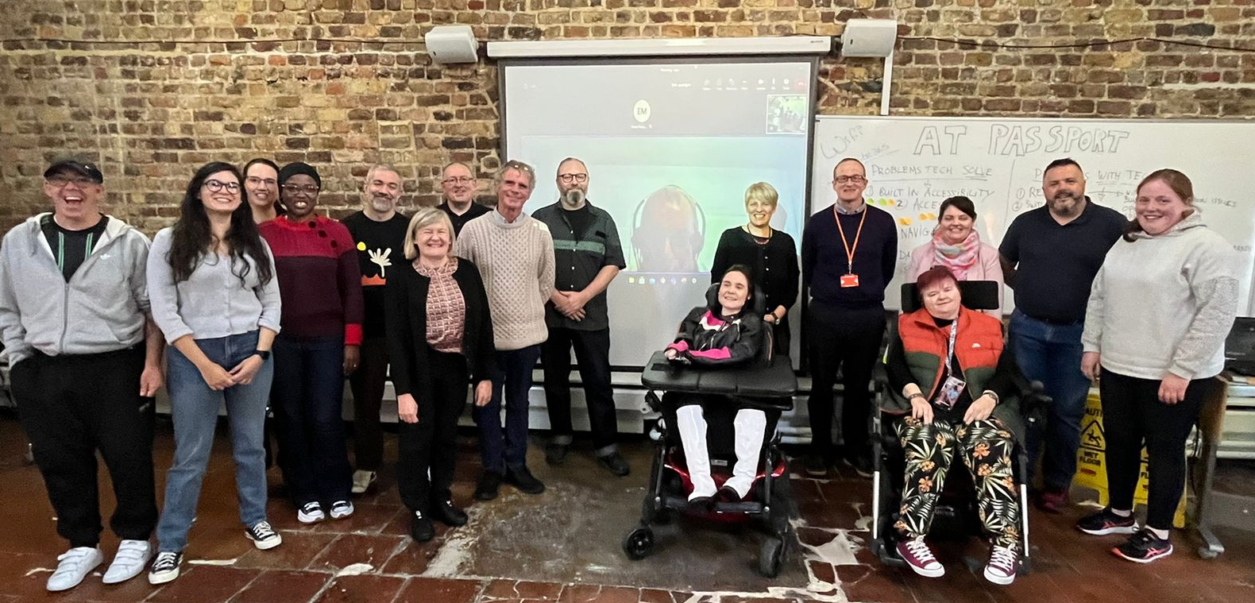




Partner organisations
Notes:
The HSE's CREATE fund allowed the partnership of Enable Ireland, Disability Federation Ireland St. John of God Community Services, Headway Ireland and Multiple Sclerosis Ireland to build an AT Passport Prototype. Microsoft Ireland has been hugely supportive of this initiative for a long time and they have assisted us in project managing the AT Passport. Tekenable are the technical partner and they have built this web-based AT Passport.

Slide 3
AT Passport 2.0
The AT Passport support people to identify their needs and match it with AT
Supports transitions across education, employment, and community life
Helps people communicate supports and accommodations more easily
Promotes independence, confidence, and continuity
Notes:
We needed to go beyond the four service providers and lean on the wider AT community to gather their needs for this AT Passport. The AT Passport support people to identify their needs and match it with AT
Supports transitions across education, employment, and community life
Helps people communicate supports and accommodations more easily
Promotes independence, confidence, and continuity

Slide 4
Why the AT Passport Matters
Many AT users face delays accessing supports
People often repeat their story to new services or organisations
AT needs change across different stages of life
The passport puts the person at the centre of the journey
Notes:
Why we needed AT Passport 2.0 Many people who could benefit from AT are not linked to services.
People often repeat their story to new services or organisations
AT needs change across different stages of life
The passport puts the person at the centre of the journey

Slide 5
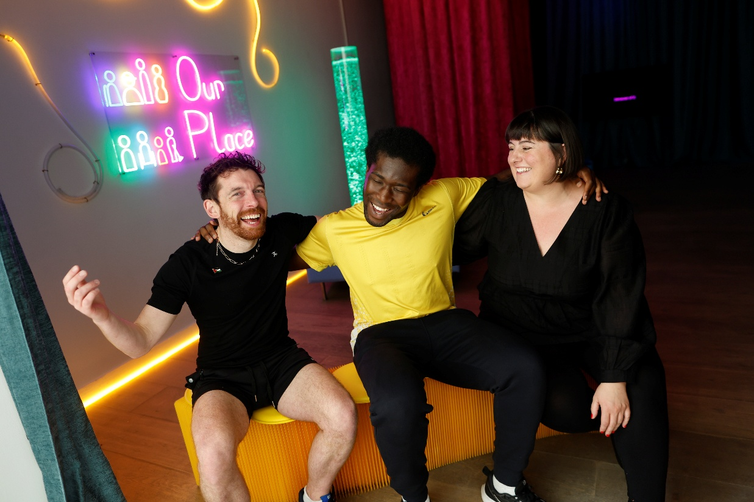
How it helped me? Daniel
Access to information about what technology can help me
I could select New AT based on new Needs
I could share my needs with others
I was more Confident and felt more independent
Notes:
Last year, I started a college course and already had an iPad; the college could only give me a laptop, but it wasn’t enough. I needed something to help me with my assignments and improve my grammar and spelling.
When I signed up for the AT Passport, it suggested a number of free trials. I chose Grammarly. It was great in College.
Now, I can write with more confidence. It helps me with spelling, grammar, and getting my ideas across.
The Passport also lets me keep all my AT needs in one place. I can share it easily with new people I meet.
That makes starting something new, like a job or a course, much easier, because I don’t have to keep explaining everything from the beginning.
The AT Passport gave me tools, confidence, and a way to share my needs and get things done.

Slide 6
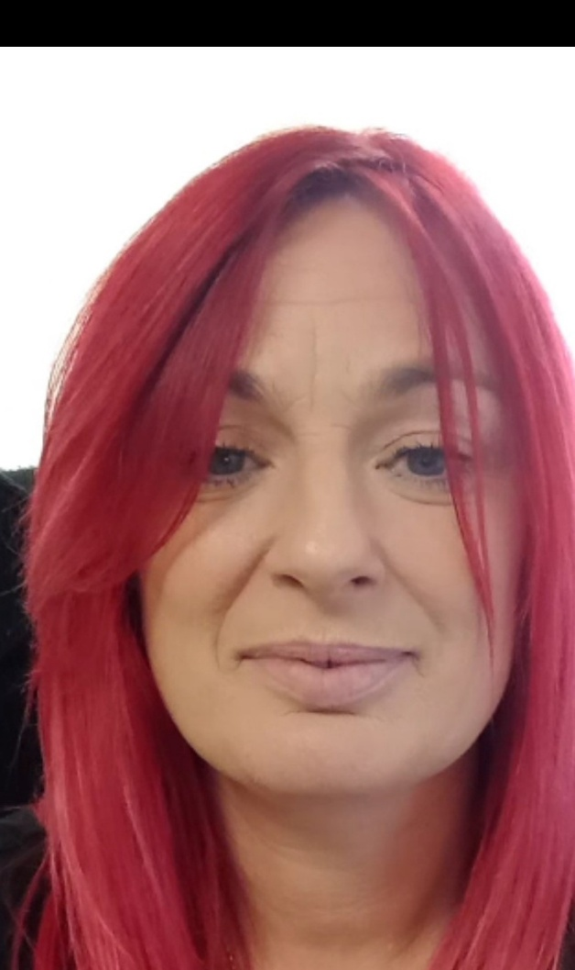
How it helped me? Niamh
Supported transitions in career development
Helped identify needs clearly
Encouraged trying new technologies
Made accessing information easier
Supported confidence

Slide 7
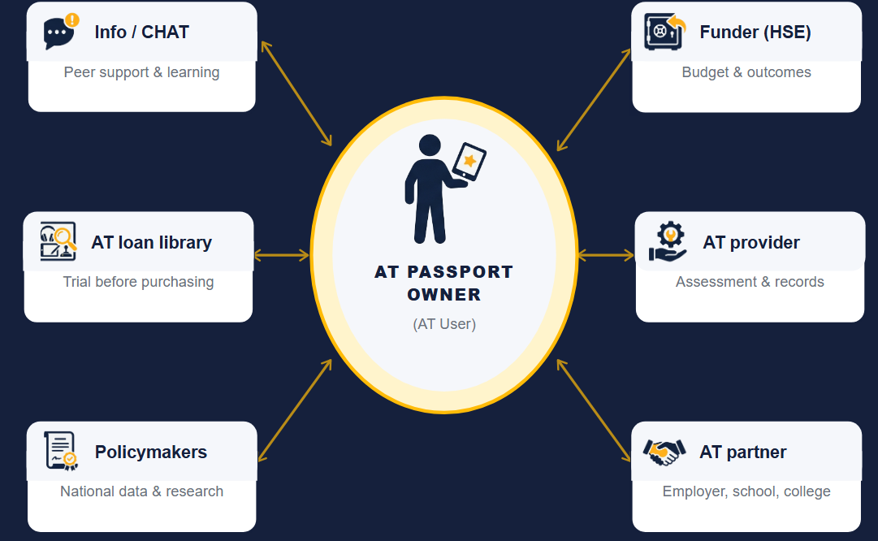
AT Passport mindmap

Slide 8
Innovation:
Places AT user at centre of own journey
Eases transitions across lifespan
Promotes no-cost/low-cost solutions as the first step in the process
Potential to reduce the waiting list by empowering prospective AT users to identify and resource their own needs, where possible
Extends reach of HSE Aids & Appliances budgets
Notes:
The AT Passport prototype places the user at the centre of their own journey in getting the AT they need. They can share details of the AT they use with others throughout their life, whether that's from school to college, or school to employment or with county councils who might be funding techology for their home.
The Passport focuses first on no cost/low cost solutions and then progresses to more dedicated solutions where needed
We believe that the AT Passport has the potential to reduce waiting lists by empowering AT usrs to identify, and where possible, source their own AT, especially if it's low cost or no cost
In this way, the AT Passport has the potential to stretch the HSE's Aids and Appliances budgets further: to benefit more people
For the first time in Ireland there is a system that captures the full cycle for AT support where we attempt to learn from the key identifiers in the users needs and match them with AT. The more we grow this database the more we an learn and provide more options to the AT users and fast-track the process. As shared in Mohammed research the AT users wanted a passport that “facilitating transitions, acting as a source of information, and enabling effective communication. They also said it could enhance their ability to access and effectively use AT. They see it as a tool that could address many of the current barriers in AT service provision, expanding their capabilities and opp ortunities to participate fully in society. They wanted something to work for diverse groups and with that in mind we are building on the idea of the user to take the lead – with a gateway into the original passport for those with higher support needs and traditional assessment requirements. Many people who need AT can share their needs or the things they struggle with but sometimes finding the right AT can be a challenge. Looking of the work that AXS and others have done we want to support this group of AT users to have a passport that works for them.

Slide 9
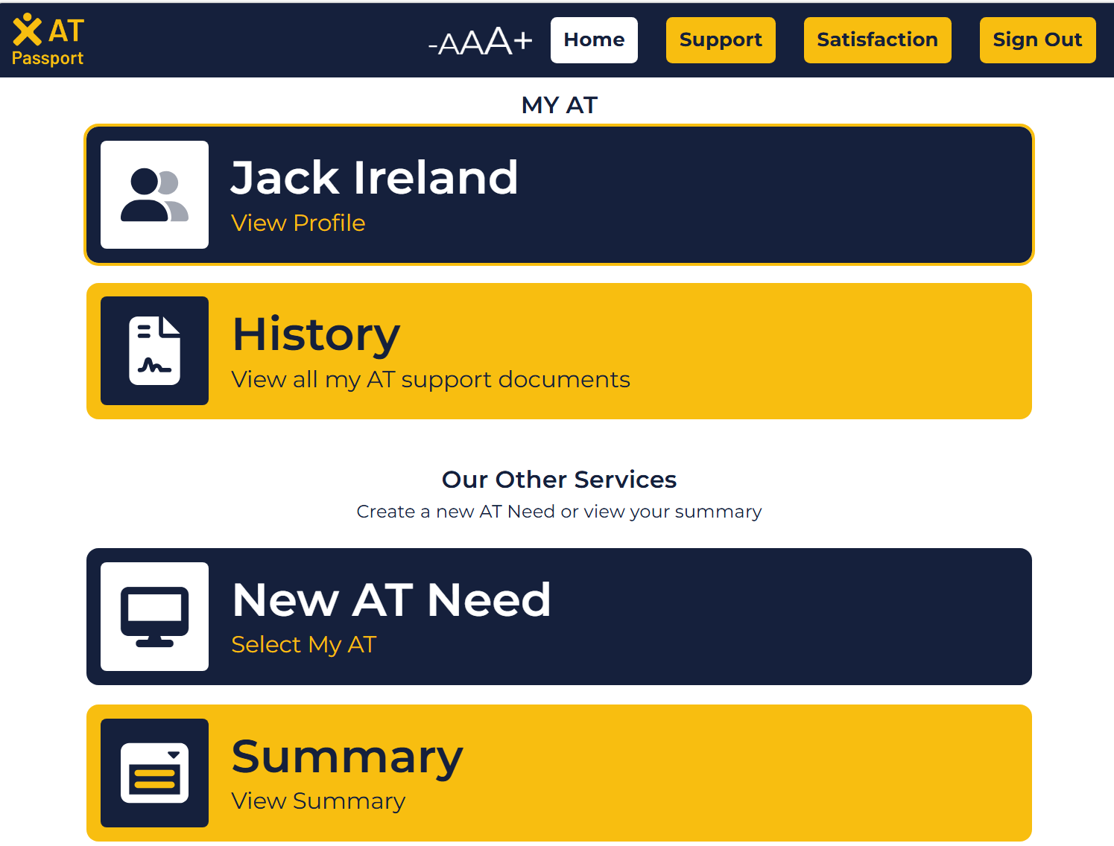
Key Features of AT Passport 2.0:
Self-identification of AT needs
AT profile creation and sharing
Trial and feedback on assistive technology
Information on funding and supports
Connection to local AT services when needed

Slide 10

Expand the reach of the AT Passport

Slide 11



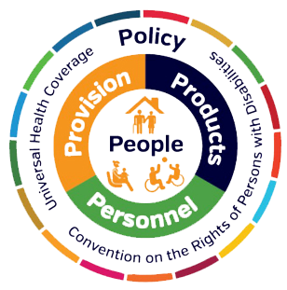

AT Passport : Global Impact
Notes:
Addresses 6 of the 10 key recommendations of Global Report on AT:
Improve access to AT
Ensure that assistive products are safe, effective and affordable
Enlarge, diversify and improve human resource capacity
Actively involve users of AT and their families
Invest in data and evidence-based policy
Invest in research, innovation and an enabling ecosystem
An AT Passport is a user-centred solution to enable AT users and prospective users to proactively secure the technologies and supports they need.
The Assisting Living and Learning Institute of Maynooth University, in partnership with Enable Ireland, and supported by Microsoft, are actively researching the key components of the proposed AT Passport: identifying key features to ensure its successful adoption and integration within a national AT ecosystem.
Integrating AI within the AT Passport will be key to its success.
Case study: Life with/without an AT Passport for a 19 year old student
With an AT Passport Without an AT Passport
AT in place on first day in college X Awaits AT Assessment: receives AT on
final week of first semester: falling
behind in studies as a result
Commutes to/from college seamlessly X Has to alert train station in advance of
her arrival to ensure wheelchair ramp
is in place
Internship: employer sets up her X She must ask employer on her first day to
accommodations in advance of her arrival source/set up the AT she requires.

Slide 12
Looking Ahead
With Government support, we want to:
Expand the reach of the AT Passport nationally
Grow partnerships across education, health, and employment
Use AI to personalise recommendations and support
Continue co-design with AT users and lived experience leaders
Notes:
Read bullet points

