Slide 1
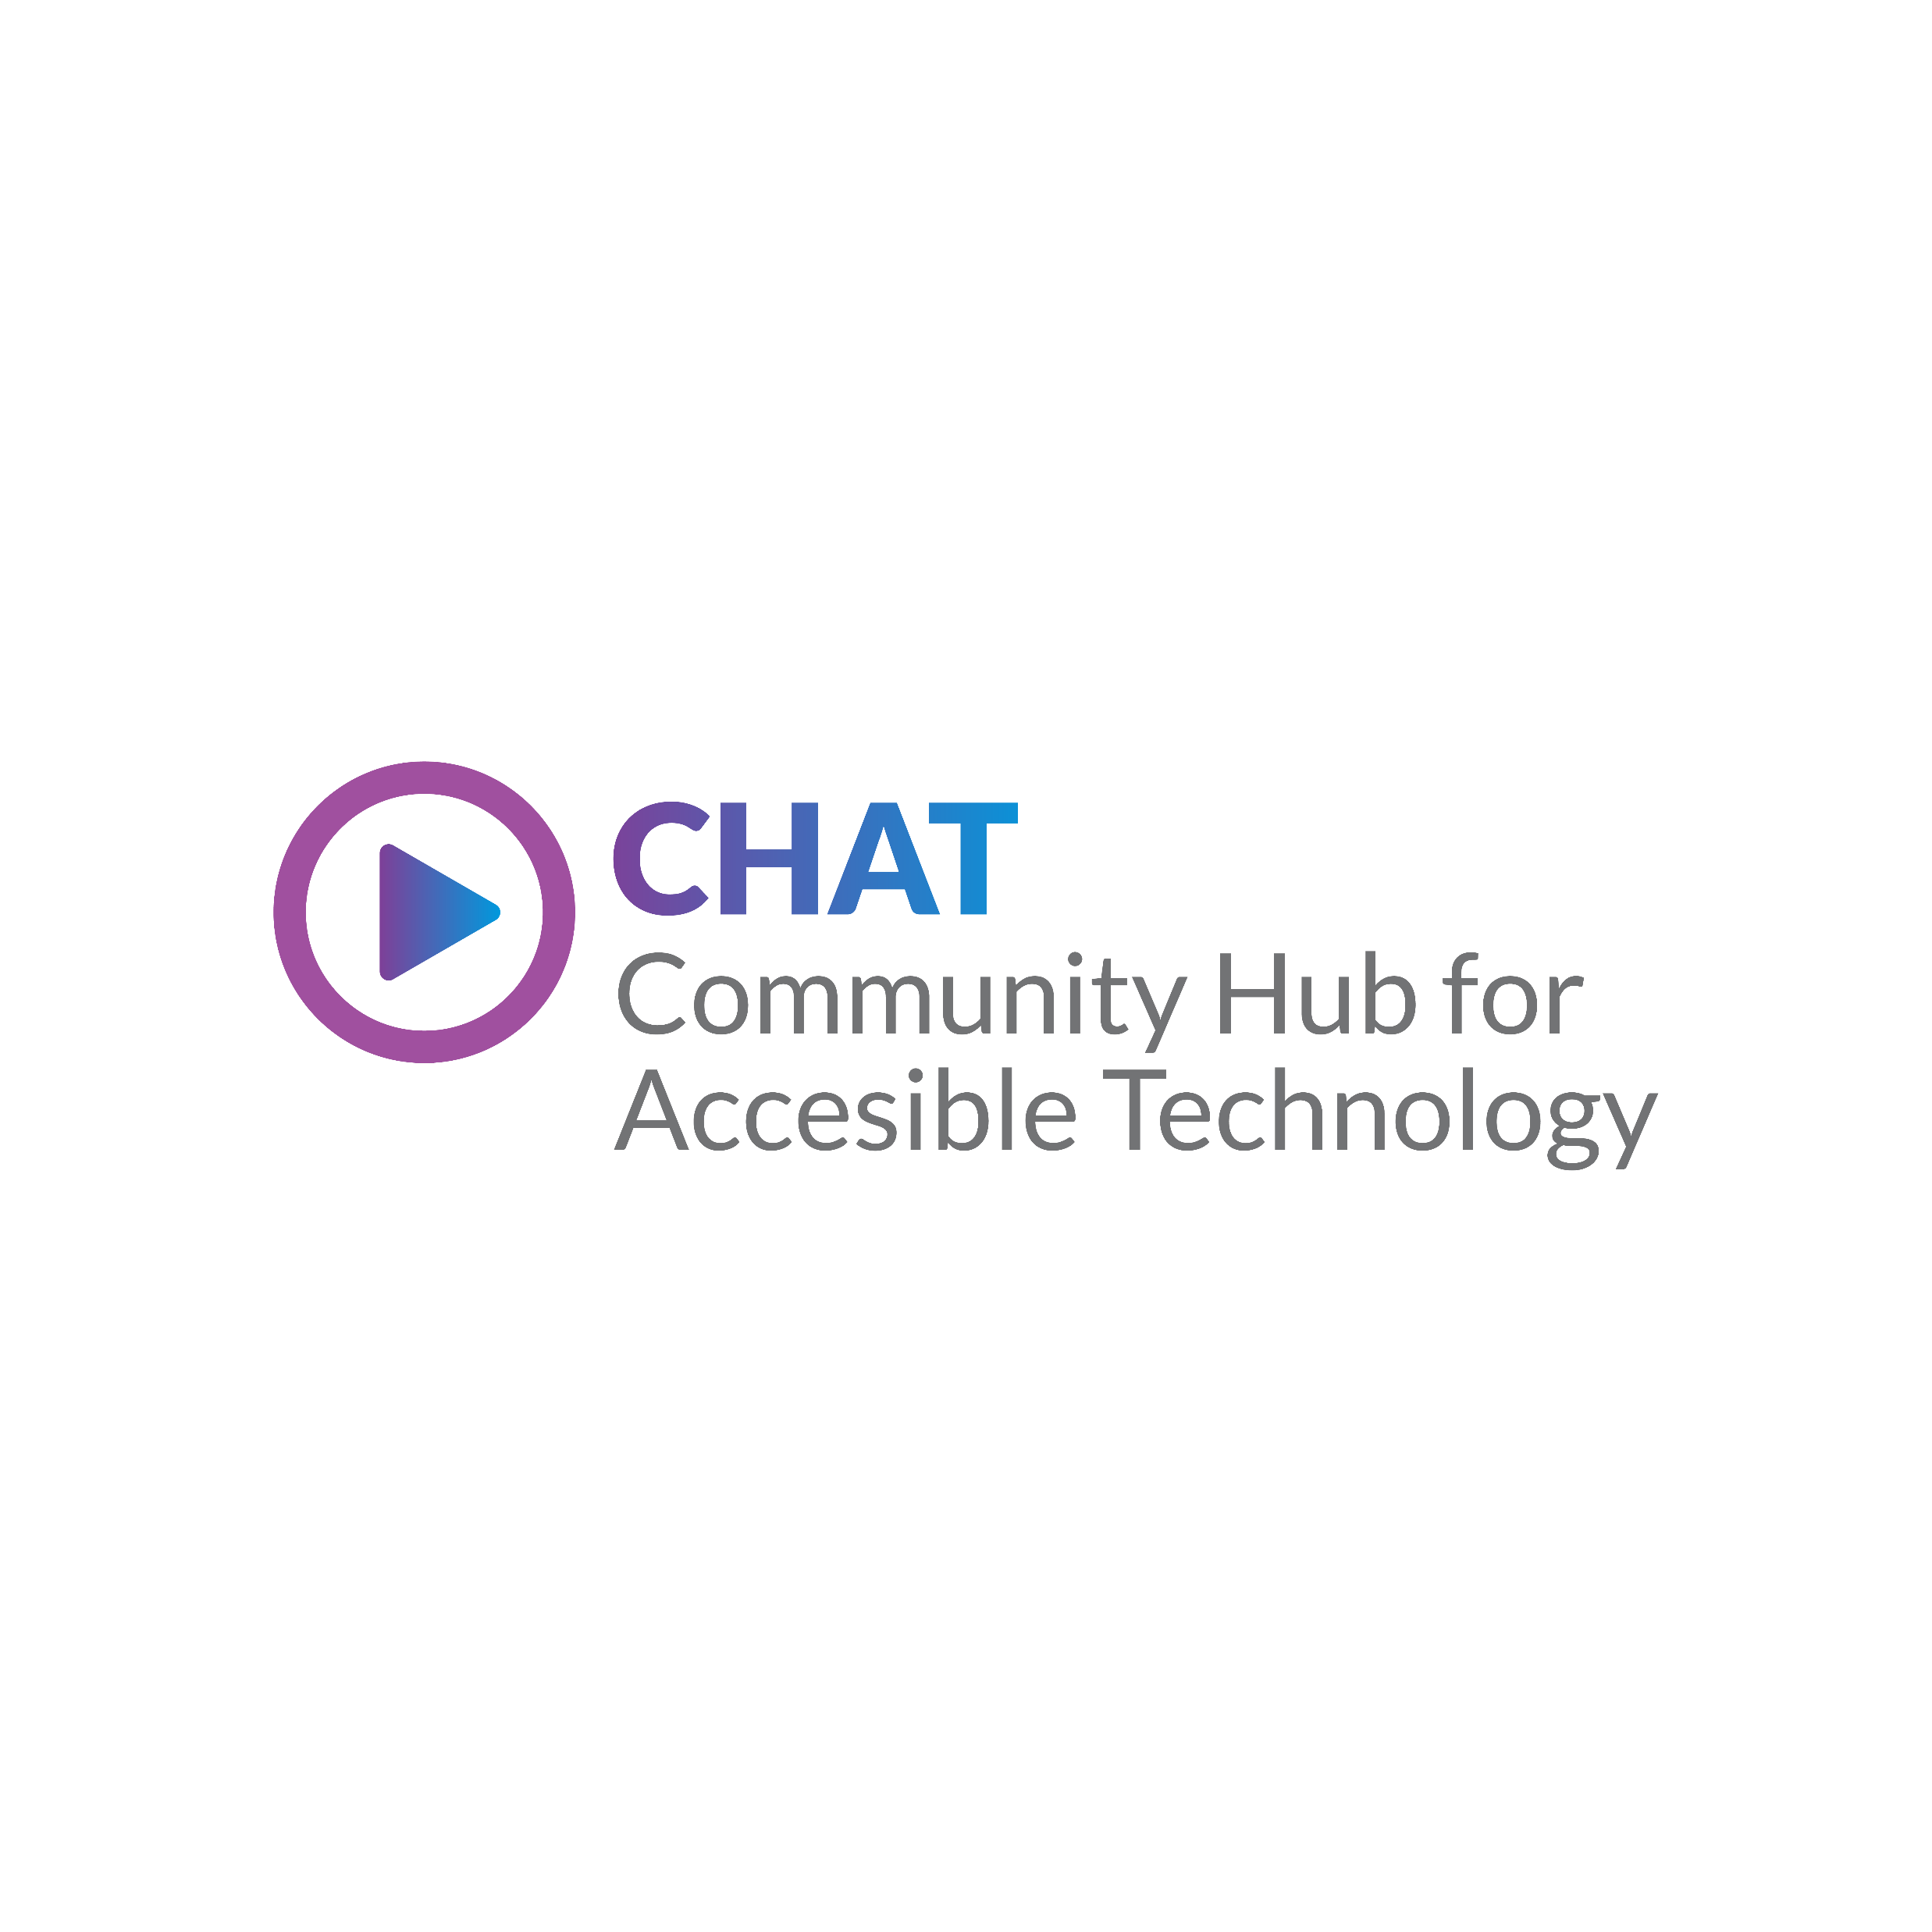





CHAT: Community Hub for Accessible Technology
Advancing Inclusive Assistive Technology Dialogue, Policy, and Practice
Sarah Boland
Declan Meenagh
Sponsored by:

Slide 2




WHAT is CHAT?
A national community of practice showcasing the transformative power of Assistive Technology (AT) for independence and inclusion.
Led by lived experience and strengthened by professional expertise.
Brings together AT users, suppliers, developers, and practitioners to collaborate.
Promotes knowledge-sharing, problem-solving, and co-design in an inclusive, peer-led space.
Shapes national strategy by identifying AT challenges and sharing innovative solutions.
Notes:
CHAT is a national community of practice focused on the transformative power of assistive technology (AT) to improve lives, inclusion, and independence.
Driven by lived experience and professional insight, CHAT fosters meaningful collaboration between AT users, suppliers, developers, and practitioners.
Promotes knowledge-sharing and problem-solving through a peer-led, inclusive approach, creating space to identify AT challenges, share solutions, and inform national strategies.

Slide 3
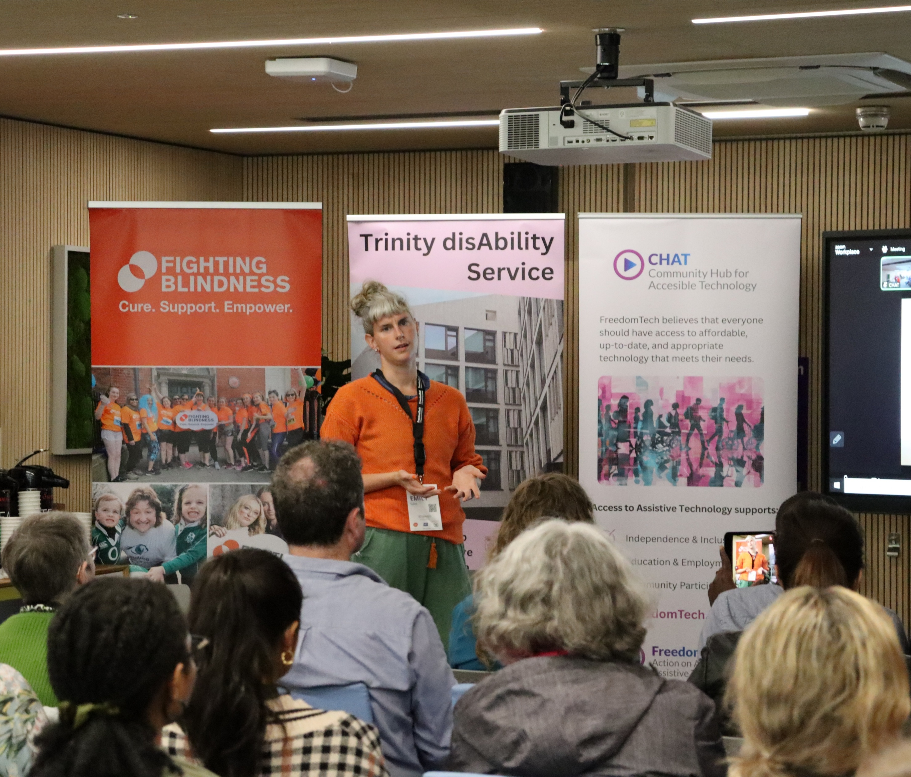
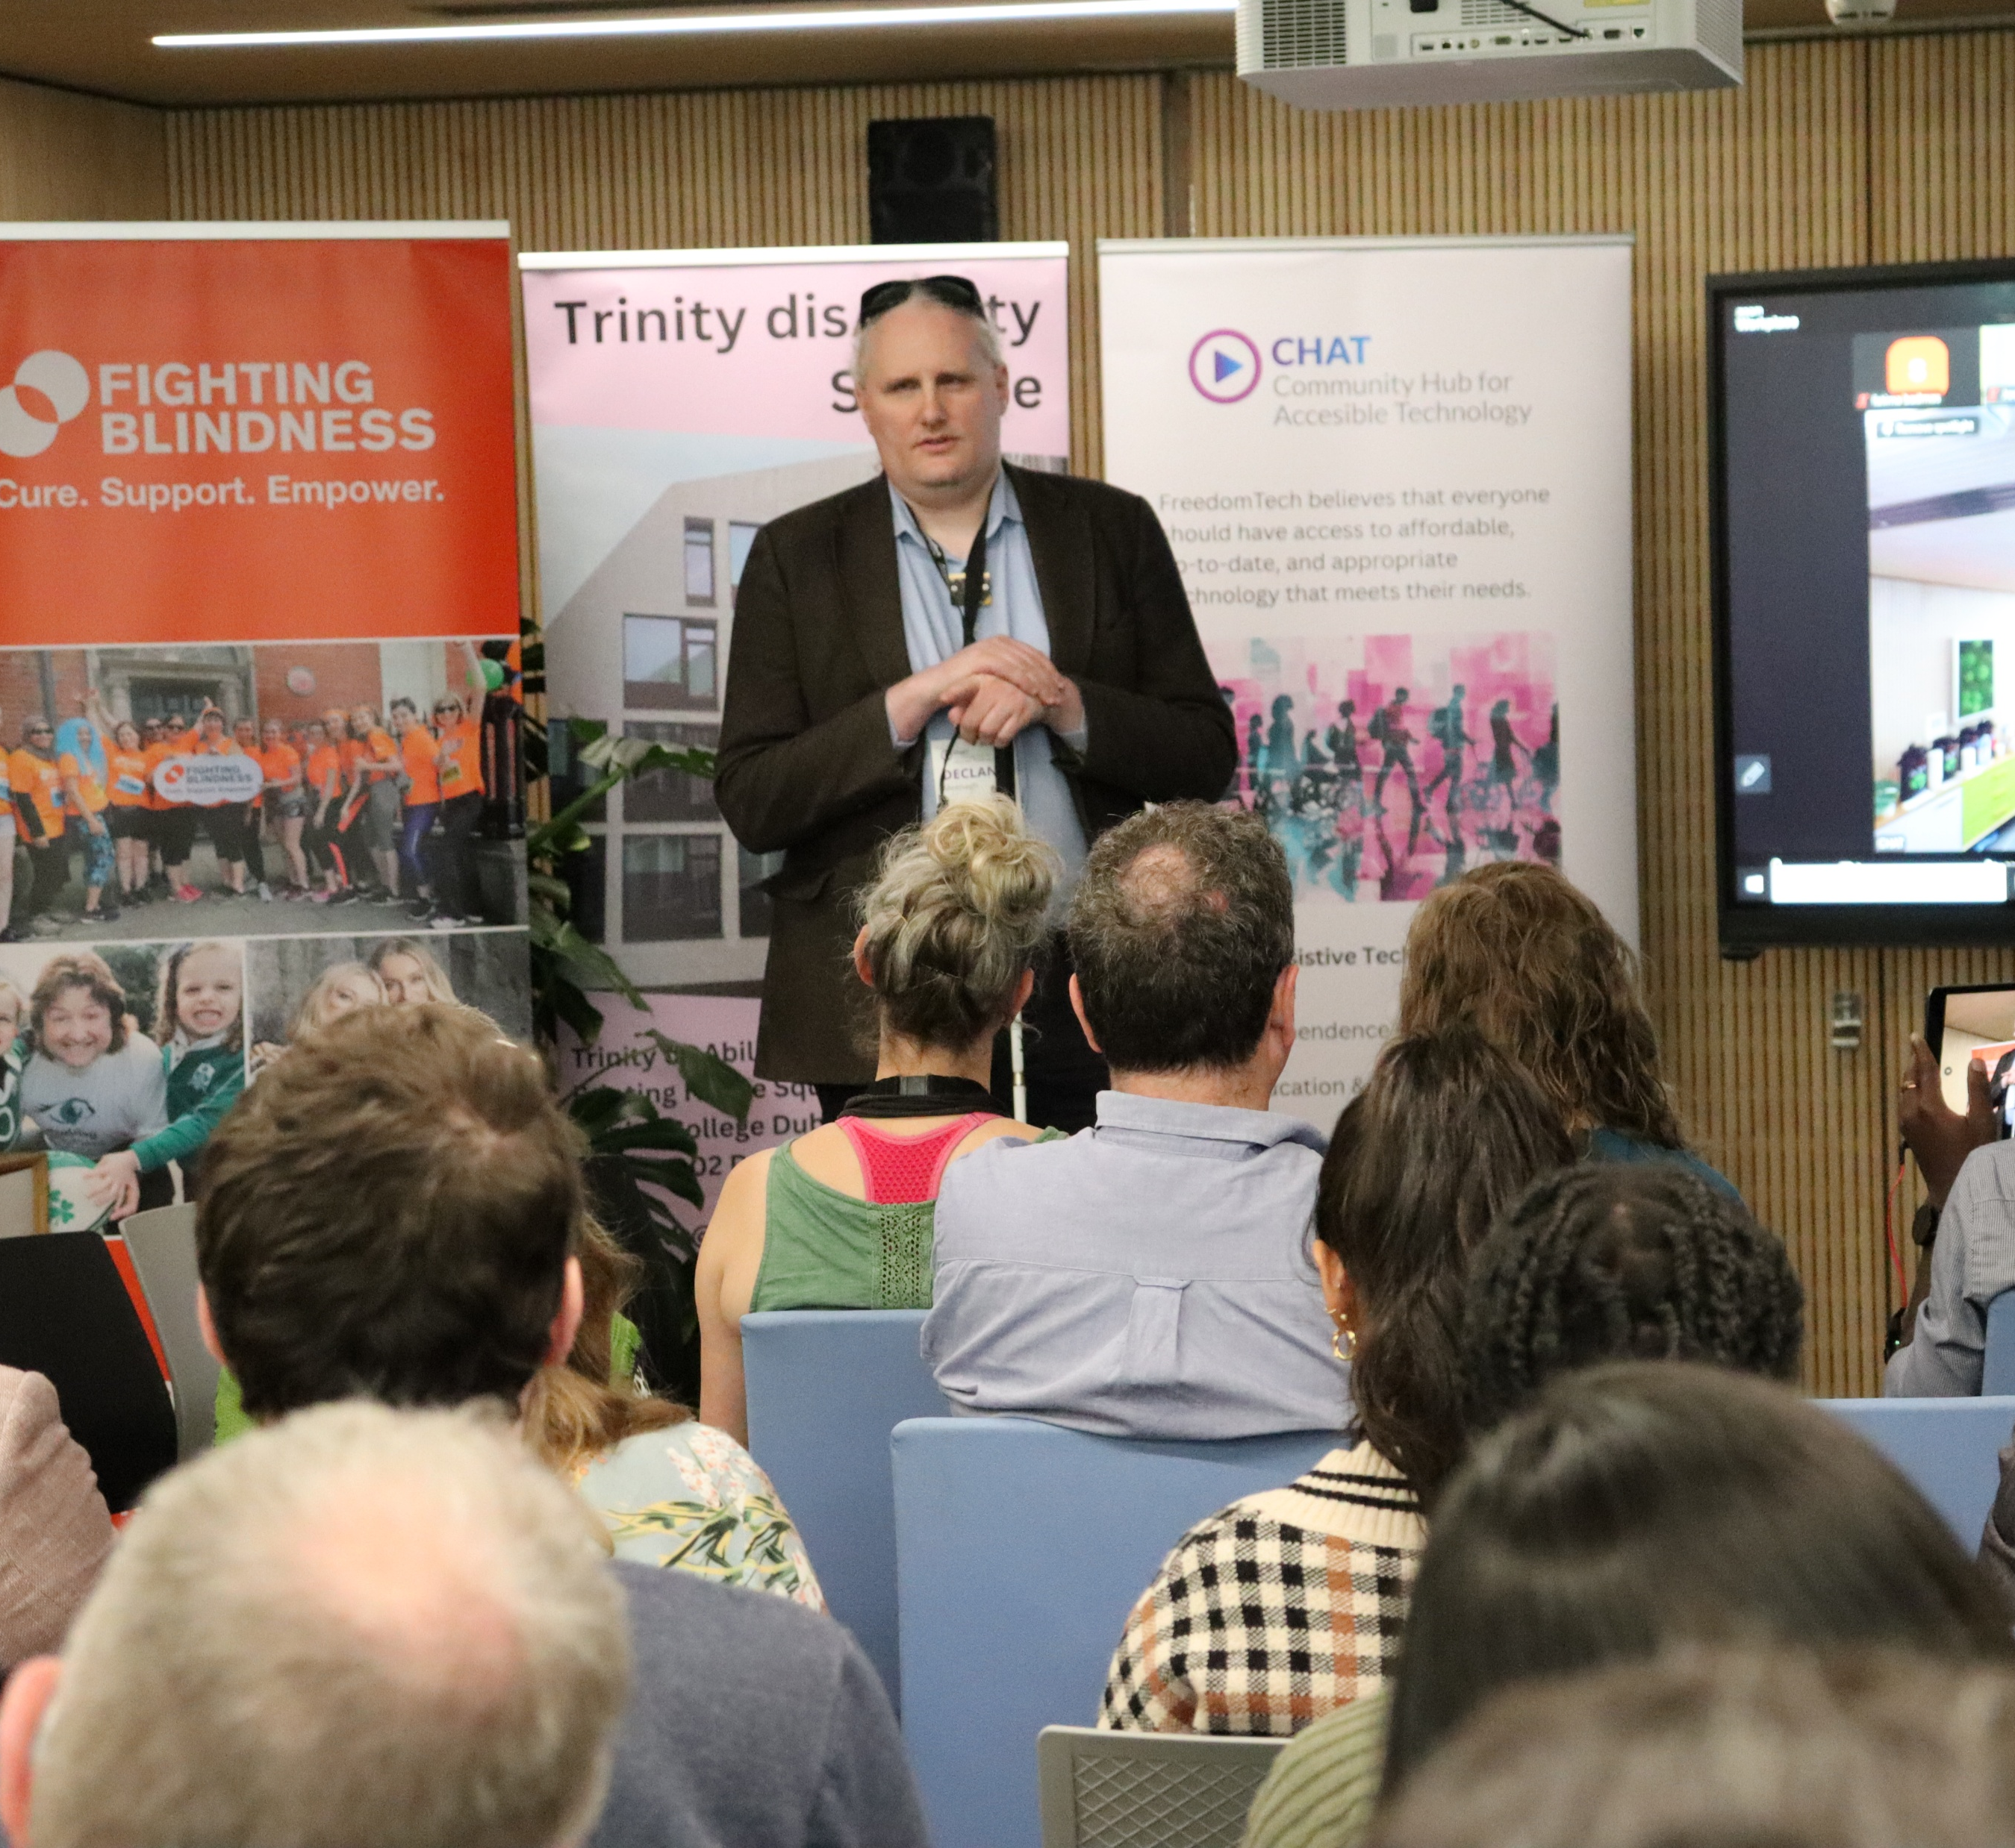
Description of the Innovation
Ireland’s only Assistive Technology
Community of Practice
Multi-stakeholder platform for inclusive AT dialogue, policy, and practice
Hosted by FreedomTech (Enable Ireland + DFI partnership)
Connects AT users, providers, researchers, policymakers, and innovators
Notes:
CHAT (Community Hub for Accessible Technology) is Ireland’s only AT Community of Practice:
Multi-stakeholder platform for inclusive AT dialogue, policy, and practice
Fostered by FreedomTech (Enable Ireland + DFI)
Brings AT users, providers, researchers, policymakers, and innovators together
Since 2018, CHAT has hosted 30 national events, offering:
Trusted space for AT users to share lived experiences
Open conversations on barriers and opportunities
Strategic collaboration, aligned with global AT trends
Co-development of impactful tools (AT Passport, National AT Training Network

Slide 4

Vision & Objectives
Promote digital inclusion and access to AT
Build cross-sector communities of practice
Support co-designed AT solutions
Inform the national AT ecosystem development
Notes:
Vision & Objectives – Speaking Notes
🔹 Promote digital inclusion and access to AT
“Our vision starts with inclusion. We want to ensure that every person who needs assistive technology can access it—without barriers, without delays, and with the confidence that it will support their independence and participation in everyday life.”
🔹 Build cross-sector communities of practice
“CHAT exists as a space where voices from different sectors—health, education, research, technology, and policy—come together. It’s not about one organisation leading, but about collaboration and shared ownership of the AT agenda.”
🔹 Support co-designed AT solutions
“A central principle is co-design. We believe the people who use AT must shape the solutions. By elevating lived experience, we’re building tools and practices that are not just innovative, but relevant and meaningful.”
🔹 Inform the national AT ecosystem development
“Finally, CHAT plays a role in shaping Ireland’s AT ecosystem. Through our events, reports, and partnerships, we highlight gaps, share solutions, and influence strategy so that AT becomes embedded as a core part of rights-based inclusion.”

Slide 5
Our Impact at a Glance
Engages over 250 active members from across Ireland, including:
Disabled individuals (expert and non-expert AT users)
Clinicians and AT practitioners
Researchers and educators
Technology developers and suppliers
Service providers, policy-makers, and advocates
26 events
2,462 participants
Over 2,000 engagements
100+ partner organisations
Notes:
“CHAT now engages over 250 active members from across Ireland, bringing together disabled individuals with lived experience of assistive technology, clinicians and practitioners, researchers and educators, technology developers and suppliers, as well as service providers, policymakers, and advocates.
Since 2018, we’ve hosted 26 national events with more than 2,462 participants. Importantly, this has led to over 2,000 meaningful engagements—conversations and collaborations that go beyond the events themselves. Across this journey, CHAT has connected with more than 100 partner organisations, making it Ireland’s leading community of practice for assistive technology and a trusted platform for shaping national and international conversations.”

Slide 6
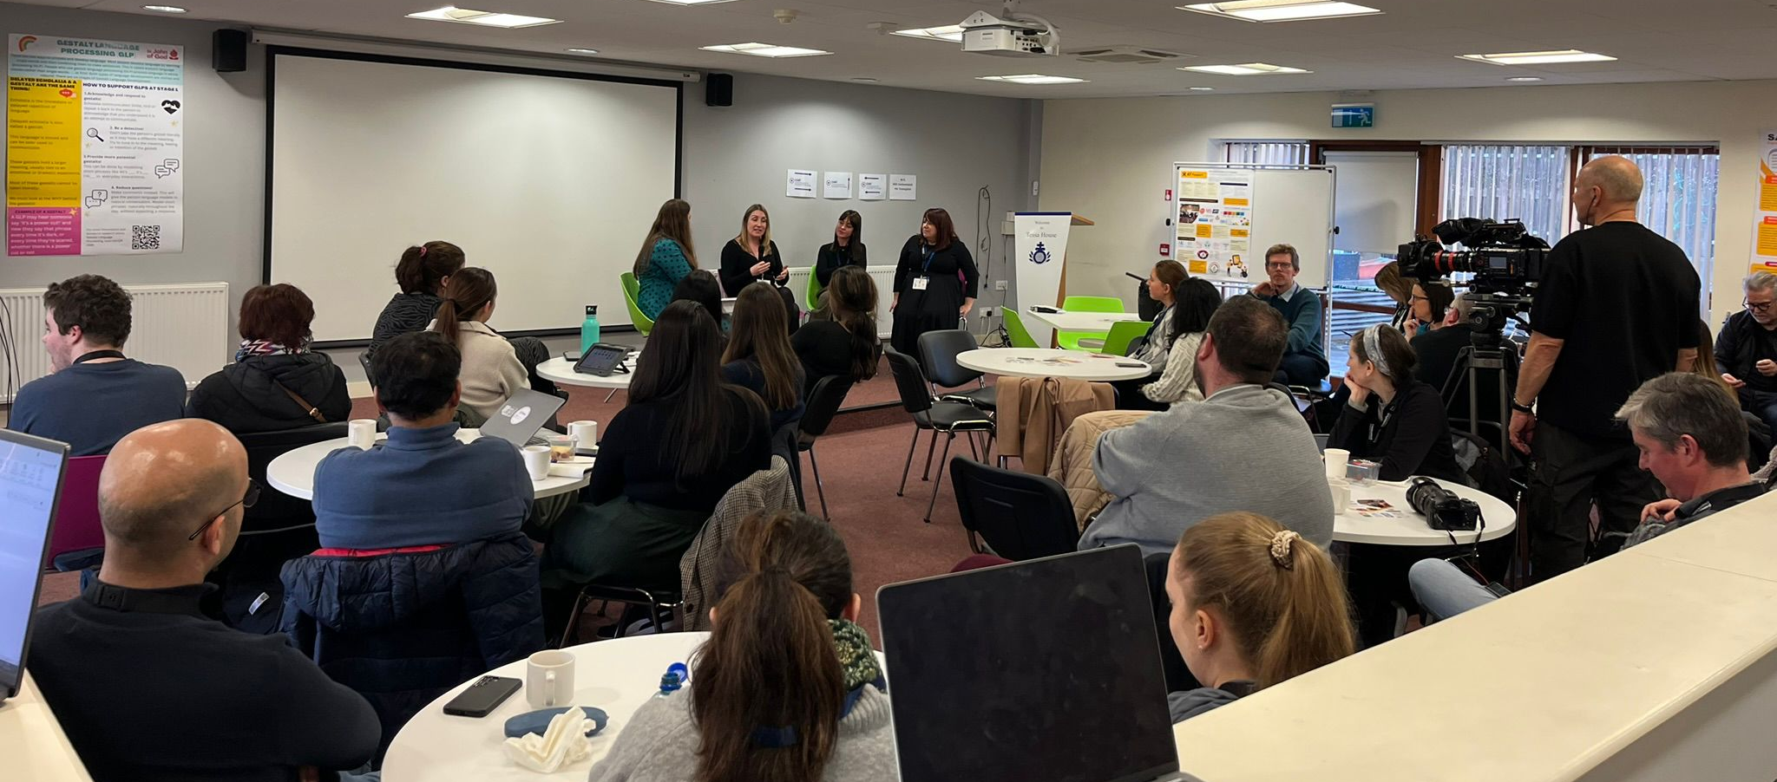
CHAT Journey
Rooted in inclusion, trust, and learning
Continues to grow and adapt
Welcomes new stakeholders across sectors
Ensures lived experience, evidence, and innovation are integrated into AT development
Notes:
At the heart of CHAT is a culture of inclusion, trust, and continuous learning. This has allowed the community to grow and adapt over time.
We welcome new stakeholders across sectors – from disabled people and families to clinicians, educators, researchers, and technology developers – because the strength of CHAT comes from that diversity.
Most importantly, we ensure that lived experience, evidence, and innovation are always combined. This ensures that assistive technology development in Ireland is not just about devices but about creating real opportunities for independence, participation, and equity."

Slide 7
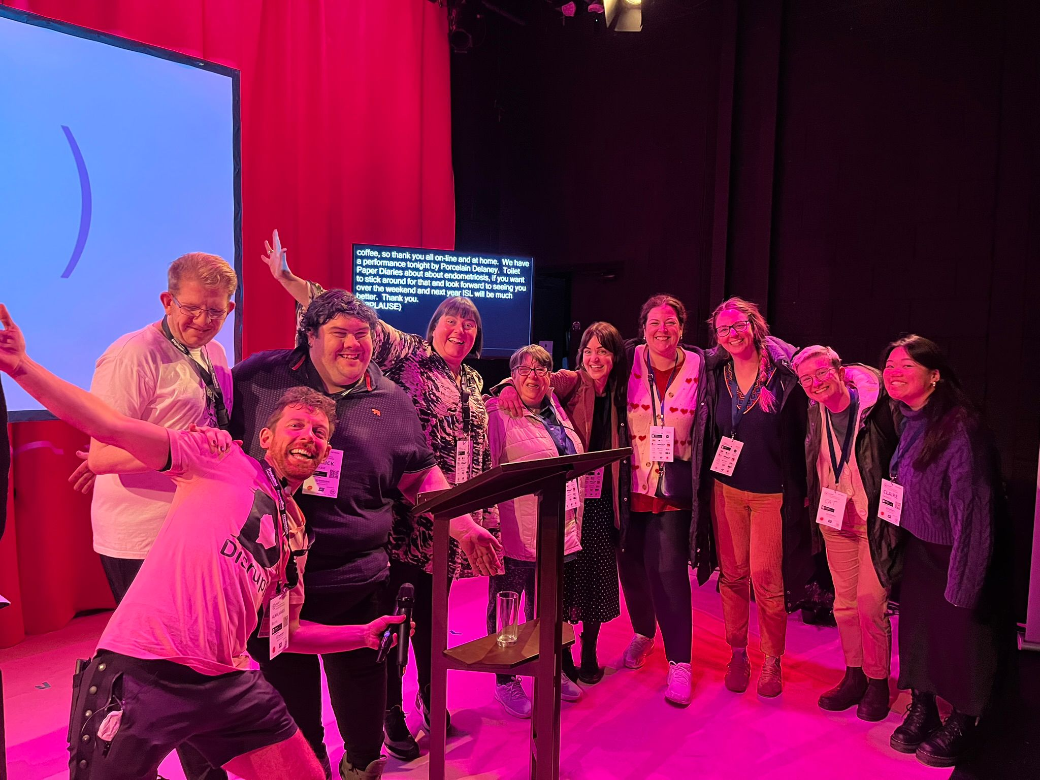
What CHAT means to US
Where I first heard about different types of AT
Where we built partnerships with TUDublin
Started the Co-Design journey
Led to me being upskilled in Co-Design,
Co-research and co-facilitation.
Paid roles for four years thanks to CHAT
Notes:
CHAT has been really important for me.
It’s where I first learned about different types of assistive technology.
Through CHAT, we started the partnership with TU Dublin and started my co-design journey.
I got training and new skills in co-design, co-research, and co-facilitation.
Because of CHAT, I’ve had paid roles for the past four years.
For me, CHAT means learning, working, and being part of something that makes a difference.

Slide 8
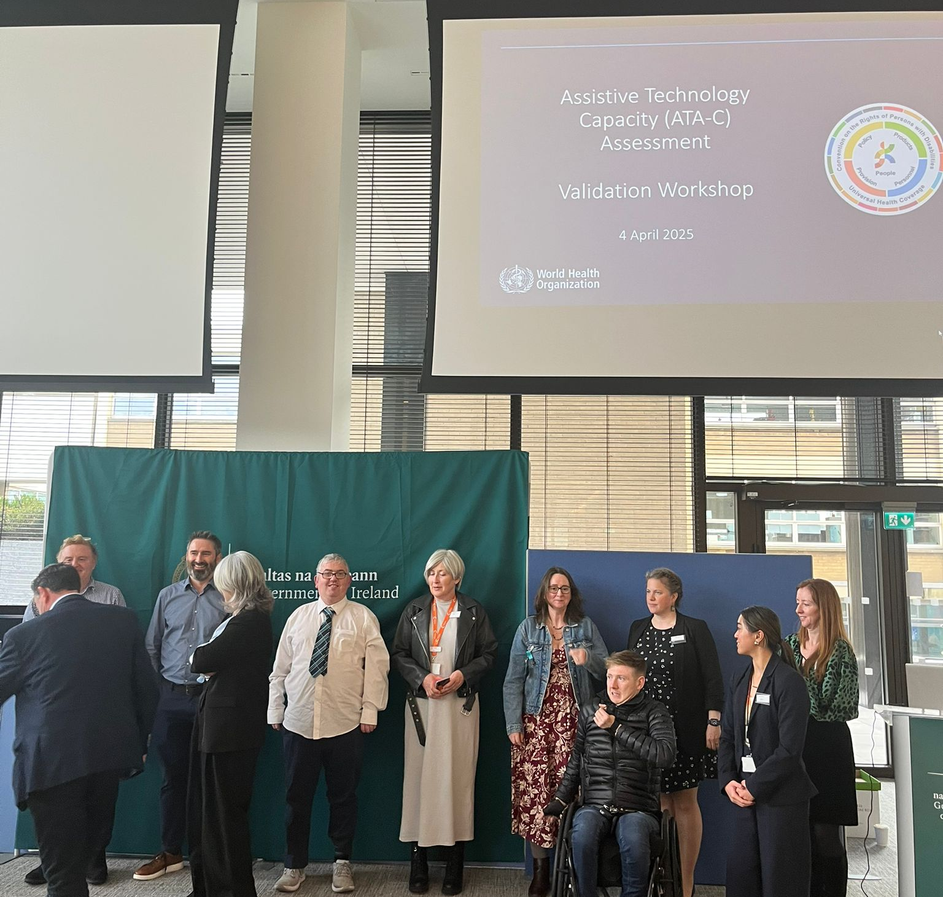
Level of Innovation
Key achievements:
  Over 2,400 stakeholder engagements
  Supported Ireland’s WHO AT Capacity Assessment (ATA-C)
  Hosted 30 CHATS in 8 years showcasing AT
  Amplified AT user stories and peer learning
  Drove momentum behind the AT Passport
  Built a cross-sector network for AT training and digital inclusion
Notes:
CHAT supported Ireland’s WHO Assistive Technology Capacity Assessment (ATA-C), ensuring the voices of AT users and practitioners were central.
We’ve also hosted two national events to showcase the CREATE pilot projects, highlighting innovation and real-world impact.
Another achievement has been amplifying AT user stories and peer learning, making lived experience a driver of change.
CHAT also drove momentum behind the AT Passport, a practical tool now shaping service delivery.
And importantly, we’ve support the building a cross-sector network for AT training and digital inclusion, laying the foundations for systemic progress."

Slide 9
CHAT as Infrastructure
CHAT is not a service or product - it is infrastructure for collaboration:
A catalyst for innovation
A space where real-world solutions are shared
Shapes Ireland’s AT landscape from the ground up
Notes:
When we talk about CHAT, it’s important to be clear: it’s not a service, and it’s not a product.
It’s something more foundational – it’s infrastructure for collaboration.
First, CHAT acts as a catalyst for innovation. By bringing people together, it sparks new ideas, solutions, and projects that wouldn’t happen in isolation.
Second, it’s a space where real-world solutions are shared. This means AT users, practitioners, and developers can bring real challenges and test out practical answers together.
And third, CHAT helps shape Ireland’s AT landscape from the ground up. It creates the conditions for systemic change by making sure lived experience, evidence, and innovation are all part of the national conversation.

Slide 10










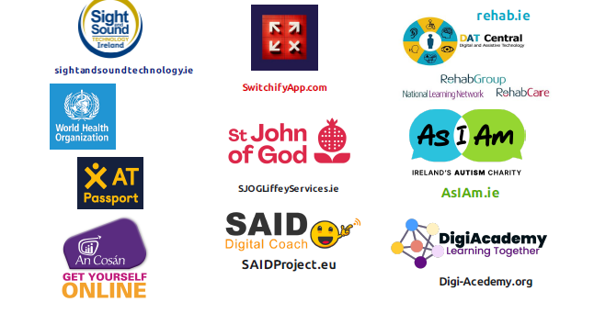

Who’s Involved?
Disability Services
Advocacy
Research
Tech
International bodies
Government
Health
Education
Notes:
This year alone, CHAT has connected voices from across every sector.
We’ve engaged with disability and advocacy services, clinicians and researchers, and assistive technology developers and suppliers.
We’ve linked into international bodies like the World Health Organization, and we’ve had contributions from government departments — health, social protection, and education.
And when we look at contributors, the range speaks for itself: Tilting the Lens, Drake Music, Rehab Group, the AT Passport initiative, An Cosán, DigiAcademy, AsIAm, All In, Arts & Disability Ireland – and many more.
What this really shows is that CHAT isn’t just a meeting space. It’s a national hub where people who use AT, those who design it, and those who shape policy can come together, learn from each other, and build solutions that actually work.

Slide 11
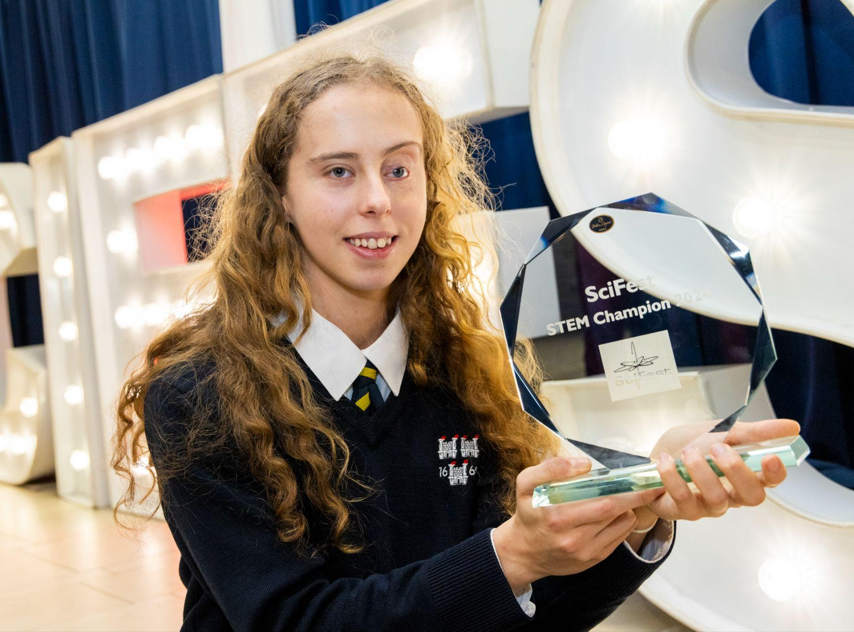
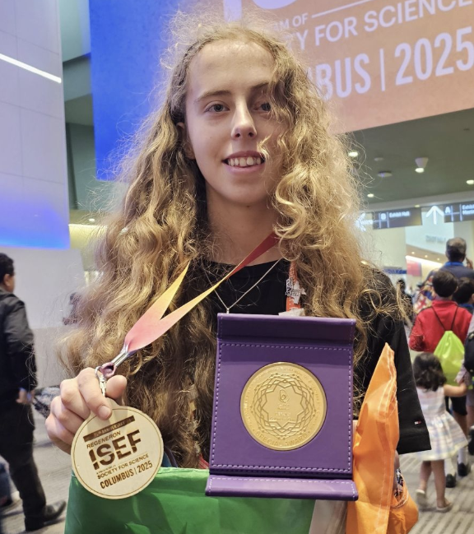
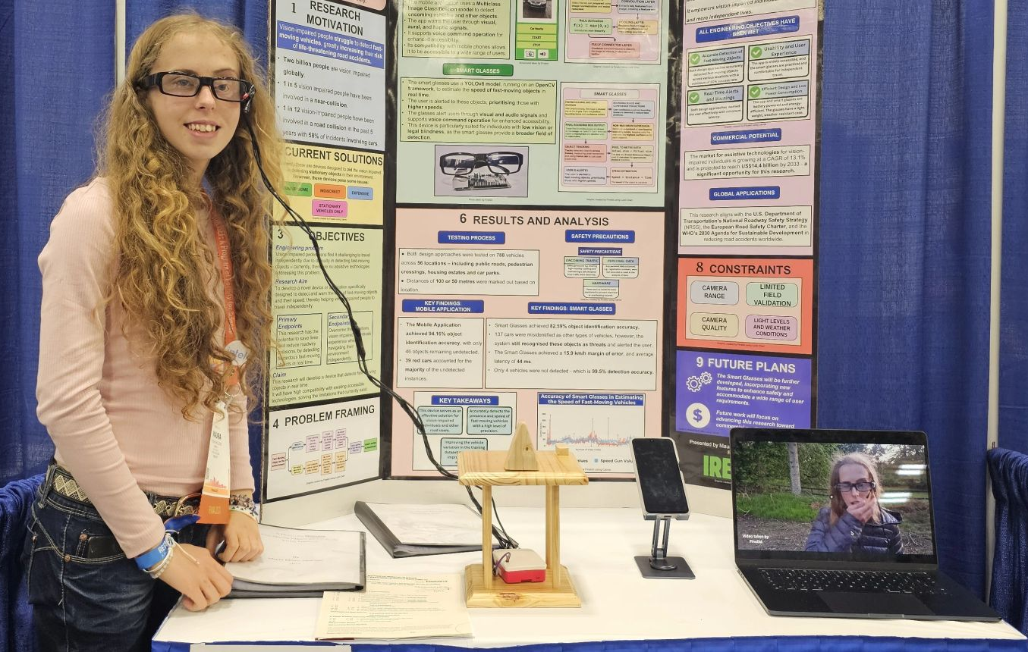
A Device for Detecting
Fast-Moving Objects for Use by the Vision Impaired
Notes:
This is Maura Higgins she had just got back from Ohio when who attended a CHAT in Trinity earlier this year and shared her SCIFest project. Showcasing how people with disabilities can lead innovation in AT

Slide 12
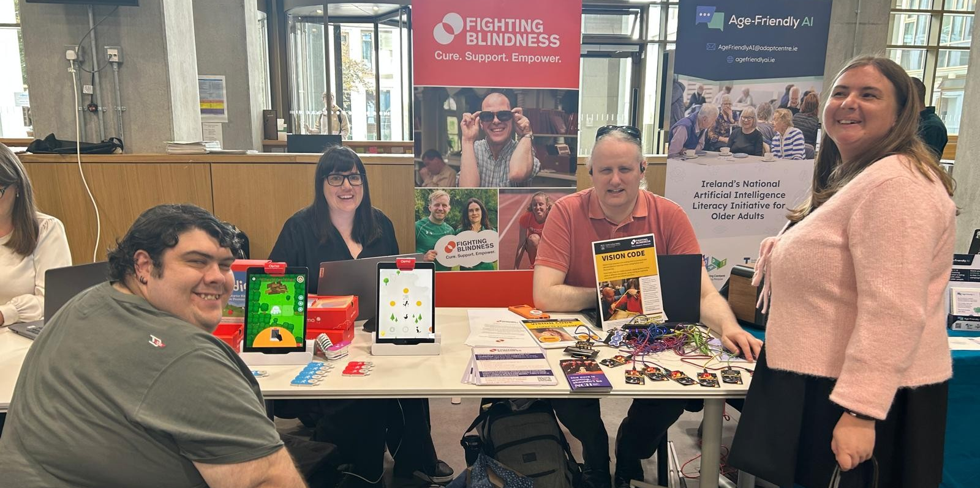
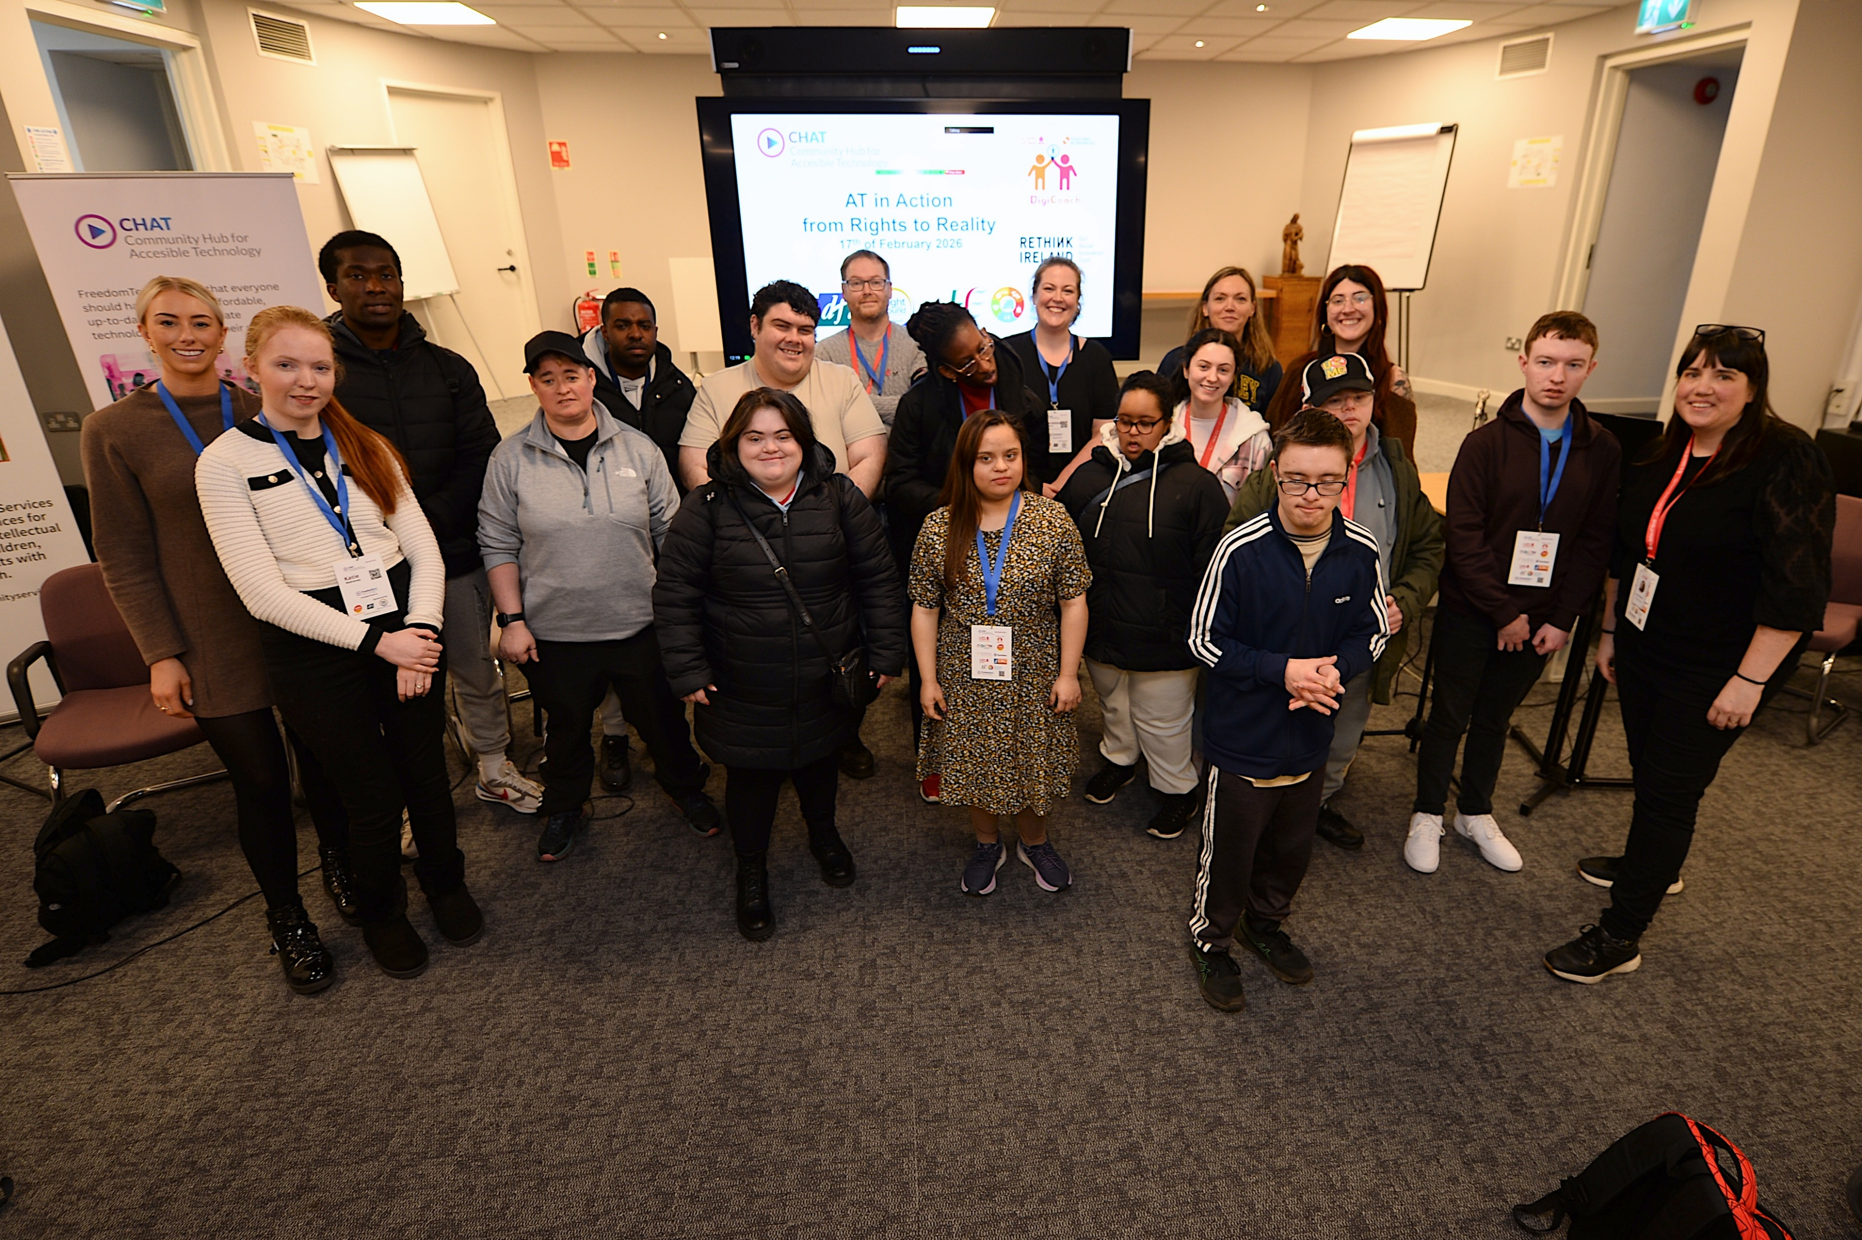
Where the DigiCoach project started and scaled.
Notes:
DigiCoach

Slide 13
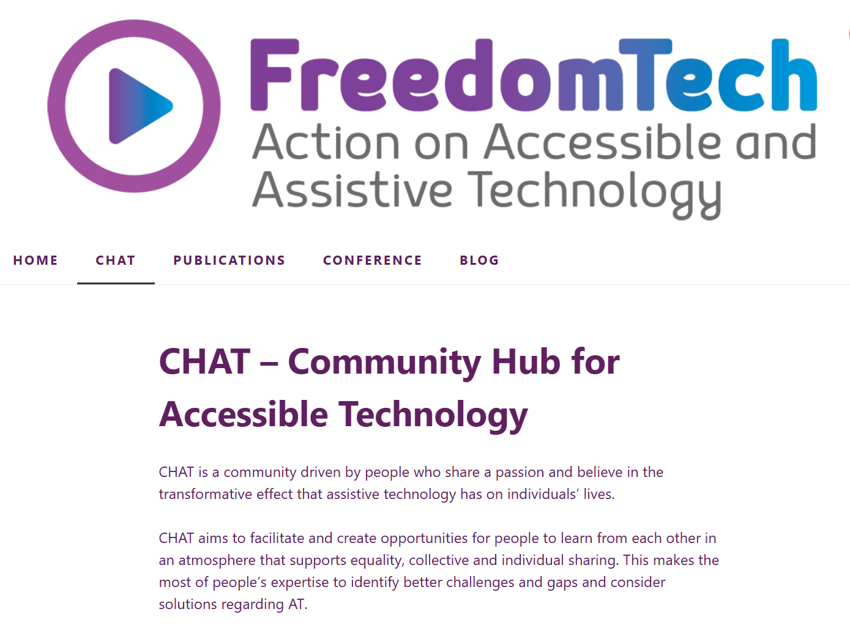
CHAT website

Slide 14
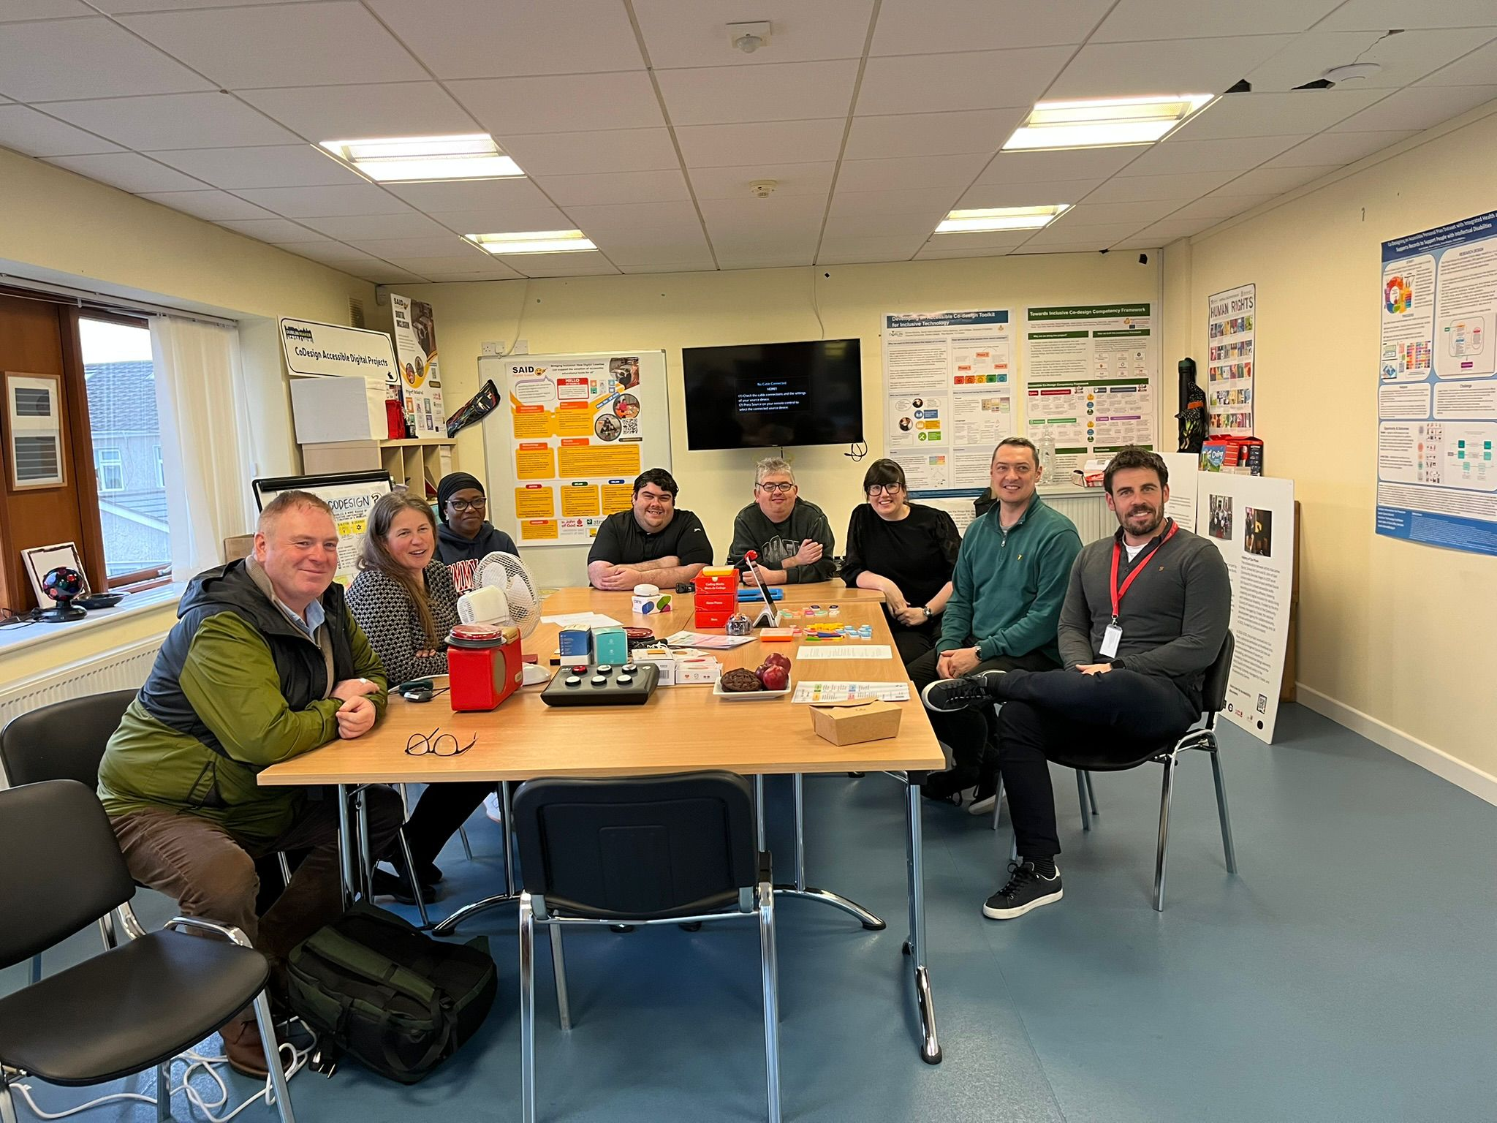
Strategic Contributions
AT Passport
WHO AT Capacity Assessment (ATA-C)
CREATE Grant dissemination
National Training Network

Slide 15
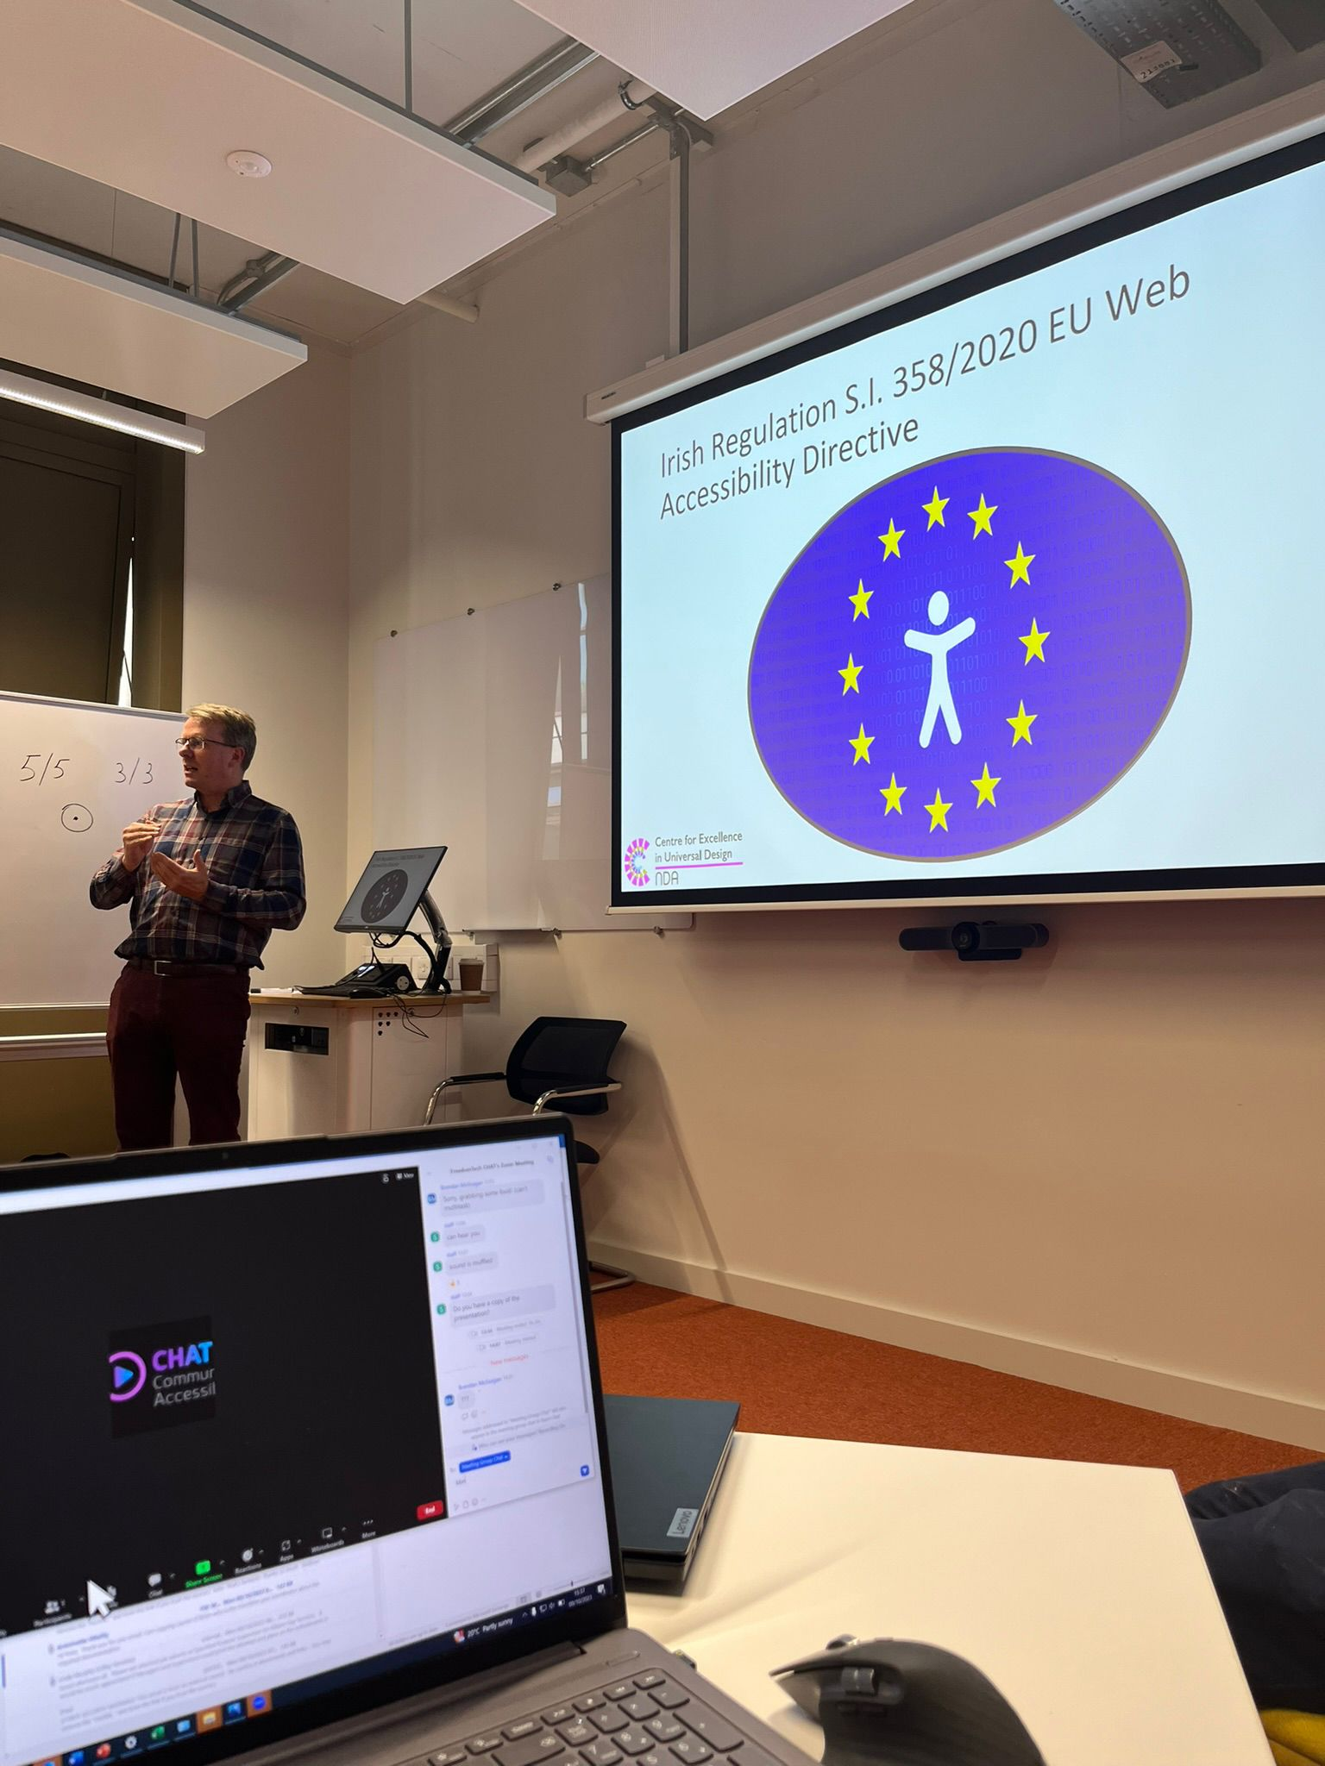
Themes Emerging from CHAT
Access as design
Co-design & peer learning
Scalable infrastructure
Inclusive policy
Digital literacy

Slide 16
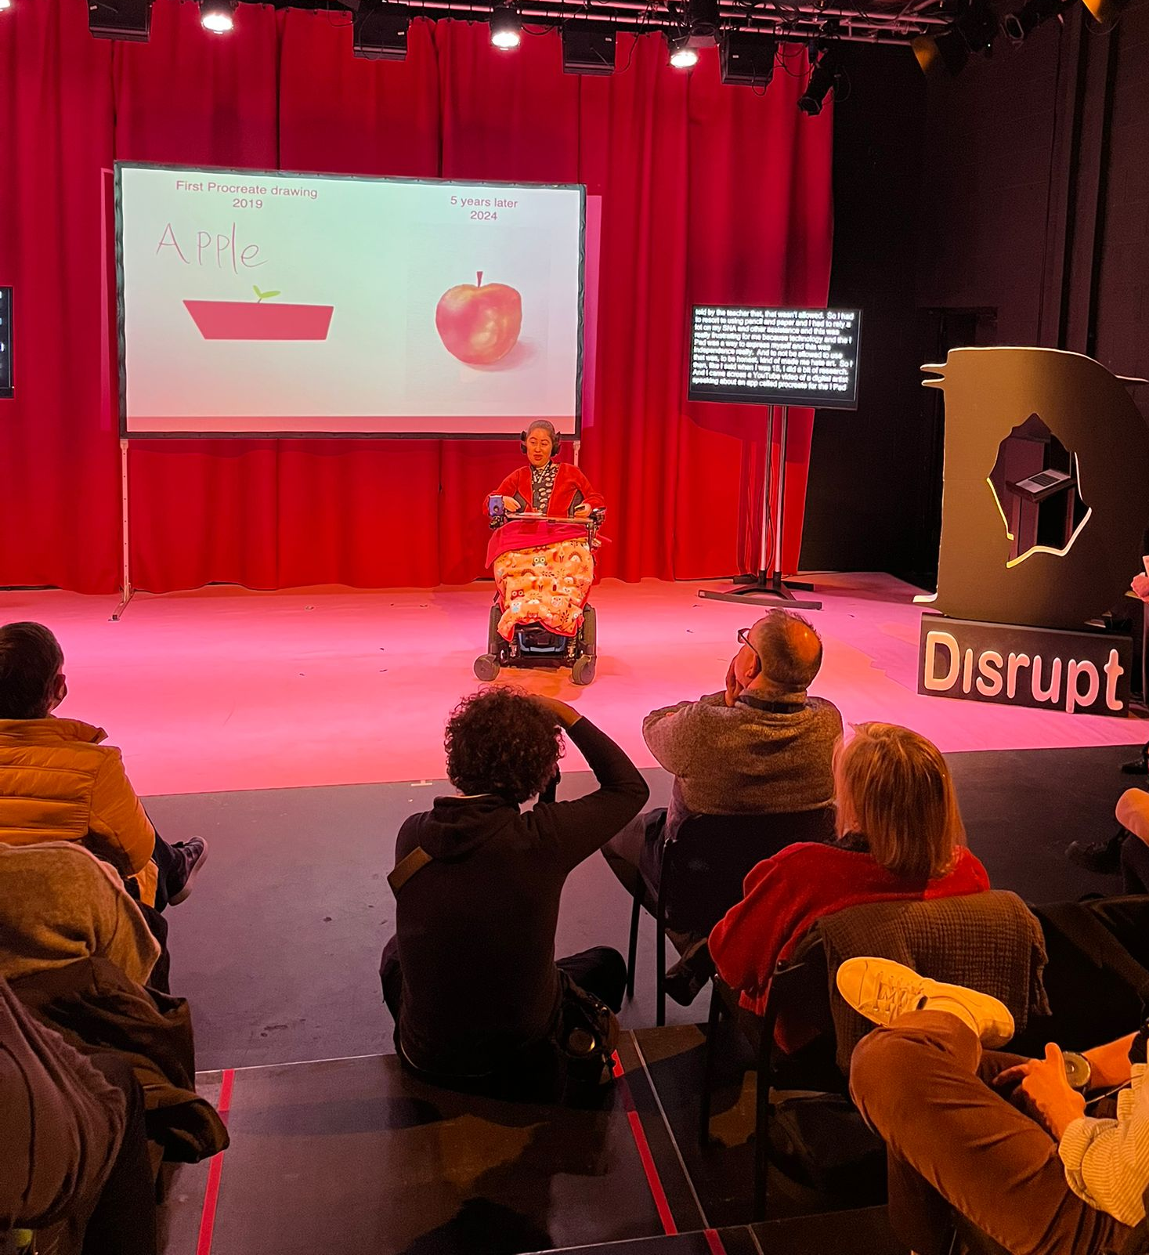
Future Directions
New digital presence
Renewed FreedomTech Advisory Group
Continued cross-sector advocacy
Inclusive AT ecosystem building

