Slide 1

The Assistive Technology Role
Trevor Boland
Assistive Technology Officer
Support Students with Disabilities in the use of Assistive Technology.
I occupy the "space between" (Dwyer and Buckle, 2009)
Third space professional (Whitchurch, 2026)

Slide 2
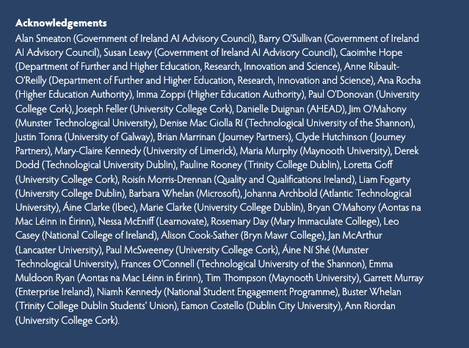
Generative AI in Education
Generative artificial intelligence refers to systems that can produce new content, such as text, images, or code, in response to prompts, based on patterns learned from large datasets.
Large language models like ChatGPT, Copilot, and Claude are the most prominent example.
…Our sector needs to move beyond both uncritical adoption and uncritical rejection…

Slide 3
AT-acadabra: The great vanishing act of Assistive Technology (AT).
Context: A problem of AT practice.
Policy: This HEA Gen AI Policy / Framework.
Analysis: Carol Bacchi’s (2026) "What’s the Problem Represented to Be" (WPR) framework.

Slide 4
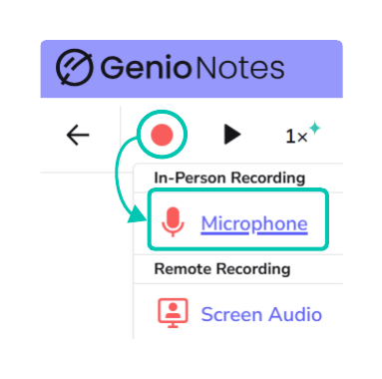
1. My Problem of Practice - Recording
Genio has AI features that convert recordings into transcripts and a quiz feature that turns the class recording into a set of questions, so students can test their knowledge.
Reasonable Accomadation - match to disability.
Genio poses a problem - AI within AT is new to Teaching staff and is raising questions about AI's place in the classroom.

Slide 5
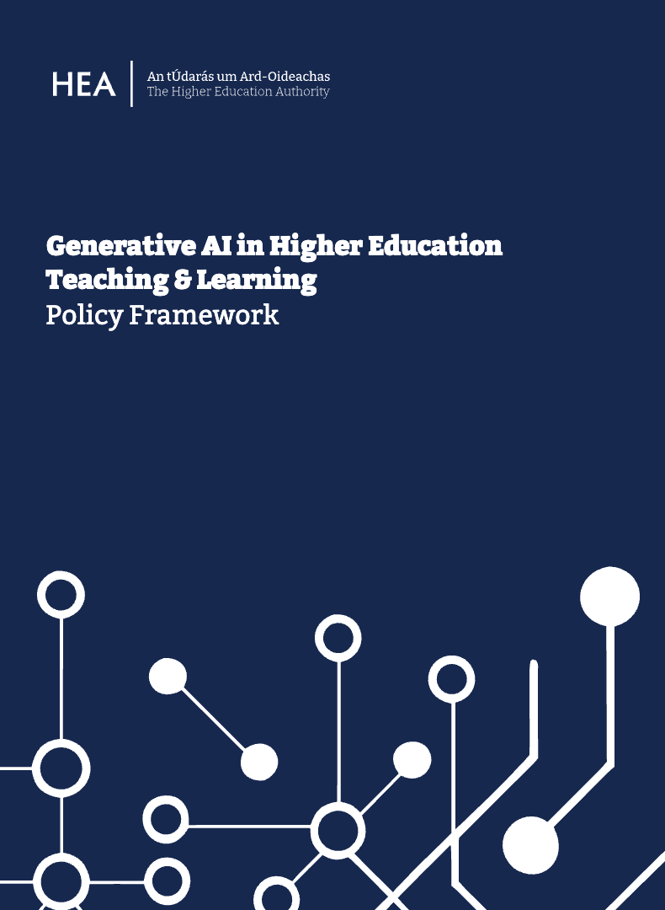
The HEA Gen AI Policy / Framework
It guides Irish HEI’s through five core principles: Academic Integrity, Equity, AI Literacy, Privacy, and Sustainable Pedagogy.
The document serves a dual purpose:
As a policy, it establishes values-based standards, institutional accountability, and GDPR compliance.
As a framework, it offers a structured, adaptable national reference point rather than rigid rules, respecting institutional autonomy.

Slide 6

What's the Problem Represented (WPR)
WPR, developed by Carol Bacchi (1999, 2009), shifts away from traditional policy problem-solving.
WPR serves as an evolving critical framework rooted in Foucault’s theories of governmentality (Foucault, 1991; Rönnblom and Edwards, 2025).
Bacchi’s (2025) WPR framework moves beyond simply solving educational issues to interrogate how governing occurs in many forms that aim to shape behaviours in specific ways.

Slide 7
The 6 WPR Questions and Step 7
Question 1 | What's the ‘problem’ (AI and AT) represented to be in a specific proposal in the HEAGAIP?
Question 2 | What deep-seated assumptions underlie this representation of the ‘problem’?
Question 3 | How has this representation of the ‘problem’ come about?
Question 4 | What is left unproblematic in this problem representation? What is silenced?
Question 5 | What effects (discursive, subjectification, objectification, lived) are produced by this representation of the ‘problem’?
Question 6 | How and where has this representation of the ‘problem’ been produced, disseminated and defended?
Process 7 | Apply this list of questions to your own problem representations as a practice of the self.

Slide 8
Question 1
Aim: shift the paradigm from "problem-solving" to "problem-questioning”.
The policy states that Gen AI is a ‘fundamental threat to academic integrity’ (O’Sullivan et al., 2025, p. 7). By proposing that AI constitutes a ‘threat’, the policy defines the problem as a risk to institutional values.
Institutions should design AI adoption with inclusion at its centre, not as anafterthought (O’Sullivan et al., 2025, p. 10)
These represent a tension between AI advancing inclusion and fears about the risks AI poses to education. This opens a "space being governed", which stimulates the interrogation of how governing takes place (Bacchi, 2023).
Questioning: Proposing to "design AI adoption with inclusion at its centre" while for academic work “protecting the right of staff to decline its [AI] use where they judge it inappropriate to their learning or teaching” (O’Sullivan et al., 2025, p. 9).
Genio: Resistance from Teaching staff / Regulated vs unregulated AI use / AI vs Inclusion / AT and AI vs inclusion

Slide 9
Question 2
Aim: focuses on deep-seated assumptions that underlie this ‘problem’, using a Foucauldian archaeology to identify and interrogate the ‘embedded knowledges’.
The policy has a pillar on equity and inclusion, the terms ‘disability’ and ‘assistive technology’ are not mentioned. There is an assumption that word ‘inclusion’ always involves PWDs.
The definition of inclusion has expanded to address a broader demographic, the specific rights of SWDs become diluted within generalised institutional discourse (Norwich, 2008; Slee, 2018).
The oversight of ‘disability’ fails to acknowledge the exclusionary history of education for PWDs (Britzman, 2009; Ainscow and Messiou, 2018; Stiker, Sayers and Mitchell, 2019). Reasonable accommodation
Genio: the absence of these terms means I cannot draw on the policy to support SWDs when staff raise questions regarding Genio

Slide 10
Question 3
Aim: WPR framework requires a ‘genealogical sensibility’, a way of thinking that argues everything has a history (Foucault, 1977).
The policy is explicit about AI-related risks within assessment. The policy “signals that responsible AI use in higher education is inseparable from equality of opportunity and respect for diversity” (O’Sullivan et al., 2025).
The short history of AI in education has signalled fears around AI, as AI-driven learning platforms would deskill the profession and replace them entirely with cost-effective software (Selwyn, 2016).
Concerns about AI hindering the development of critical thinking, and undermining the authenticity of earned grades (Akgun and Greenhow, 2022; Sidorkin, 2025).
AI-powered AT has existed in HEIs for several years through Google (Al-Hassani et al., 2025).
Genio: if the policy focused more on positive awareness, it would support Genio as just another AI tool for inclusion rather than risk emphasis.

Slide 11
Question 4
Aim: Bacchi (2026) interrogates the silences within a problem representation to expose what is left unproblematic.
Does AI overcome the current medical model of disability? e.g. Gemini - Gen AI by Google.
By mainstreaming AT / AI, we uphold the principles of the Salamanca World Conference, ensuring an inclusive approach that fulfils the mandate of 'Education for All.' (EFA) (Ainscow, Slee and Best, 2019).
Zorec et al. (2025) argue that AT is no longer a niche tool and often stigmatised technology offered by specialised experts, instead, it is a fundamental pillar of inclusive education that requires a collective approach - challenge the current funding structure for SWDs that uses the medical model as a gatekeeper to disability supports
Genio: considered a niche tool, accessed through the medical model, which limits its visibility and mainstream adoption to normalise this support.

Slide 12
Question 6
Aim: explores how and where this representation of the ‘AI and inclusion problem’ has been produced, disseminated and defended, drawing on national and transnational policies.
The United Nations (2024) states that AI is at the forefront of emerging technologies, reshaping human interactions and has the potential to enhance disability inclusion.
OECD noted that AI can be crucial in empowering PWDs to live more independently (Touzet, 2023).
The EU AI Act (2024) further supports the view that AI in education has the potential to advance inclusion.
HEA AI Policy / Framework: Flexible language supports adoption / interpretable terms like inclusion to suggest disability and AT, thereby losing explicit consideration.
International, European, and national AI policies and reports, acknowledge the potential for inclusion but at times overlook the critical roles of AT and Disability - absence of ‘AT’ and at times ‘Disability’.
Genio: Until roadmaps are created, a risk-free, inclusive AI experience cannot be achieved with AI tools for SWDs like Genio.

Slide 13
Process 7: Self-problematisation
Aim: requires researchers to interrogate their own assumptions and knowledge regimes. Engagement with their own belief systems by using the six WPR questions.
Dual positionality: ATO / AT user. I both see and experience the level playing field that AT offers, and how AI can advance this equality. Agent of inclusion-dismantle the deficit disability narratives.
As an ATO, a third-space professional interacting with teaching staff about SWDs recording in class, I may be assumed to be administrative staff (Whitchurch, 2025). EU classified Assistive Technologists as teaching roles (ESCO, 2026).
HEA created AT roles and AI policy - tension or complimentary?
As the policy is primarily focused on teaching staff, there was no AT Officers representation in its formulation.
Genio: The potential refusal of AI-integrated AT by teaching staff can be interpreted as a form of ableism, as AT, even with AI, if institutional power is prioritised over the lived experiences and technological agency of SWDs (Foley and Melese, 2025; Marland and Arantes, 2026).

Slide 14
AT-acadabra: Has AT disappeared?
AT awareness is an issue global and local
‘AT’ and ‘Disability’ can be missing when Inclusion is central
AT absences in policy affects ground level AT support
Disability awareness affects reasonable accommodation (recording)
AT practice can be an in between space in HE professionalism
AI then is seen as a risk and threat
AI by SWD can be considered AT
HEA created the AI policy and the AT roles.
AT then AI then Disability with ATO practice - layered barriers

Slide 15
Where do you sit with Gen AI?
Is ‘disability’ and ‘AT’ needed in the HEA policy/ framework?
or
‘Inclusion’ says enough about disability and inclusion?

