Slide 1


How to support without overstepping
Lorraine Gallagher
AHEAD Information & Training Officer

Slide 2

Transitions
Change = Stress
Letting go = Difficult
Notes:
Go to orientation!! Students who entered through DARE may be offered a separate group orientation or an individual one (on request)

Slide 3
College relationship with parents
Colleges are unable to liaise with parents once a student is registered.
Many colleges offer information sessions for parents so they can find out what supports are on offer to students and how to access them.

Slide 4
Getting Supports in College
Register with Disability Office
Meet Disability Officer for a Needs Assessment
Report that outlines accommodations – communicate to lecturers
Notes:
Disclosure if you haven’t already! Register with the disability office, meet disability officer for a needs assessment, report that outlines accommodations and communicate to lecturers

Slide 5

Student Services…
Students Union | Library I Careers Service
| Sports Centre | Chaplaincy Service |
| Disability Support Service |

Slide 6

Clubs & Societies
A great way to meet new people…
Debating | Music | Fencing | Politics | Drama | Soccer… etc

Slide 7

Troubleshooting
Student should get advice from:
Department/Course staff
Student services
The Students Union
Contact AHEAD

Slide 8
Power of Disability Conference/ Advisory Group
AHEAD/USI Annual Conference for Students with Disabilities
Student led
Mix of educational/empowerment/information sharing
This year being brought online
Students with Disabilities Advisory Group
Group of engaged SWD
Feeds into work of AHEAD
Discusses issues on the ground

Slide 9
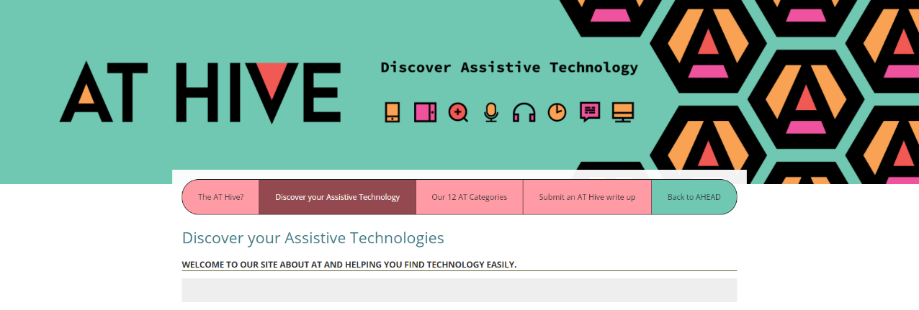


AT Hive – Discover Assistive Technology
Explore Assistive Technology ideas and guides easily
Just answer 3 questions
W: www.ahead.ie/Discover-your-AT

Slide 10

Any questions?
My contact details:
Email: lorraine.gallagher@ahead.ie
Tel: 01 582 6171

