Slide 1




ONSIDE: Outreach Navigation for Social Inclusion and Digital Engagement.
The ONSIDE Project has been supported by the EU’s INTERREG VA Programme, managed by the Special EU Programmes Body (SEUPB).

Slide 2
ILMI
Independent Living Movement of Ireland
Disabled Persons Organisation (DPO)
Working towards an Ireland where disabled persons have freedom, choice and control and live a life of self determination.
Promotes a rights-based social model of disability, where Disability Equality is a matter of human rights.
Working towards the removal of societal barriers that prevent active equal and equitable participation of disabled people.
‘Nothing about us without us’

Slide 3
What is the ONSIDE Project?
ONSIDE actively engaged with over 1200 disabled adults (16+) in Counties Donegal, Sligo, Leitrim, Cavan, Monaghan and Louth from summer 2019 until summer 2022. At the end of the project, ILMI had 675 ONSIDE graduates.
We delivered free 8-week IT and Social Inclusion workshops and group based programmes at local mainstream community venues. Workshops included everyday (and specific AT) IT training, plus, social inclusion inputs from a variety of local mainstream services, such as ETB, MABS, CICs, GAA, FAI, Women's-groups, Menshed, Threshold, Area Partnerships/Leader, etc.
These workshops supported disabled adults to access information and opportunities, and make real lifestyle choices in their local communities.

Slide 4
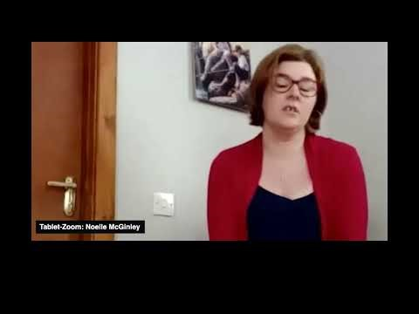
Video - ILMI

