Slide 1


Getting College Ready
Lorraine Gallagher
Information & Training Officer

Slide 2

What does AHEAD Do?
Working Directly with Students and Graduates
Accessing College
In 3rd Level
Employment
Info: Admissions Routes, How to Apply,
Supports Available
Through: Publications, Website,
Helpline
Event:
Annual College Fair – Better Options
Info: Getting Support, Self Advocacy, Disclosure, Preparing for Work
Through: Website, Helpline, Workshops
Event: Student event with USI – Power of Disability
Info: Disclosure, Legislation, Preparing for Work
Through: WAM Placement Programme,
Publications, Website, Helpline
Events: Annual Careers Fair – Building the Future, Interview Prep Workshops
Working Behind the Scenes
Upskilling Guidance Counsellors
Staff Training Publications
Academic Conferences
CPD Resources Online Courses
Employer Events Networking
Training
Needs Assessments
Contribution to Policy Formation
The Bigger Picture
Lobbying
Research – Annual Stats
Link – European Network
Contributing to Policy
Notes:
Proposed new

Slide 3
Choosing Where to Study
Attend college open days/online events
Visit the campus to get a feel for what it is like
Getting to college – transport /accommodation
Vantastic
Notes:
Are you going to live at home and commute to college each day or are you going to move away from home? If you’re considering studying away from home i.e. in another part of the country start exploring your accommodation options. Some colleges have on campus accommodation or student housing options in the local area or there are private landlord options.
If you have difficulty accessing public transport Vantastic/taxi thru DSS

Slide 4
Financial Assistance in further and third level colleges
Fund for Students with Disabilities pays for disability related supports needed in college/online learning – administered through the disability support service
Disability support funding is also available in further education colleges – contact disability support service
College Scholarships (for SWD) for example 1916 Bursary
SUSI Student Grant (college fees/maintenance grant).
Back to Education Allowance
Student Assistance Fund.
For more information about funding at third level check out the following website: www.studentfinance.ie
Notes:
Fund for SWD – will pay for part time course disability support but not on private courses.
If going to university and getting the BTEA – will need to apply to SUSI to be considered for the free frees scheme, get college fees paid but will not get the maintenance grant

Slide 5
Getting Supports in College
Register with Disability Office
Meet Disability Officer for a Needs Assessment
Report that outlines accommodations – communicate to lecturers
Notes:
Register with the disability office, meet disability officer for a needs assessment, report that outlines accommodations and communicate to lecturers

Slide 6

What is a Reasonable Accommodation?
A Reasonable Accommodation is any action that helps to lessen a disadvantage due to a disability or medical condition.
Notes:
Accommodations are regularly put in place in a variety of different environments, like supports in third level education for students with disabilities around exam supports, participation in lectures etc.

Slide 7
Exam Accommodations
89% of students with disabilities in 2021/22 received exam accommodations. These need to be discussed at the needs assessment and are arranged in advance.
Extra time
Alternative venue
Use of tip sheet /sticker
Use of computer – with or without AT
Reader
Alternative format (electronic, braille, enlarged paper)
Notes:
For the examiner - use of sticker or tip sheet to refer examiners to marking guidelines for students with a Specific Learning Difficulty or who are Deaf or hard of hearing

Slide 8




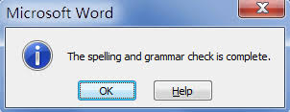






Assistive Technology is Everywhere
Low Tech
Pencil Grip
Eyeglasses
Walking Stick
Spellcheck in Word
Mouse
Calculator
Remote Control
Google Home / Amazon Echo
Siri / Google Assistant / Cortana
Nest Thermostat?
Mid Tech
High Tech
Notes:
Right now AT is being used by all in one way or another.

Slide 9



AT Hive – Discover your Assistive Technology
Explore Assistive Technology ideas and guides easily
Just answer 3 questions
W: www.ahead.ie/Discover-your-AT

Slide 10

Staying Organised
Notes:
Starting anything new, you’ll be dealing with a lot of change. The best way to avoid getting overwhelmed is to get organised.
By taking time at the start of the year to do this, it will help later on when things get busier.

Slide 11
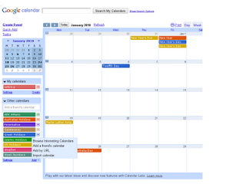
Set up A Calendar
Notes:
There’s a lot to keep on track of. So use a calendar to plan out your time between study, classes, extra curricular activities, work and social life.
You can use a physical calendar or diary, or use an online version like google calendar. A lot of the time you can input your class schedules on to these.

Slide 12
Your Organisation Checklist
Consult your diary/calendar
Keep a tidy study place
Use to-do lists to break down tasks
Make a study plan and keep it realistic
Prioritise good note taking, and refer back
Develop a system for organising class material and reading

Slide 13
Get Involved – Clubs and Societies
Getting involved in Clubs or Societies is a great way to make friends, learn new skills and find a new hobby. They are usually a few euro to join and there are so many on offer.
Notes:
Develop skills and talents you may not develop or learn through academics
Meet like-minded people and expand your networks
Provides a world of opportunity and can open doors to future careers
Build on so many skills – intrapersonal, event organisation, teamwork etc.

Slide 14



Get Involved - Clubs and Societies
Many colleges have their own specific disability clubs or societies:
DCU Neurodivergent society
NUIG IMPACTE Society
Trinity Sign Language Society
If there isn’t one in your college - you can make your own!

Slide 15
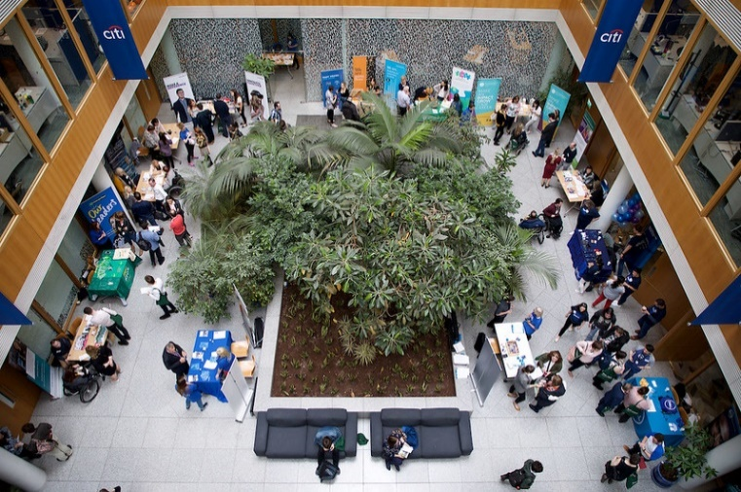
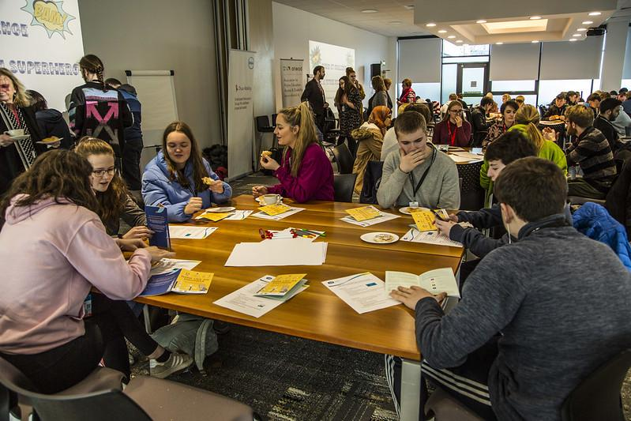
GetAHEAD Programme
A network of student and graduates with disabilities currently making the transition from third-level education to full time employment.
Upskill through training events, information and resources including;
Work Placement
Interview Preparation
Writing Your CV
Job Seeking
Legal Entitlements
Grants Available
Disclosure
Notes:
A network of student and graduates with disabilities currently making the transition from third-level education to full time employment.
Work placement - WAM

Slide 16
Power of Disability Conference/ Advisory Group
AHEAD/USI Power of Disability Conference for Students with Disabilities on 7th & 8th Feb 2024.
Student led
Mix of educational/empowerment/information sharing
This year being brought online
Students with Disabilities Advisory Group
Group of engaged SWD
Feeds into work of AHEAD
Discusses issues on the ground

Slide 17

Any Questions?
My contact details:
lorraine.gallagher@ahead.ie
Notes:
Or come to a drop in and talk to me private

