Slide 1
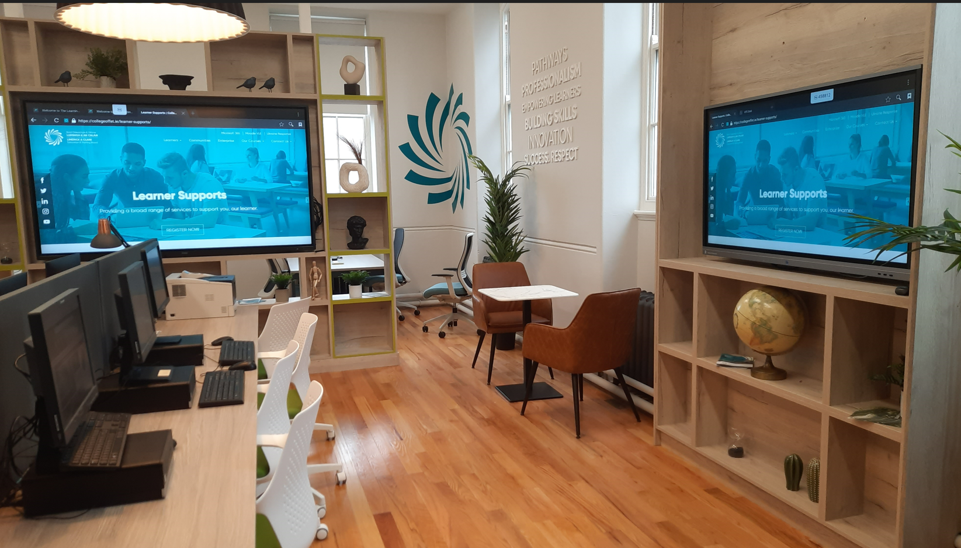


Learning hubs
Learning Hubs
@ Limerick and Clare ETB
Learner Supports @FET
cian.otiarnaigh@lcetb.ie
Where the
Active Inclusion Support Service (AISS) and TEL Collide
and where the
Learner Support Personality Shines

Slide 2
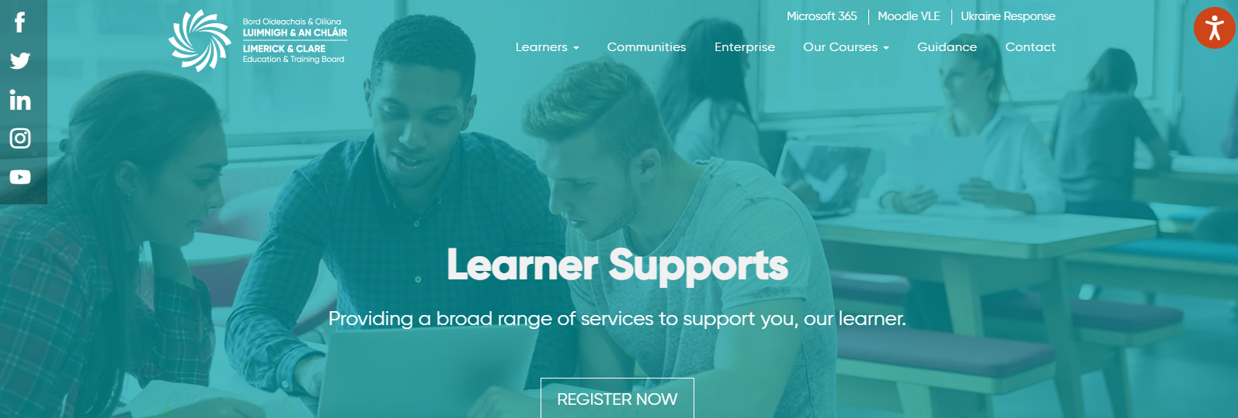
aiss
Learner Supports via ACTIVE INCLUSION SUPPORT SERVICE (AISS)
Learner Supports | College of FET
Learning Hubs @ Limerick and Clare ETB

Slide 3
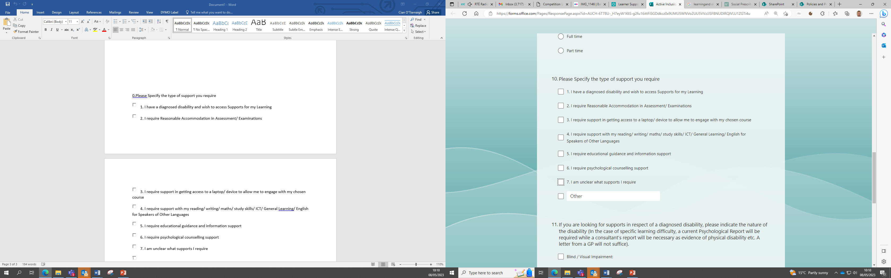
Referrals
Managing Referrals
MyMind - Counselling and Psychotherapy face to face and online
cian.otiarnaigh@lcetb.ie

Slide 4
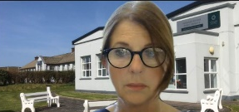
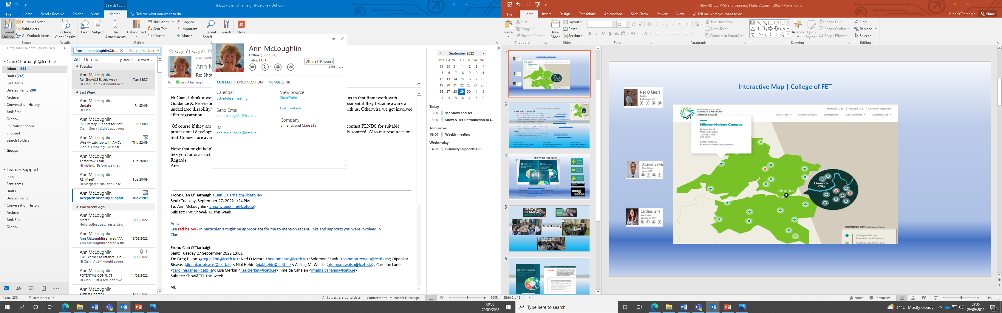
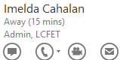
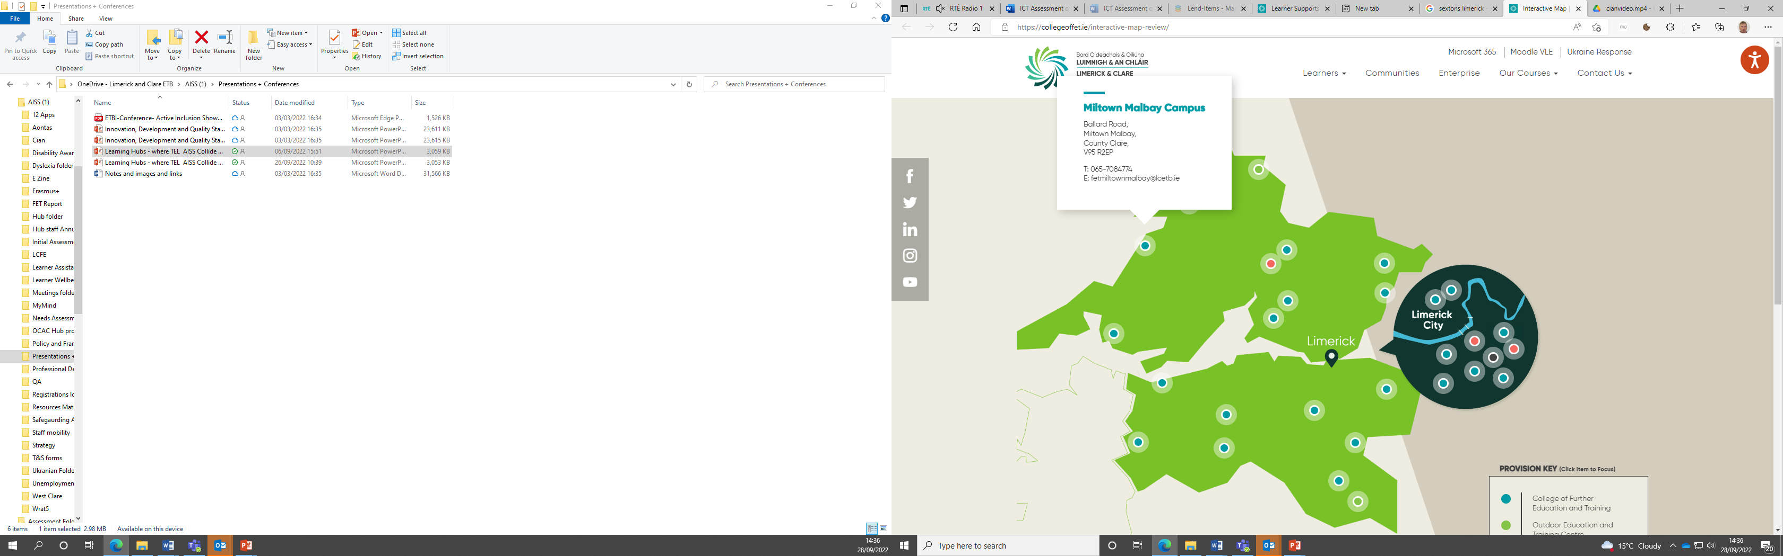
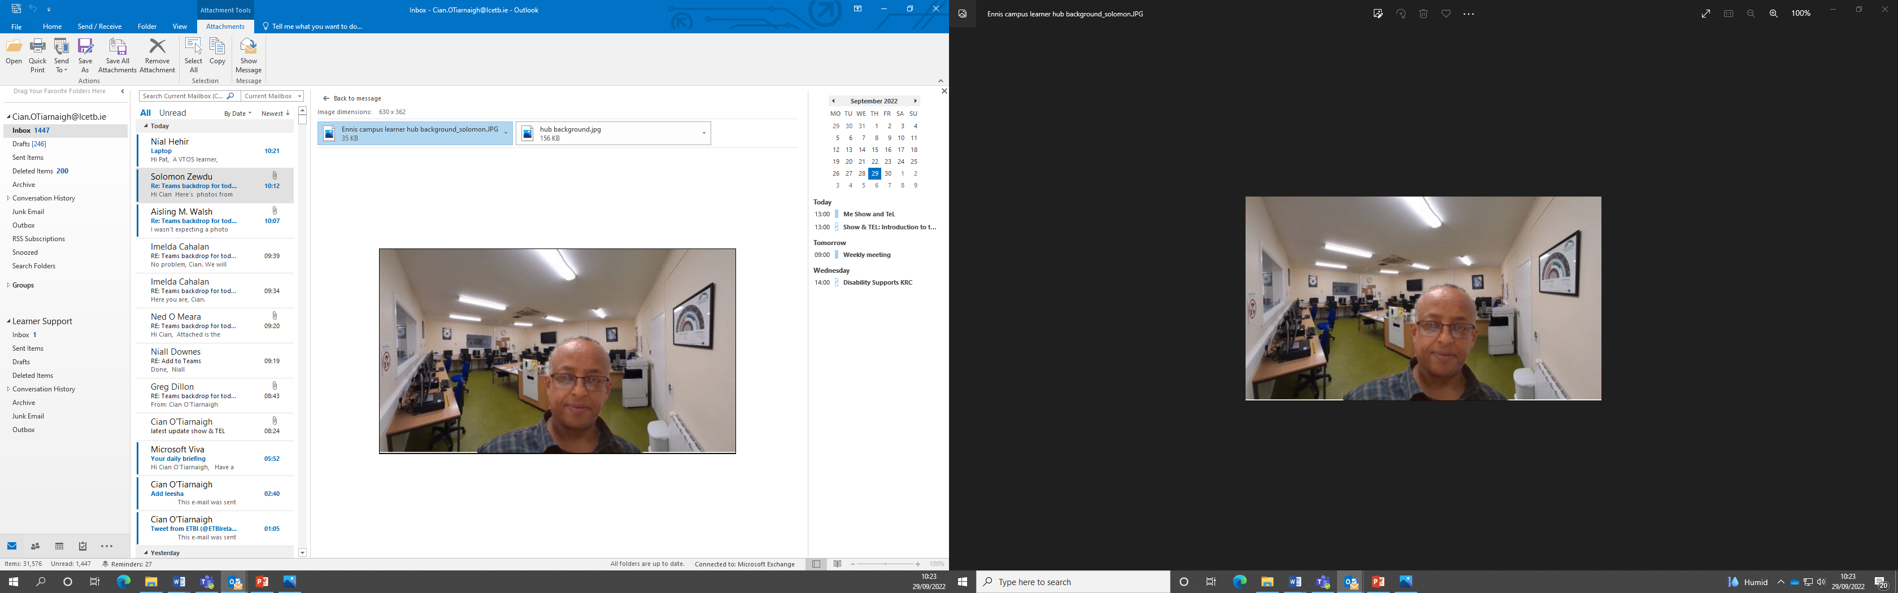
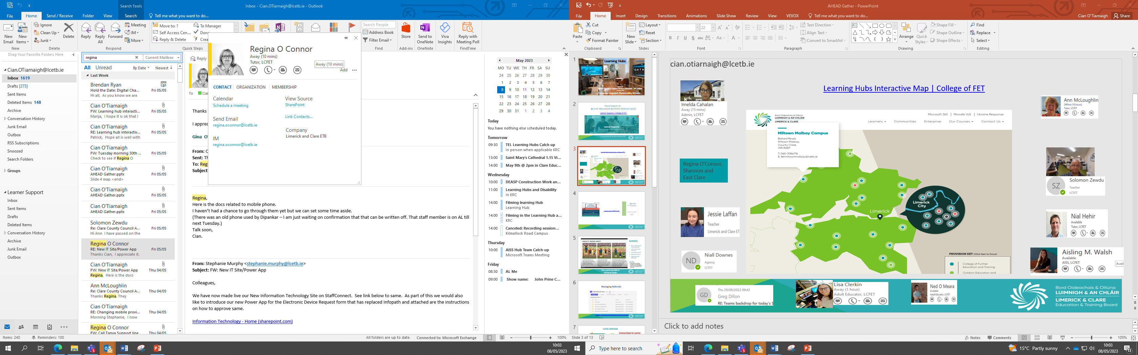
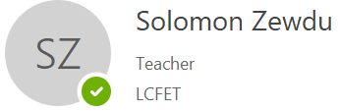
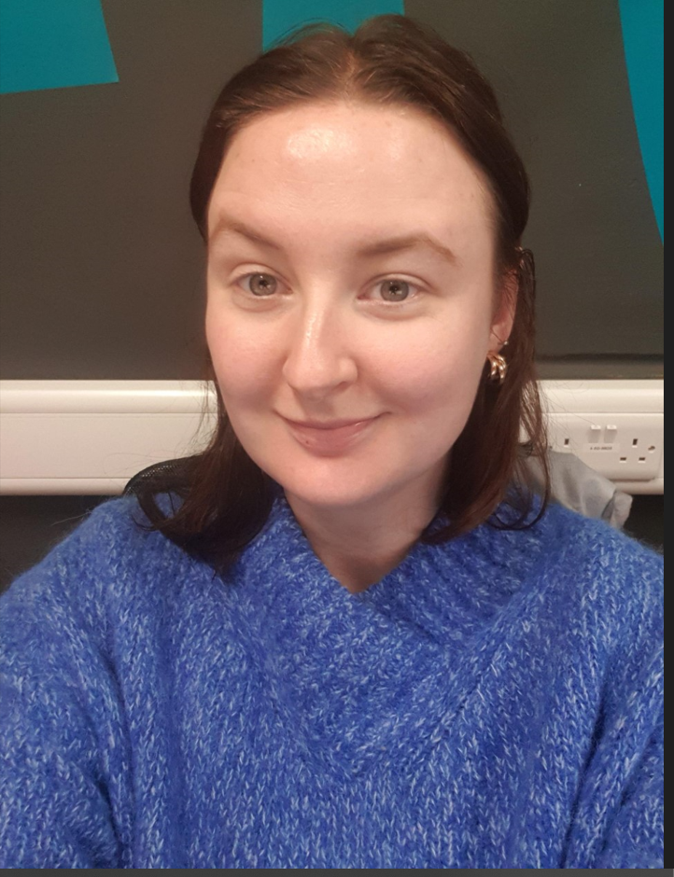
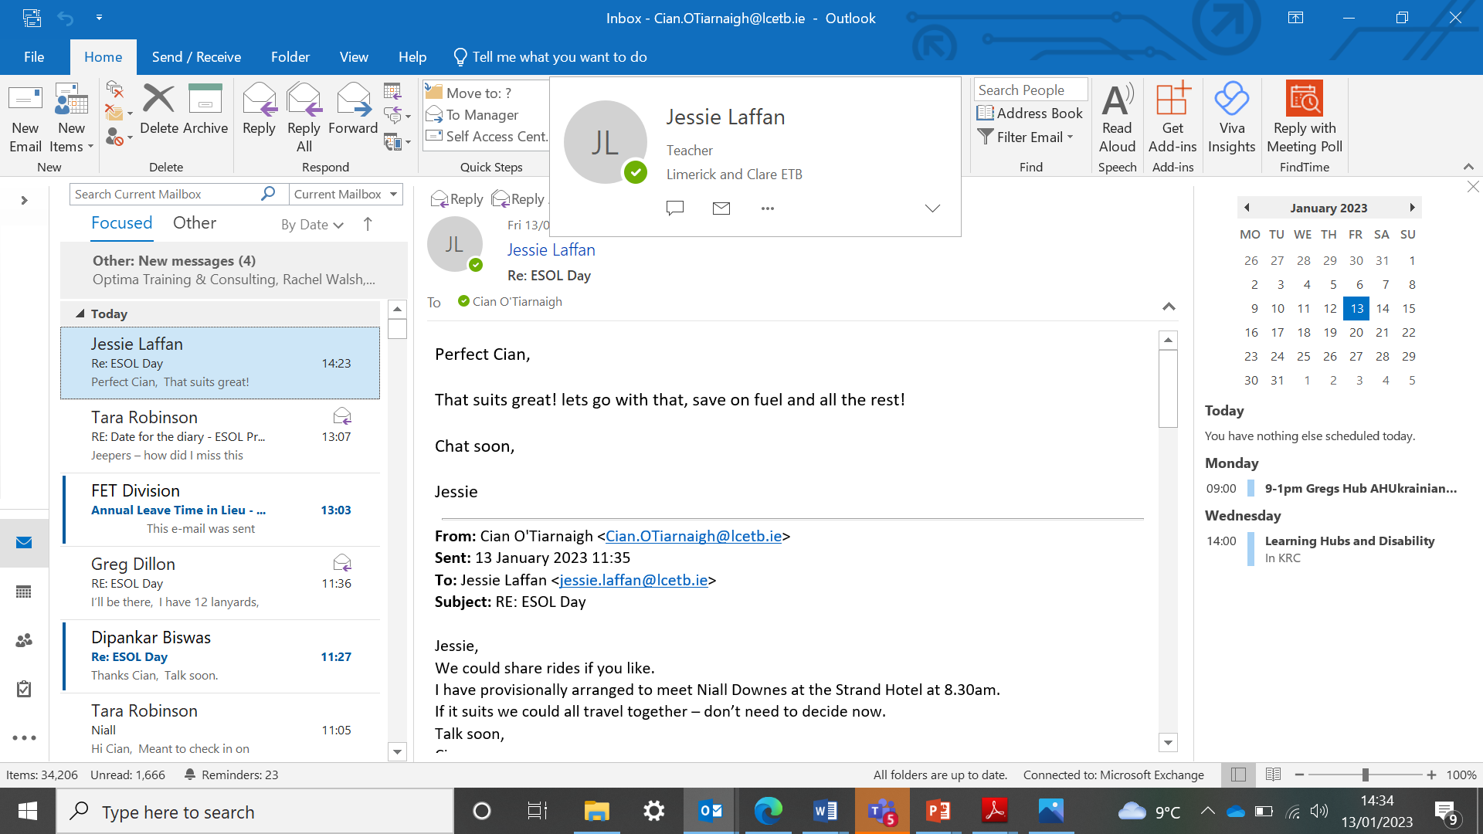
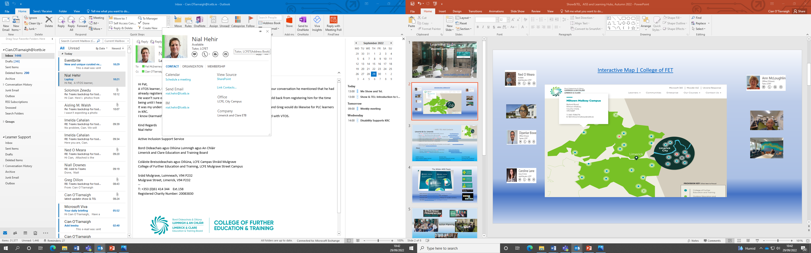
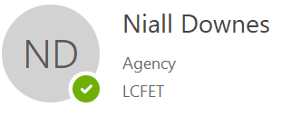
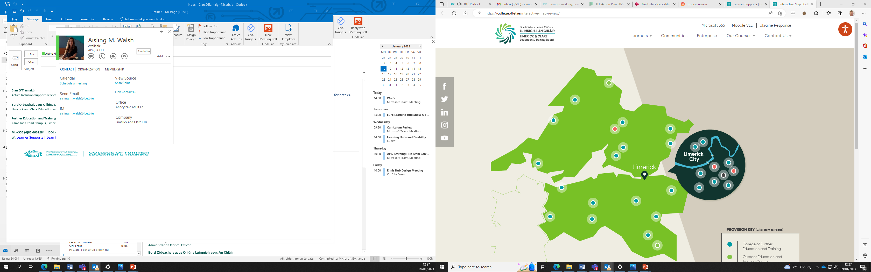
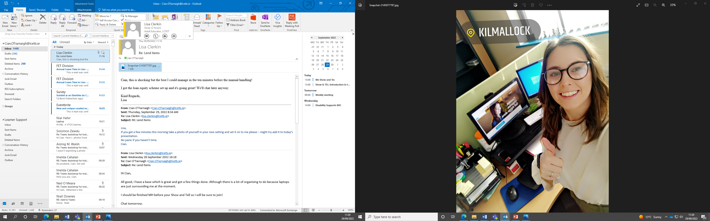
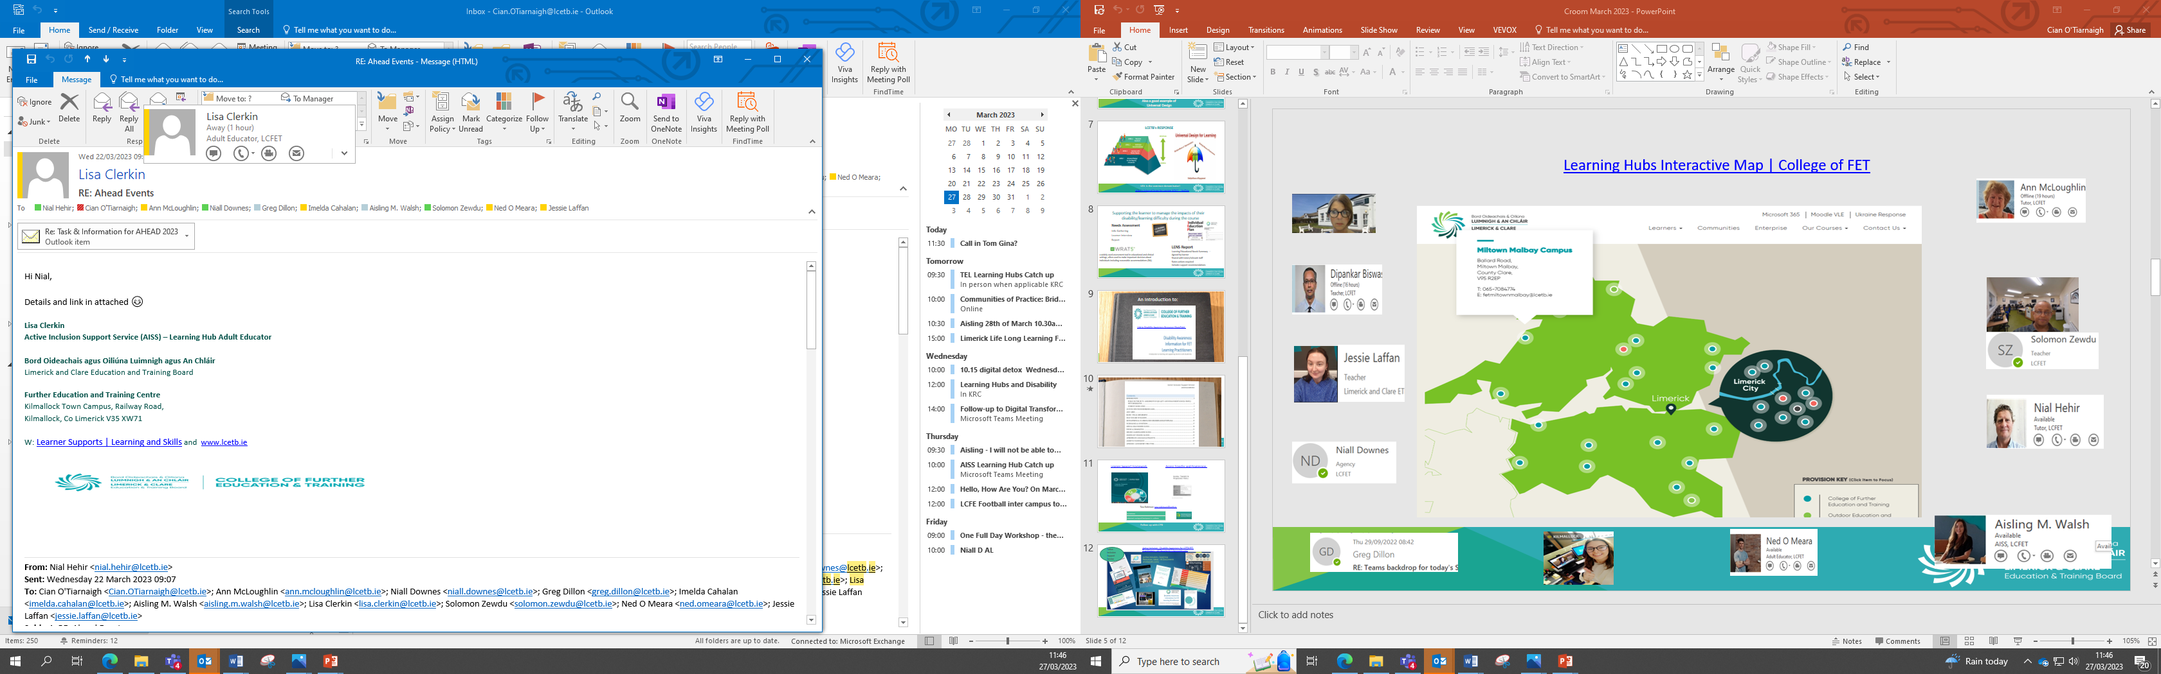
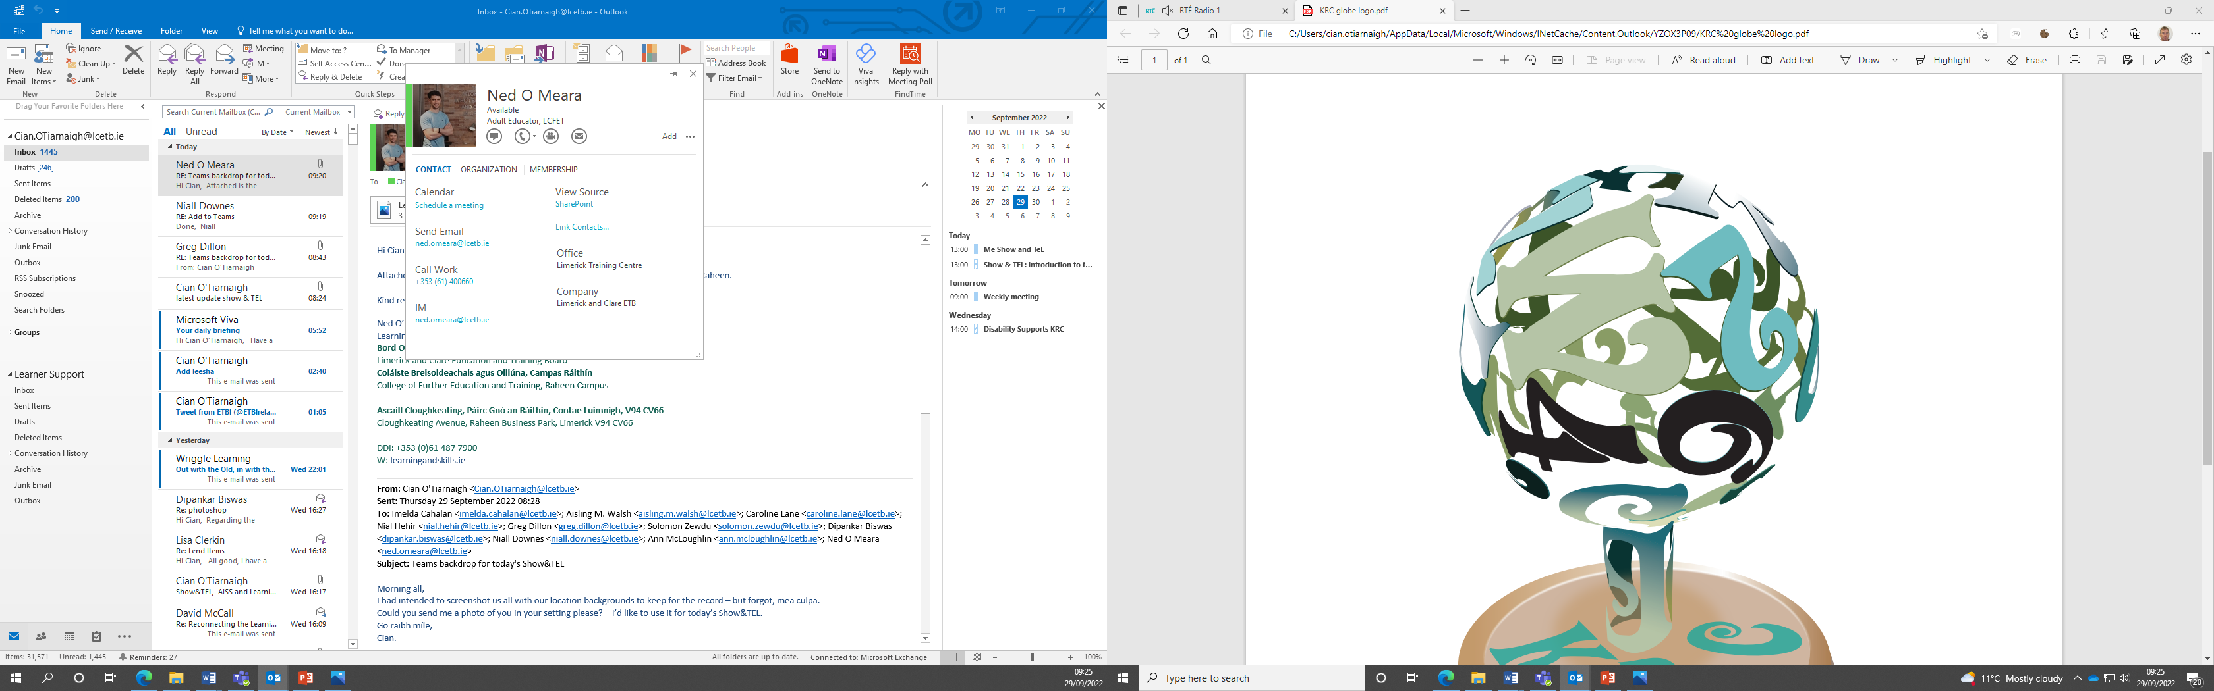
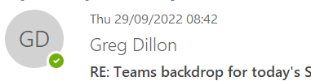
Learning hub map
Learning Hubs Interactive Map | College of FET

Slide 5
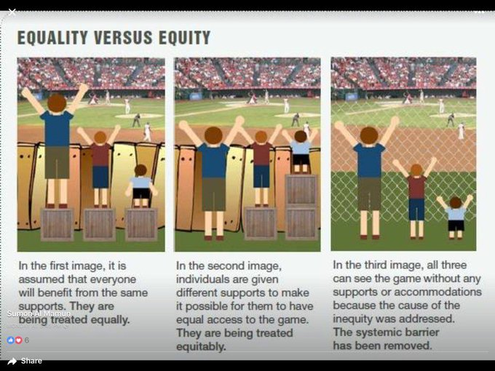
BARRIERS
Access, Attitudes & Communication
Lack of economic resources
Perception of Self
Attitude of others
Communication difficulties
Including
Applying Universal Design concepts in learning design is proven to be the most effective means of removing barriers for all learners.
‘All can see the game without accommodations, barrier removed for all’ –
Also a good example of Universal Design
Notes:
Quote - ‘All can see the game without accommodations, barrier removed for all’ – Also a good example of Universal Design

Slide 6
Closing Slide
Learning Hubs
@ Limerick and Clare ETB
Learner Supports @FET
cian.otiarnaigh@lcetb.ie
Where the
Active Inclusion Support Service (AISS) and TEL Collide
and where the
Learner Support Personality Shines

