Slide 1
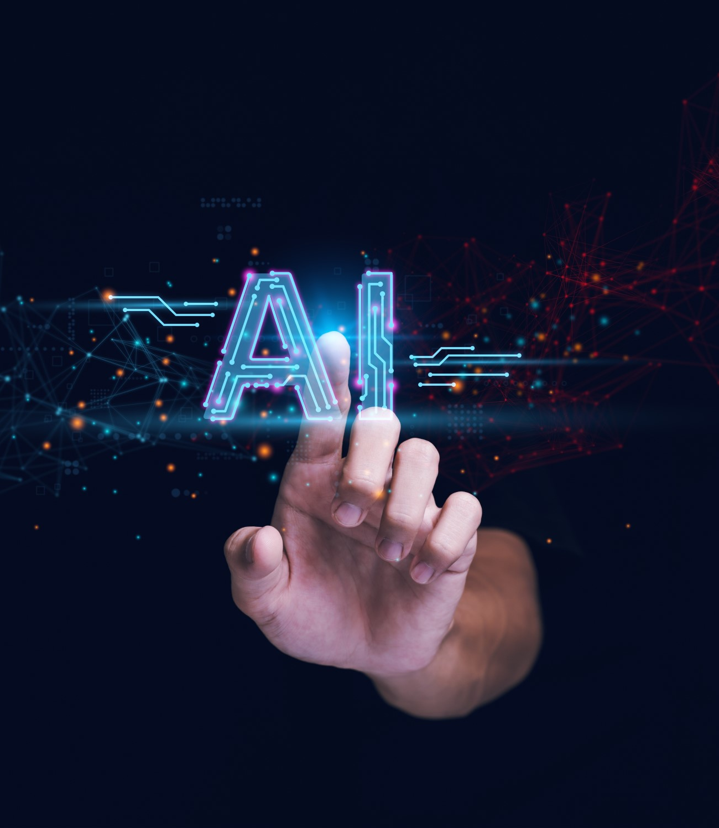

Harnessing AI for inclusive education and employment: new possibilities for physical, cognitive and communication access
Marie Cox (Senior Speech and Language Therapist)
Sharon Leahy (Senior Occupational Therapist)

Slide 2

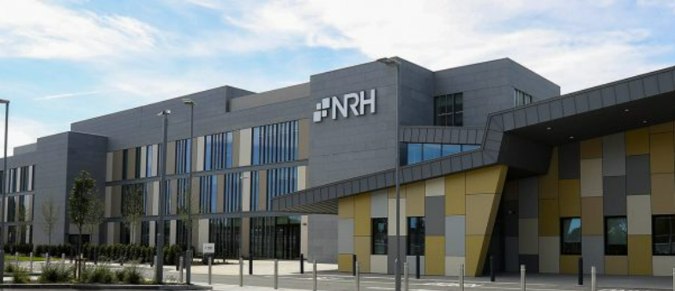
NRH
Notes:
-Outline NRH
-Introduce AT service in the NRH

Slide 3
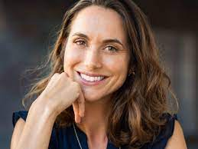
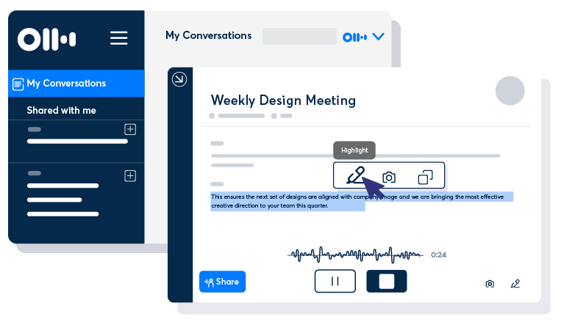

Jane
Subarachnoid Haemorrhage – 2 years post onset
Return to work – HR Executive Officer
Concerns: Note taking for meetings was a concern, handwriting difficulties, dual tasking challenging
Goals: to be able to take notes in meetings
Tools:
Otter AI
Notes:
UF
Otter AI – Note taking and transcription with keyword summaries, audio recording and 30 second summary. Can assign action items from meeting. Can be used in Zoom and Teams.
GDPR issues – need consent to use

Slide 4
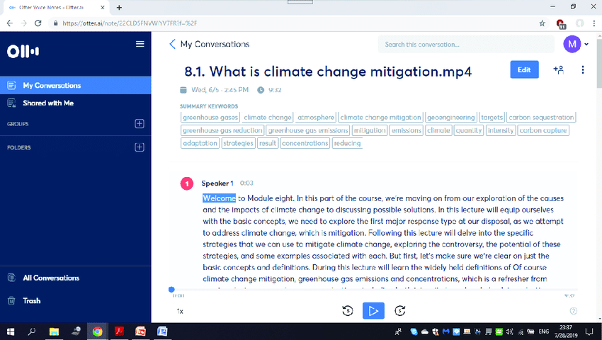
Otter ai
Notes:
Organization in relation to folders
Keywords summary
Play back with highlight
Audio transcription
Rename speakers
Can add pictures to the note
Can add comments

Slide 5
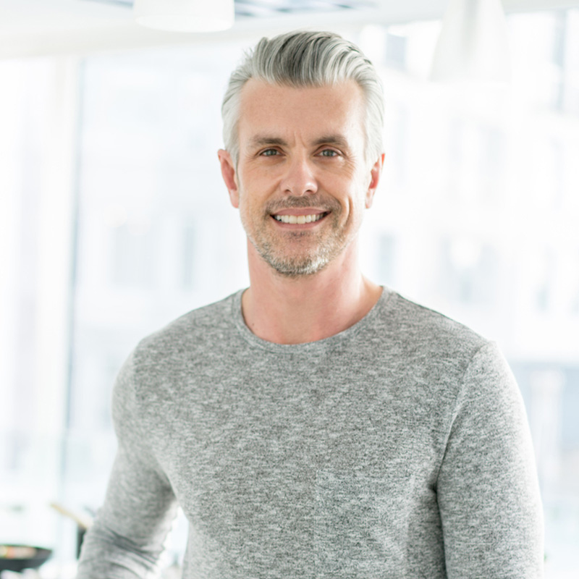
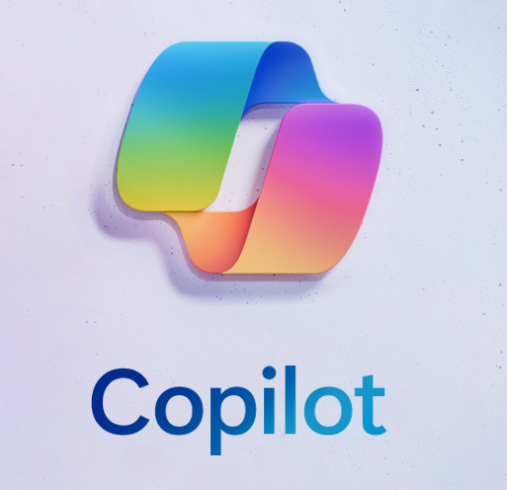

Michael
Stroke – 10 months post onset
Return to work – freelance advertising copywriter
Concerns: Difficulty with formulating and organising his thoughts; Word finding difficulties (circumlocution strategy)
Goals: to be able to write appropriate emails and generate appropriate text for adds
Tools:
Copilot
Goblin Tools
Notes:
KM
Goblin Tools – Formalizer – More to the point and thesaurus (single word) modes

Slide 6
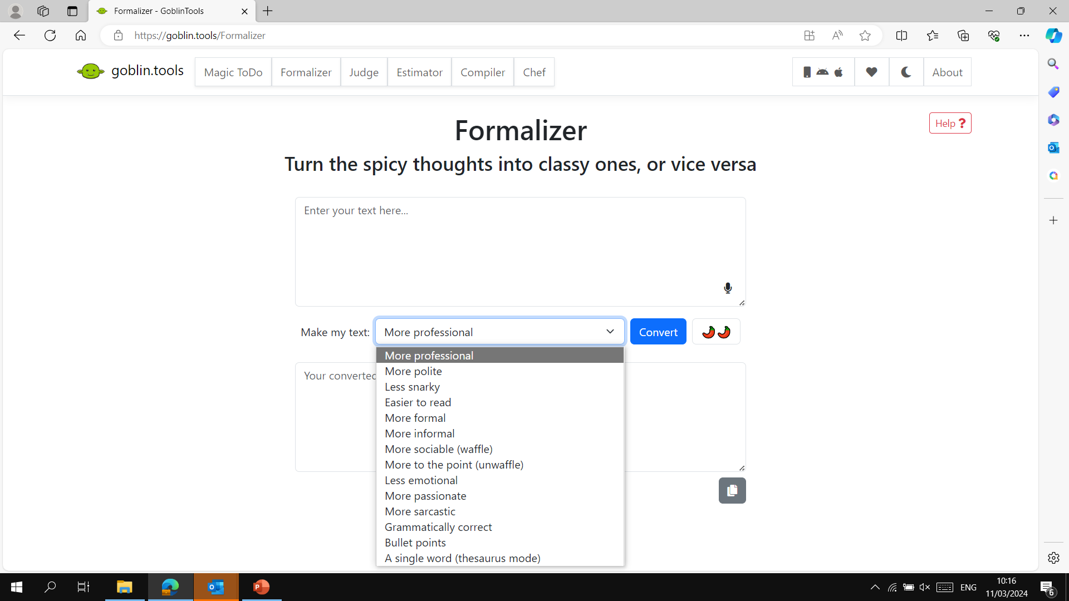
Goblin tools
Notes:
Goblin Tools – Formalizer – More to the point and thesaurus (single word) modes

Slide 7
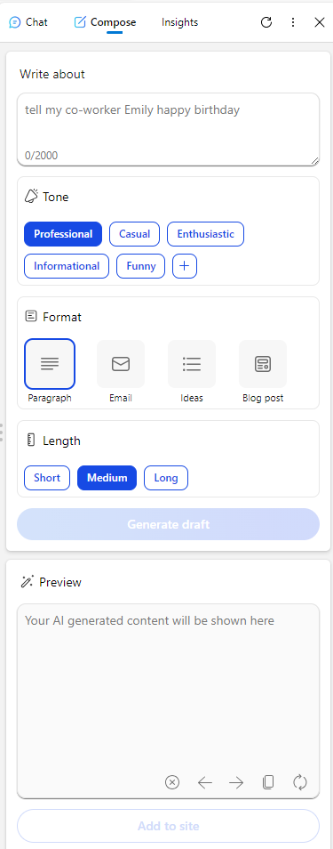
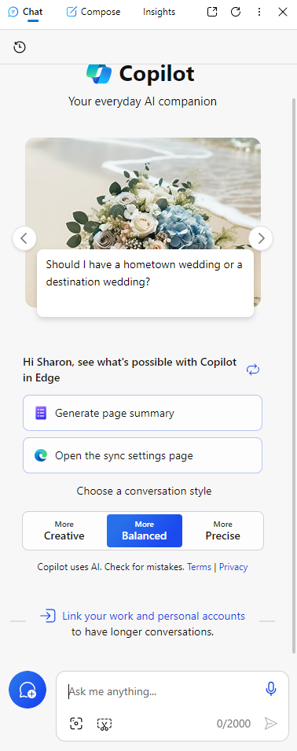
Copilot
Notes:
Copilot embedded within Edge browser

Slide 8

Thank you!

