Slide 1
Aligning Professional Accreditation expectations with UDL
Marion Brown, MSW, PhD, RSW
Associate Dean Academic
Notes:
I am coming to you from Dalhousie University, which is located in Mi’kma’ki, the ancestral and unceded territory of the Mi`kmaq.
There are three key components to the statement. The first is particular acknowledgement that the land Dalhousie sits on is part of Mi’kma’ki, the territory of the L’nu’k. The second is the acknowledgement of the territory as both ancestral and unceded — recognizing that the Peace and Friendship treaties signed between the British Crown and the Mi’kmaq (unlike many other historic treaties in Canada) did not involve surrender of land. “We are all Treaty people”, Mi’kmaki, which reflects that the Peace and Friendship treaties apply to all parties involved, Indigenous and settler alike.
We recognize that African Nova Scotians are a distinct people whose histories, legacies and contributions have enriched that part of Mi’kma’ki known as Nova Scotia for over 400 years.
Having resided in the region for over 400 years, African Nova Scotian contributions to Nova Scotia and Canada began over 150 years before Canada became a country. African Nova Scotians came to the province through enslavement or through fleeing enslavement elsewhere, and continue to experience all manner of structural, systemic and individual discrimination. Until 1961, more than half of all Black people in Canada were African Nova Scotian. The Province of Nova Scotia identifies African Nova Scotians as a founding culture.

Slide 2
Accredited Health Programs
Priorities:
Standardized assessment of competencies
Objectivity, clarity & consistency in evaluation

Slide 3
Health Education at Dalhousie
Priorities:
Preparation for licensing exams
Universal Design for Learning
Culturally Responsive Pedagogies

Slide 4
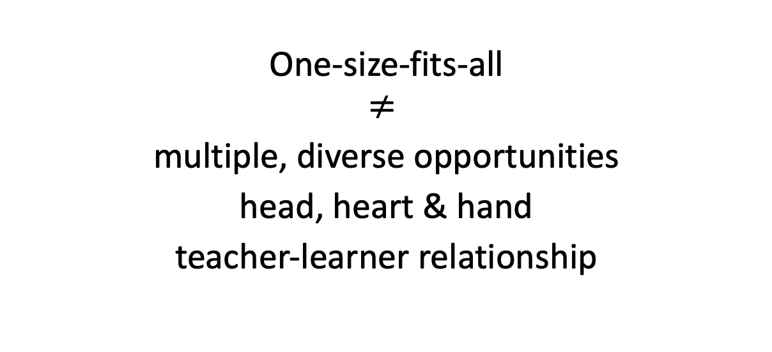
Concern
One-size-fits-all
$$≠$$
multiple, diverse opportunities
head, heart & hand
teacher-learner relationship

Slide 5
What to do?
Reflect on reactions
Unpack assumptions
Think & create beyond
Connect to the bigger picture
Advocate for change

Slide 6
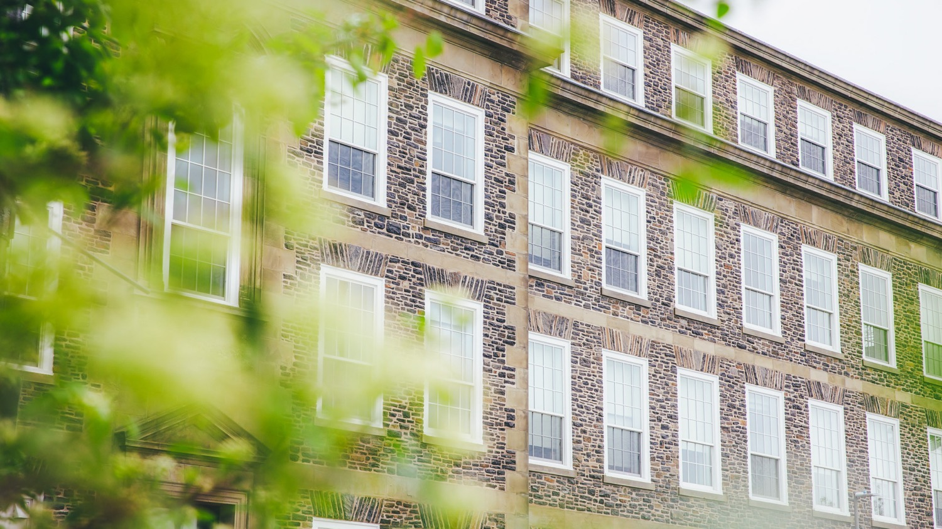
Thank you
6

