Slide 1

Whole institution approach to students´ diversity and inclusion in European universities: A SWOT analysis
AHEAD 2024 Conference
Panorama: Widening the Lens for Systemic Inclusion in Tertiary Education
March 21, 2024
Dr. Hemendra Mistry Prof. Maria Cruz Sanchez Gomez
MSCA COFUND Fellow Professor of Educational Science
Department of Didactics, Organization, and Research Methods (DOYMI)
Faculty of Education
University of Salamanca, Spain

Slide 2
Introduction
SDG 4, ¨Quality and accessible education for all¨
Higher education is considered a key factor in economic prosperity and social well-being.
An inclusive university is one that welcomes diversity as an attitude and value on the rise (Martin, Borges, & Goncalves, 2018).
Universities are insufficiently prepared to include all students from an inclusive standpoint (Moliner et al., 2019).
Only a few European countries have followed up with concrete action at the system level (European University Association, 2019)

Slide 3
Method
Ethical approval – informed consent, examined and approved study protocol by USAL SREC
Participants – 30 universities responded voluntarily (France-4, Spain-8, Sweden-7, UK-8)
Materials and procedure - Online survey questionnaire

Slide 4
Results
Address in specific strategies and code of conducts (87%)
EDI unit in campus (87%)
Reasons – social responsibility (87%), explicit value (80%), legal obligation (73%)
Leadership – central level governing bodies (83%), rector´s cabinet (70%)
Major way to address – print, electronic and social media (90%)
Diversity address in data collection – gender (63%), age (60%), race (47%) and disability (47%)
Use of measures – guidance, counselling and mentoring (87%), tools and techniques for inclusive learning (83%)

Slide 5




SWOT Analysis
Strengths
Opportunities

Slide 6

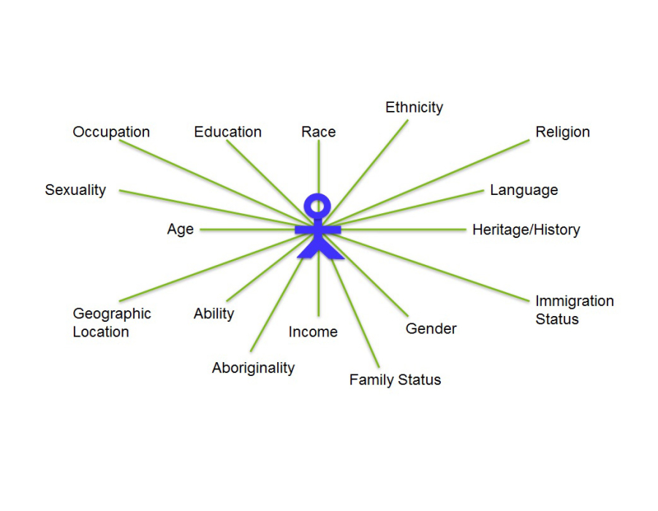


SWOT Analysis (2)
Weaknesses
Threats

Slide 7
Conclusion
Collaboration among stakeholders, policy-makers and administrators.
More training opportunities.
Collaboration with other educational institutions and diversity organizations.
Adequate funding from the government.
Focus of students´ diversity and inclusion in universities´ main strategy

Slide 8
Thank you

